Slide 1
Non-coding RNA

Slide 2
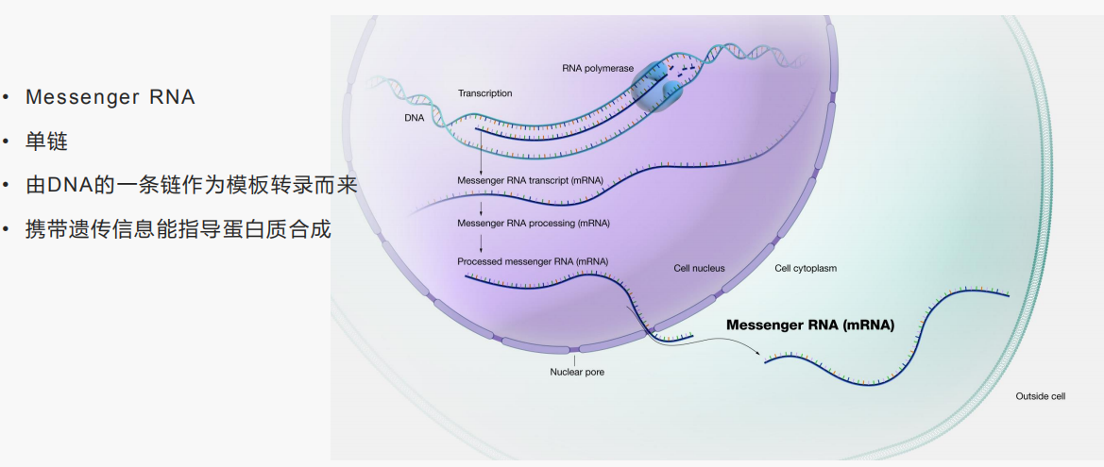
mRNA

Slide 3
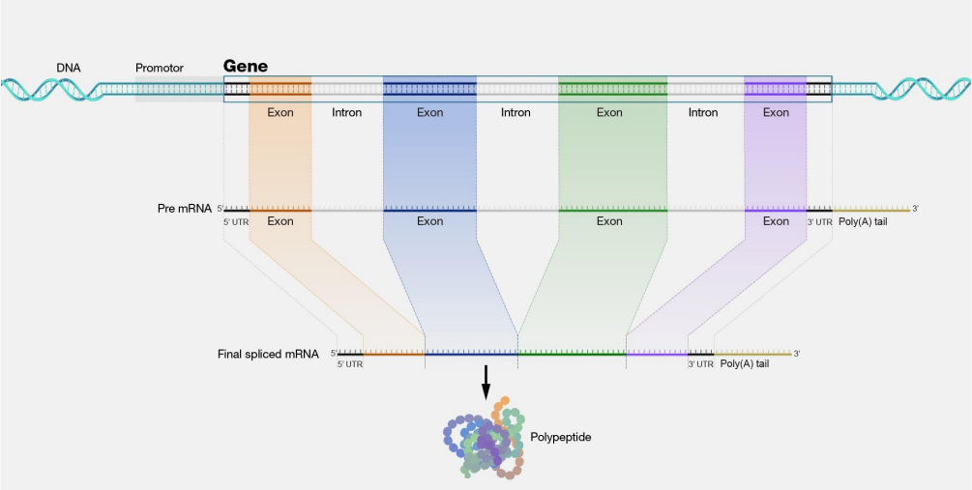
Gene structure
常规的RNA-Seq，利用Poly(A)尾巴的特征富集mRNA

Slide 4
A non-coding RNA (ncRNA) is a functional RNA molecule that is not translated into a protein. Less-frequently used synonyms are non-protein-coding RNA (npcRNA), non-messenger RNA (nmRNA) and functional RNA (fRNA).
The DNA sequence from which a non-coding RNA is transcribed is often called an ncRNA gene.

Slide 5
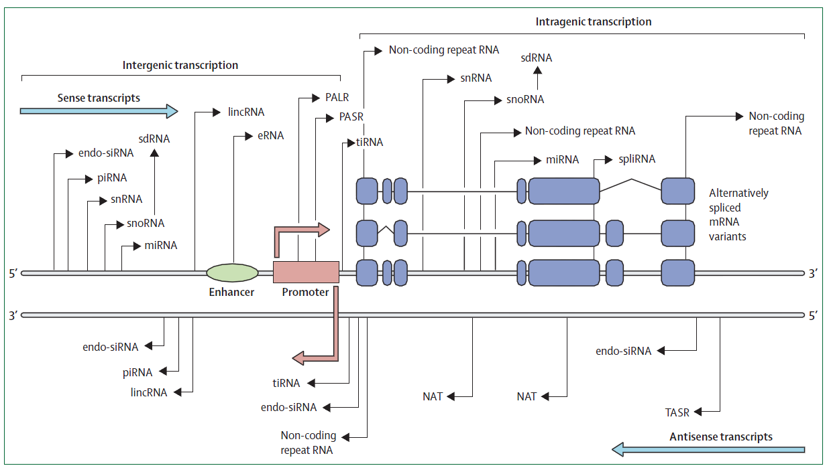
Complexity of transcription patterns of ncRNAs

Slide 6
House-keeping noncoding RNAs:
- rRNA
- tRNA
- snRNA
- snoRNA
Small noncoding RNAs:
- siRNA
- miRNA
- piRNA
Long or large noncoding RNAs (>200nt):
- Precursor of small noncoding RNA
- Pol IV- and Pol V-dependent long noncoding RNA (plant-specific)
- mRNA-like long noncoding RNA
New types
- Circular RNA
http://rfam.xfam.org/

Slide 7
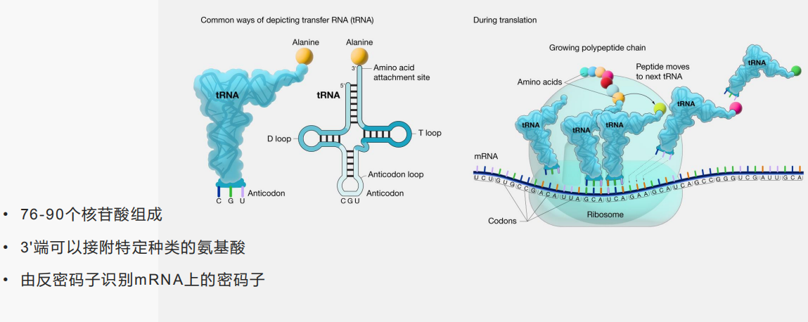
tRNA

Slide 8
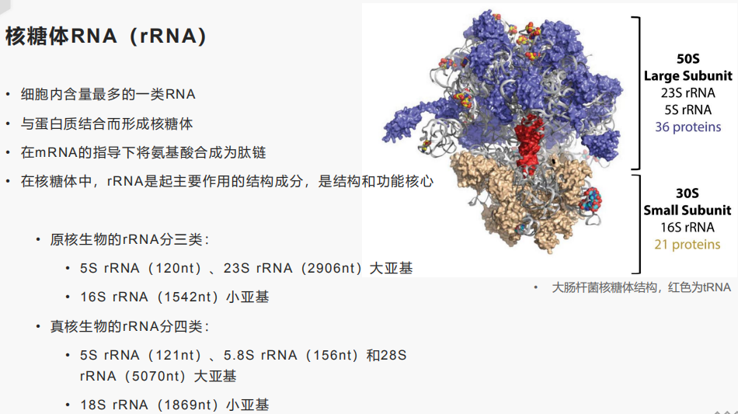
rRNA
去rRNA方式的RNA-Seq，富集其它类型RNA

Slide 9
1、miRNA and siRNA
  MicroRNAs were discovered in 1993 by Victor Ambros, Rosalind Lee and Rhonda Feinbaum during a study of the gene lin-14 in C. elegans development.
  However, miRNAs were not recognized as a distinct class of biological regulators with conserved functions until the early 2000s. Since then, miRNA research has revealed multiple roles in negative regulation (transcript degradation and sequestering, translational suppression) and possible involvement in positive regulation (transcriptional and translational activation). By affecting gene regulation, miRNAs are likely to be involved in most biological processes.
wikipedia

Slide 10
miRNA: miRNAs (microRNAs) are small regulatory RNAs of 20–24 nt that are encoded by endogenous MIR genes. Their primary transcripts form precursor RNAs, which have a partially double-stranded stem-loop structure and which are processed by DCL proteins to release mature miRNAs (in Plants).

Slide 11
siRNA: siRNAs are generated from perfectly double-stranded RNAs that can originate from different sources such as RNAs transcribed from inverted repeats, natural cis-antisense transcript pairs, the action of RNA-dependent RNA polymerases (RDRs) which convert single stranded RNA into dsRNA, the replication of RNA viruses, and regions of the genome rich in retroelements.

Slide 12
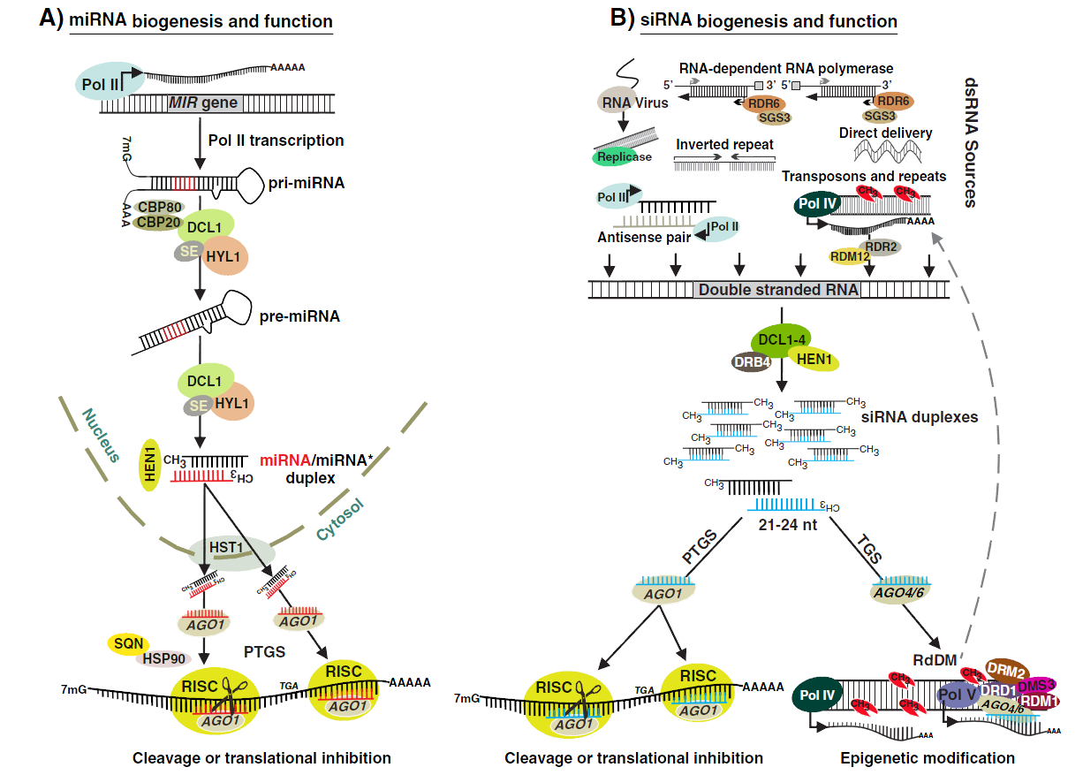
Biogenesis of miRNAs and siRNAs
Khraiwesh
et al., 2012

Slide 13
miRNA
Originate from capped & polyadenylated full length precursors; single chain (pri-miRNA)
Hairpin precursor 60-400 nt (pre-miRNA)
Mature miRNA 20-24 nt (miRNA)
miRNA::miRNA* complex (non-perfect matching)
Dicer-like RNase III endonuclease (DCL) and Argonaute protein (AGO)
RISC (RNA-induced silencing complex)
PTGS (posttranscriptional gene silencing)
trans- or cis- acting
First discovered in 1993 by Victor Ambros at Harvard (lin-4)
Let-7 discovered in 2000 by Frank Slack as a postdoc at Harvard (Ruvkun lab)
The first miRNA of plants was discovered in Arabidopsis

Slide 14
siRNA
Originate from dsRNA (synthesis by RDR or bimolecular duplexes: NATs, natural antisense transcripts)
Various types due to the divergence of biogenesis and mechanism processes
Cleaved by miRNA, sometimes
Dicer-like RNase III endonuclease (DCL) and Argonaute protein (AGO)
RISC (RNA-induced silencing complex)
PTGS and TGS (transcriptional gene silencing)
Nearly perfect matching with target sites
Cis- acting （also trans-）
New tool for researchers

Slide 15
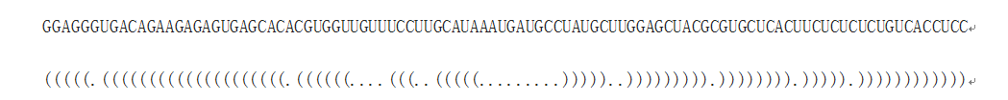
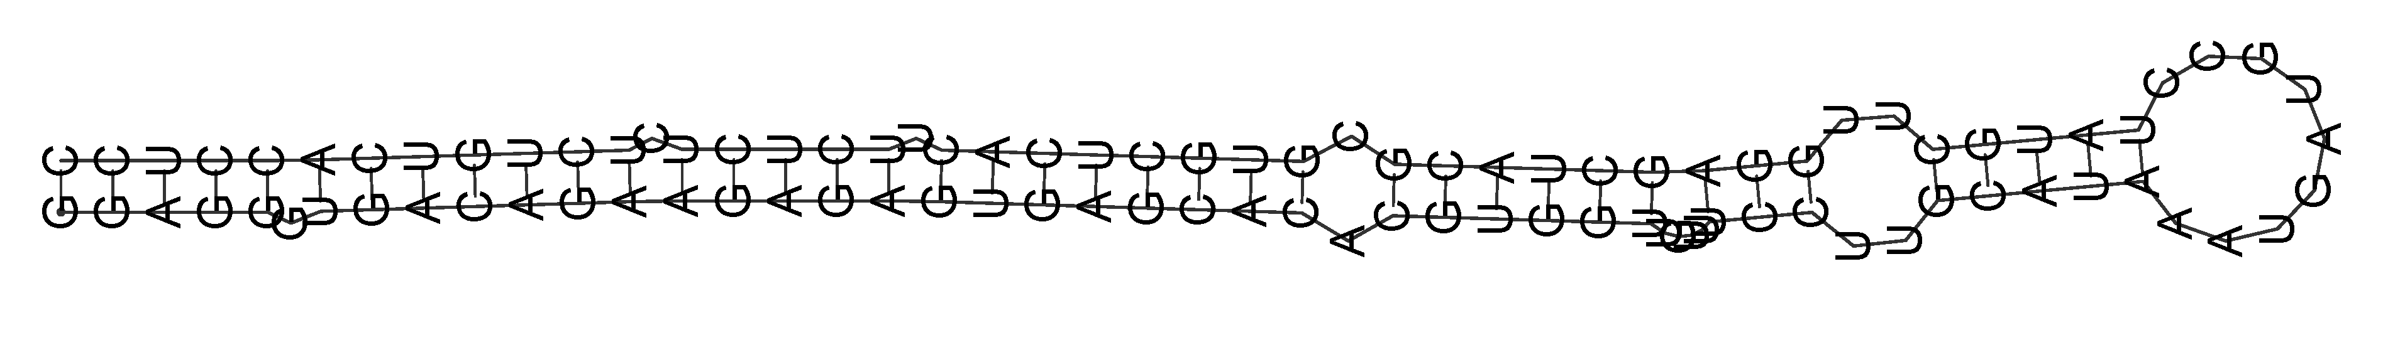
Identification of miRNAs
GGAGGGUGACAGAAGAGAGUGAGCACACGUGGUUGUUUCCUUGCAUAAAUGAUGCCUAUGCUUGGAGCUACGCGUGCUCACUUCUCUCUCUGUCACCUCC

Slide 16
Small RNA sequencing :
SE, < 50nt
Millions of reads
High sensitivity
FASTQ & FASTA
Genomic sequence:
WGS/GSS/EST
Pipeline:
Quality filtering
Trim adaptors
eliminate the redundancy
Mapping to reference sequence
Removing small RNA mapping to tRNA, rRNA, snRNA, snoRNA, mRNA et al.
Prediction (sofware or webserver, based on structure and property of miRNA)

Slide 17
Software for prediction of miRNA
miReap: A tool which can be used to identify both known and novel microRNAs from small RNA libraries deeply sequenced by Solexa/454/Solid/Illumia technology
miRDeep: a completely overhauled tool which discovers microRNA genes by analyzing sequenced RNAs.
miRAbela: tool from the Swiss Biozentrum at Basel. It will predict if your sequence contains miRNA-like structures, giving a score and the putative pre-miRNA sequence.
SSCprofiler: human genome scanner for the prediction of putative miRNA genes.
miRNAfinder: miRNAFinder can predicts potential intronic miRNA in intron regions of expressed genes (ESTs/cDNAs), find possible miRNA in genomic sequence or predict if the input small RNA is a mature miRNA.
EumiR: eukariotic miRNA precursor prediction server.
MirEval: user friendly tool for the evaluation of a sequence in regards to its possible microRNA-like properties. The properties used to evaluate each sequence are : microRNA precursor-like structure, sequence similarity with a known microRNA and sequence conservation.
SplamiR: prediction of spliced-miRNAs in plants.
CID-miRNA: computational identification of miRNAs in several organisms.
MiRscan: classical miRNA prediction server by the Bartel's lab.

Slide 18
Pipeline of MIREAP
(1). Installation:
[root@localhost mireap_0.2]# tar -zxvf mireap_0.2.tar.gz
[root@localhost mireap_0.2]# export PERL5LIB=/path/to/mireap_0.2/lib
[root@localhost mireap_0.2]# ls -R
.:
bin lib README test
./bin:
mireap.pl
./lib:
FFW1.pm FFW2.pm Struct.pm
./test:
map.txt ref.fa smrna.fa
(2). Usage
Perl mireap.pl -i <smrna.fa> -m <map.txt> -r <reference.fa> -o <outdir>
Options: -i <file> Small RNA library, fasta format, forced
-m <file> Mapping file, tabular format, forced
-r <file> Reference file, fasta format, forced
-o <dir> Directory where results produce (current directory)
……

Slide 19
(3). Result
[root@localhost root]# ls
mireap-xxx.aln mireap-xxx.gff mireap-xxx.log
[root@localhost root]# more mireap-xxx.aln
mireap
xxx-m0001 AB175913.1:1:53:+ 53(nt) -25.80(kcal/mol)
ATGTCGTGCTGCGGAGGAAACTGCGGCTGCGGATCCGGCTGCCAGTGCGGCAG xxx-m0001 4
.(((((..((((((.(((..((((....)))).)))..))).)))..))))).
ATGTCGTGCTGCGGAGGAAACT******************************* xxx-m0001-5p 4
ATGTCGTGCTGCGGAGGAAACT------------------------------- rufi_root_755193_22_1 1
ATGTCGTGCTGCGGAGGAAACT------------------------------- rufi_root_755193_22_1 1
ATGTCGTGCTGCGGAGGAAACTGC----------------------------- rufi_root_755194_24_1 1
ATGTCGTGCTGCGGAGGAAACTGC----------------------------- rufi_root_755194_24_1 1
//
mireap
xxx-m0002 AB175914.1:1:53:+ 53(nt) -25.80(kcal/mol)
ATGTCGTGCTGCGGAGGAAACTGCGGCTGCGGATCCGGCTGCCAGTGCGGCAG xxx-m0002 4
.(((((..((((((.(((..((((....)))).)))..))).)))..))))).
ATGTCGTGCTGCGGAGGAAACT******************************* xxx-m0002-5p 4
ATGTCGTGCTGCGGAGGAAACT------------------------------- rufi_root_755193_22_1 1
ATGTCGTGCTGCGGAGGAAACT------------------------------- rufi_root_755193_22_1 1
ATGTCGTGCTGCGGAGGAAACTGC----------------------------- rufi_root_755194_24_1 1
ATGTCGTGCTGCGGAGGAAACTGC----------------------------- rufi_root_755194_24_1 1
//
[root@localhost root]# more mireap-xxx.gff
AB175913.1 mireap precursor 1 53 . + . ID=xxx-m0001;Count=4;mfe=-25.80
AB175913.1 mireap mature-5p 1 22 . + . ID=xxx-m0001-5p;Parent=xxx-m0001;Count=4;Seq=ATGTCGTGCTGCGGAGGAAACT
AB175914.1 mireap precursor 1 53 . + . ID=xxx-m0002;Count=4;mfe=-25.80
AB175914.1 mireap mature-5p 1 22 . + . ID=xxx-m0002-5p;Parent=xxx-m0002;Count=4;Seq=ATGTCGTGCTGCGGAGGAAACT

Slide 21
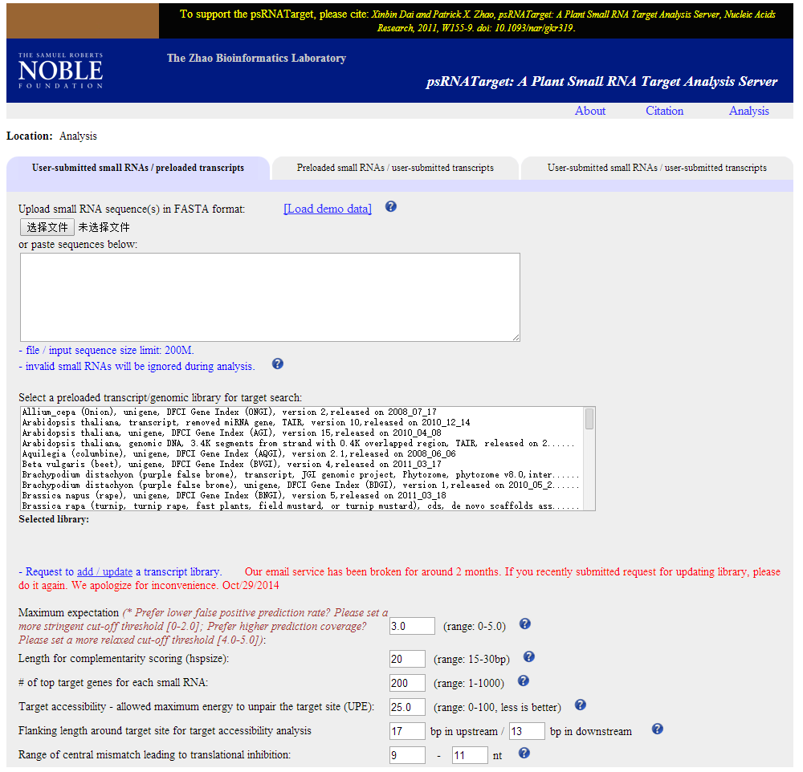
Targets prediction
psRNATarget : https://www.zhaolab.org/psRNATarget/
PITA
Diana Micro-T
MirPath
Microinspector
MaMi
miRecords
mirDIP
miRGator
Magia
Targetscan
miRTar
miRTrail

Slide 22
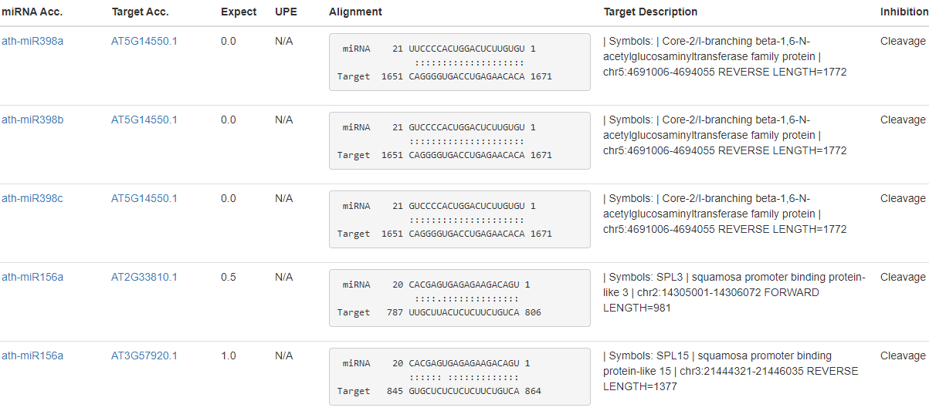

Slide 23
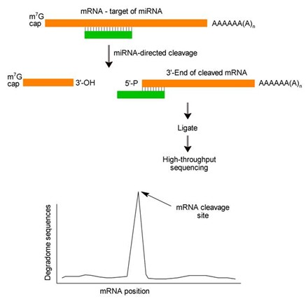
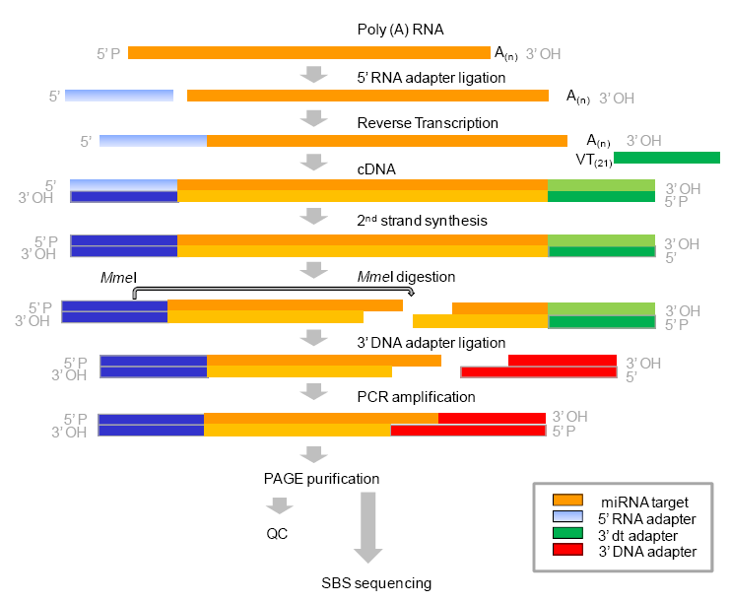
Degradome sequencing
The principle of degradome sequencing
The process of library construction

Slide 24
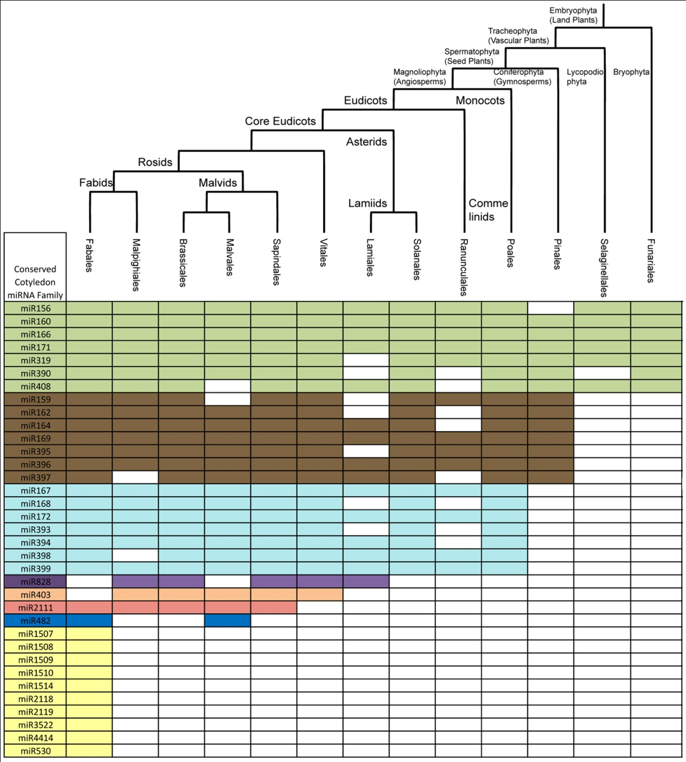
Conservation of miRNAs

Slide 25
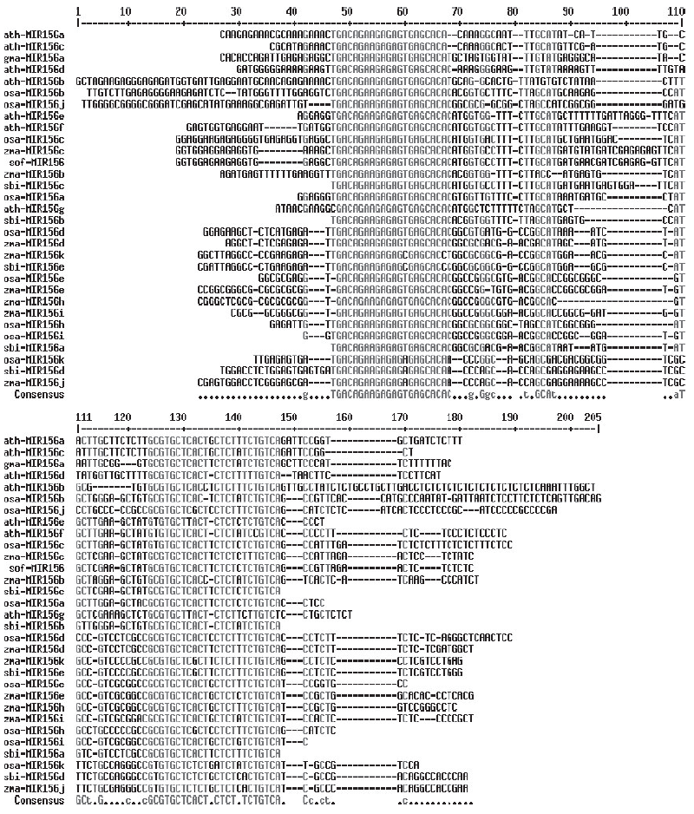
Homology Between mature miRNAs and divergence between pre-miRNAs

Slide 26
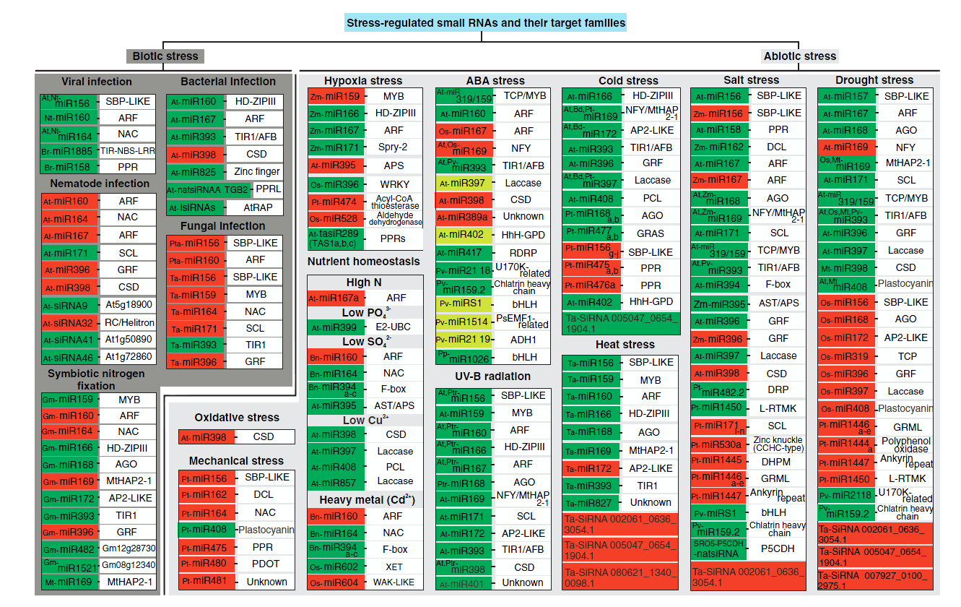
Functions of miRNA

Slide 27
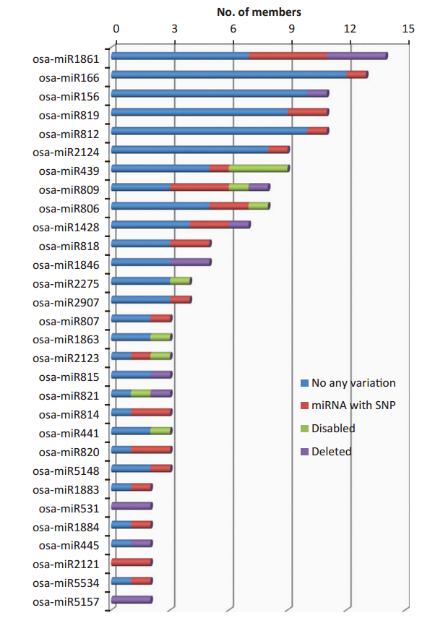
miRNAs are targets of crop domestication.
Genomic variations in precursors of 38 previously identified conserved microRNA (miRNA) families in wild rice (Oryza rufipogon).

Slide 28
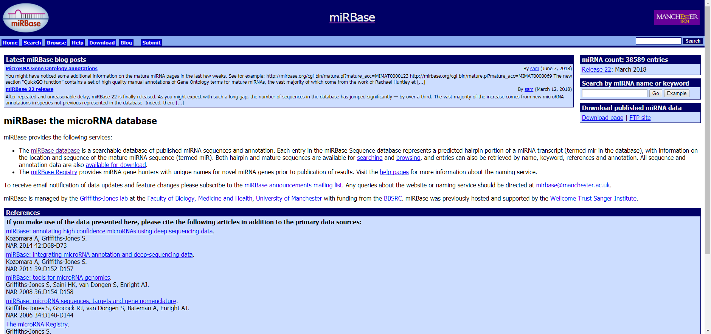
miRBase http://www.mirbase.org/
miRNA数据库

Slide 29
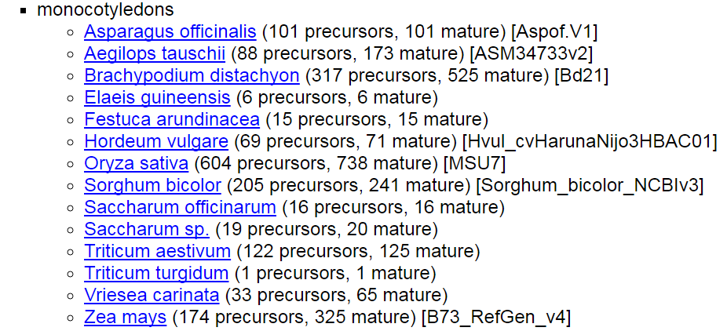

Slide 30
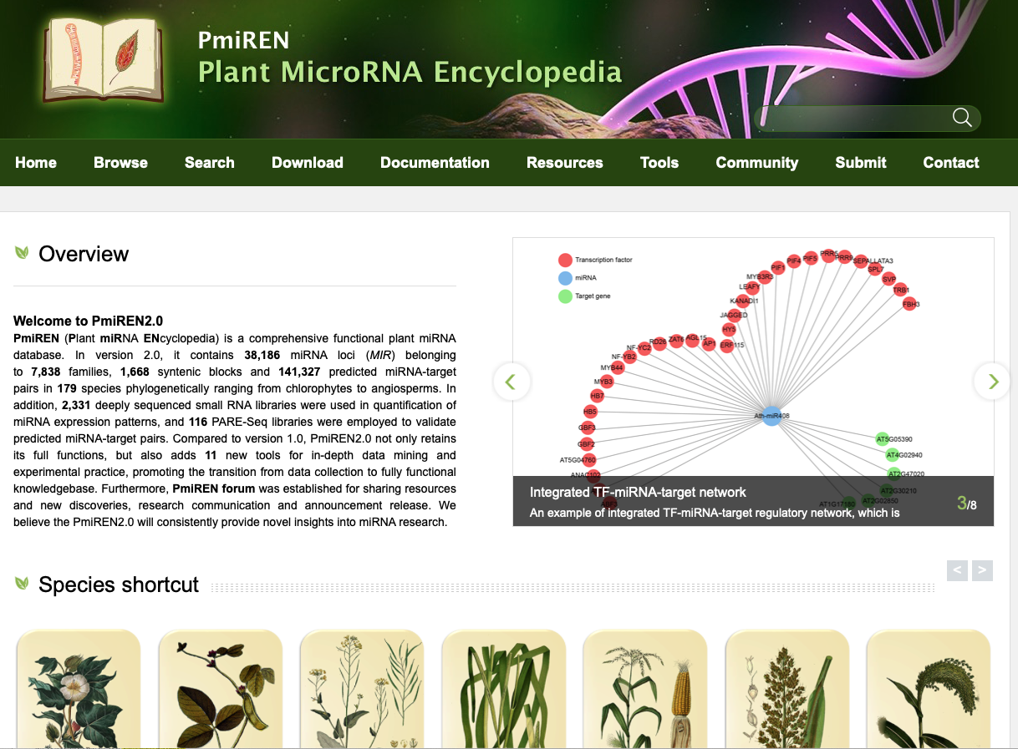
https://www.pmiren.com

Slide 31
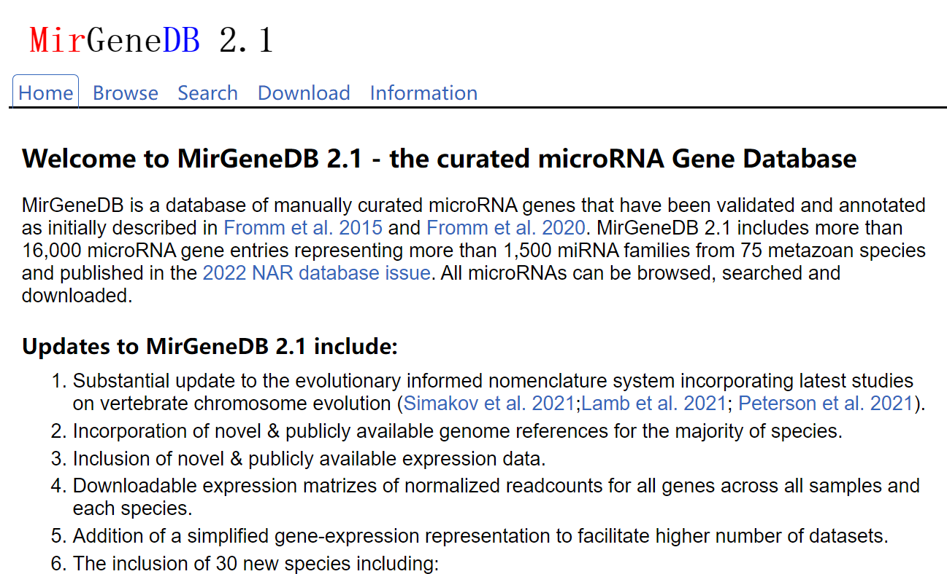
https://mirgenedb.org/

Slide 32
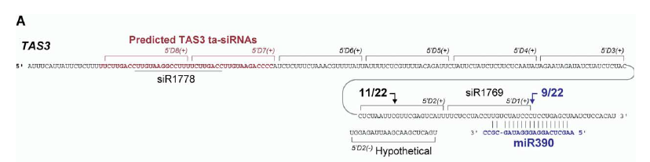
Prediction of phasiRNA
Howell et al., 2007
n = number of phase cycle positions occupied by at
least one small RNA read within an eight-cycle window,
k = the total number of reads for all small RNAs with consolidated
start coordinates in a given phase within an eight-cycle window.
Phase cycle length was set at 21 nucleotides. A positive phase
signal, therefore, was limited by the power function (n-2) to
those loci with small RNAs occupying at least three cycle positions
in a phased, 21-nucleotide register.

Slide 33
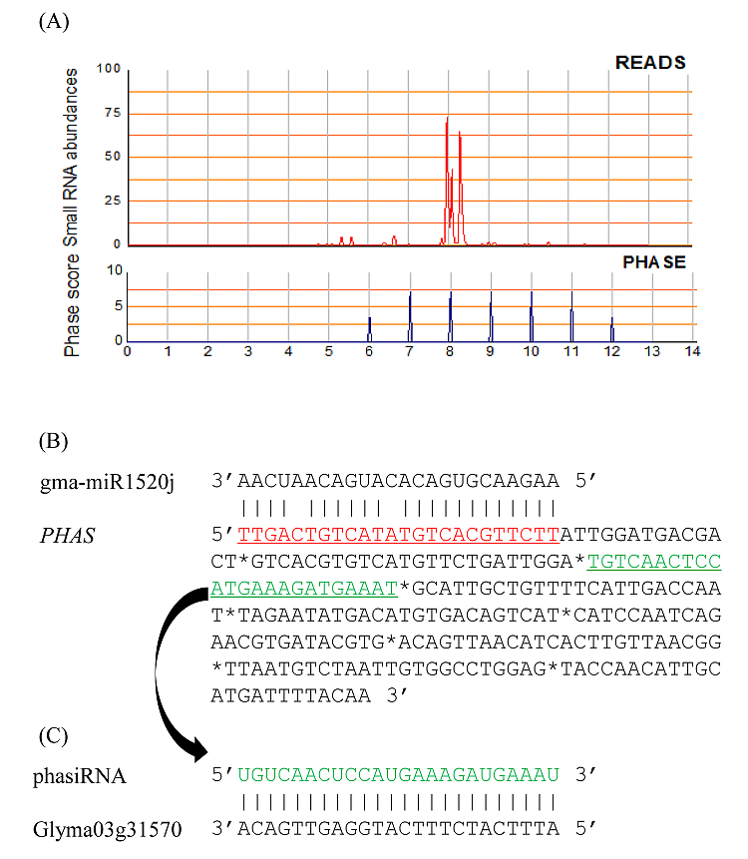

Slide 34
2、lncRNAs
Definition:
Long non-coding RNAs (long ncRNAs, lncRNA) are non-protein coding transcripts longer than 200 nucleotides.
Features:
Spatiotemporal specific expression
Tissue specific expression

Slide 35
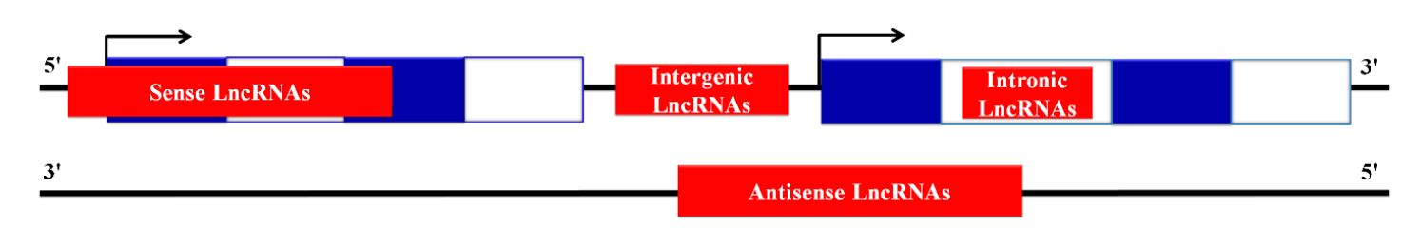
Classification

Slide 36
Identification of lncRNA
1. Microarray
2. SAGE and EST
3. RNA-Seq
4. RNA-IP
5. Chromatin Signature-Based Approach
6. ORF Length Strategy
7. Sequence and Secondary Structure
8. Conservation Strategy
9. Machine Learning Strategies
……
两者结合
常规RNA-Seq：利用Poly(A)尾巴的特征富集mRNA
去rRNA富集方式的RNA-Seq

Slide 37
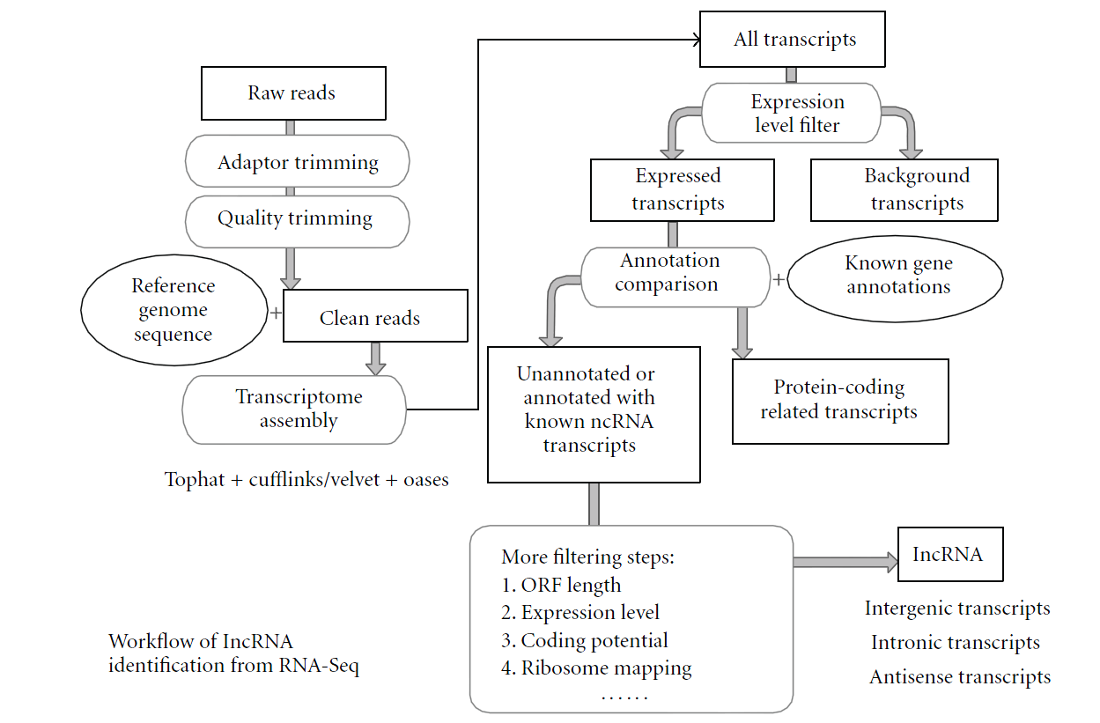
Workflow

Slide 38
eTM
The decoy RNAs bind to miRNAs via complementary sequences and therefore block the interaction between miRNAs and their authentic targets.
Both endogenous decoy RNAs (miRNA target mimics) and engineered artificial RNAs can induce target mimicry effects.

Slide 39
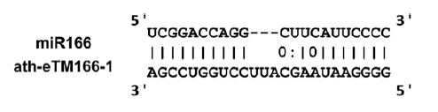
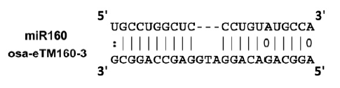
Plant eTMs
bulges were only permitted at the 5’ end ninth to 12th positions of miRNA sequence;
(2) the bulge in eTMs should be composed of only three nucleotides;
(3) perfect nucleotide pairing was required at the 5’ end second to eighth positions of miRNA sequence;
(4) except for the central bulge, the total mismatches and G/U pairs within eTM and miRNA pairing regions should be no more than three.

Slide 40
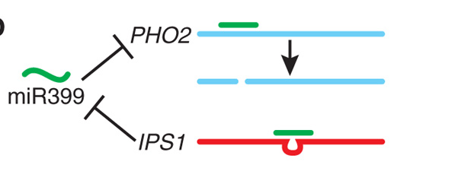
Long noncoding RNAs in plants
IPS1: sequester miR399 and control the amount of miR399 interacting with PHO2 and finally to achieve homeostasis of phosphate in leaf and root
miR399
PHO2
Pht1;8 and Pht1;9
P uptake

Slide 41
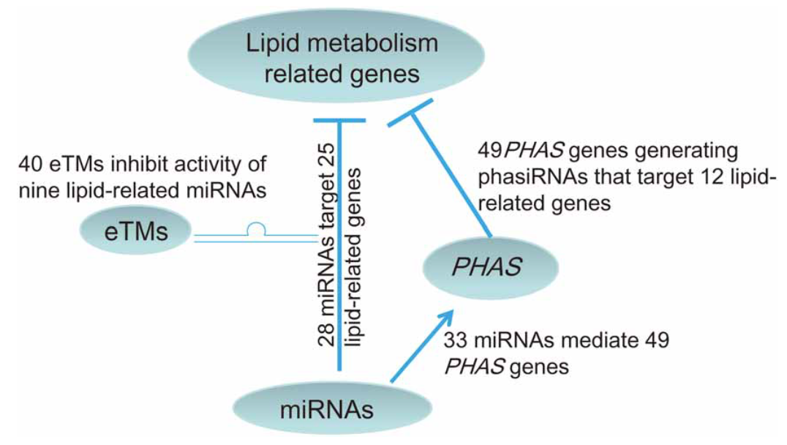

Slide 42
3、 Circular RNAs
Circular RNAs (circRNAs) are generated by a non-linear backsplicing event between a downstream splice donor and an upstream splice acceptor.

Slide 43
1967年，Sanger等人报道了一种单链的闭合环状RNA分子—植物类病毒（Viroids），它是一种裸露的传染性病毒，存在于黄瓜、番茄、土豆等高等植物中。
1979年，Hsu 等人在真核生物的细胞质中发现了环状RNA。
1980年，Arnberg 等人在酵母线粒体中发现了环状RNA。
1991年，Nigro等人发现一些基因的外显子首尾相连,不具有ploy(A)尾巴，表达量低于线形转录本。
1993年，Cocquerelle等人在人类细胞中发现由外显子形成的环状RNA可以在细胞质中稳定存在，这些环状RNA是由真核生物的mRNA前体形成的。
由于传统的生物学方法对于环状RNA的鉴定和检测能力非常有限，环状RNA只在个别基因中被鉴定到，如DCC（Nigro等，1991），NCX1（Li等，1999），ETS1（Cocquerelle等，1992），P450 2C24（Zaphiropoulos等，1996），Sry（Capel等，1993）等。环状RNA在很长一段时间内被认为是一些特殊情况下的产物，如测序错误，转录本剪切异常，或是病毒特有的（Kos等，1986）。

Slide 44
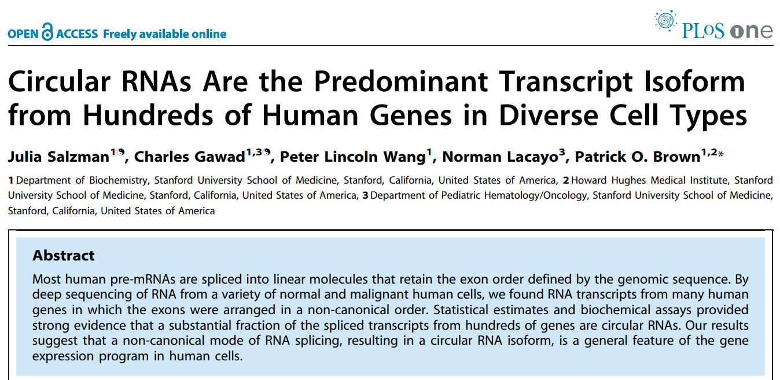
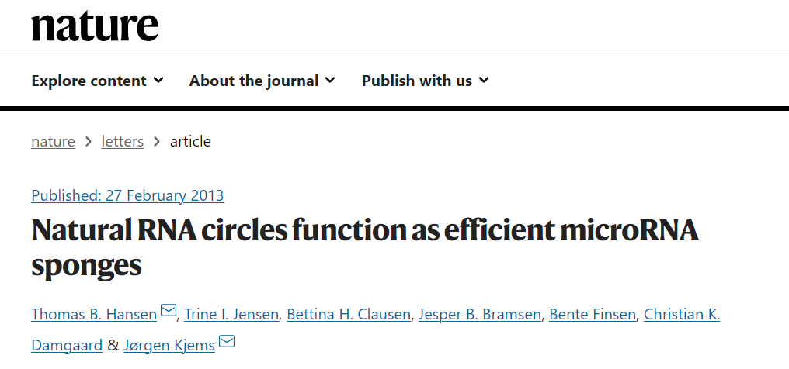
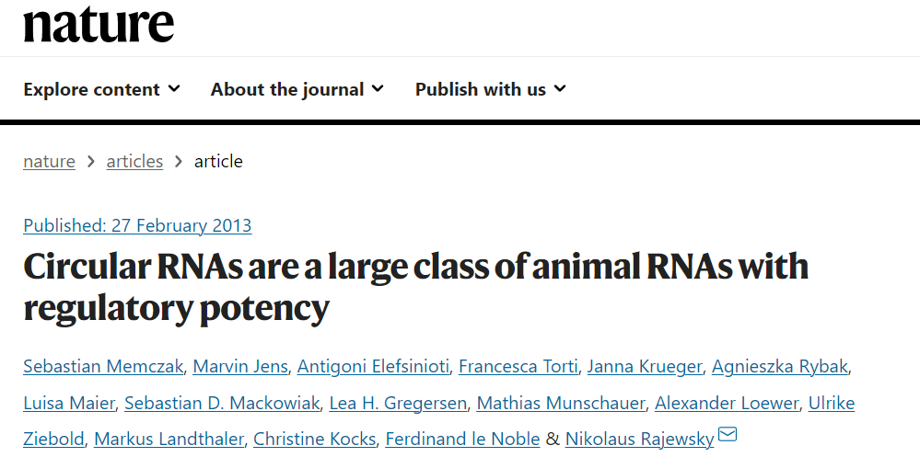

Slide 45
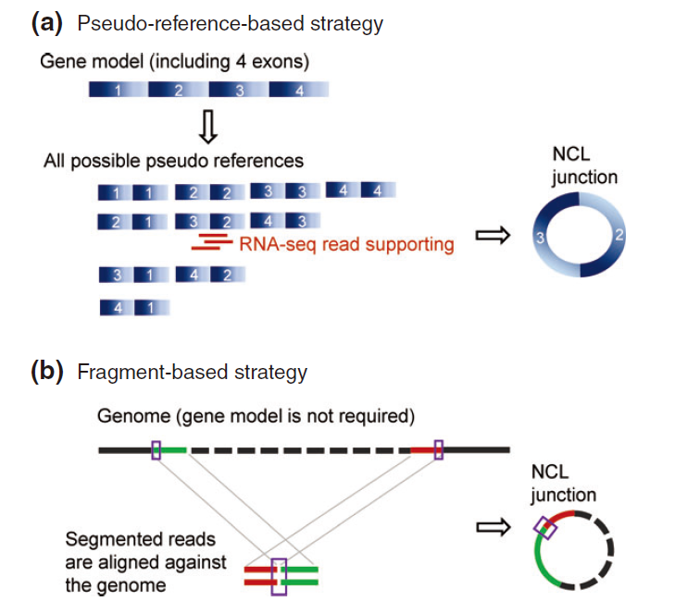

Slide 46
Identification of circRNA

Slide 47
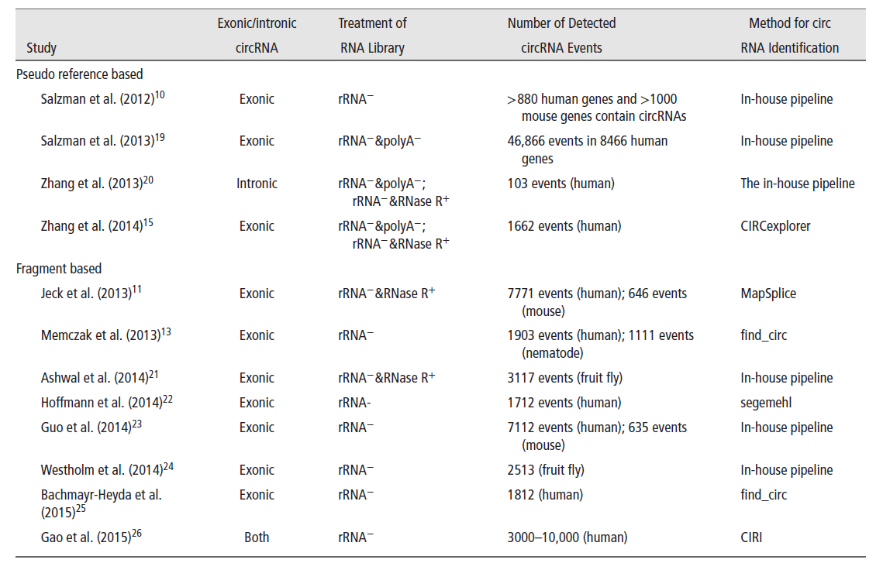

Slide 48
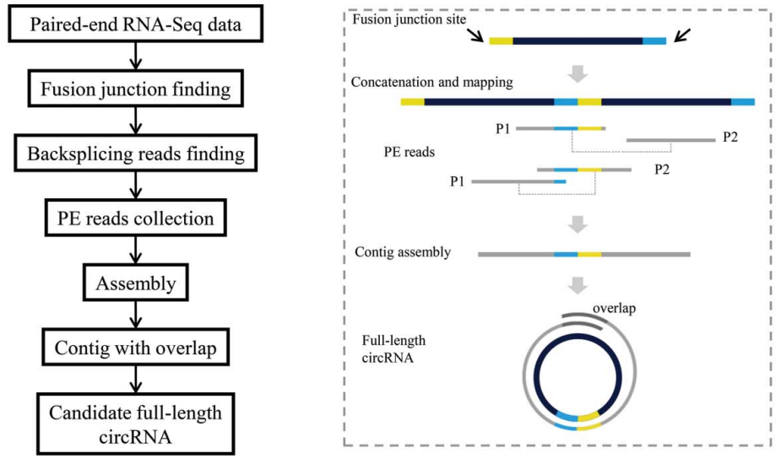
Circseq-cup: full-length circRNA assmbly

Slide 49
Validation of circRNAs by divergent PCR

Slide 50
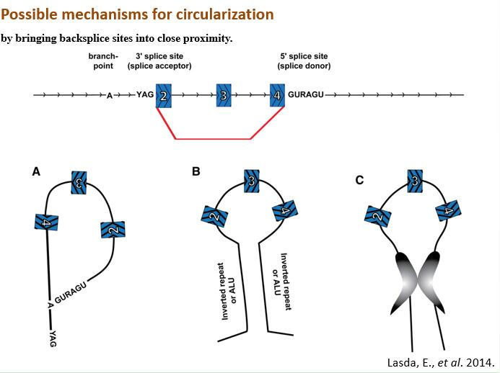

Slide 51
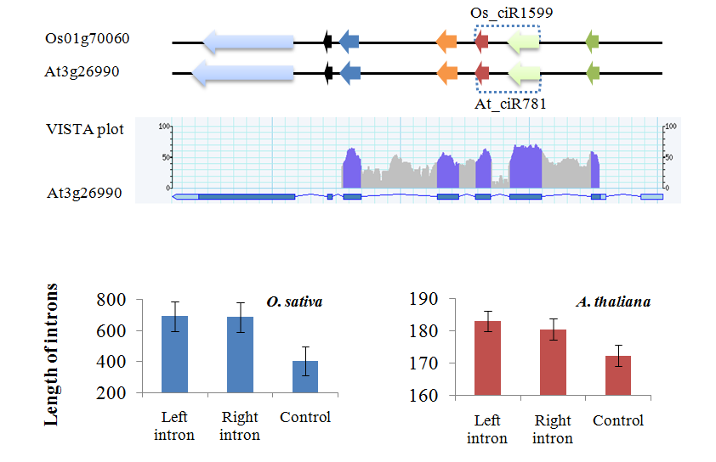
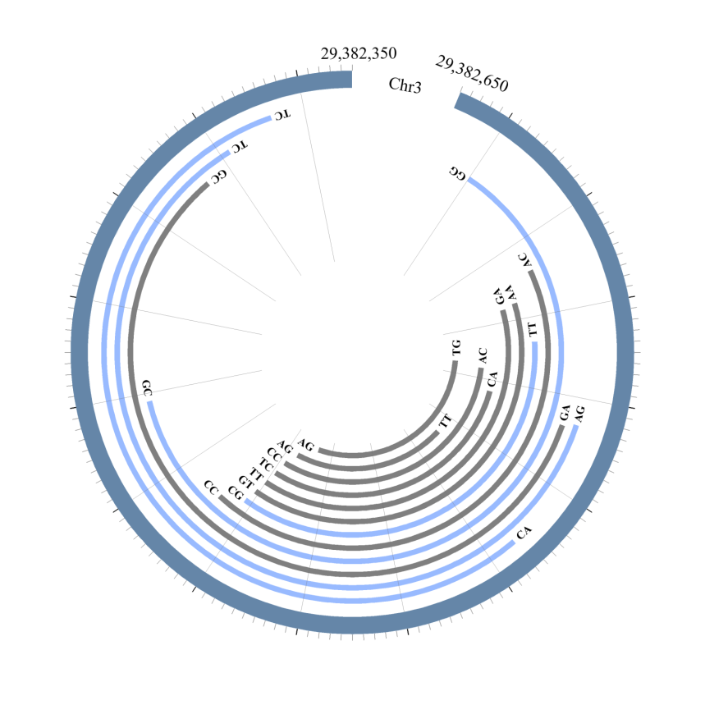
Conservation
Long introns
Multiple isoforms

Slide 52
Functions of circRNA

Slide 53
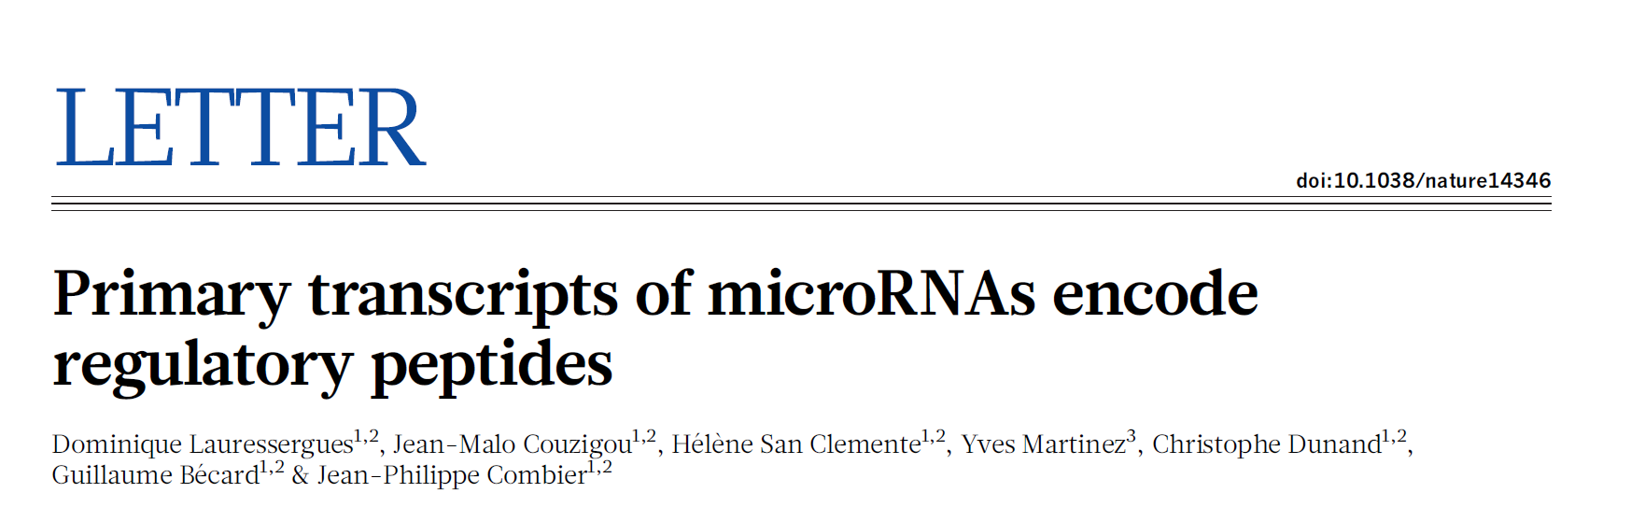
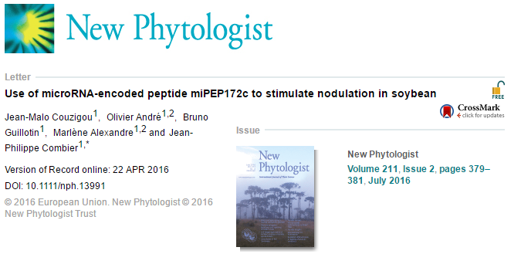
4、MicroPeptides

Slide 54
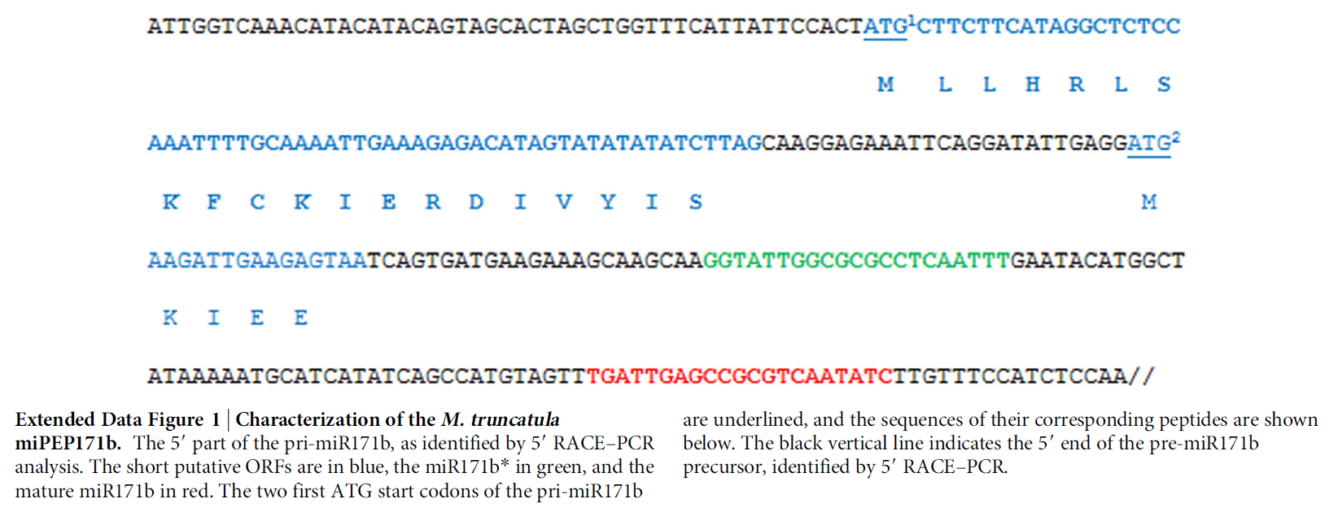

Slide 55
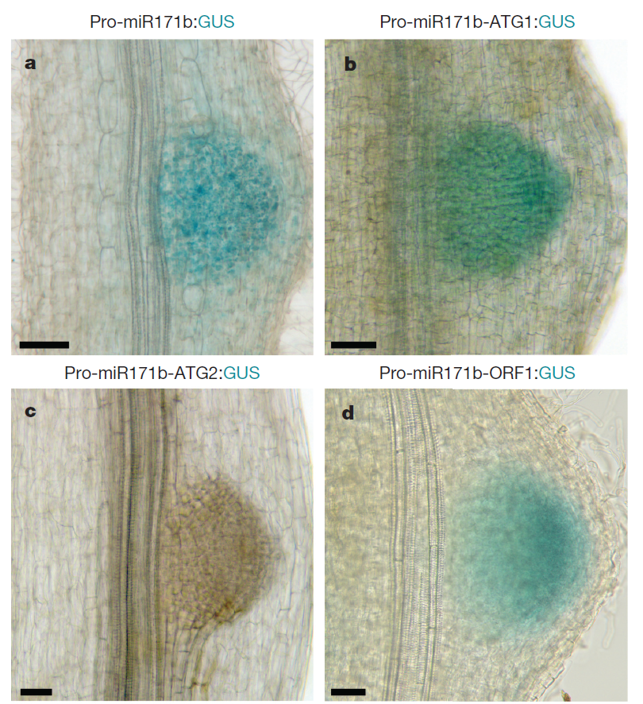
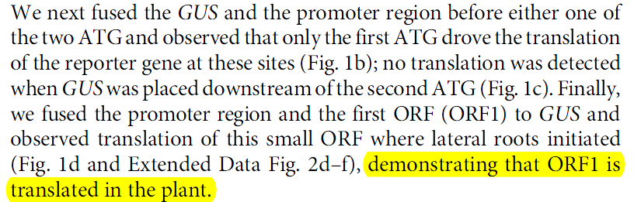

Slide 56
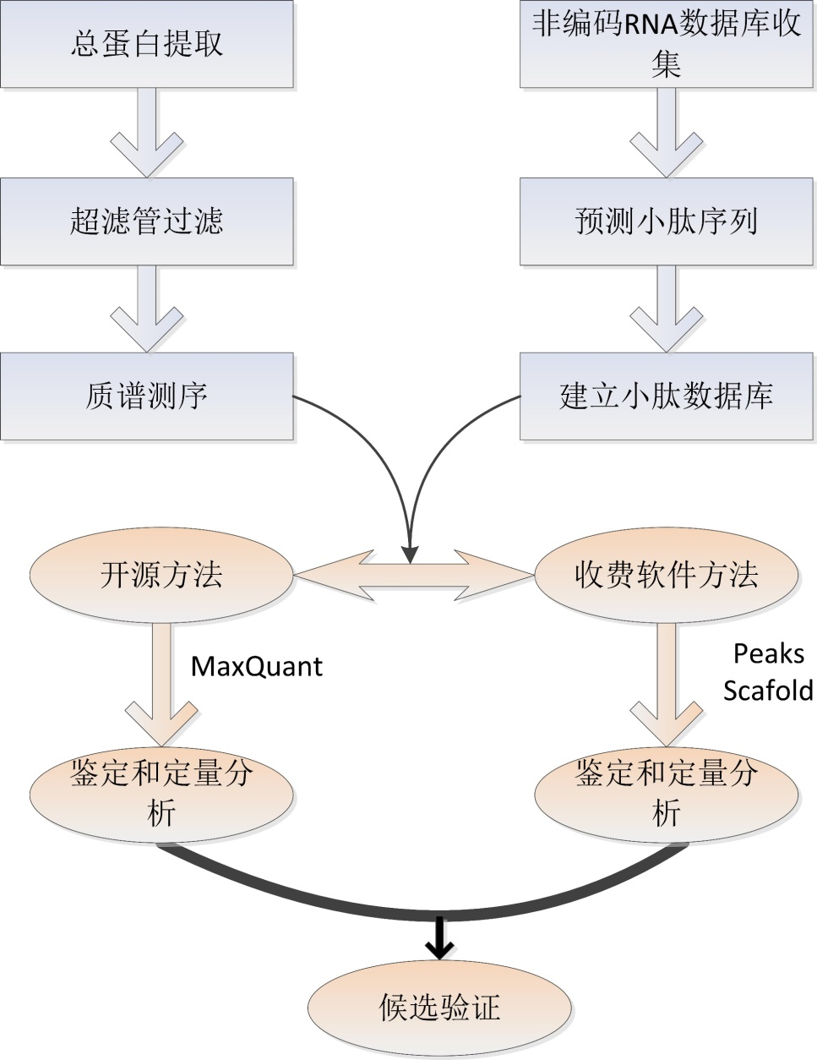
小肽鉴定

Slide 57
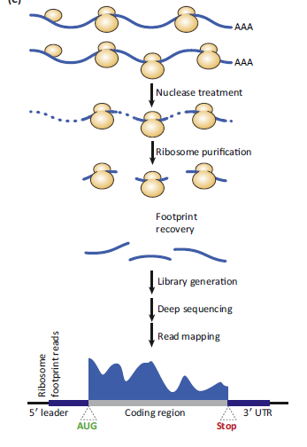
Conservation
Mass Spectrometry
Ribosome Profiling

Slide 58
小结
非编码RNA概念、类型
miRNA鉴定及特征
lncRNA鉴定及eTM
circRNA鉴定
小肽的概念

