Slide 1
Composition of plant genomes

Slide 2
基于63个植物基因组蛋白质编码基因统计（Phytozome，V12）
 | 基因数 | 最长基因的长度（bp） | 基因平均长度（bp） | 编码序列的最长长度（bp） | 编码序列的平均长度（bp） | 最多外显子个数 | 平均外显子个数 | 最长外显子长度（bp） | 平均外显子长度（bp） | 最长内含子长度（bp） | 平均内含子长度（bp）
平均值 | 32490 | 107384 | 3360 | 19377 | 1169 | 78 | 5 | 10024 | 246 | 51612 | 422
173/109
（最多）
98007 / 9629
（最多/最少）
>217.7Kb
（最长）
1.3Mb
（最长）
71.6Kb
（最长）
40.4Kb
（最长）

Slide 3
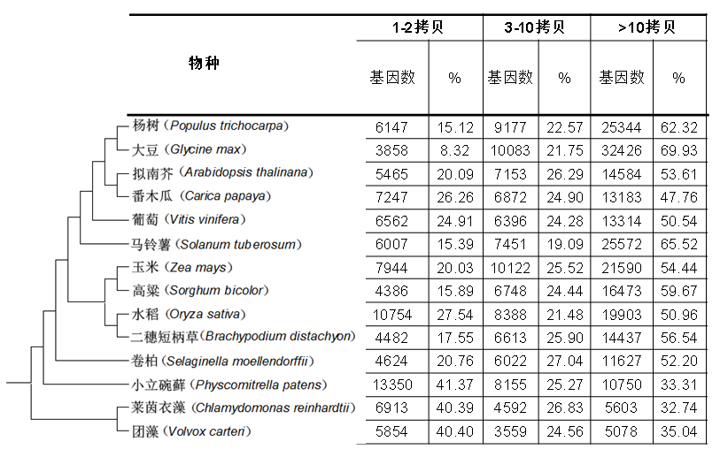

Slide 4
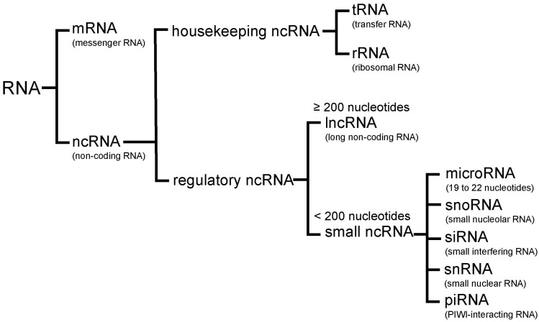

Slide 5
转录组测定
几种转录组测序建库方法比较
建库策略 | RNA类型 | rRNA含量 | 未加工RNA含量 | DNA含量 | RNA分离方法
总RNA（total RNA） | 全部RNA | 高 | 高 | 高 | 无
PolyA选择（PolyA selection） | 编码 | 低 | 低 | 低 | 用Poly（dT）低聚物杂交
去rRNA（rRNA depletion） | 编码和非编码 | 低 | 高 | 高 | 去除与rRNA互补的寡聚物
RNA捕获（RNA capture） | 目标RNA | 低 | 中等 | 低 | 用所需转录本互补的探针杂交

Slide 6
植物转录组主要构成（以水稻和拟南芥为例）
类型 | 编码特征 | 长度 | 类型 | 位点数量 | 测序技术
信使RNA | 编码 | 150bp以上 | 线性 | ~50k | RNA-Seq
小RNA（miRNA） | 非编码 | 20-24bp | 线性 | ~300-500 | sRNA-Seq
长非编码RNA | 非编码 | 200bp以上 | 线性 | ~10k | lncRNA-Seq
环状RNA | 非编码 | 50bp-5kb | 环状 | ~20k | circRNA-Seq

Slide 7
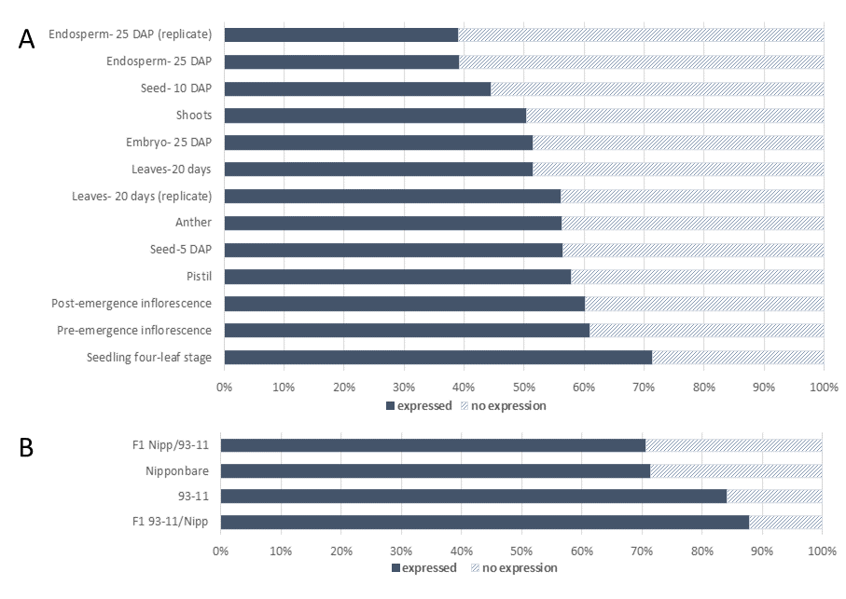
水稻基因组转录情况

Slide 8
Plant genome evolution
（part 1）
Genome evolution via du-/triplication
Genome evolution via other ways
Notes:
应用部分根据情况决定是否讲解

Slide 9
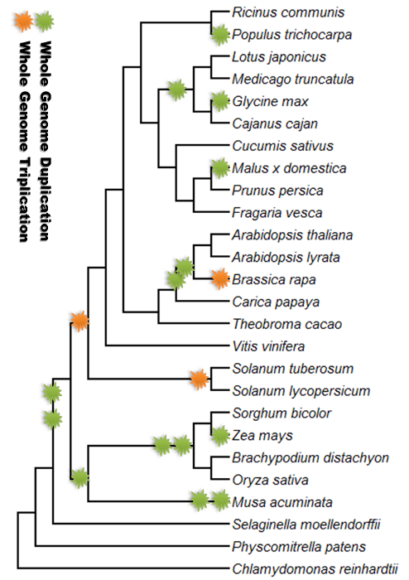
(Plant Genome Duplication Database - University of Georgia)

Slide 10
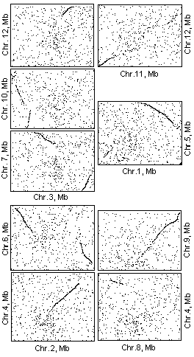
Genome duplication
Rice
13 large duplicated segments
Non-overlapped
Cover most parts of rice genome

Slide 11
An important issue
Did they occurred at a same time or different times?
  At a same time: genome duplication
  At different times: multiple duplication events in rice history

Slide 12
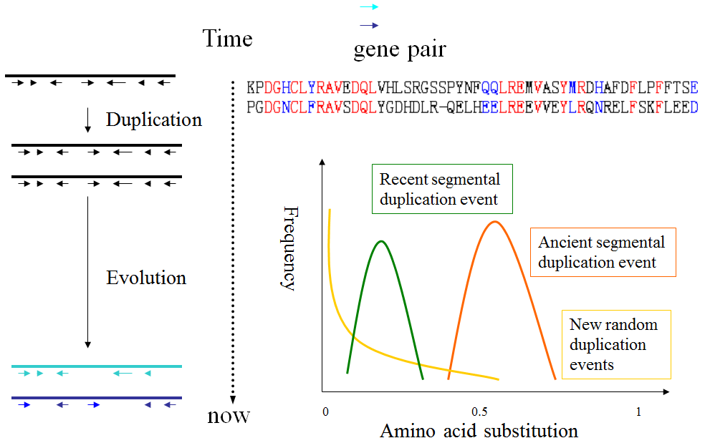

Slide 13
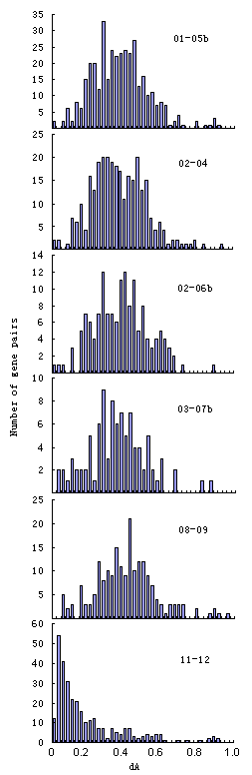
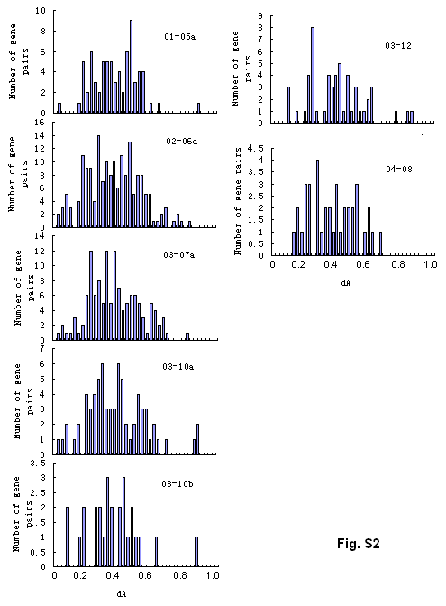

Slide 14
Summary
An ancient whole-genome duplication: Most (12) of the duplicate events were found to occur at a similar time (~87.5 million years ago), which strongly suggested that most, if not all chromosomes duplicated in rice history;
The event occurred before divergence of cereals;
A duplicate event between chromosome 11 and 12 occurred recently.

Slide 15
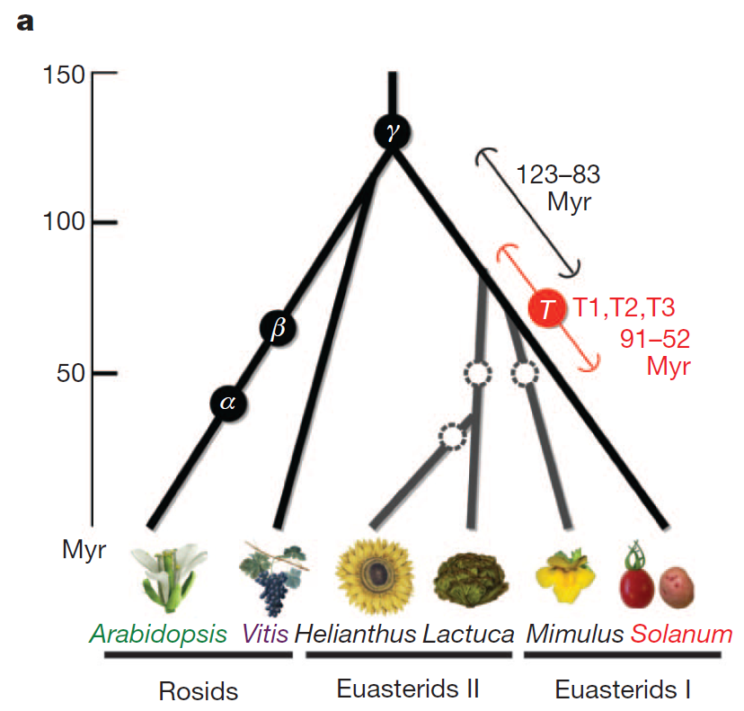

Slide 16
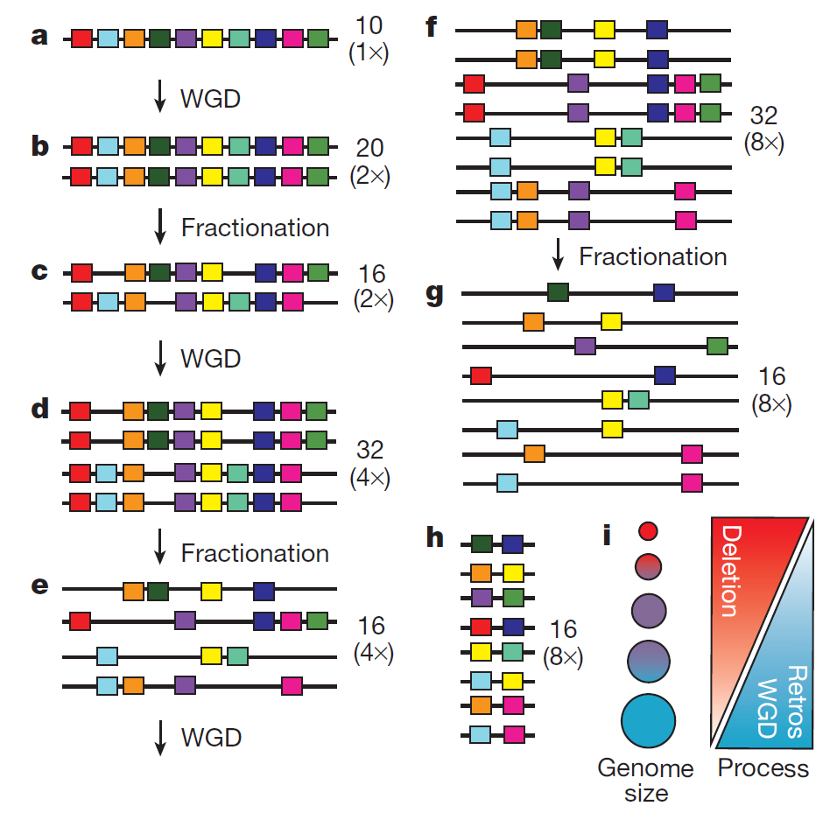
A model of genome size reduction and the plant genome size
evolutionary spectrum
Notes:
Figure 3 | A model of genome size reduction and the plant genome size
evolutionary spectrum. a, The initial diploid genome has 10 genes. b, c, After
one WGD (b), there are 20 genes in the tetraploid, which fractionate into 16
genes (c). d–g, After another round of WGD (d), the octoploid genome (32
genes) fractionates again to yield 16 genes (e), which duplicate (to 32 genes) in
yet another WGD (f), after which fractionation yields 16 genes in the 16-ploid
(g). The resulting number of genes is the same as in the fractionated genome
resulting from the first WGD (c), with only 6 more genes than the original
diploid ancestor (a). h, The resulting genome after intergenicDNA contraction
at any stage (a–g) has thus survived a high deletion rate via the net accrual of
very few gene duplicates following sequential WGDs. U. gibba has in fact
fractionated down to single copy two-thirds of its genes syntenic to tomato
genes since its three WGDs. i, An interplay of deletion and retroelement
proliferation rates relates to a continuum of plant genome size evolution, with
WGDs providing short-term buffering against loss of crucial gene functions in
small genomes affected by high endogenous deletion rates. Small genomes
result when the recombinational deletion rate is high relative to retroelement
proliferation and WGD, vice versa with large genomes.

Slide 17
Genome evolution via other ways
via transposable elements
  K. Naito et al., “Unexpected consequences of a sudden and massive transposon amplification on rice gene expression,” Nature, 461:1130-34, 2009
Notes:
High-copy-number transposable elements comprise the majority of eukaryotic genomes where they are major contributors to gene and genome evolution. However, it remains unclear how a host genome can survive a rapid burst of hundreds or thousands of insertions because such bursts are exceedingly rare in nature and therefore difficult to observe in real time. In a previous study we reported that in a few rice strains the DNA transposon mPing was increasing its copy number by approximately 40 per plant per generation. Here we exploit the completely sequenced rice genome to determine 1,664 insertion sites using high-throughput sequencing of 24 individual rice plants and assess the impact of insertion on the expression of 710 genes by comparative microarray analysis. We find that the vast majority of transposable element insertions either upregulate or have no detectable effect on gene transcription. This modest impact reflects a surprising avoidance of exon insertions by mPing and a preference for insertion into 5' flanking sequences of genes. Furthermore, we document the generation of new regulatory networks by a subset of mPing insertions that render adjacent genes stress inducible. As such, this study provides evidence for models first proposed previously for the involvement of transposable elements and other repetitive sequences in genome restructuring and gene regulation.

Slide 18
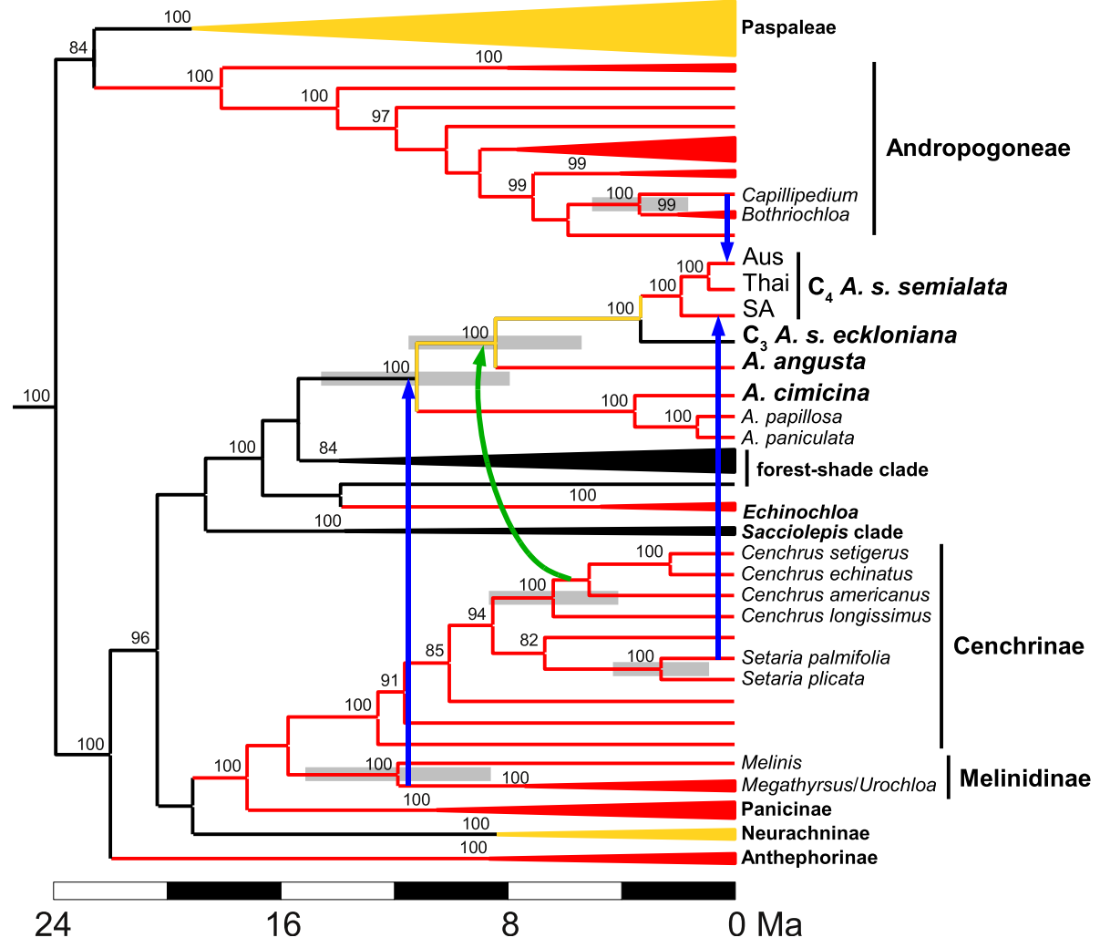
基因水平转移
（horizontal gene transfer, HGT）
禾本科Alloteropsis物种系统发生关系及四次向该物种横向转移C4途径相关基因事件（箭头表示）(Christin et al., 2012)

Slide 19
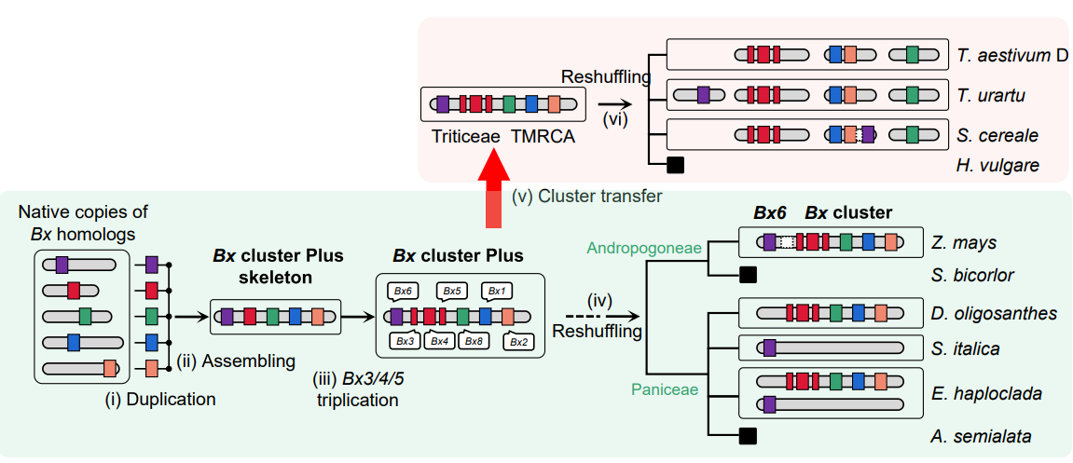
基因水平转移，形成基因簇

Slide 20
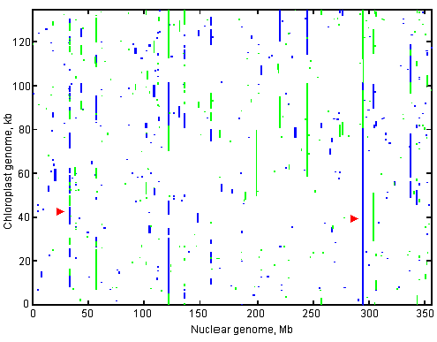
植物细胞内基因组间横向转移
水稻核基因组与叶绿体基因组序列比较图（Guo et al., 2008)

Slide 21
寄生植物向宿主植物横向基因转移
菟丝子（Cuscuta campestris）可以向宿主植物（拟南芥和本氏烟）横向转移大量mRNA和miRNA基因，即寄生植物的RNA分子能够跨物种靶向寄主mRNA从而调控其基因表达，在菟丝子寄生过程中起作用（Kim et al., 2014；Shahid et al., 2018）

Slide 22
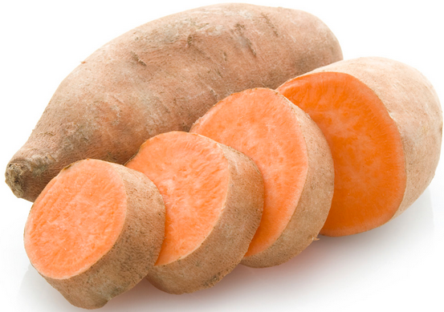
微生物向植物的横向基因转移
土壤农杆菌向植物转移：发明转基因技术
PNAS（2015）：在291个甘薯品种中，都发现了农杆菌T-DNA的序列。科学家认为在甘薯进化的过程中，曾被农杆菌侵染，而且被转入的农杆菌T-DNA在后续的自然选择中保留了下来

Slide 23
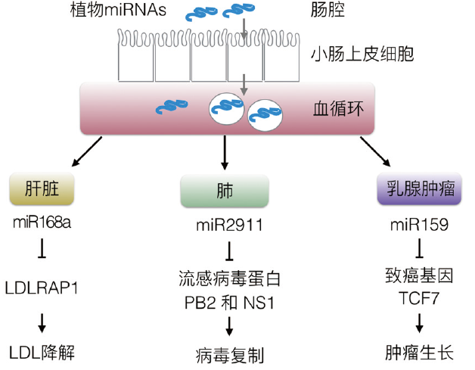
植物跨界调控
植物miRNA起怎样的调控作用？
影响脂类代谢
抗病毒
抗癌
……
（Zhang et al., 2012; Zhou et al., 2014; Chin et al., 2016.）
Notes:
植物miRNA经口服进入动物消化道，随后大部分可能被小肠上皮细胞摄入，包裹进囊泡，再分泌到血循环。通过血液循环的植物miRNA可以进一步到达靶器官，影响机体基因表达
2012年南京大学张辰宇教授所领导的研究团队，惊人地发现：在人和动物的血清以及多种器官中检测到植物miRNA的存在[113]。他们的结果表明，在汉族人的各种脏器比如心、肝、脾、肺、肾、胃、肠、脑以及血清中，稳定地检测到了如MIR156a、MIR166a和MIR168a在内的多种植物miRNA，并且这些miRNA非常稳定，能一定程度上抵抗高碘酸钠的氧化。作者进一步证明：这些植物miRNA是源自日常饮食。也即：食物中的植物miRNA可以抵抗食物收集、储存、运输、加工、烹饪过程的降解以及胃酸的消化，然后被胃肠道摄取入血，然后被各种器官所吸收。事实上，作者在给小鼠喂食大米之后，的确检测到血清和器官中植物miRNA含量的升高。作者选择了MIR168a作为对象，探索植物miRNA在人体内可能的功能。

Slide 24
ePmiRNA_finder:
Identification of extracellular plant miRNAs in human and animals
20个健康人类血液样本
45条植物miRNA
22个家族
这些miRNA来源的植物大多是可食用的

Slide 25
本讲小结
植物基因组多倍化
植物基因组进化其他机制

Slide 26
Plant genome evolution
（part 2）

Slide 27
Genomic variations
SNP: Single Nucleotide Polymorphisms
Indel: insertion and deletion
Structural variation (SV) is the variation in structure of an organism's chromosome. It consists of many kinds of variation in the genome of one species, and usually includes microscopic and submicroscopic types, such as deletions, duplications, copy-number variants, insertions, inversions and translocations. Typically a structure variation affects a sequence length about 1Kb to 3Mb, which is larger than SNPs and smaller than chromosome abnormality

Slide 28
Indel
SNP
SNP
indica_1 ATG CGG GAT CCA TTC CTT AAT GAG TTT CCT AAA ACG GTG CAC GGT TTT
indica_2 ATG TGG GAT CCA TTC CTT AAT GAG TTT CCC GAA ACG GTG CAC GGT TTT
indica_3 ATG TGG GAT CCA TTC CTT AAT GAG TTC CCT GAA ACG GTG CAC GGT TTT
joponica_1 ATG TGG --- CCA TTC CTT AAT GAG TTC CCT GAA ACC GTG CAC GGT TTT
joponica_2 ATG CGG --- CCA TTG CTT AAT GAG TTC CCT GAA ACC GTG CAC GGT TTT
joponica_3 ATG TGG GAT CCA TTG CTT AAT GAG TTC CCT GAA ACC GTG CAC GGT TTT
rufipogon_1 ATG TGG GAT CCA TTC CTT AAT GAG TTC CCT GAA ACG GTG CAC GGT TTT
rufipogon_2 ATG TGG GAT CCA TTG CTT AAT GAG TTC CCT GAA ACC GTG CAC GGT TTT
rufipogon_3 ATG TGG GAT CCA TTG CTT AAT GAG TTC CCT GAA ACC GTG CAC GGT TTT
O.nivara ATG TGG GAT CCA TTC CTT AAC GAG TTC CCT GAA ACG GTG CAC GGT TTT
  Measure of polymorphism:
    π (Tajima 1983): the average pairwise nucleotide diversity
    θ (Watterson 1975): Watterson’s estimator. Number of separating sites per nucleotide site

Slide 29
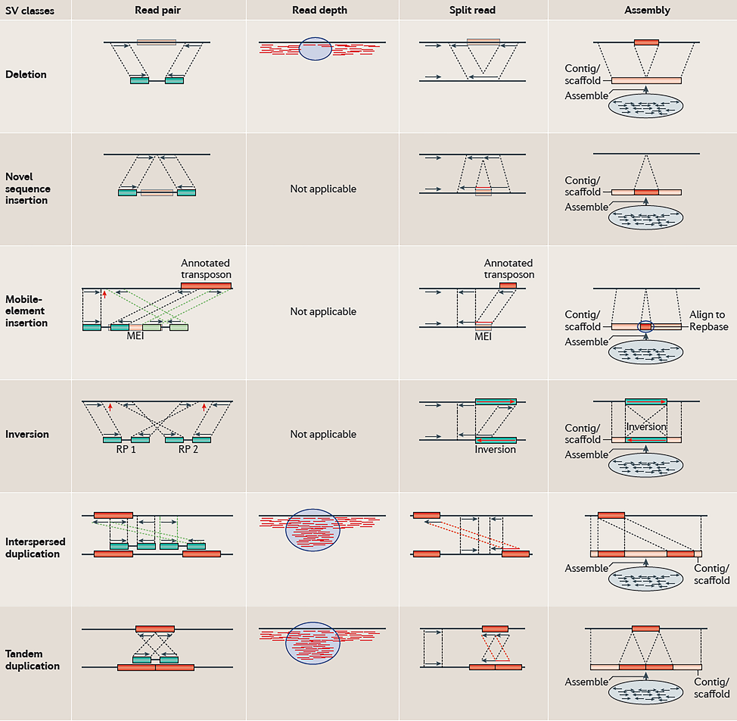
Structural Variation (SV)

Slide 30
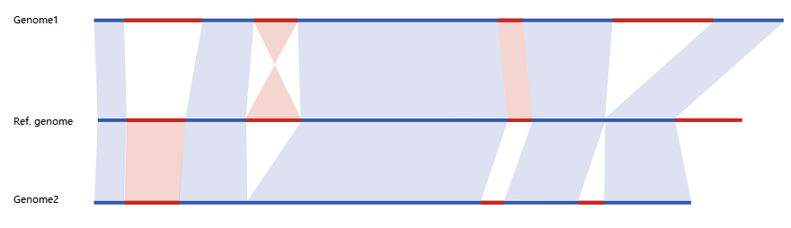
Genomic structural variations

Slide 31
Genomic phylogeny of plants
Echinochloa genus as a case
稗属具有多个重要物种：稗草和栽培稗（稗子），但其物种分类极其混乱
核和叶绿体基因组为我们提供了重要信息

Slide 32
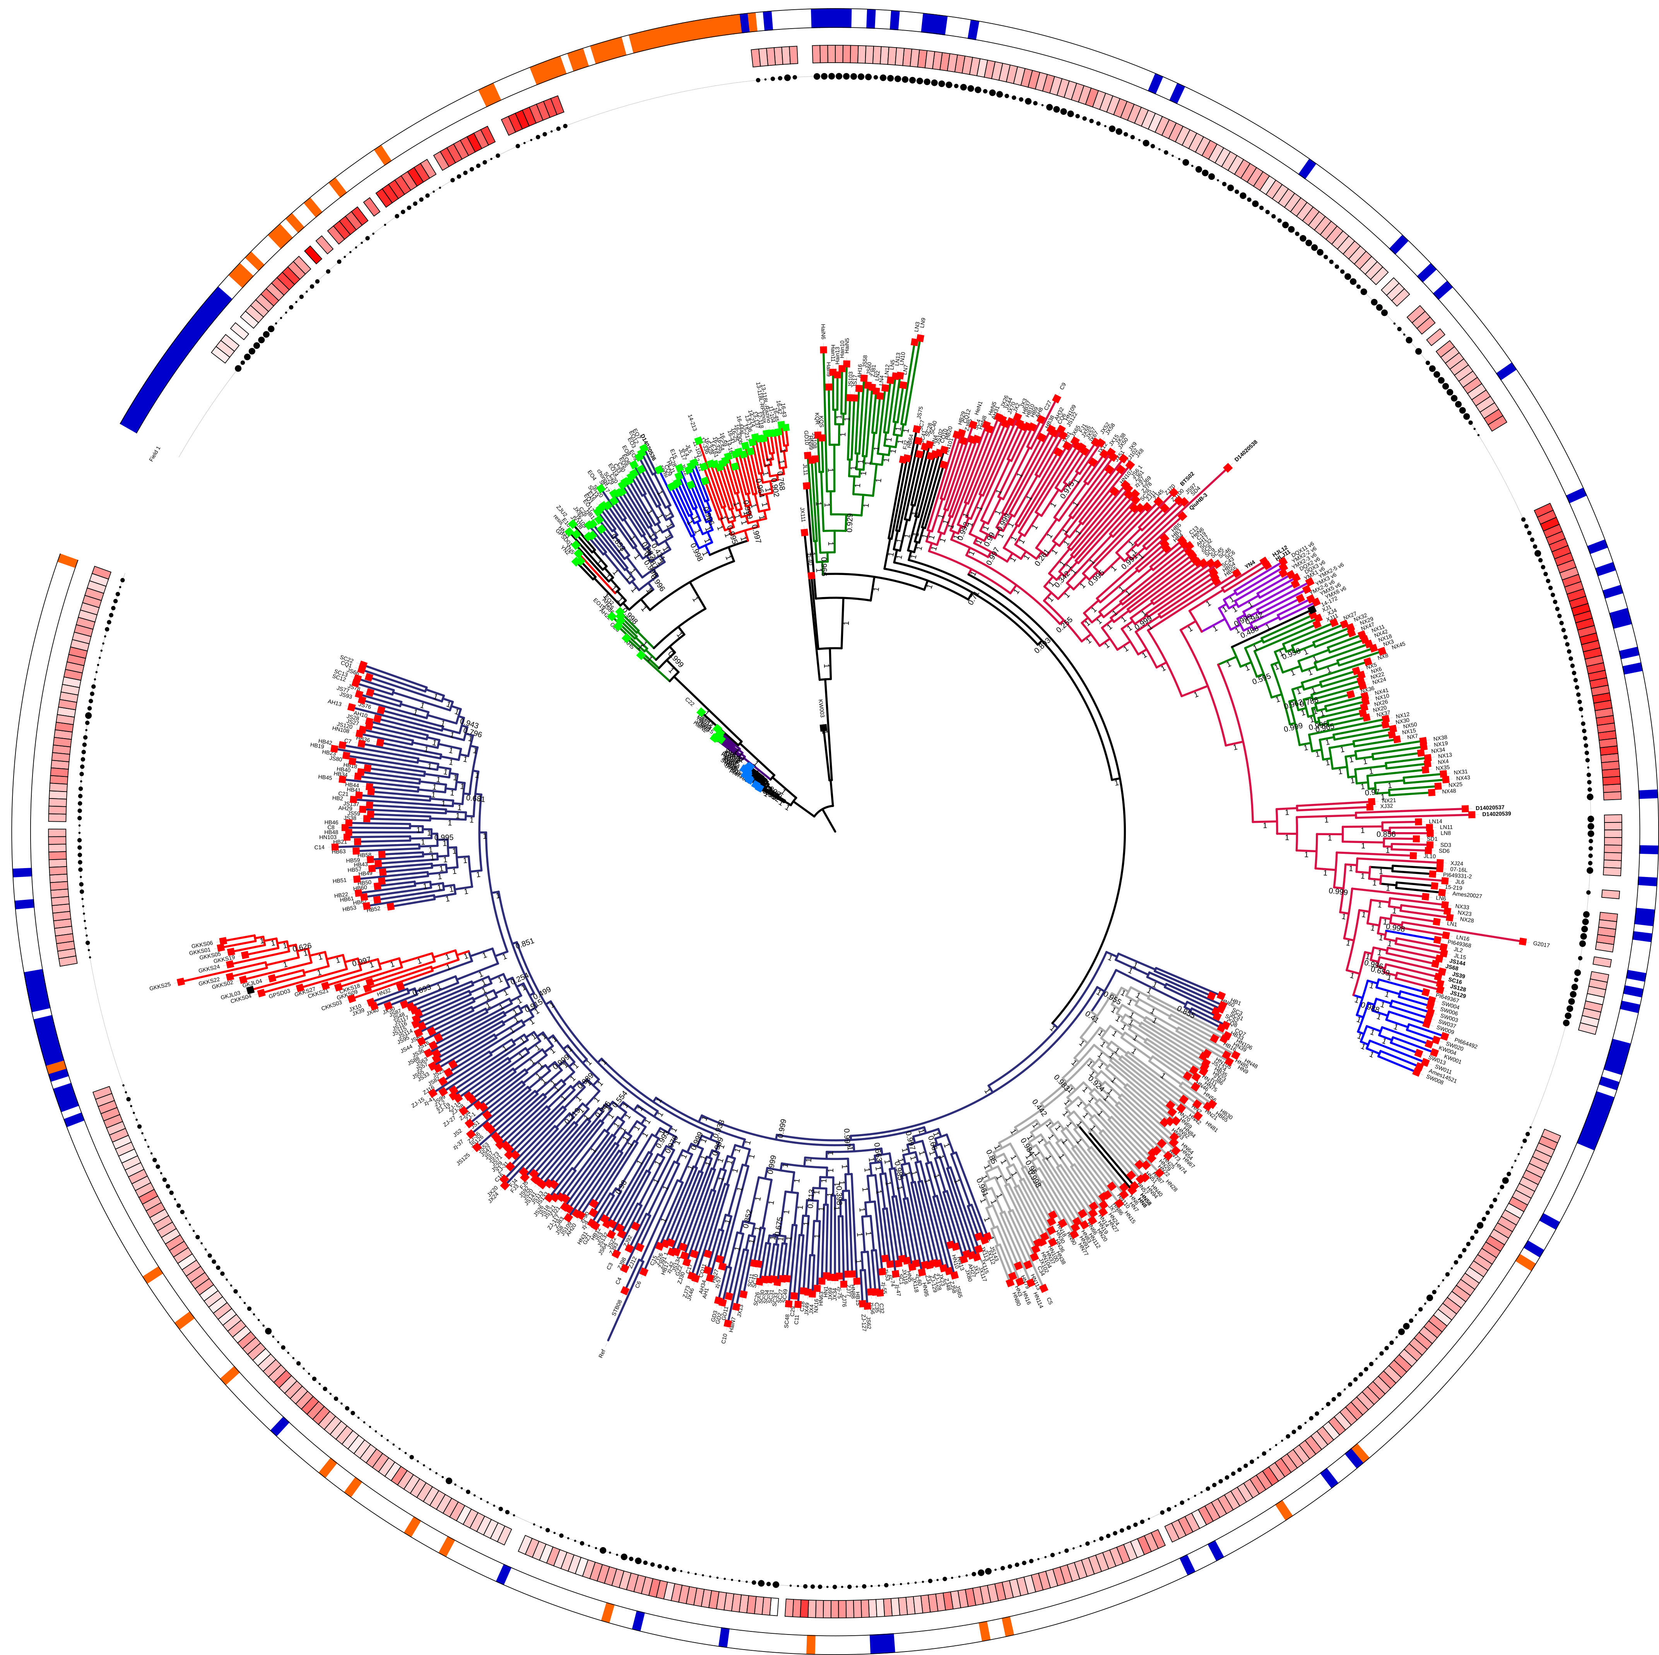
E. crus-galli var. crus-pavonis
E. oryzicola var. Y
E. crus-galli var. praticola
长江流域
云南栽培
E. oryzicola var. X
西北
E. crus-galli var. oryziodes
E. walteri
北方（包括Italy）
Malaysia
E. crus-galli var. crus-galli
JS
US
长江流域
湖南
Notes:
最近在MP发表的文章都是为了回答这个问题而努力的

Slide 33
Genomic variations in natural population
Arabidopsis as an example
Wild relatives of crops
  wild
  semi-wild
Weeds
...

Slide 34
Arabidopsis population
The 1001 Genomes Project (www.1001genomes.org)
A catalog of Arabidopsis thaliana genetic variation
Level of genomic variation (SNP density)
Notes:
几篇大文章

Slide 35
Wild progenitor populations of crops
  446 diverse O. rufipogon accession (Huang et al, 2012)
  103个大刍草等 （Chia et al., 2012）
  17个野生大豆（Lam et al., 2010）
Notes:
Zhanghaiqiang’s ppt

Slide 36
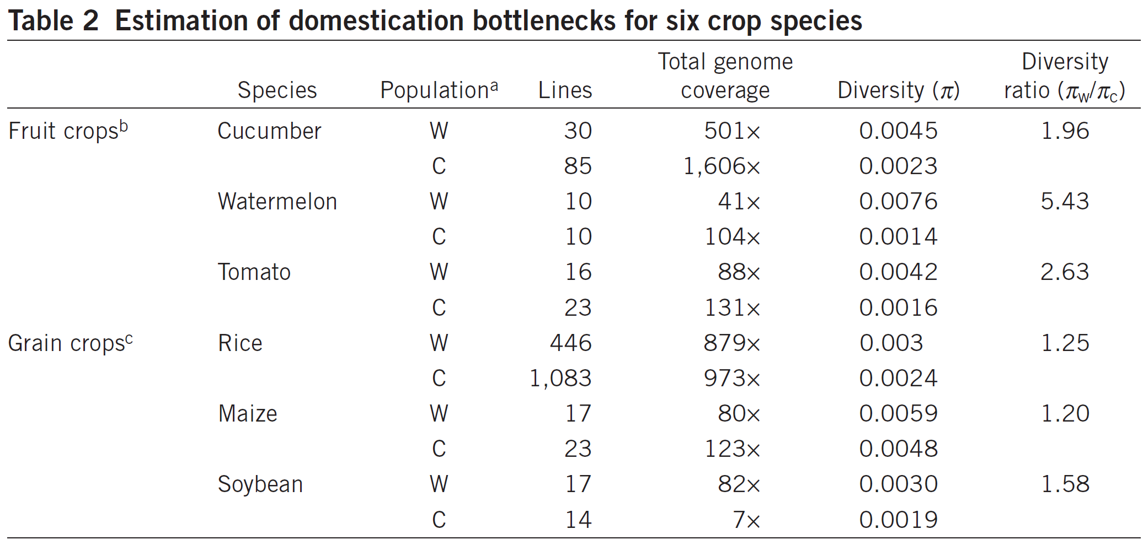
Genomic variations in crop and wild populations
(Qi et al., 2013, Nature Genetics)

Slide 37
Intercultivar variation is so big
Maize genomic variation
35% genomic synteny between two genomes of cultivars (B73 and Mo17)
2.5 Mb PAV (Mo17-specific segment)
(Sun et al., 2018)

Slide 38
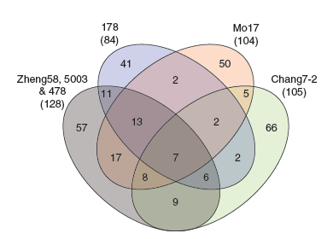
Numbers of PAVs relative to the B73 reference genome
296 high-confidence genes in B73 that were missing from at least one the six inbred lines.
One large deletion between Mo17 and B73: ~2Mb with 24 genes

Slide 39
Genomic variations and adaptation
Environmental adaptation
Natural seleciton
Artificial selection
Selection signals and positive selection
Detection of selection signals

Slide 40
Population genomics analysis
目前最为活跃的研究领域之一，作物科学的重要方向
可以直接回答作物起源进化、育种选择等重要分子机制
可以直接回答物种起源、进化（种群动态）、环境适应等重要分子机制
可以直接确定重要选择位点（包括自然和人工选择）
。。。

Slide 41
群体基因组学分析内容
Notes:
相应方法的内容已超出植物基因组学范围，在生物信息学或群体遗传学等课程讲解chao

Slide 42
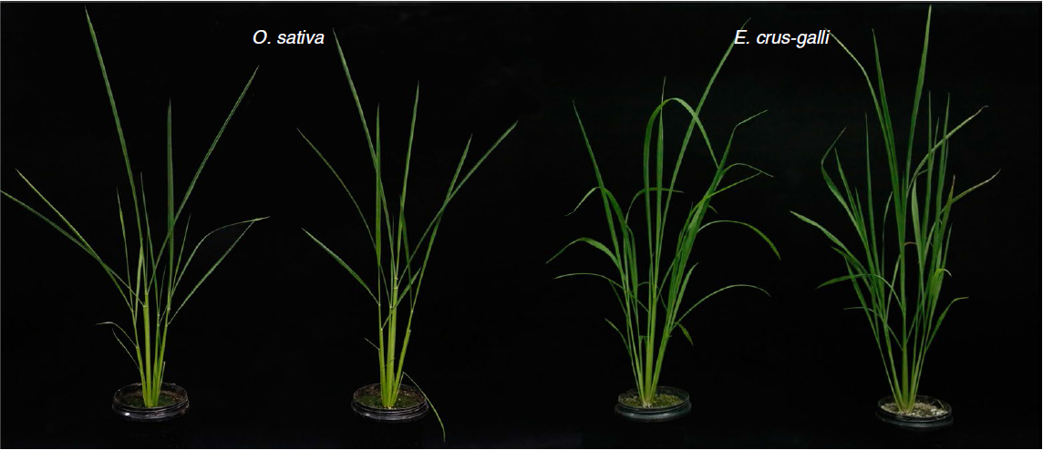
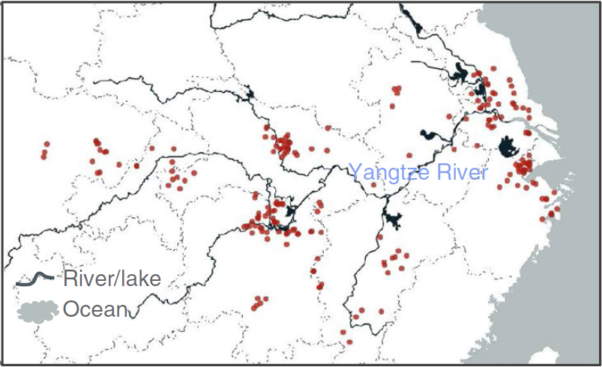
A case：稗草拟态水稻遗传机制
300余份稗草材料

Slide 43
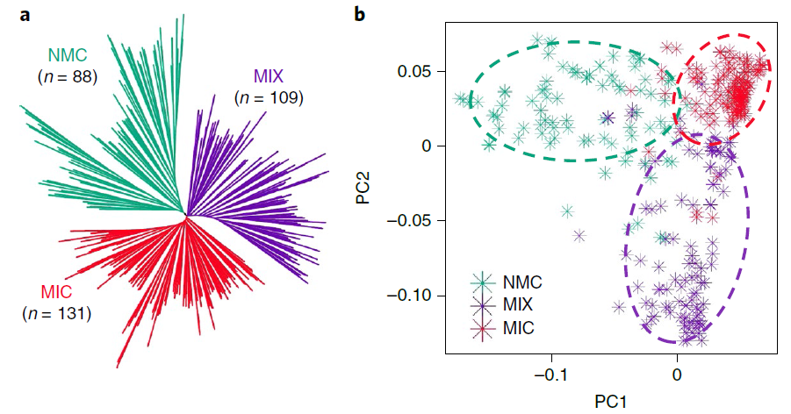
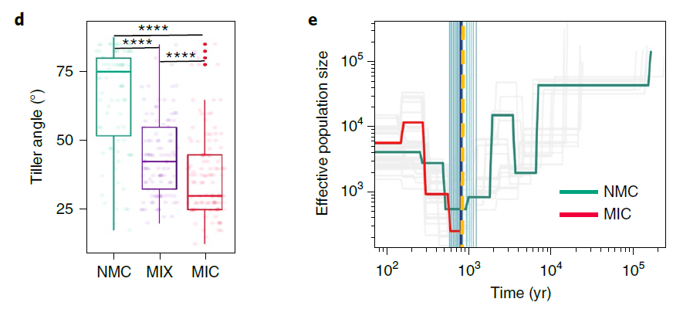
系统发生树
PCA
群体分化时间

Slide 44
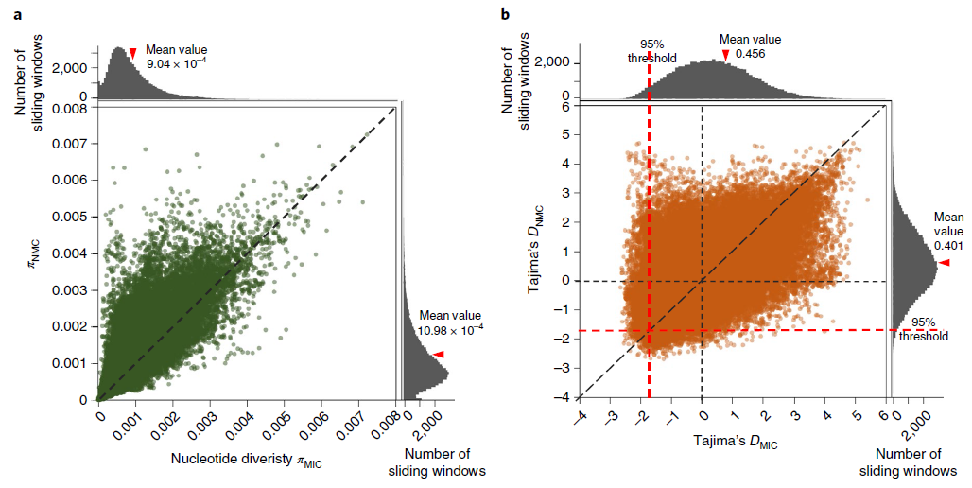
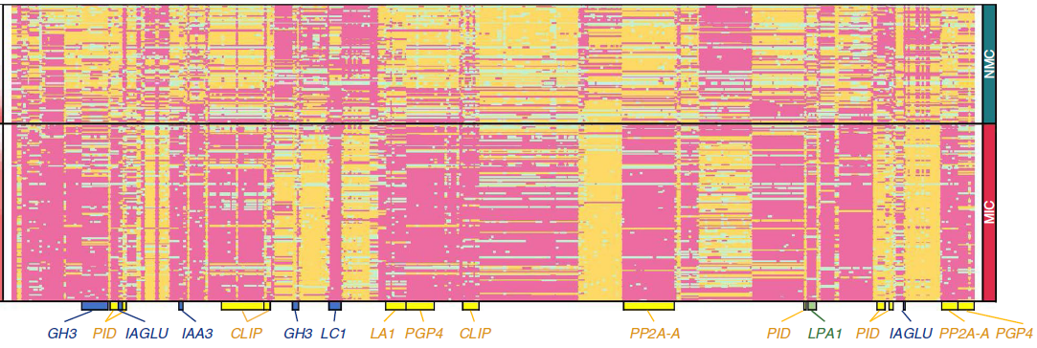

Slide 45
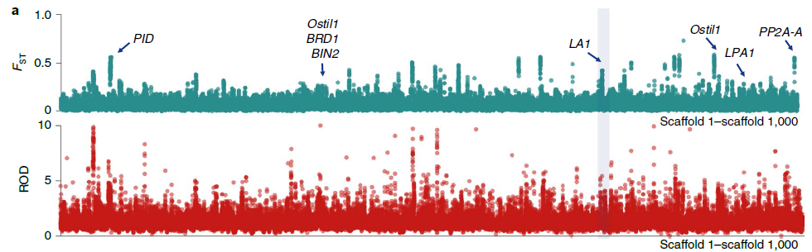
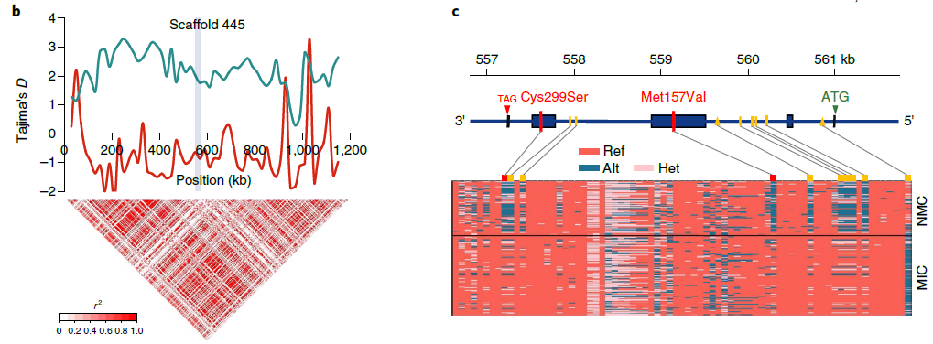
株型基因LAZY1受到选择

Slide 46
Crop population and artifical selection
Crop and artifical seleciton
Facts hidden hehind crop genomes

Slide 47
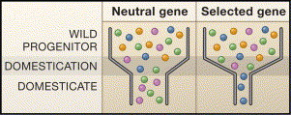
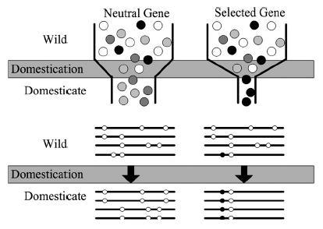
Domestication bottleneck
Domestication bottleneck = domestication selection + demography effect
(Whitt and Gaut 2005)
The effects of domestication bottleneck on genetic diversity

Slide 48
Roadmap for crop genome study
Comparative genomics
Reference genome (2002-)
Full-length cDNA project
?
pedigree genome
(maize, Lai et al. 2010)
Population genome
Rice, maize, soybean, millet
~50 rice lines (Xu et al. 2011)
~500 rice lines (Huang et al. 2009)
~1000 rice lines (Huang et al. 2012)
First haplotype map of maize (Gore et al. 2009)
~31 soybean lines (Lam et al. 2010)
~1000 millet lines (Peng et al. 2013)
Inbred line genome?
Notes:
Ency

Slide 49
Crop populations: what hidden behind their genomes?
  Origin of crops
  Molecular basis of breeding
    Regions under artificial selection
    Demographic history
  Genome-based pedigree
  Genome selection
  ......

Slide 50
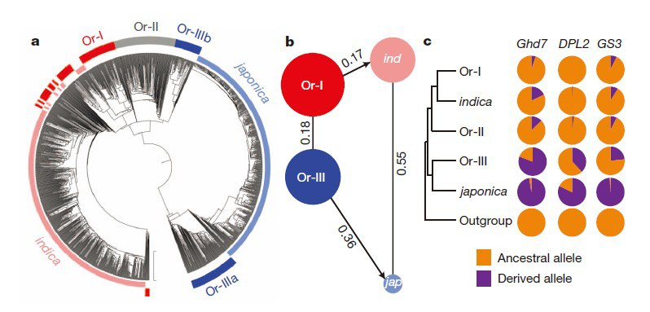
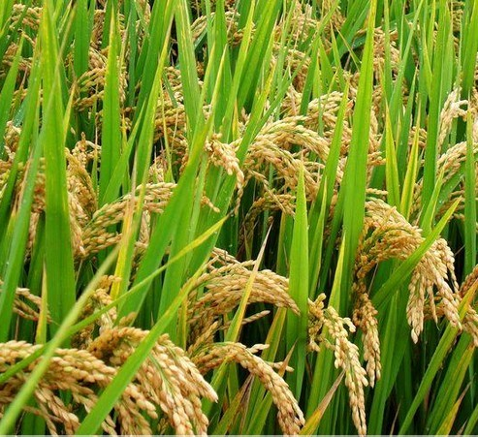
背后故事1：作物起源——基因组证据
Whole-genome sequencing data for a large panel of accessions containing 446 O. rufipogon accessions and 1,083 O. sativa varieties were used to explore their phylogenetic relationships.
（Huang et al., 2012. Nature）

Slide 51
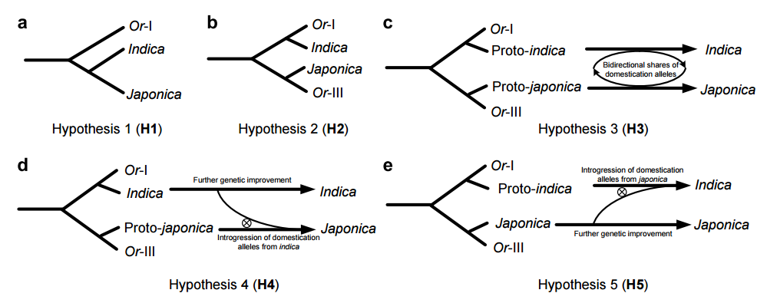
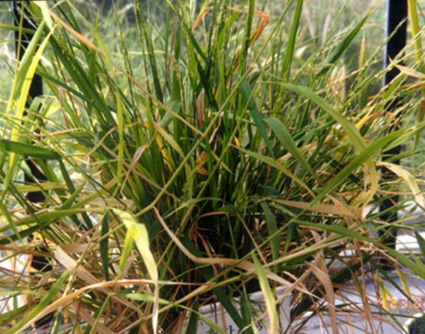
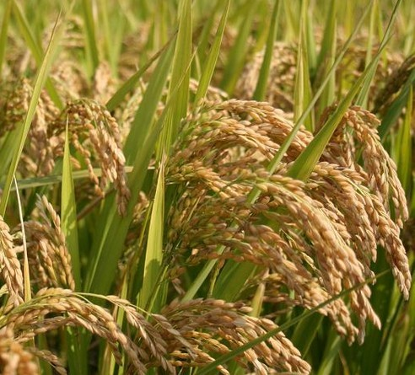
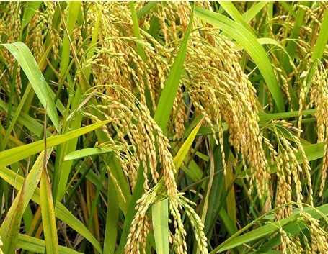
O. rufipogon
Oryza sativa japonica
Oryza sativa indica

Slide 52
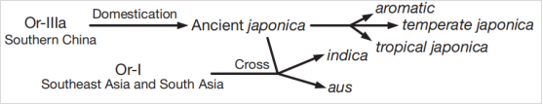
韩斌：“一次起源，两次驯化”
（Huang et al., 2012）

Slide 53
背后故事2：Footprint of artificial seletion on crop genomes
Genome-wide identification of selection loci/regions in crops: rice, maize, soybean, millet
Targets of artificial selection: non-coding microRNAs are directly targets of artificial selection

Slide 54
作物育种在基因组上选择的区域有多大？
栽培稻群体人工选择位点连带效应大小
选择位点 | 选择性状 | 选择连带范围（Kb） | 文献
sh4 | 落粒性 | 60, 400 | et al., 2011; et al., 2012
Prog1 | 分蘖角 | 300, 600 | He et al., 2011; Huang et al., 2012
qSH1 | 落粒性（粳稻） | 800 | Lu et al., 2018
Rc | 果色 | 20, 300 | He et al., 2011; Huang et al., 2012
An1 | 芒长 | 700 | et al., 2018
waxy | 糯性 | 260 | Purugganan and Fuller, 2009
Bh4 | 稻壳颜色 | 500 | Huang et al., 2012
qSW5 | 粒宽 | 600 | Huang et al., 2012
badh2 | 香气 | 100 | Wang et al., 2014
OsAMT1 | 养分吸收（氨） | 100 | Ding et al., 2011
SD1 | 株高（赤霉素合成） | 404 | Paterson and Li, 2011
Pib | 稻瘟病抗性 | 500 | Lu et al., 2018
GAD1 | 粒数、粒长 | 900 | Jin et al., 2016
平均值* |  | 474.2（403.4）

Slide 55
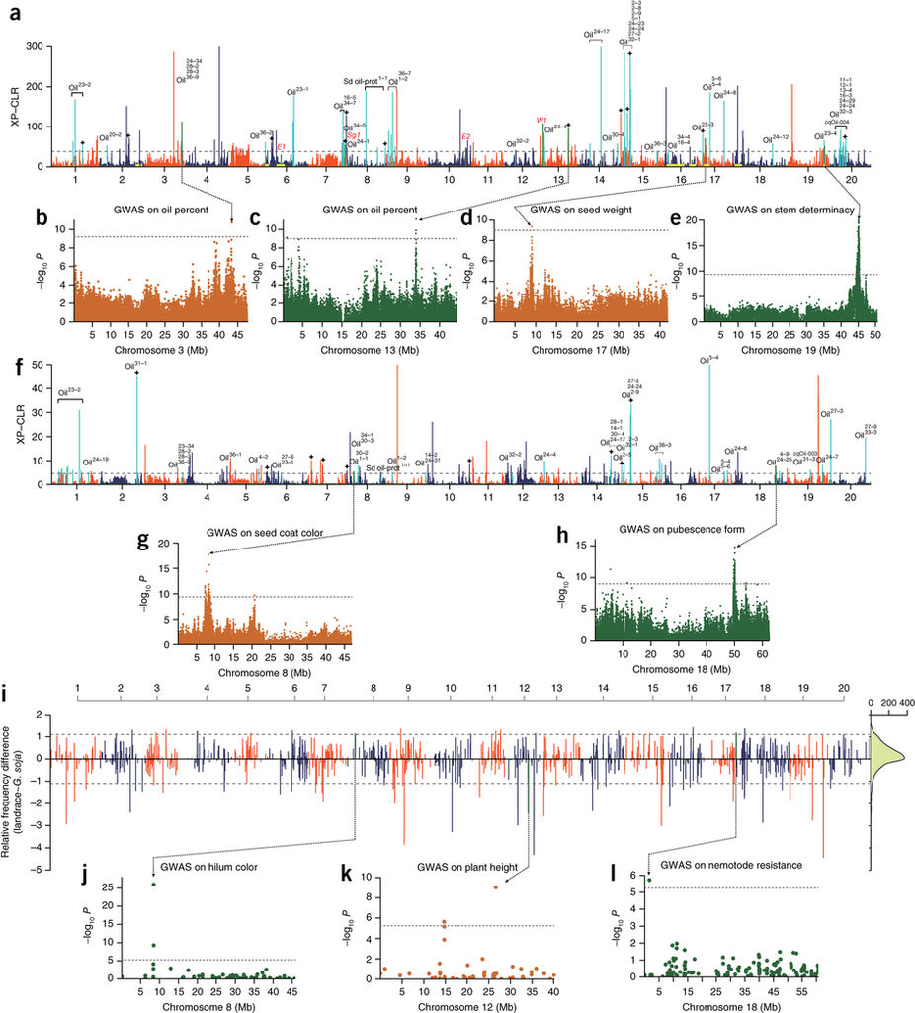
大豆驯化和改良过程中全基因组范围区域的选择和功能注释（Zhou等，2015）
a和f表示在在驯化和改良中全基因组范围内的选择信号，b-e，g和h是六个重叠强选择性信号的GWAS结果。i显示驯化期间选择拷贝数变异（CNV）的全基因组筛选与功能注释，j-l显示了与强选择性CNV重叠的三个GWAS结果。

Slide 56
10%区域？
“基于韩斌课题组研究结果，以π野生/π栽培 > 3等标准，共检测到籼稻和粳稻受到选择位点各60和62个，导致的选择连带区域大小平均535Kb和587Kb，分别累计32Mb和36Mb（Huang et al., 2012）”
“可以做个简单的估计，假设水稻基因组中有100个驯化和遗传改良相关基因受到强烈人工选择，每个受选择影响的基因组区域平均在450KB左右，这样累计45Mb区域受到选择影响，涵盖10%以上的水稻基因组区域”
（樊龙江，2020，《植物基因组学》）
Notes:
80%的基因组区域是表达，有功能的

Slide 57
Evolution of non-cong RNAs: artificial selection
Role of small RNAs in crop domestication and genetic improvement

Slide 58
  Transcript factor targets: protein-coding genes
  Non-coding small RNA targets: transcript factor
  Domestication targets: transcript factor
Protein-coding genes
Domestication selection
Transcript factors
Question:
Targets of domestication selection: small RNAs?
Small RNAs

Slide 59

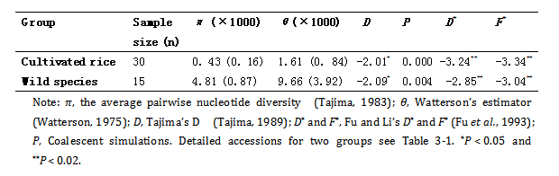
Selection on microRNA MIR156b/c in rice
Target a domestication gene, a transcript factor (Xie et al. 2006; Chuck et al. 2007)
Only 8.9% DNA diversity of wild rice was maintained in cultivated rice
Jiao et al. Nature Genetics, 2010
Regulation of OsSPL14 by OsmiR156 defines ideal plant architecture in rice
(Wang et al. FEBS Lett, 2007)
Notes:
SPL, tag1 in maize
后被证实：理想株型基因
Jiao et al. Nature Genetics, 2010
Regulation of OsSPL14 by OsmiR156 defines ideal plant architecture in rice

Slide 60
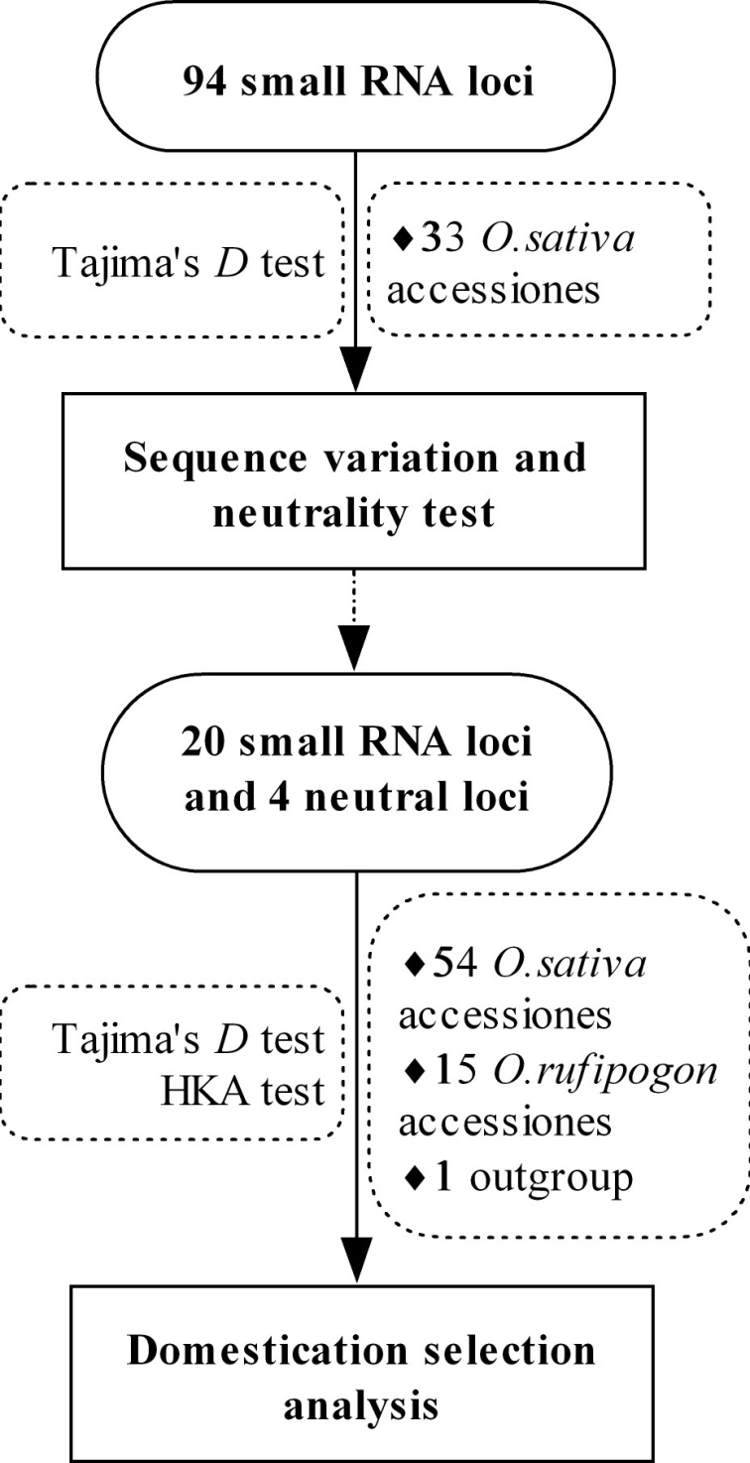
(Wang et al. 2010, BMC Evol Biol)

Slide 61
Sequence diversity, Tajima’s D and HKA test results
Small RNA |  | O. sativa |  |  |  |  |  |  |  |  |  |  |  |  |  | O. rufipogon |  |  |  |  |  | Target | Candidate
 |  | Indica subgroup |  |  |  |  |  |  | Japonica subgroup |  |  |  |  |  |  |  |  |  |  |  |  |  | Status
 |  | N | L | S | π | D | HKA-P |  | N | L | S | π | D | HKA-P |  | N | L | S |  | D | HKA-P
MIR164e |  | 21 | 553 | 6 | 1.18 | -1.9033* | 0.101 |  | 21 | 551 | 3 | 2.19 | 1.1834 | 0.285 |  | 10 | 549 | 7 | 3.40 | -1.0403 | 0.4474 | NAC | Putative
MIR390 |  | 25 | 723 | 2 | 0. 32 | -1.2137 | 0.1064 |  | 20 | 741 | 1 | 0. 36 | -0.0861 | 0.0138 |  | 11 | 741 | 7 | 2.25 | -1.2177 | 0.2568 | TAS3 | Putative
MIR-b |  | 27 | 418 | 11 | 3.59 | -1.558 | NA |  | 21 | 646 | 13 | 2.56 | -1.9396* | NA |  | 11 | 594 | 8 | 2.93 | -1.4933 | NA | APS/AST | Putative
TAS2 |  | 28 | 765 | 33 | 5.49 | -1.8578* | 0.0288 |  | 24 | 763 | 21 | 5.66 | -0.8475 | 0.158 |  | 10 | 764 | 12 | 3.89 | -1.3459 | 0.5026 | ARF | Putative
AK120922 |  | 25 | 645 | 2 | 0. 91 | 0.2607 | 0.0034 |  | 18 | 644 | 8 | 1.77 | -1.7663 | 0.0546 |  | 11 | 645 | 34 | 10.06 | -2.0541* | 0.2498 | Unknown | ND
MIR |  | 25 | 518 | 2 | 1.75 | 1.544 | 0.1294 |  | 22 | 517 | 7 | 2.19 | -1.3099 | 0.2152 |  | 11 | 517 | 11 | 5.83 | -0.8448 | 0.4326 | Unknown | ND
MIR |  | 23 | 574 | 16 | 6.47 | -0.5139 | 0.1674 |  | 23 | 574 | 18 | 7.02 | -0.6312 | 0.2968 |  | 8 | 574 | 18 | 13.19 | 0.4691 | 0.2936 | NAC | ND
MIR164d |  | 25 | 416 | 2 | 0.99 | -0.4764 | 0.1466 |  | 21 | 414 | 4 | 1.47 | -1.2874 | 0.2596 |  | 12 | 428 | 12 | 5.87 | -1.5419 | 0.4638 | NAC | ND
MIR |  | 29 | 515 | 9 | 2.99 | -1.0247 | 0.1610 |  | 23 | 515 | 10 | 3.99 | -0.814 | 0.3416 |  | 10 | 515 | 24 | 15.79 | -0.1961 | 0.4192 | HD-ZIPШ | ND
MIR395i-k |  | 25 | 651 | 8 | 4.26 | 0.9811 | 0.1058 |  | 18 | 687 | 6 | 2.14 | -0.5168 | 0.2478 |  | 9 | 687 | 8 | 3.71 | -0.5981 | 0.2446 | APS/AST | ND
MIR |  | 21 | 502 | 7 | 3.22 | -0.5442 | 0.0894 |  | 20 | 502 | 2 | 1.48 | 0.7637 | 0.2878 |  | 10 | 501 | 5 | 2.92 | -0.6823 | 0.47 | GRL | ND
MIR |  | 27 | 579 | 2 | 1.04 | 0.347 | 0.0992 |  | 24 | 579 | 3 | 1.01 | -0.6775 | 0.2784 |  | 14 | 579 | 1 | 0.85 | 1.2121 | 0.4032 | PT | ND
MIR399d |  | 23 | 393 | 28 | 7.24 | -2.3651* | 0.1072 |  | 22 | 465 | 2 | 0.72 | -0.8712 | 0.0016 |  | 12 | 392 | 33 | 15.26 | -2.0439* | 0.2554 | PT | ND
MIR399i |  | 22 | 485 | 5 | 1.92 | -0.9459 | 0.1022 |  | 22 | 485 | 9 | 3.44 | -1.0832 | 0.1958 |  | 11 | 485 | 7 | 3.67 | -1.0325 | 0.4418 | PT | ND
MIR440 |  | 25 | 619 | 4 | 1.73 | 0.0357 | 0.0966 |  | 20 | 621 | 4 | 1.45 | -0.5705 | 0.137 |  | 14 | 621 | 19 | 5.96 | -1.5827 | 0.3386 | Unknown | ND
MIR443 |  | 29 | 531 | 9 | 4.51 | 0.1466 | 0.1482 |  | 21 | 530 | 20 | 6.10 | -1.5683 | 0.2736 |  | 9 | 529 | 12 | 7.66 | -0.3859 | 0.3006 | Unknown | ND
MIR1318 |  | 22 | 638 | 12 | 5.66 | 0.3436 | 0.0782 |  | 21 | 638 | 9 | 3.16 | -0.6545 | 0.227 |  | 12 | 638 | 8 | 3.68 | -0.4531 | 0.439 | Unknown | ND
MIR1432 |  | 26 | 450 | 15 | 9.23 | 0.1996 | 0.0808 |  | 22 | 450 | 14 | 5.42 | -1.3024 | 0.1756 |  | 10 | 450 | 4 | 3.60 | 0.5655 | 0.382 | EF | ND
MIR1862d |  | 21 | 426 | 7 | 5.56 | 0.7094 | 0.1134 |  | 20 | 425 | 8 | 5.08 | -0.1372 | 0.2704 |  | 9 | 665 | 27 | 9.31 | -1.8797* | 0.3938 | NAC | ND
MIR1867 |  | 24 | 696 | 13 | 3.26 | -1.2053 | 0.0942 |  | 24 | 699 | 11 | 2.83 | -1.1081 | 0.2804 |  | 10 | 701 | 12 | 4.78 | -0.9437 | 0.4934 | Unknown | ND
(Wang et al. 2010, BMC Evol Biol)

Slide 62
miRNAs are targets of artificial selection
Our results illustrated MIRNA genes, like protein-coding genes, might have been significantly shaped during rice domestication and could be one of the driven forces contributed to rice domestication.

Slide 63
背后故事3：作物系谱——育种遗传传递
Pedigree and genomic relationship between members
Notes:
为设计育种的重要依据

Slide 64
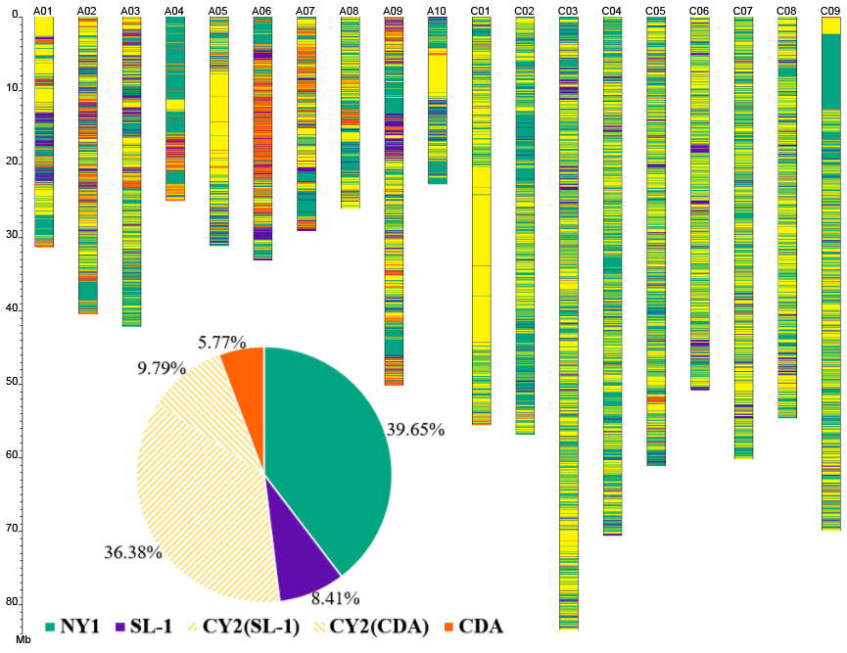
SL-1
×
CDA
油菜：宁油7号系谱
(B. napus)
(B. rapa)
NY1
×
CY2
NY7
.....
（Zou et al., 2019.
Plant Biotechnology Journal）

Slide 65
本讲小结
基因组变异类型
群体基因组学一般分析内容
群体基因组学在作物育种理论和方法上的应用有哪些？

