Slide 1
Lecture #4. How plant genomes evolve? (Part 2)
4.1 Genomic variations and adaptation
4.2 Population genomics analysis
4.3 Crop population and artifical selection
4.4 Crop pan-genomes
《植物基因组学》配套PPT（樊龙江主编，2020，科学出版社）
Notes:
应用部分根据情况决定是否讲解

Slide 2
4.1 Genomic variations
Types of genomic variation
Genomic variations of crops

Slide 3
Genomic variations
SNP: Single Nucleotide Polymorphisms
Indel: insertion and deletion
Structural variation (SV) is the variation in structure of an organism's chromosome. It consists of many kinds of variation in the genome of one species, and usually includes microscopic and submicroscopic types, such as deletions, duplications, copy-number variants, insertions, inversions and translocations. Typically a structure variation affects a sequence length about 1Kb to 3Mb, which is larger than SNPs and smaller than chromosome abnormality

Slide 4
Indel
SNP
SNP
indica_1 ATG CGG GAT CCA TTC CTT AAT GAG TTT CCT AAA ACG GTG CAC GGT TTT
indica_2 ATG TGG GAT CCA TTC CTT AAT GAG TTT CCC GAA ACG GTG CAC GGT TTT
indica_3 ATG TGG GAT CCA TTC CTT AAT GAG TTC CCT GAA ACG GTG CAC GGT TTT
joponica_1 ATG TGG --- CCA TTC CTT AAT GAG TTC CCT GAA ACC GTG CAC GGT TTT
joponica_2 ATG CGG --- CCA TTG CTT AAT GAG TTC CCT GAA ACC GTG CAC GGT TTT
joponica_3 ATG TGG GAT CCA TTG CTT AAT GAG TTC CCT GAA ACC GTG CAC GGT TTT
rufipogon_1 ATG TGG GAT CCA TTC CTT AAT GAG TTC CCT GAA ACG GTG CAC GGT TTT
rufipogon_2 ATG TGG GAT CCA TTG CTT AAT GAG TTC CCT GAA ACC GTG CAC GGT TTT
rufipogon_3 ATG TGG GAT CCA TTG CTT AAT GAG TTC CCT GAA ACC GTG CAC GGT TTT
O.nivara ATG TGG GAT CCA TTC CTT AAC GAG TTC CCT GAA ACG GTG CAC GGT TTT
Measure of polymorphism:
π (Tajima 1983): the average pairwise nucleotide diversity
θ (Watterson 1975): Watterson’s estimator. Number of separating sites per nucleotide site

Slide 5
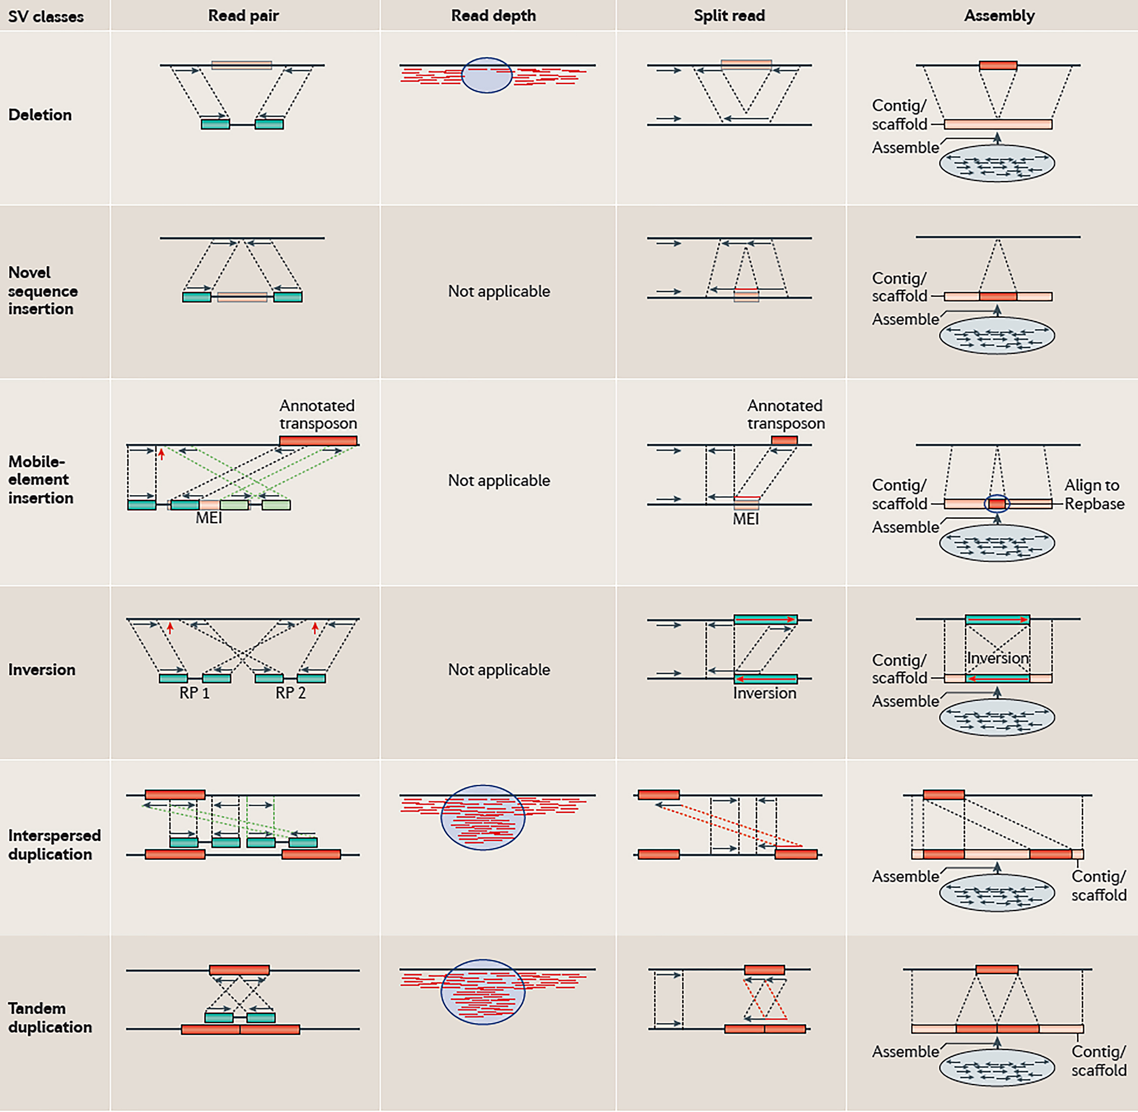
Structural Variation (SV)

Slide 6
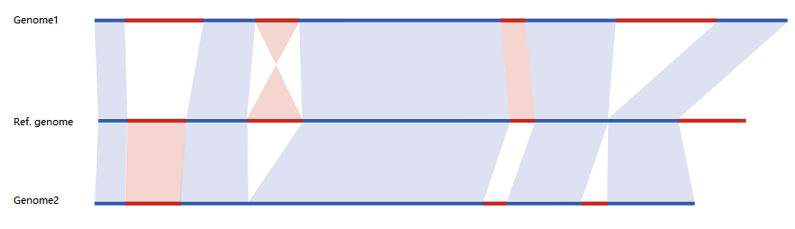
Genomic structural variations

Slide 7
Genomic variations in natural population
Arabidopsis as an example
Wild relatives of crops
wild
semi-wild
Weeds
...

Slide 8
Arabidopsis population
The 1001 Genomes Project (www.1001genomes.org)
A catalog of Arabidopsis thaliana genetic variation
Level of genomic variation (SNP density)
Notes:
几篇大文章

Slide 9
Wild progenitor populations of crops
446 diverse O. rufipogon accession (Huang et al, 2012)
103个大刍草等 （Chia et al., 2012）
17个野生大豆（Lam et al., 2010）
Notes:
Zhanghaiqiang’s ppt

Slide 10
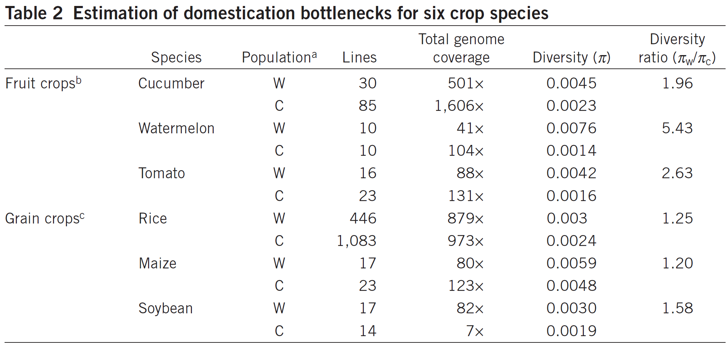
Genomic variations in crop and wild populations
(Qi et al., 2013, Nature Genetics)
拟南芥 | Arabidopsis thaliana | 1135 | 0.006 | The 1001 Genomes Consortium, 2016
稗草 | E. crus-galli | 328 | 0.001 | Ye et al., 2019

Slide 11
Intercultivar variation is so big
Maize genomic variation
35% genomic synteny between two genomes of cultivars (B73 and Mo17)
2.5 Mb PAV (Mo17-specific segment)
(Sun et al., 2018)

Slide 12
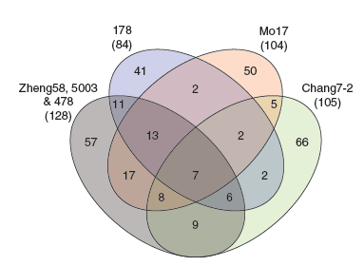
Numbers of PAVs relative to the B73 reference genome
296 high-confidence genes in B73 that were missing from at least one the six inbred lines.
One large deletion between Mo17 and B73: ~2Mb with 24 genes

Slide 13
Genomic variations and adaptation
Environmental adaptation
Natural seleciton
Artificial selection
Selection signals and positive selection
Detection of selection signals

Slide 14
4.2 Population genomics analysis
目前最为活跃的研究领域之一，作物科学的重要方向
可以直接回答作物起源进化、育种选择等重要分子机制
可以直接回答物种起源、进化（种群动态）、环境适应等重要分子机制
可以直接确定重要选择位点（包括自然和人工选择）
。。。

Slide 15
群体基因组学分析内容
Notes:
相应方法的内容已超出植物基因组学范围，在生物信息学或群体遗传学等课程讲解chao

Slide 16
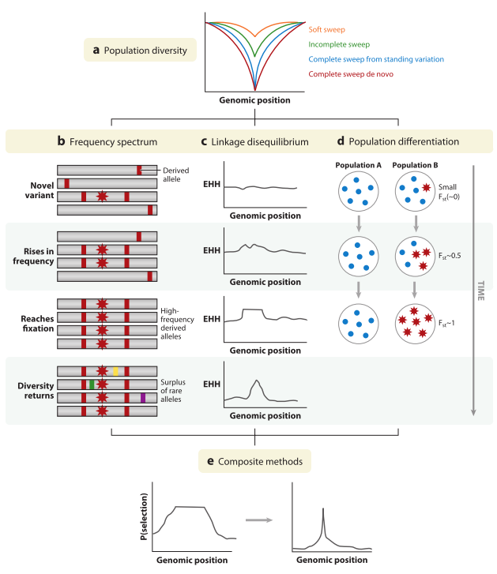
选择信号检测原理和方法
（Vitti et al., 2013）

Slide 17
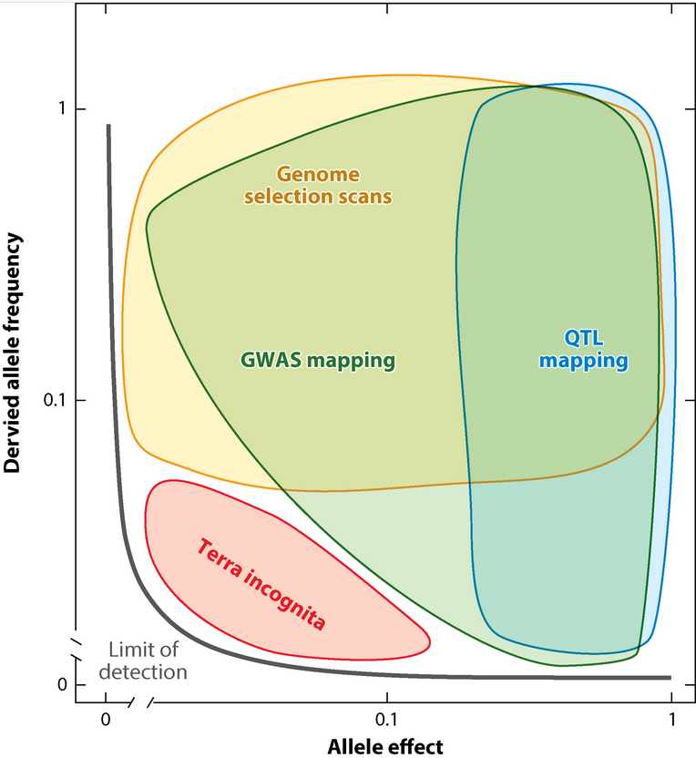
(Weigel et al., 2015)

Slide 18
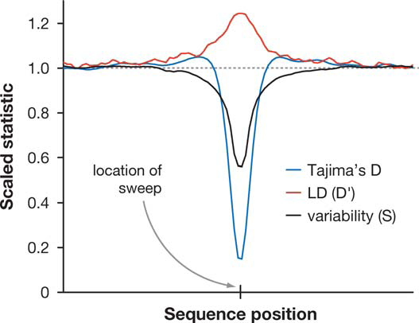
选择位点及其连带效应
(Nielsen, 2005)

Slide 19
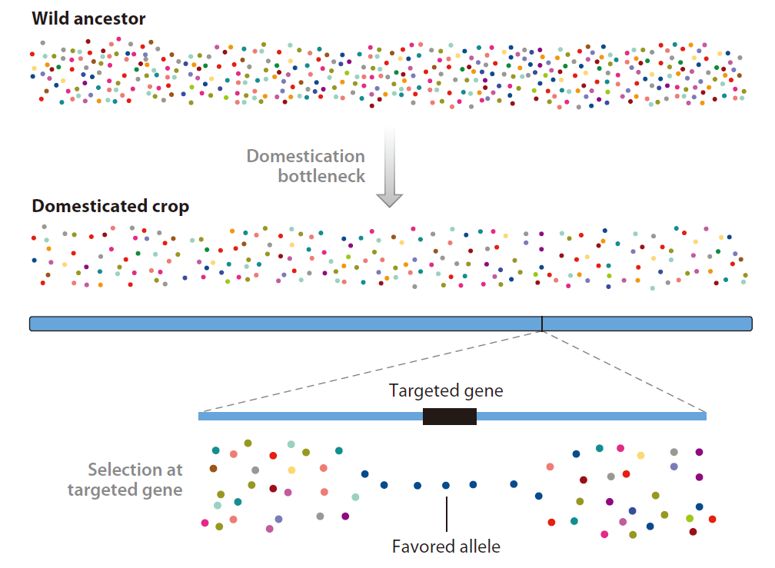
人工选择位点

Slide 20
4.3 Crop population and artifical selection
Crop and artifical seleciton
Facts hidden hehind crop genomes
*本节聚焦在生物学特征和育种理论，育种利用部分将在“基因组数据资源与育种利用”一节讲解

Slide 21
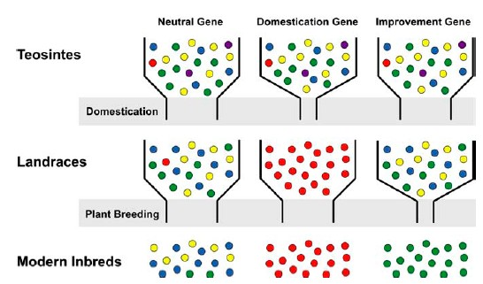
Domestication and improvement of crops
(Yamasaki et al., 2005)

Slide 22
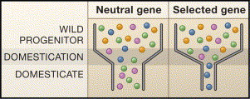
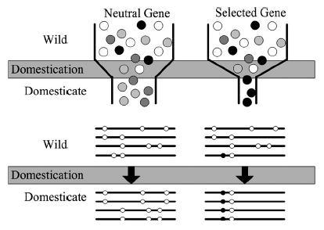
Domestication bottleneck
Domestication bottleneck = domestication selection + demography effect
(Whitt and Gaut 2005)
The effects of domestication bottleneck on genetic diversity

Slide 23
Roadmap for crop genome study
Comparative genomics
Reference genome (2002-)
Full-length cDNA project
?
pedigree genome
(maize, Lai et al. 2010)
Population genome
Rice, maize, soybean, millet
~50 rice lines (Xu et al. 2011)
~500 rice lines (Huang et al. 2009)
~1000 rice lines (Huang et al. 2012)
First haplotype map of maize (Gore et al. 2009)
~31 soybean lines (Lam et al. 2010)
~1000 millet lines (Peng et al. 2013)
Inbred line genome?
Notes:
Ency

Slide 24
Crop populations: what hidden behind their genomes?
Origin of crops
Molecular basis of breeding
Regions under artificial selection
Demographic history
Genome-based pedigree
Genome selection
......

Slide 25
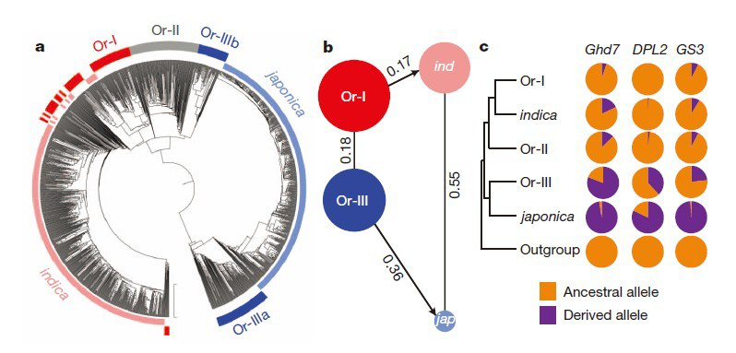
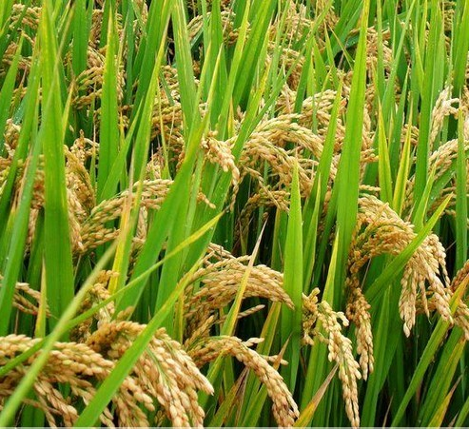
背后故事1：作物起源——基因组证据
Whole-genome sequencing data for a large panel of accessions containing 446 O. rufipogon accessions and 1,083 O. sativa varieties were used to explore their phylogenetic relationships.
（Huang et al., 2012. Nature）

Slide 26
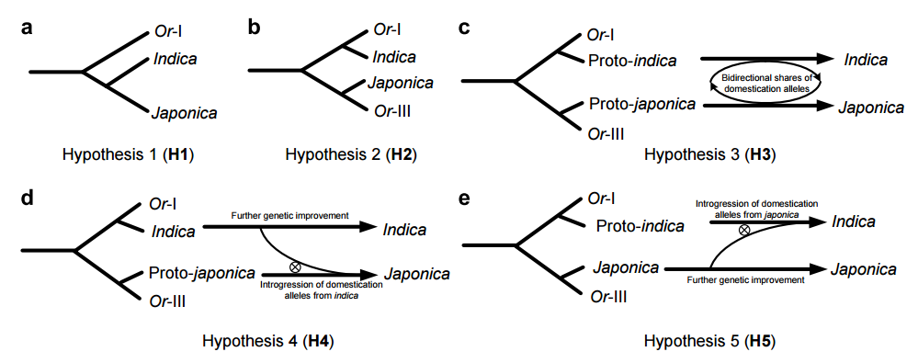
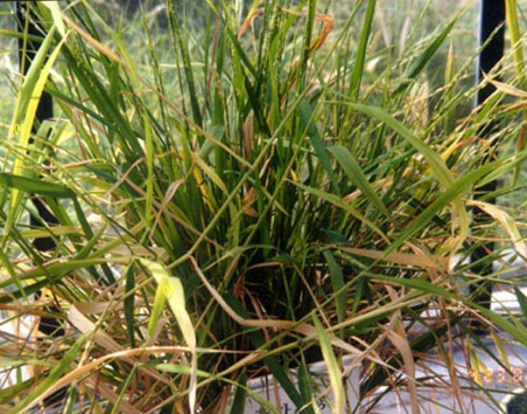
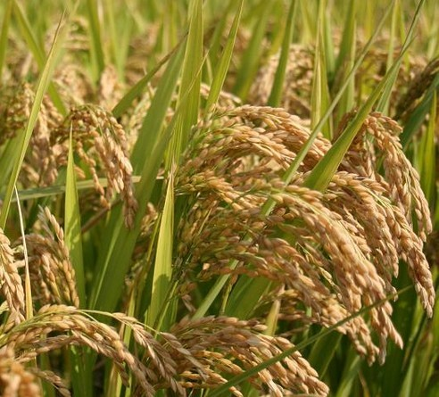
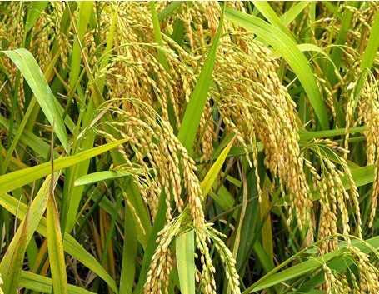
O. rufipogon
Oryza sativa japonica
Oryza sativa indica

Slide 27
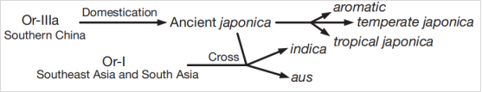
韩斌：“一次起源，两次驯化”
（Huang et al., 2012）

Slide 28
背后故事2：Footprint of artificial seletion on crop genomes
Genome-wide identification of selection loci/regions in crops: rice, maize, soybean, millet
Targets of artificial selection: non-coding microRNAs are directly targets of artificial selection

Slide 29
作物育种在基因组上选择的区域有多大？
栽培稻群体人工选择位点连带效应大小
选择位点 | 选择性状 | 选择连带范围（Kb） | 文献
sh4 | 落粒性 | 60, 400 | et al., 2011; et al., 2012
Prog1 | 分蘖角 | 300, 600 | He et al., 2011; Huang et al., 2012
qSH1 | 落粒性（粳稻） | 800 | Lu et al., 2018
Rc | 果色 | 20, 300 | He et al., 2011; Huang et al., 2012
An1 | 芒长 | 700 | et al., 2018
waxy | 糯性 | 260 | Purugganan and Fuller, 2009
Bh4 | 稻壳颜色 | 500 | Huang et al., 2012
qSW5 | 粒宽 | 600 | Huang et al., 2012
badh2 | 香气 | 100 | Wang et al., 2014
OsAMT1 | 养分吸收（氨） | 100 | Ding et al., 2011
SD1 | 株高（赤霉素合成） | 404 | Paterson and Li, 2011
Pib | 稻瘟病抗性 | 500 | Lu et al., 2018
GAD1 | 粒数、粒长 | 900 | Jin et al., 2016
平均值* |  | 474.2（403.4）

Slide 30
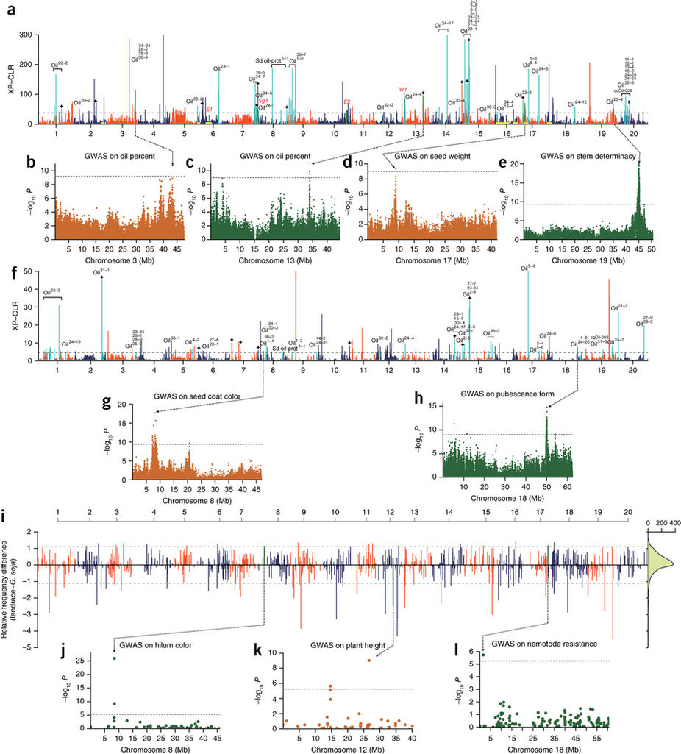
大豆驯化和改良过程中全基因组范围区域的选择和功能注释（Zhou等，2015）
a和f表示在在驯化和改良中全基因组范围内的选择信号，b-e，g和h是六个重叠强选择性信号的GWAS结果。i显示驯化期间选择拷贝数变异（CNV）的全基因组筛选与功能注释，j-l显示了与强选择性CNV重叠的三个GWAS结果。

Slide 31
10%区域？
“基于韩斌课题组研究结果，以π野生/π栽培 > 3等标准，共检测到籼稻和粳稻受到选择位点各60和62个，导致的选择连带区域大小平均535Kb和587Kb，分别累计32Mb和36Mb（Huang et al., 2012）”
“可以做个简单的估计，假设水稻基因组中有100个驯化和遗传改良相关基因受到强烈人工选择，每个受选择影响的基因组区域平均在450KB左右，这样累计45Mb区域受到选择影响，涵盖10%以上的水稻基因组区域”
（樊龙江，2020，《植物基因组学》）
Notes:
80%的基因组区域是表达，有功能的

Slide 32
Evolution of non-cong RNAs: artificial selection
Role of small RNAs in crop domestication and genetic improvement

Slide 33
Transcript factor targets: protein-coding genes
Non-coding small RNA targets: transcript factor
Domestication targets: transcript factor
Protein-coding genes
Domestication selection
Transcript factors
Question:
Targets of domestication selection: small RNAs?
Small RNAs

Slide 34

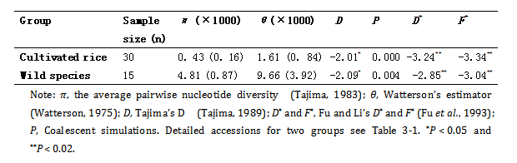
Selection on microRNA MIR156b/c in rice
Target a domestication gene, a transcript factor (Xie et al. 2006; Chuck et al. 2007)
Only 8.9% DNA diversity of wild rice was maintained in cultivated rice
Jiao et al. Nature Genetics, 2010
Regulation of OsSPL14 by OsmiR156 defines ideal plant architecture in rice
(Wang et al. FEBS Lett, 2007)
Notes:
SPL, tag1 in maize
后被证实：理想株型基因
Jiao et al. Nature Genetics, 2010
Regulation of OsSPL14 by OsmiR156 defines ideal plant architecture in rice

Slide 35
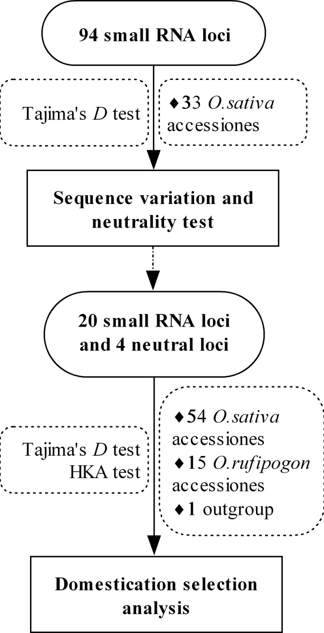
(Wang et al. 2010, BMC Evol Biol)

Slide 36
Sequence diversity, Tajima’s D and HKA test results
Small RNA |  | O. sativa |  |  |  |  |  |  |  |  |  |  |  |  |  | O. rufipogon |  |  |  |  |  | Target | Candidate
 |  | Indica subgroup |  |  |  |  |  |  | Japonica subgroup |  |  |  |  |  |  |  |  |  |  |  |  |  | Status
 |  | N | L | S | π | D | HKA-P |  | N | L | S | π | D | HKA-P |  | N | L | S |  | D | HKA-P
MIR164e |  | 21 | 553 | 6 | 1.18 | -1.9033* | 0.101 |  | 21 | 551 | 3 | 2.19 | 1.1834 | 0.285 |  | 10 | 549 | 7 | 3.40 | -1.0403 | 0.4474 | NAC | Putative
MIR390 |  | 25 | 723 | 2 | 0. 32 | -1.2137 | 0.1064 |  | 20 | 741 | 1 | 0. 36 | -0.0861 | 0.0138 |  | 11 | 741 | 7 | 2.25 | -1.2177 | 0.2568 | TAS3 | Putative
MIR-b |  | 27 | 418 | 11 | 3.59 | -1.558 | NA |  | 21 | 646 | 13 | 2.56 | -1.9396* | NA |  | 11 | 594 | 8 | 2.93 | -1.4933 | NA | APS/AST | Putative
TAS2 |  | 28 | 765 | 33 | 5.49 | -1.8578* | 0.0288 |  | 24 | 763 | 21 | 5.66 | -0.8475 | 0.158 |  | 10 | 764 | 12 | 3.89 | -1.3459 | 0.5026 | ARF | Putative
AK120922 |  | 25 | 645 | 2 | 0. 91 | 0.2607 | 0.0034 |  | 18 | 644 | 8 | 1.77 | -1.7663 | 0.0546 |  | 11 | 645 | 34 | 10.06 | -2.0541* | 0.2498 | Unknown | ND
MIR |  | 25 | 518 | 2 | 1.75 | 1.544 | 0.1294 |  | 22 | 517 | 7 | 2.19 | -1.3099 | 0.2152 |  | 11 | 517 | 11 | 5.83 | -0.8448 | 0.4326 | Unknown | ND
MIR |  | 23 | 574 | 16 | 6.47 | -0.5139 | 0.1674 |  | 23 | 574 | 18 | 7.02 | -0.6312 | 0.2968 |  | 8 | 574 | 18 | 13.19 | 0.4691 | 0.2936 | NAC | ND
MIR164d |  | 25 | 416 | 2 | 0.99 | -0.4764 | 0.1466 |  | 21 | 414 | 4 | 1.47 | -1.2874 | 0.2596 |  | 12 | 428 | 12 | 5.87 | -1.5419 | 0.4638 | NAC | ND
MIR |  | 29 | 515 | 9 | 2.99 | -1.0247 | 0.1610 |  | 23 | 515 | 10 | 3.99 | -0.814 | 0.3416 |  | 10 | 515 | 24 | 15.79 | -0.1961 | 0.4192 | HD-ZIPШ | ND
MIR395i-k |  | 25 | 651 | 8 | 4.26 | 0.9811 | 0.1058 |  | 18 | 687 | 6 | 2.14 | -0.5168 | 0.2478 |  | 9 | 687 | 8 | 3.71 | -0.5981 | 0.2446 | APS/AST | ND
MIR |  | 21 | 502 | 7 | 3.22 | -0.5442 | 0.0894 |  | 20 | 502 | 2 | 1.48 | 0.7637 | 0.2878 |  | 10 | 501 | 5 | 2.92 | -0.6823 | 0.47 | GRL | ND
MIR |  | 27 | 579 | 2 | 1.04 | 0.347 | 0.0992 |  | 24 | 579 | 3 | 1.01 | -0.6775 | 0.2784 |  | 14 | 579 | 1 | 0.85 | 1.2121 | 0.4032 | PT | ND
MIR399d |  | 23 | 393 | 28 | 7.24 | -2.3651* | 0.1072 |  | 22 | 465 | 2 | 0.72 | -0.8712 | 0.0016 |  | 12 | 392 | 33 | 15.26 | -2.0439* | 0.2554 | PT | ND
MIR399i |  | 22 | 485 | 5 | 1.92 | -0.9459 | 0.1022 |  | 22 | 485 | 9 | 3.44 | -1.0832 | 0.1958 |  | 11 | 485 | 7 | 3.67 | -1.0325 | 0.4418 | PT | ND
MIR440 |  | 25 | 619 | 4 | 1.73 | 0.0357 | 0.0966 |  | 20 | 621 | 4 | 1.45 | -0.5705 | 0.137 |  | 14 | 621 | 19 | 5.96 | -1.5827 | 0.3386 | Unknown | ND
MIR443 |  | 29 | 531 | 9 | 4.51 | 0.1466 | 0.1482 |  | 21 | 530 | 20 | 6.10 | -1.5683 | 0.2736 |  | 9 | 529 | 12 | 7.66 | -0.3859 | 0.3006 | Unknown | ND
MIR1318 |  | 22 | 638 | 12 | 5.66 | 0.3436 | 0.0782 |  | 21 | 638 | 9 | 3.16 | -0.6545 | 0.227 |  | 12 | 638 | 8 | 3.68 | -0.4531 | 0.439 | Unknown | ND
MIR1432 |  | 26 | 450 | 15 | 9.23 | 0.1996 | 0.0808 |  | 22 | 450 | 14 | 5.42 | -1.3024 | 0.1756 |  | 10 | 450 | 4 | 3.60 | 0.5655 | 0.382 | EF | ND
MIR1862d |  | 21 | 426 | 7 | 5.56 | 0.7094 | 0.1134 |  | 20 | 425 | 8 | 5.08 | -0.1372 | 0.2704 |  | 9 | 665 | 27 | 9.31 | -1.8797* | 0.3938 | NAC | ND
MIR1867 |  | 24 | 696 | 13 | 3.26 | -1.2053 | 0.0942 |  | 24 | 699 | 11 | 2.83 | -1.1081 | 0.2804 |  | 10 | 701 | 12 | 4.78 | -0.9437 | 0.4934 | Unknown | ND
(Wang et al. 2010, BMC Evol Biol)

Slide 37
miRNAs are targets of artificial selection
Our results illustrated MIRNA genes, like protein-coding genes, might have been significantly shaped during rice domestication and could be one of the driven forces contributed to rice domestication.

Slide 38
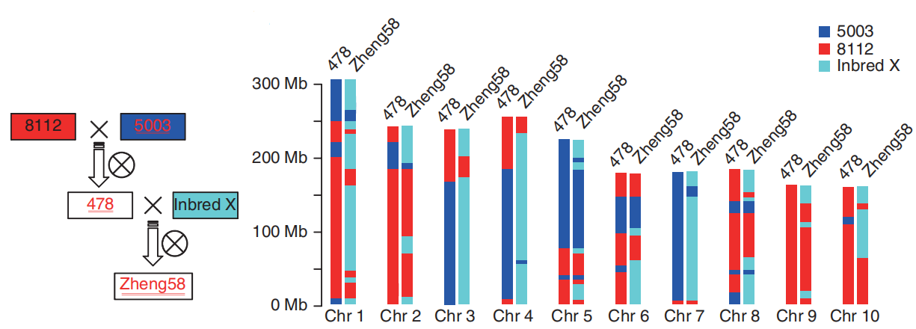
背后故事3：作物系谱——育种遗传传递 Pedigree and genomic relationship between members
玉米：郑58系谱
(Lai et al., 2012. Nature Genetics)
Notes:
为设计育种的重要依据

Slide 39
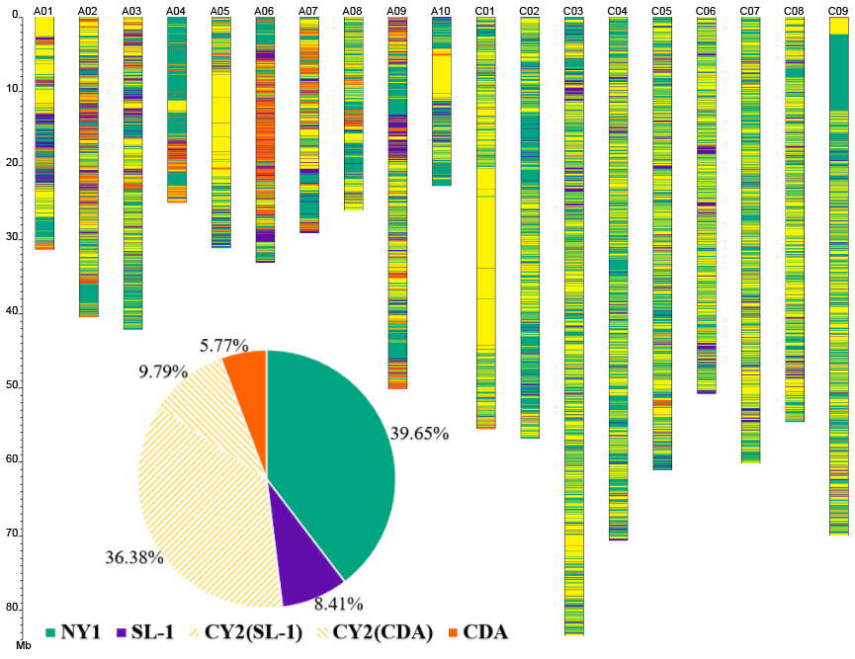
SL-1
×
CDA
油菜：宁油7号系谱
(B. napus)
(B. rapa)
NY1
×
CY2
NY7
.....
（Zou et al., 2019.
Plant Biotechnology Journal）

Slide 40
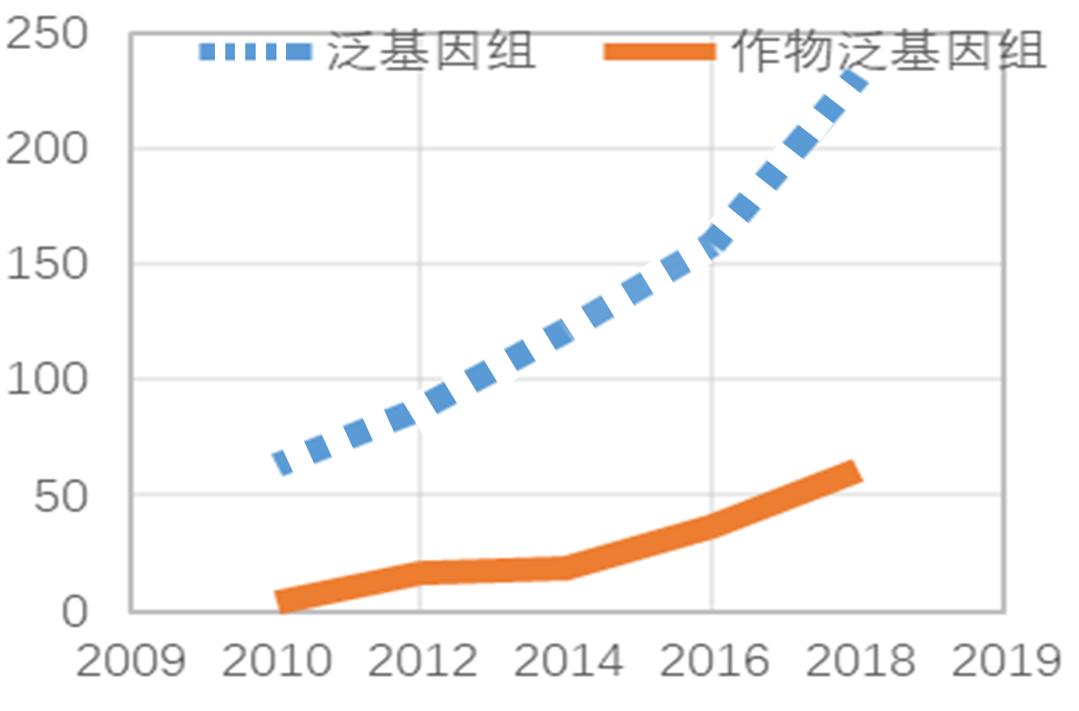
4.4 Crop pan-genomes
作物基因组学一个前沿领域

Slide 41
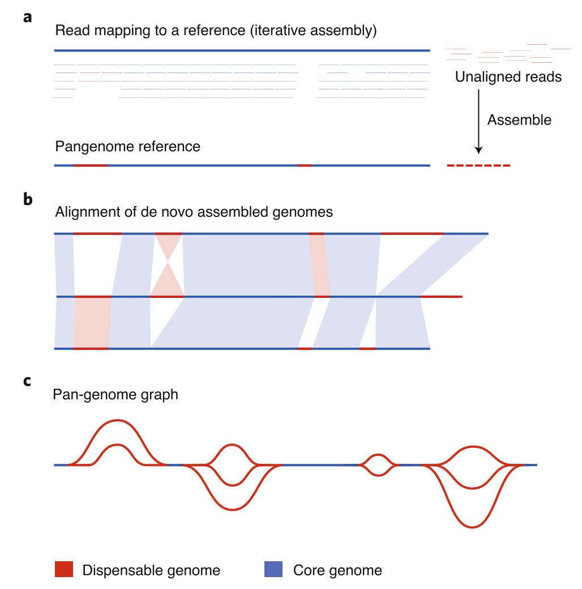
(Bayer et al., 2020)

Slide 42
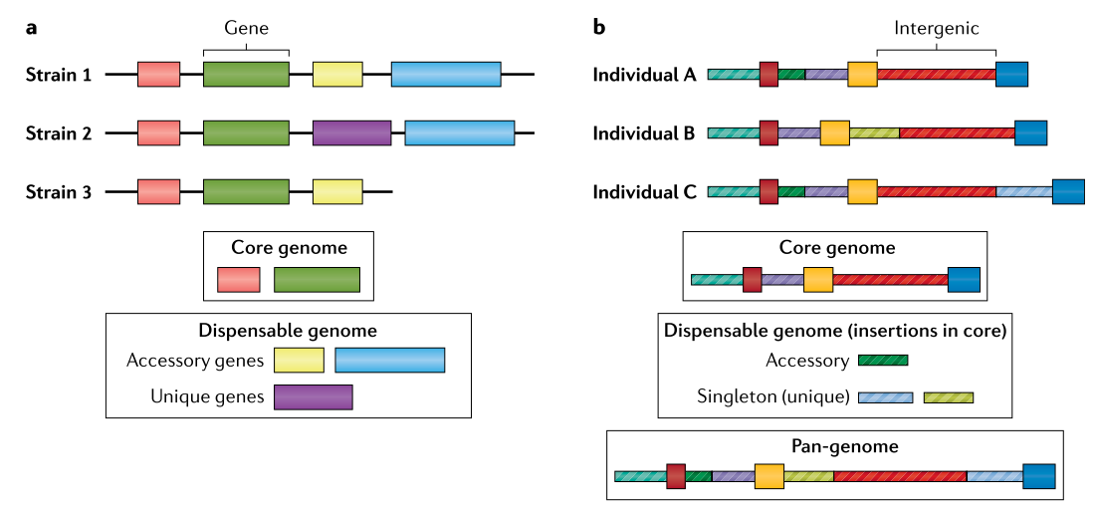
Sherman et al., 2020

Slide 43
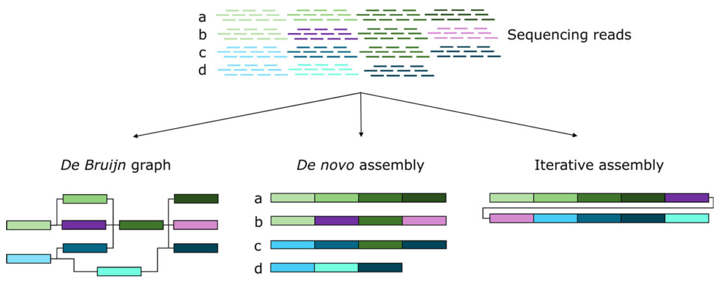
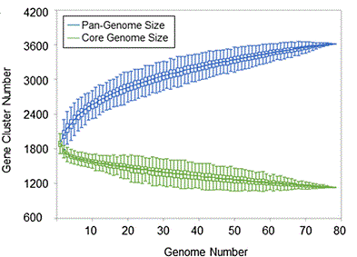
泛基因组的三种基因组拼接和分析策略
图中a-d指同一物种4个不同个体材料（Golicz et al., 2016）
泛基因组相关数据变化
随着测定个体基因组数量增加，特定物种泛基因组和核心基因组大小变化趋势（引自Golicz et al., 2016）

Slide 44
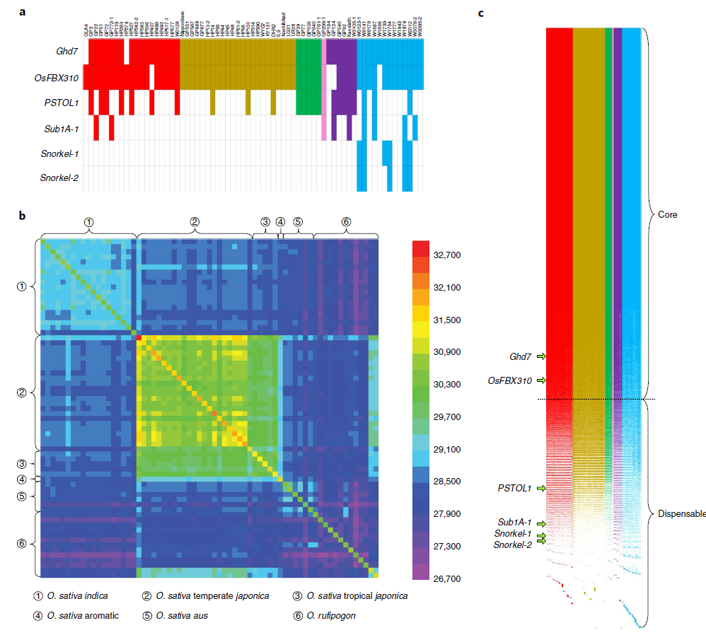
Zhao et al. 2018

Slide 45
Pan-genome of wild and cultivated soybeans
27个栽培和野生大豆基因组（从头拼接）
1
2
3
.
.
.
27
（Liu et al., 2020）

Slide 46
本讲小结
基因组变异类型
群体基因组学一般分析内容
群体基因组学在作物育种理论和方法上的应用有哪些？
泛基因组概念

