Slide 1
5. Phylogenetic Tree
《生物信息学》（第二版）（樊龙江主编，2021）配套PPT5
5.1 Genetic polymorphism and phylogenetic tree
5.2 Construction of phylogenetic tree
Notes:
For second time:
First three slides; bioinformatics history; bioinformatics map

Slide 2
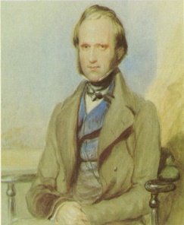
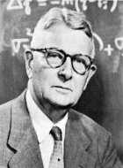
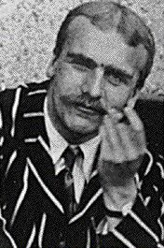
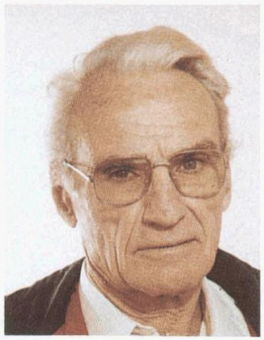
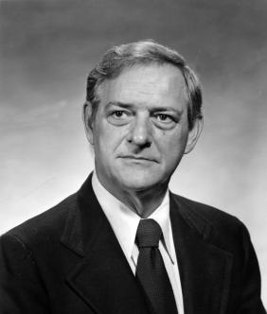
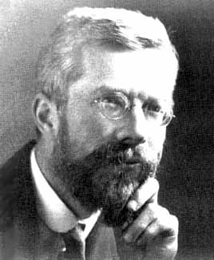
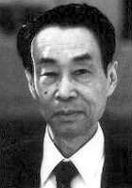
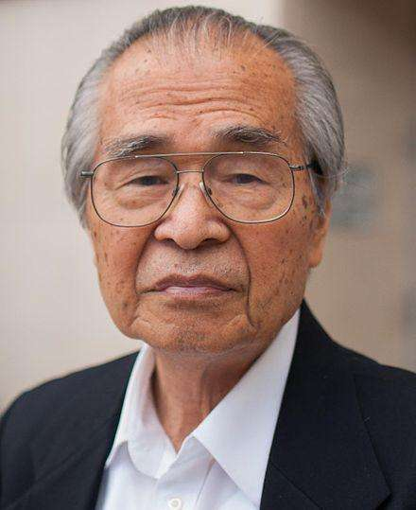
历史与人物
达尔文
费希尔（Fisher）、莱特（Wright）和霍尔丹（Haldane）（群体遗传学三巨头）
马莱科特（Malecot）、科克汉姆（Cockerham）等
木村资生（Kimura）、根井根正（M. Nei）等
Wright
Haldane
Great trinity
Fisher
Notes:
For second time:
First three slides; bioinformatics history; bioinformatics map

Slide 3
5.1 Genetic polymorphism and phylogenetic tree
Polymorphism in the genomes
Introduction about tree

Slide 4
Polymorphism in the genomes
  Types of polymorphism
    Single nucleotide polymorphism (SNP)
    Insertion/deletion (indel)
    Copy-number variation (CNV)
    Frame-shift
    Presence and absence variation (PAV)
Notes:
知识点：遗传变异类型；系统发育树构建方法

Slide 5
n
indica_1 ATG CGG GAT CCA TTC CTT AAT GAG TTT CCT AAA ACG GTG CAC GGT TTT
indica_2 ATG TGG GAT CCA TTC CTT AAT GAG TTT CCC GAA ACG GTG CAC GGT TTT
indica_3 ATG TGG GAT CCA TTC CTT AAT GAG TTC CCT GAA ACG GTG CAC GGT TTT
joponica_1 ATG TGG --- CCA TTC CTT AAT GAG TTC CCT GAA ACC GTG CAC GGT TTT
joponica_2 ATG CGG --- CCA TTG CTT AAT GAG TTC CCT GAA ACC GTG CAC GGT TTT
joponica_3 ATG TGG GAT CCA TTG CTT AAT GAG TTC CCT GAA ACC GTG CAC GGT TTT
rufipogon_1 ATG TGG GAT CCA TTC CTT AAT GAG TTC CCT GAA ACG GTG CAC GGT TTT
rufipogon_2 ATG TGG GAT CCA TTG CTT AAT GAG TTC CCT GAA ACC GTG CAC GGT TTT
rufipogon_3 ATG TGG GAT CCA TTG CTT AAT GAG TTC CCT GAA ACC GTG CAC GGT TTT
O.Nivara ATG TGG GAT CCA TTC CTT AAC GAG TTC CCT GAA ACG GTG CAC GGT TTT
m
  Measure of polymorphism
    π (Tajima 1983): the average pairwise nucleotide diversity
    θ (Watterson 1975): Watterson’s estimator. Number of separating sites per nucleotide site

Slide 6
Why do a phylogenetic analysis?
Important for deciphering relationships in gene function and protein structure and function in different organisms
Helps to utilize genetic information of a model organism to analyze a second organism
Helps to sort out gene family relationships
Valuable tool for tracing the evolutionary history of genes

Slide 7
Evaluating sequence relationships
sequence A ERKSIQDLFQSFTLFERRLLIEF
sequence B ERLSISELIGSLRLYERRLIIEY
sequence C DRKSISDLIGSLRLALLIEF
sequence D DRKDLISSLRKALLIEW
1. Account for all column variations
|A,B and C,D form similar groups based on col. 1
|A,C,D based on col. 3
2. Count differences between sequences
A,B 17/23 similar, 6/23 different
C,D 21/23 similar, 2/23 different

Slide 8
What is a tree?
A graphical representation of the sequence similarities among a group of nucleic acid or protein sequences
For example: number of differences between 3 sequences may be represented by ..
2
7
A B C
A 9 7
B 12
A
B
5
C

Slide 9
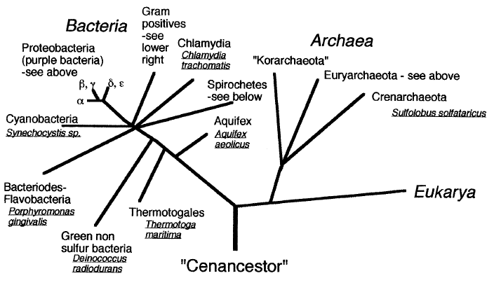
Tree of life

Slide 10
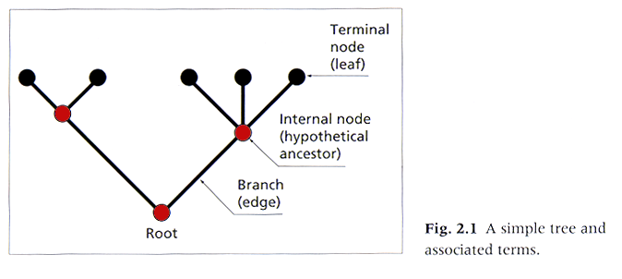
Phylogenetic tree
(dendrogram)
Nodes: branching points
Branches: lines
Topology: branching pattern

Slide 11
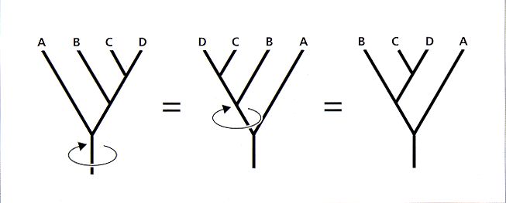
Branches can be rotated at a node, without changing the
relationships among the OTU’s.

Slide 12
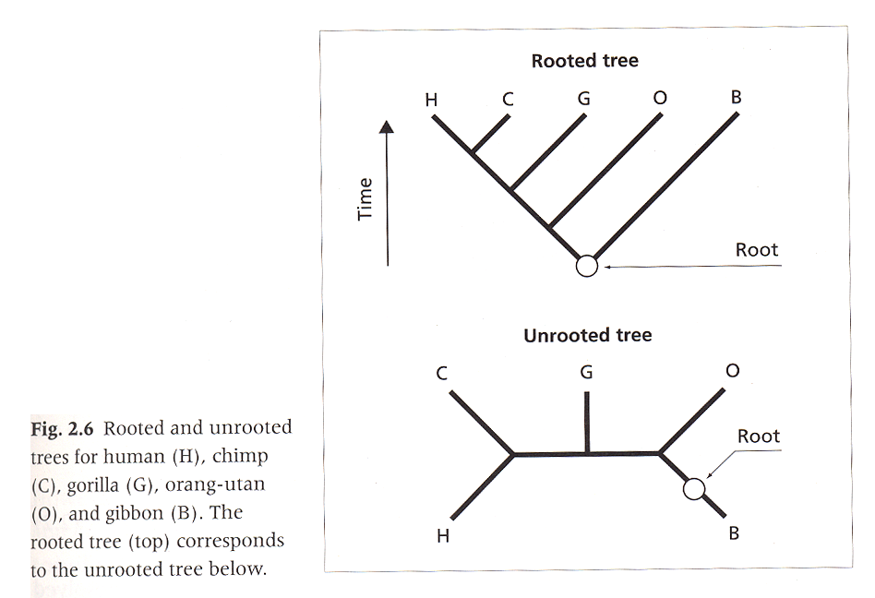
Rooted: unique path from root.
Unrooted: degree of kinship, no evolutionary path.

Slide 13
Assumptions about rate of change in branches of tree
May assume constant rate of change throughout tree - then branch length is proportional to no. of changes and we can easily root the tree using a simple algorithm
May have variable rate
no ancestor sequence
ancestor sequence

Slide 14
Tree reconstruction as optimization
Number of possible trees is 2^{S}. Considering branch lengths makes the problem harder.
Want the tree that maximizes some quality score. Score based on either
  Characters (e.g. sites in a sequence) directly, or
  Distances between character sets (e.g. alignment scores)

Slide 15
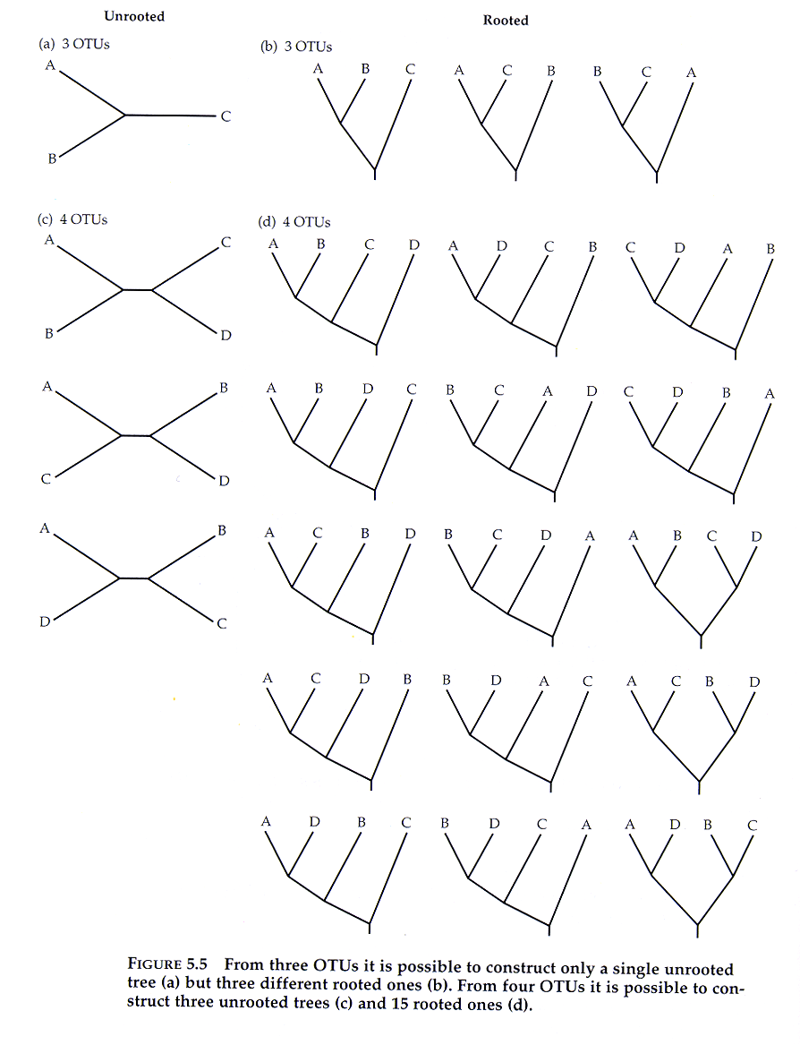
Number of possible
phylogenetic trees
3 OTU’s: 1 unrooted tree
3 rooted trees
4 OTU’s: 3 unrooted trees
15 rooted trees.
实用分类单位(operational taxonomic units，OTU)

Slide 16
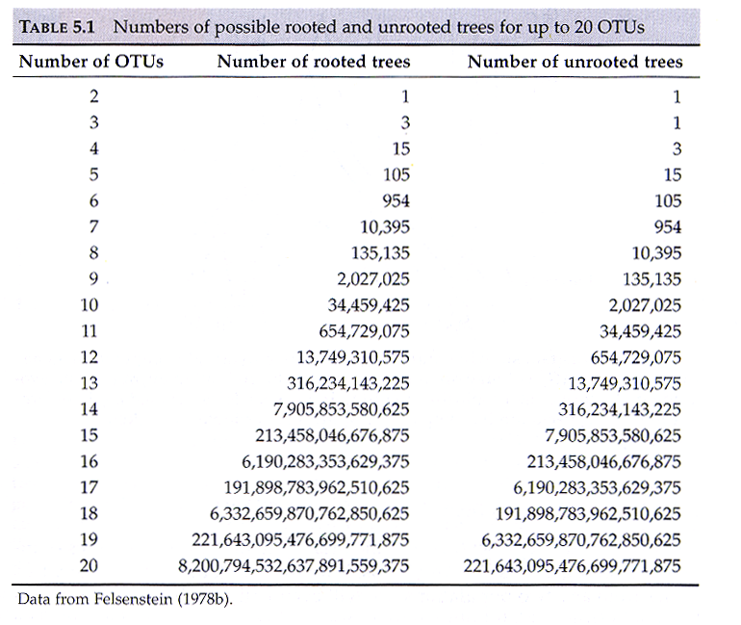

Slide 17
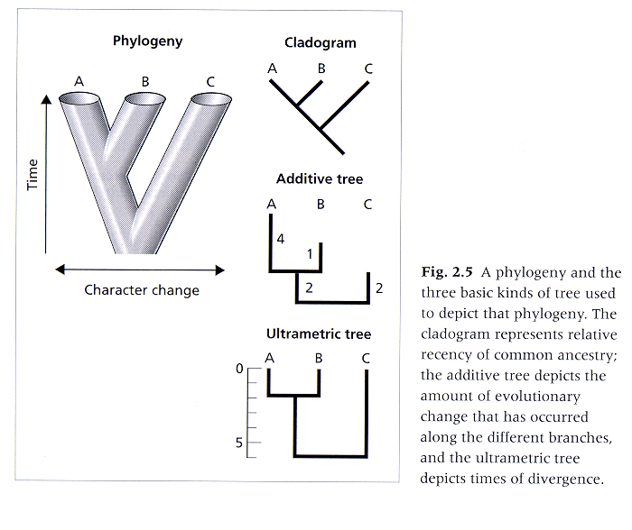
TYPES OF
TREES

Slide 18
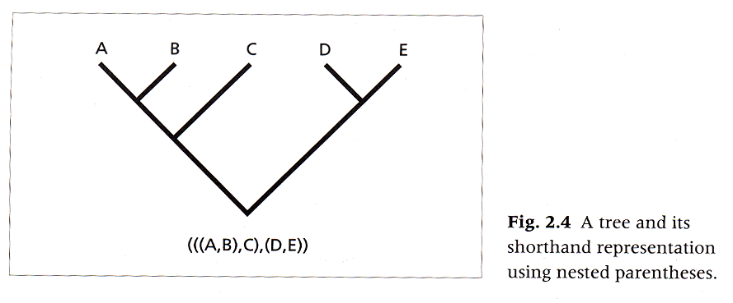
Newick (shorthand) format
--- text based representation of relationships.

Slide 19
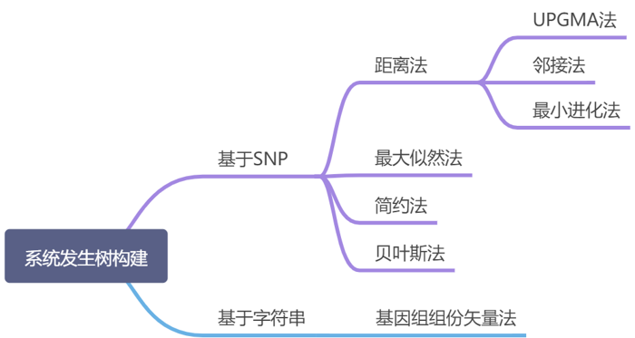
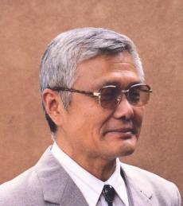
5.2 Construction of phylogenetic tree

Slide 20
目前应用最为广泛方法
  Distance methods
  Probabilistic methods: maximum likelihood (ML)

Slide 21
The flowchart for phylogenetic prediction
A msa
yes
yes
Is there strong sequence similarity?
Is there clearly recognizable sequence similarity?
Maximum parsimony (MP)
Distance method
no
no
ML

Slide 22
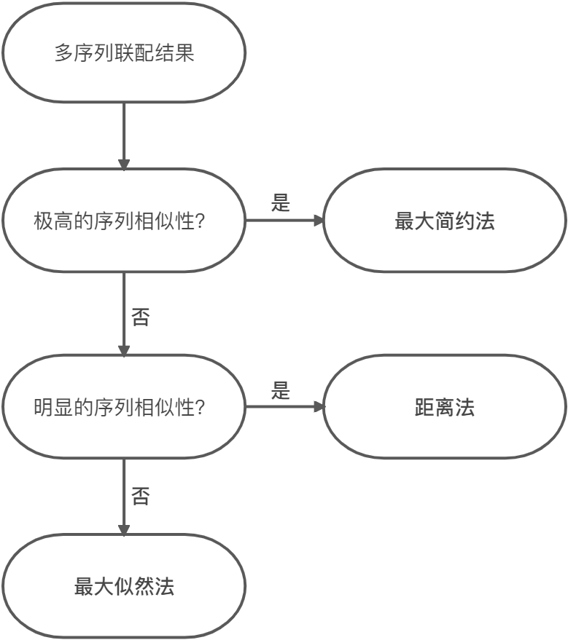

Slide 23
Because the maximum parsimony method has to attempt to fit all possible trees to the data, the method is not suitable for more than 12 sequences because there are too many trees to test.
Maximum likelihood methods are particularly useful when the sequences are more variable. However, they are computationally intense.
ML can test diverse evolutionary models for a best tree

Slide 24
5.2.1 Distance methods
Basic idea:
  Employs the number of changes between each pair in a group of sequences to produce a phylogenetic tree of the group;
  For phylogenetic analysis, the distance score between two sequences is used. This score between two sequences is the number of mismatched positions in the alignment or the number of sequence positions that must be changed to generate the other sequence. Gaps may be ignored in these calculations or treated like substitutions.
  When a scoring or substitution matrix is used, the calculation is slightly more complicated, but the principle is the same.

Slide 25
Theory of gene duplication
Homoplasy: Sequence similarity NOT due to shared ancestry, such as convergent or parallel evolution; horizontal transmission

Slide 26
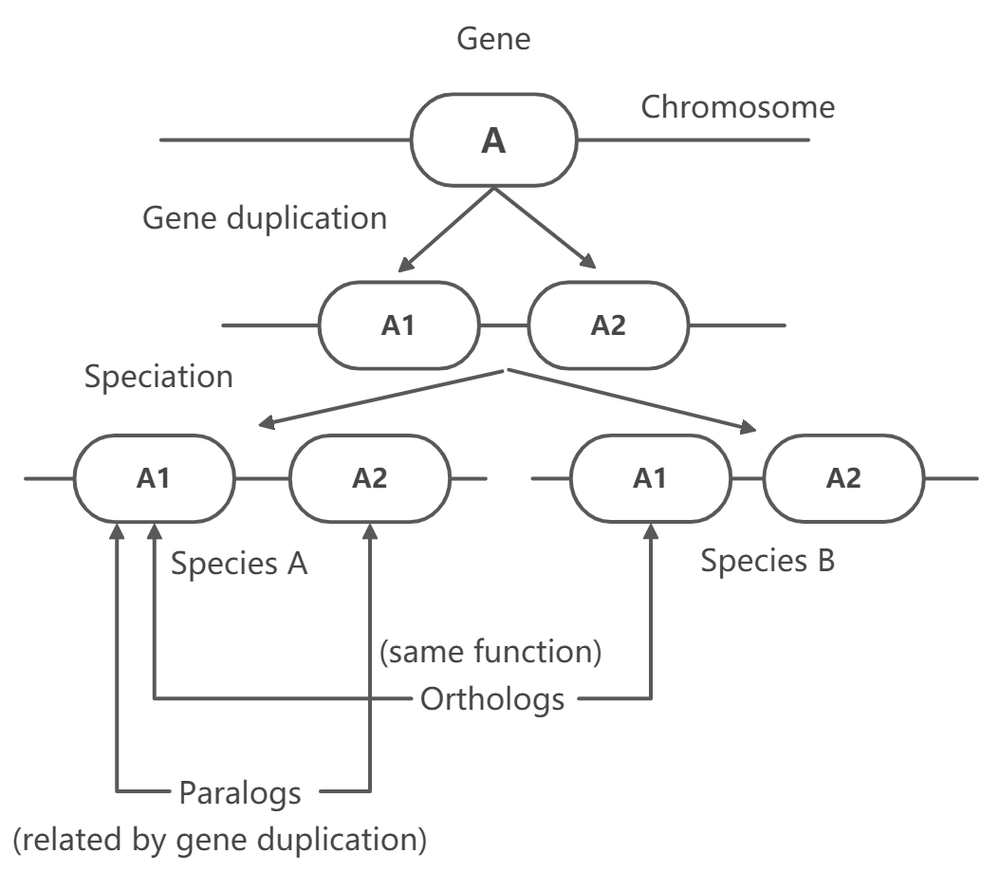

Slide 27
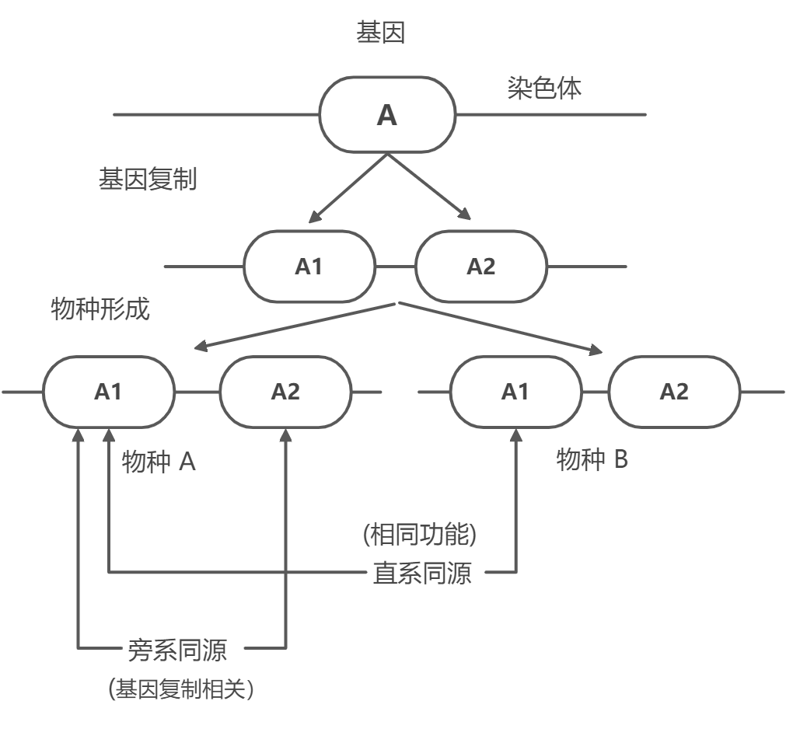

Slide 28
A
C
T
G
A
A
C
G
T
A
A
C
G
C
祖先序列
后代1 后代2
A
C
T
G
A→C→T
A
C→G
G
T→A
A
A→C→T
C
G
C
A
C→A 单一替换 (single substitution)
T
G
A 多重替换 (multiple substitutions)
A
C→A 同义替换 (coincidental substitutions)
G
T→A 平行替换 (parallel substitutions)
A
A→T 趋同替换 (convergent substitution)
C
G
C→T→C 反转替换 (back substitution)

Slide 29
Distance
Converting sequence similarity to distance scores
Correction of distance between nucleic acid sequences for multiple changes and reversions
Notes:
D=-LONG(S)
K

Slide 30
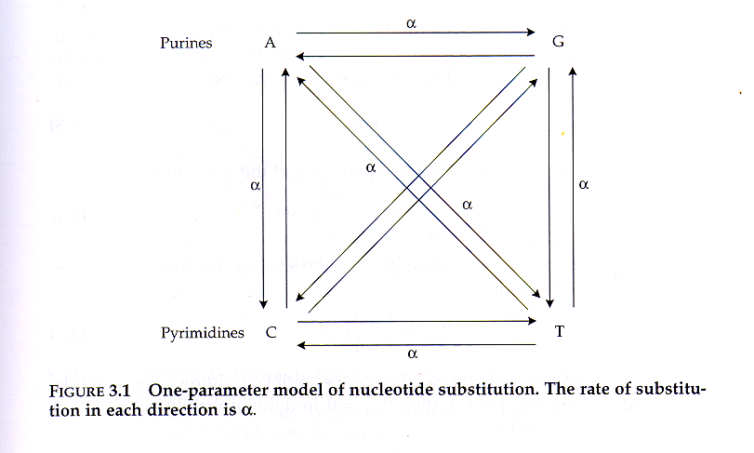
遗传模型和序列距离
Judes-Cantor单参数模型 (1969)

Slide 31
Motoo Kimura
Kimura两参数模型(木村资生,1980):
转换（transition,α):嘌呤间或嘧啶间的替换；
颠换（transversion,β): 嘌呤和嘧啶间的替换。
在大多数DNA片段中， 转换出现的频率高于颠换。
Notes:
替换：替代，置换等

Slide 32
序列距离
Generally, genetic distance is thought of as related to the time and requires a genetic model specifying the processes such as mutation and drift causing the populations to diverge.
Judes和Cantor(1969)提出了DNA序列距离K计算公式：
其中q为经过t世代祖先序列的趋异变化后同源DNA序列中具有相同碱基的概率，μ为碱基替换频率。

Slide 33
Kimura在其两参数模型下证实，由于趋异变化，由转换造成差异(Ｉ型变化)或由颠换造成差异(Ⅱ型变化)的碱基，随时间而变化。如果k＝а＋2β是单位时间碱基替换的总频率 ，则

Slide 34
同义与非同义替换
在蛋白质编码基因中，突变后仍为同义密码子的核苷酸替换称为同义或沉默替换（synonymous/silent substitution)，而导致非同义密码子的替换，称为非同义或氨基酸更换替换（nonsynonymous/amino acid replacement substitution)。另外，导致形成终止密码子的突变，称为无义突变（nonsense mutation).

Slide 35
分歧度
(sequence divergence)
DNA序列距离K又可称为DNA序列间的分歧度，即序列间相异性的一个指标。蛋白质编码序列的分歧度分为两序列同义变化的分歧度(K_{S})和非同义变化的分歧度(K_{A}) 。根据Jukes-Cautor单参数模型和Kimura两参数模型等遗传模型，可以分别计算得到两序列的分歧度(或称为蛋白质序列间的距离)。

Slide 36
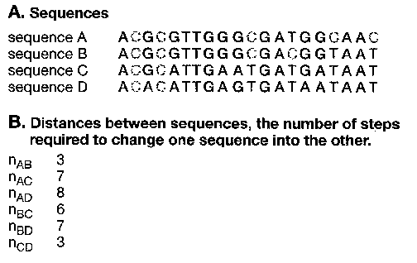
How to construct a tree: A simple example
Notes:
The branch lengths of an assumed tree are additive

Slide 37
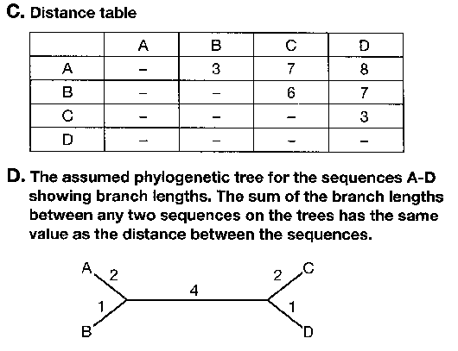

Slide 38
Methods for tree construction
UPGMA (Unweighted pair group method using arithmetic mean)
Neighbor-joining (NJ) distance method
Fitch-Margoliash method
Minimum evolution (ME)

Slide 39
UPGMA
Unweighted pair group method using arithmetic mean (非加权平均连接聚类法 ).
A form of agglomerative clustering (successive pairing of closest nodes)
Method:
  Let initial organisms be leaves of the tree.
  Iteratively add a parent to the closest pair of existing nodes
  Define the distance from an internal node to be the mean distance to its children.
Notes:
应用算术平均数的非加权成组配对法，unweighted pair-group method using an arithmetic average

Slide 40
实例: 线粒体DNA序列
5个线粒体序列的差异核苷酸数(对角线下)和Jukes- Cantor距离(对角线上)
人类(hu)
黑猩猩(ch)
大猩猩(go)
猩猩
(or)
长臂猿(gi)
人类
(hu)
-
0.015
0.045
0.143
0.198
黑猩猩(ch)
1
-
0.030
0.126
0.179
大猩猩(go)
3
2
-
0.092
0.179
猩猩
(or)
9
8
6
-
0.179
长臂猿
(gi)
12
11
11
11
-

Slide 41
最近的距离是人类和黑猩猩之间的，将它们合并为一个类。其它序列与这个新类之间的距离就是该序列到新类各成员间的平均距离：
(hu-ch)
go
or
gi
hu-ch
0.037
0.135
0.189
go
0.179
or
0.179
gi

Slide 42
其中人类－黑猩猩（hu-ch）与大猩猩（go）之间的距离最小。将它们合并为一类。新距离为：
(hu-ch-go)
or
gi
0.121
0.185
(hu-ch-go)
or
0.179
gi

Slide 43
平均连接聚类法系统树
人
黑猩猩
大猩猩
猩猩
长臂猿
0.092 0.060 0.019 0.007

Slide 44
Neighbor Joining Method
(邻接法)
Another agglomerative clustering method
Method:
  Let A be active set, initially all leaves (organisms)
  Let r(i) be the average distance from i to all other leaves
  Define D(i,j) = d(i,j) – (r(i) + r(j))
  Pick i,j with smallest D(i,j). Create parent k of i and j.
  Set d(i,k) = ½ [d(i,j)+r(i)-r(j)], and d(j,k) = d(i,j) - d(i,k)
  For all other m ∈ A, set d(k,m) = ½[d(i,m)+d(j,m) – d(i,j)]
  Replace i and j in A with k.
  Repeat until |A| = 1.

Slide 45
根井正利（Masatoshi Nei）（1931-）

Slide 46
邻接法的一般步骤
①计算第i终端节点(即分类单位i)的净分歧度r_{i}
其中N为终端节点数，d_{ik}为节点i和节点k之间的距离，有d_{ik}=d_{ki}
②计算并确定最小速率校正距离(rate-corrected distance) M_{ij}：

Slide 47
③定义一个新节点u，u节点由节点i和j组合而成。节点u与节点i和j的距离为：
节点u与系统树其它节点k的距离为：
④从距离矩阵中删除列节点i和j的距离，N值(总节点数)减去1
⑤如果尚余2个以上终端节点，返回到步骤①继续计算，直至系统树完全建成。

Slide 48
同样以线粒体DNA为例
邻接法计算线粒体序列的距离d_{ij} (上对角线部分) 和M_{ij} (下对角线部分)
hu
ch
go
or
gi
净分歧度
j=1
j=2
j=3
j=4
j=5
r_{i}
hu
i=1
0.000
0.015
0.045
0.143
0.198
0.401
ch
i=2
-0.235
0.000
0.030
0.126
0.179
0.350
go
i=3
-0.204
-0.202
0.000
0.092
0.179
0.346
or
i=4
-0.171
-0.171
-0.203
0.000
0.179
0.540
gi
i=5
-0.181
-0.183
-0.181
-0.246
0.000
0.735
Notes:
*hu、ch、go、or和gi分别代表人、黑猩猩、大猩猩、猩猩和长臂猿

Slide 49
第一步，or和gi之间的M_{ij}值最小，则它们用节点1取代，进入第2步，则新节点(节点1)到这二个节点的距离为：

Slide 50
hu
ch
go
节点1
j=1
j=2
j=3
j=4
r_{i}
hu
i=1
0.000
0.015
0.045
0.081
0.141
ch
i=2
-0.110
0.000
0.030
0.063
0.108
go
i=3
-0.086
-0.084
0.000
0.046
0.121
节点1
i=4
-0.085
-0.086
-0.110
0.000
0.190
go
节点1
节点2
go
节点3
j=1
j=2
j=3
r_{i}
j=1
j=2
go
i=1
0.000
0.046
0.030
0.076
go
i=1
0.000
0.005
节点1
i=2
-0.141
0.000
0.065
0.111
节点3
i=2
0.000
节点2
i=3
-0.141
-0.141
0.000
0.095

Slide 51
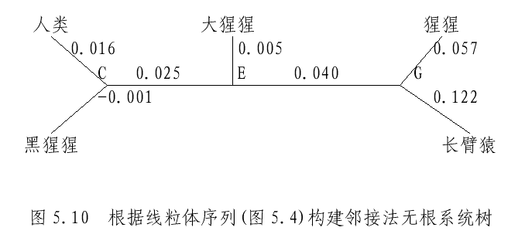
人
黑猩猩
大猩猩
猩猩
长臂猿
0.092 0.060 0.019 0.007

Slide 52
5.2.2 Maximum parsimony methods
（简约法）
Parsimony:
General scientific criterion for choosing among
competing hypotheses that states that we should accept
the hypothesis that explains the data most simply and
efficiently.
Maximum parsimony method of phylogeny reconstruction:
The optimum reconstruction of ancestral character states is
the one which requires the fewest mutations in the phylogenetic
tree to account for contemporary character states.
Notes:
简约和ML方法不讲

Slide 53
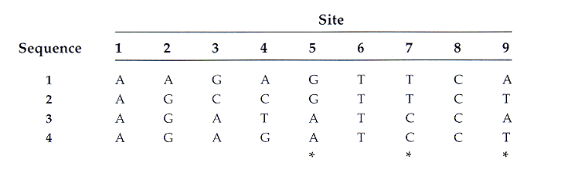
First step : Identify all of the informative sites
Invariant: all OTU’s possess the same character state at the site. Any invariant site is uninformative.
对于DNA序列，信息位点是指那些至少存在2个不同的碱基且每个不同碱基至少出现两次的位点。只有一个碱基且只在一个序列中出现的位点不属于信息位点，因为那种独特的碱基位点是由于在直接通向它所在序列的分枝上发生单个碱基变更所引起的。这种碱基变更可与任何拓扑结构相容。

Slide 54
Two types of variable sites:
Informative: favors a subset of trees over other possible trees.
Uninformative: a character that contains no grouping
information relevant to a cladistic problem (i.e. autapomorphies).

Slide 55
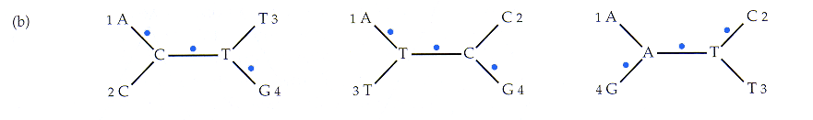
Uninformative: each tree 3 steps
Notes:
. is a substitution

Slide 56
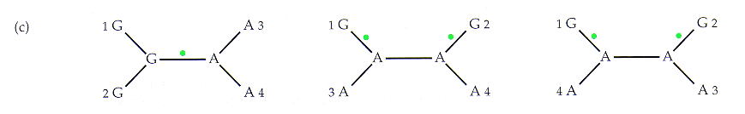
2nd step: Calculate the minimum number
of substitutions at each informative site
1 step
2 steps
2 steps
Informative: favors tree 1 over other 2 trees.

Slide 57
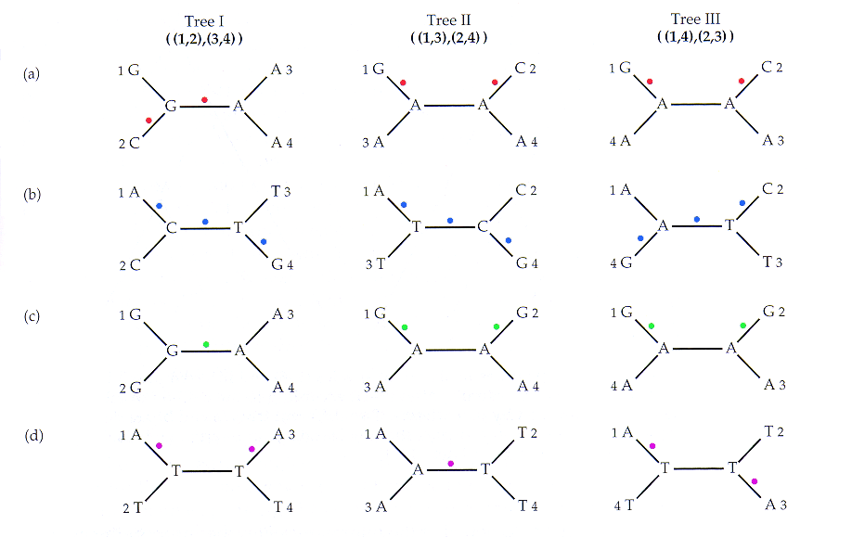
Final step: Sum the number of changes over all informative sites for each possible tree and choose the tree associated with the smallest number of changes.
Site 3
Site 4
Site 5
Site 9
3 steps
3 steps
4 steps

Slide 58
Parsimony Search Methods
Exhaustive search method: searches all possible fully resolved topologies
and guarantees that all of the minimum length cladograms will be found.
(not a practical option, time consuming)
Branch and bound methods: begins with a cladogram. The length
of starting cladogram is retained as an upper bound for use
during subsequent cladogram construction. As soon as a length
of part of the tree exceeds the upperbound, the cladogram is
abandoned. If equal length, cladogram is saved as an optimal
topology. If length is less, it is substituted for the original as the optimal
upperbound. (good option for fewer than 20 taxa, time consuming)
Heuristic methods: approximate or “hill climbing technique”
Begin with a cladogram, add taxa and swap branches until
a shorter length cladogram is found. Procedure can be replicated many
times to increase chance of finding minimum length cladogram.

