Slide 1
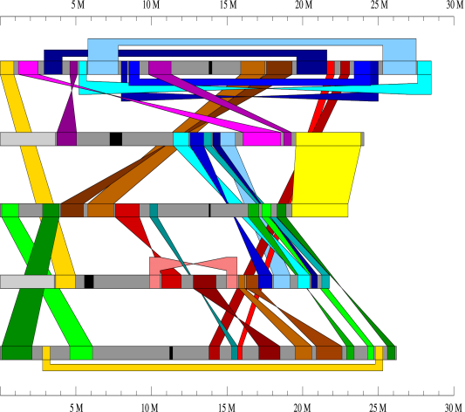
4. Genome analysis
《生物信息学》（第二版）（樊龙江主编，2021）配套PPT4
4.1 Composition of genome
4.2 Gene finding
4.3 Non-coding gene finding
4.4 Genome-wide expression profiling
4.5 Repeat and other elements finding
4.6 Organism finding in DNA samples
Notes:
本科生本节知识点：如何找蛋白质编码基因；如何找非编码小RNA基因。还可以介绍美国国防部的算法悬赏。
基因组拼接/转录组分析研究生课程讲解；
基因组研究历史和测序等在本科植物基因组课程可以详细讲相关内容。

Slide 2
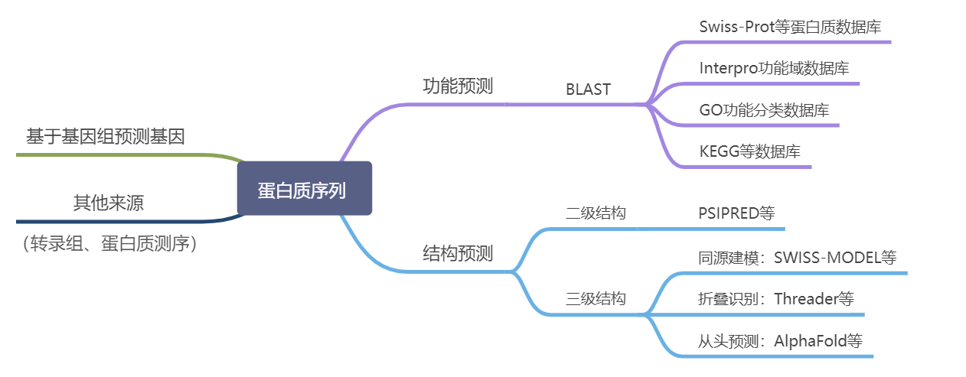

Slide 3
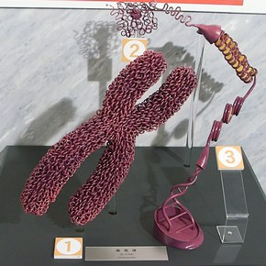
4.1 Composition and evolution of genome
Genome Anatomy: Structure and Composition of Genomes

Slide 4
Appearance of Genome
What does 50 kb of sequence look like?
♞One to many chromosomes
♞ Repeat sequences common in some genomes e.g. 35% of human are transposable elements -10% Alu, 14.6% LINE1 sequences
♞ Gene structure varies – no. and length of introns
repeat
Pseudogene
Intron-exon components of a gene
Human – very few genes - repeats
Yeast – many genes (~25) – few repeats
Maize – mostly repeats

Slide 5
不同生物基因组构成比较模式图

Slide 6
“Jungle-Desert” Or “Big –Small”?
The Gene “Jungle”
The Gene “Desert”
Intergenic
Intergenic
Intergenic
Gene Space ~50%
Many Small Genes
Two Big Genes
Intergenic
Intronic
Intergenic
Intronic
Gene Space ~90%

Slide 7
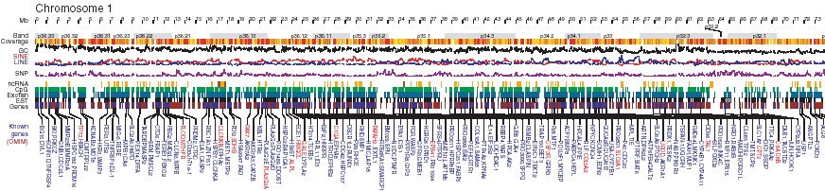
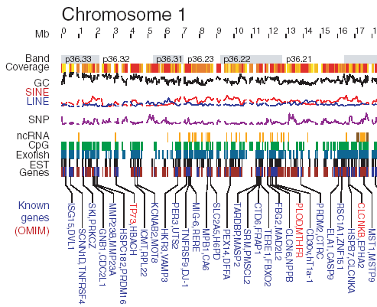
Human Genome
Nature, 2001
Science, 2001
Notes:
Human
Nature, 2001

Slide 8
Rice
Human

Slide 9
4.2 Gene finding
4.1 Introduction
4.2 Gene finding strategies

Slide 10
4.1 Introduction
Given the sequence of a genome, we would like to be able to identify:
  Genes
  Exon boundaries & splice sites
  Beginning and end of translation
  Alternative splicings
  Regulatory elements (e.g. promoters)
Only certain way to do this is experimentally, but computational methods can achieve reasonable accuracy quickly, and help direct experimental approaches.

Slide 11
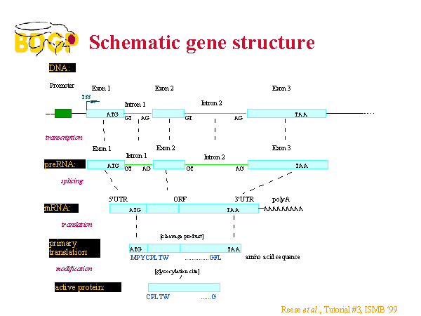

Slide 12
ORFs
ORF = Open Reading Frame. Region of sequence that has the potential to be translated into a protein.
  Six possible “reading frames” (3 starts x 2 strands)
  Starts with a atg (methionine)
  Ends with a stop codon (taa, tag or tga).
  No intervening stop codons
Not all ORFs are exons, but all exons must be in an ORF.

Slide 13
How to identify
ORFs that are exons?
Observed length distribution is non-random
  Long ORFs more likely to be exons
  Proposed 12 part mixture model of length distributions
Signatures of exons
  CpG islands
  intron splice junctions
  (hexa)nucleotide frequencies
Signatures of non-exons (repeats, ALUs, etc.)
Compatibility with surrounding sequence & other exons (e.g. consistent reading frame)

Slide 14
General challenges: gene finding is difficult
DNA sequence signals have low information content (degenerated and highly unspecific) and It is difficult to discriminate real signals
Short exons are hard to find, but not uncommon. Shortest human exon is 3bp!
First and last exons are particularly difficult
  No bounding intron, so no splice site signal (although start and end codons are related signals)
  Generally contain non-coding sequence as well as coding sequence, so hexamer signals are diluted.
Alternative splicing means that there are multiple true solutions for some genes.
Sequencing errors

Slide 15
Prokaryotes
High gene density and simple gene structure
Short genes have little information
Overlapping genes
Eukaryotes
Low gene density and complex gene structure
Alternative splicing
Pseudo-genes

Slide 16
4.2 Gene finding strategies
There is no (yet known) perfect method for finding genes. All approaches rely on combining various “weak signals” together and assemble into a consistent gene model
Homology method
Gene structure can be deduced by homology
Requires a not too distant homologous sequence
Ab initio method
Requires two types of information
  . compositional information
  . signal information

Slide 17
LOCUS AP003280 147201 bp DNA linear PLN 27-NOV-2003 DEFINITION Oryza sativa (japonica cultivar-group) genomic DNA, chromosome 1, PAC clone:P0557A01.
COMMENT Genes were predicted from the integrated results of the following: GENSCAN1.0, BLASTN2.0, BLASTX2.0 as well as SplicePredictor (October 1998 version). The genomic sequence was searched against NCBI NonRedundant Protein database, nr (ftp://ncbi.nlm.nih.gov/blast/db) and the cDNA sequence database at RGP. Protein homologies of the coding regions were searched against NCBI NonRedundant Protein database with BLASTP2.0. ESTs represent the identified cDNA sequences using BLASTN 2.0 with the corresponding DDBJ accession no. and RGP clone ID.
A gene with identity or significant homology to a protein is classified based on the protein name to indicate the homology level such as same name, 'putative-' and '-like protein'. A gene without significant homology to any protein but with EST homology (covering almost the entire length of partial sequence) is classified as an 'unknown' protein. A gene predicted with a gene prediction program is classified as a 'hypothetical' protein.

Slide 18
Homology method
Principles of the homology method:
Coding regions evolve slower than non-coding regions, i.e. local sequence similarity can be used as a gene finder.
Homologous sequences reflect a common evolutionary origin and possibly a common gene structure, i.e. gene structure can be solved by homology (mRNAs, ESTs, proteins, domains).
Standard homology search methods can be used (BLAST, Smith-Waterman, ...).
Include ”gene syntax” information (start/stop codons, ...).
Homology methods are also useful to confirm predictions inferred by other methods

Slide 19
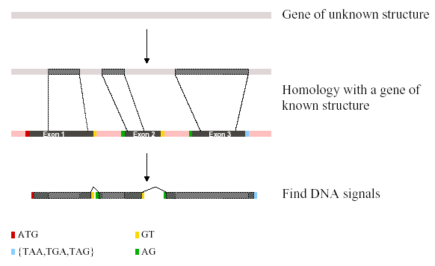
A simple view

Slide 20
Inference by homology
For exon finding, we need to find matches to
  mRNA/cDNA sequences
  ESTs
  Known exons

Slide 21
ESTs can be helpful in confirming a gene model
Genome sequence
Predicted
exons
ESTs should match exons
may need to fill in gaps by RT PCR and often need to obtain the whole cDNA sequence
same mRNA may be spliced differently in different tissues giving a different protein or mRNA may be edited to change sequence

Slide 22
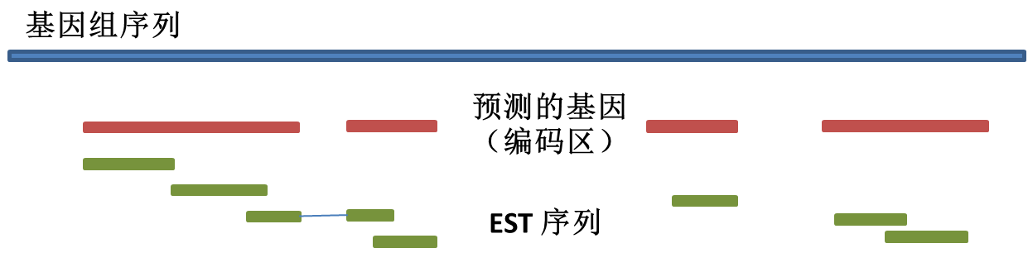

Slide 23
Ab initio method
Principles of the ab initio methods
  Integration of signal detection and coding statistics
  Signal detection and coding statistics are deduced from a training set
  Probabilistic frameworks are used to infer a probable gene structure
  A solid scoring system can be used to evaluate the predictions

Slide 24
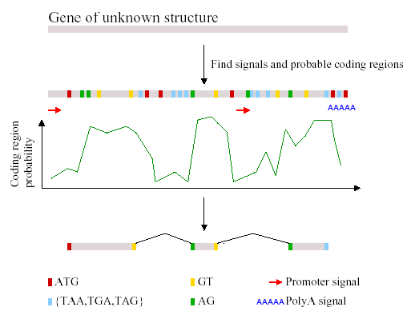
A simple review

Slide 25
Sequence model
Sequence models
  iid: niid and eiid
  Morkov chain/Hidden Morkov model (HMM)
  weigh matrix
  regular expression (consensus sequence/pattern)
Genetic model:
Y=μ+G+e (Johannsen, 1909)
Y= μ+(A+D+I)+e (Fisher, 1918)
Y= μ+(A+D+(AA+AD+DD))+e (Cockerham, 1954)
Notes:
independent and identically distributed (iid)

Slide 26
Probabilistic framework
We can express all of these weak signals as probabilities
  P(exon | length)
  P(exon | hexamer composition)
  P(exon | CpG content)
  P(exon | adjacent “splice” signals)
  etc. etc.

Slide 27
马尔可夫过程/链
马尔可夫过程是由一个个状态所谓“态”构成，态之间的转换是以概率发生的。也就是说，“将来”与“现在”是通过一个概率去联系，同样“现在”与“过去”也是通过一个概率去联系，这样的概率我们叫转移概率；
对于一条DNA序列，我们可以构建一个简单的马尔可夫模型：？

Slide 28
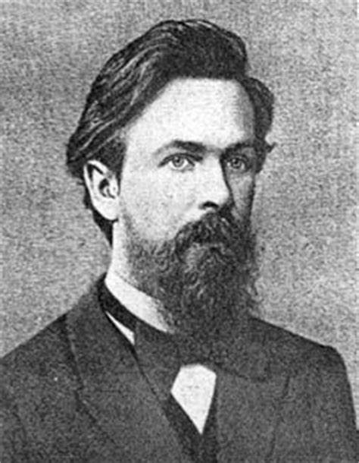
安德雷·安德耶维齐·马尔可夫（1856－1922）

Slide 30
一个略为复杂的例子：
对于一个基因内，为了建立识别5’端外显子和内含子间剪切位点方法，我们可以构建一个马尔可夫模型：

Slide 31
1、作为马尔可夫模型的拓展和应用最为广泛的马尔可夫模型之一，它是在上世纪60年代在Leonard E. Baum等人发展起来的。HMM被广泛应用到多个领域，如70年代应用到语音识别；80年代它首先被应用到序列分析中，用于序列联配（Bishop和Thompson 1986），而后其在生物信息学领域被广泛应用，在找基因（gene finding）、功能域分析等方面得到很好应用。
2、HMM（Hidden Markov Model）是一种用参数表示的用于描述随机过程统计特性的概率模型，是一个双重随机过程，由两个部分组成：马尔科夫链和一般随机过程。其中马尔科夫链用来描述状态的转移，用转移概率描述。一般随机过程用来描述状态与观察序列间的关系，用观察值概率描述。
隐马尔可夫模型（HMM）

Slide 32

鲍姆（Leonard Baum）（1931-2017）

Slide 34
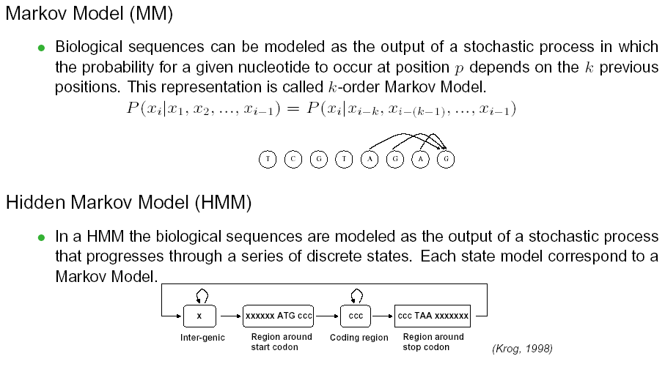
HMM
（参见BSA课件）
Notes:
可以单独成为一节！！！见HUNTER’S PPT chapter5
参见BSA课件

Slide 35
GENSCAN基因预测HMM模型（Burge和Karlin, 1997）

Slide 36
Protein domain/family db
Interpro
PROSITE Patterns / Profiles
ProDom Aligned motifs (PSI-BLAST) (Pfam B)
PRINTS Aligned motifs, OWL
Pfam HMM (Hidden Markov Models)
SMART HMM
TIGRfam HMM
DOMO Aligned motifs
BLOCKS Aligned motifs (PSI-BLAST)
CDD(CDART) PSI-BLAST(PSSM) of Pfam and SMART
Notes:
PROSITE,home of regular expressions and profiles;
Pfam, SMART and TIGRFAMs, keepers of hidden markov models(HMMs);
PRINTS, provider of fingerprints (groups of aligned, un-weightedmotifs);
All come from SWISS-PROT
InterPro is a database of protein families, domains and functional sites in which identifiable features found in known proteins can be applied to unknown protein sequences.

Slide 37
HMM for domain
请构建该模型

Slide 38
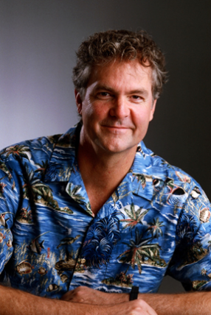
HMM概型方法（profile HMM）发明人
戴维·豪斯勒（David Haussler，1953—）

Slide 39
GENSCAN
A Semi-Markov Model
  Explicit model of how long to stay in a state (rather than just self-loops, which must be exponentially decaying)
Tracks “phase” of exon or intron (0 coincides with codon boundary, or 1 or 2)
Tracks strand (and direction)

Slide 40
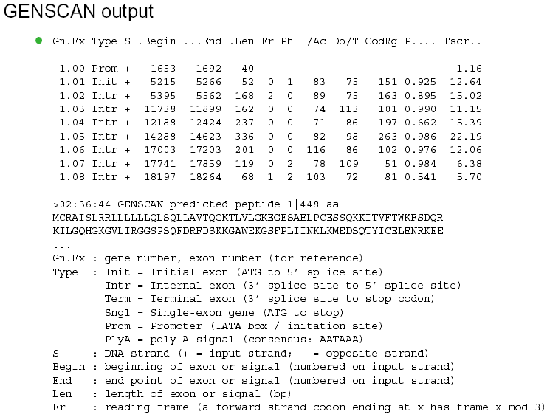

Slide 41
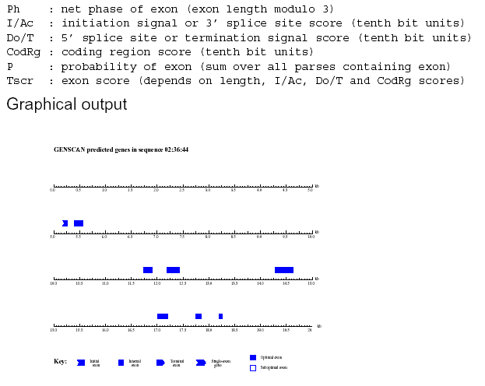

Slide 42
Fgenesh
(www.softberry.com)
Fgenes (Find genes) is the multiple gene prediction program based on dynamic programming;
Fgenesh: Hidden Markov Model (HMM)-based gene prediction program (Salamov and Solovyev 2000,
Genome Res)
Fgenesh+: is a version of Fgenesh, which uses additional information from the available protein homolog. When exons predicted by Fgenesh show high similarity to a protein from the database, it is often advantageous to use this information to improve the prediction accuracy.
Notes:
Linear discriminant analysis (LDA)

Slide 43
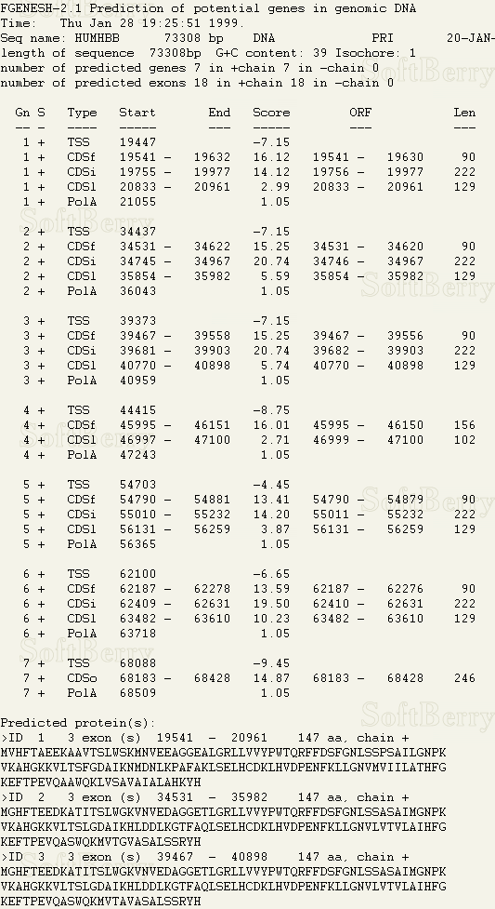
Fgenesh output:
G - predicted gene number, starting from start of sequence;
Str - DNA strand (+ for direct or - for complementary);
Feature - type of coding sequence: CDSf - First (Starting with Start codon), CDSi - internal (internal exon), CDSl - last coding segment, ending with stop codon);
TSS - Position of transcription start (TATA-box position and score);
Start and End - Position of the Feature;
Weight - Log likelihood*10 score for the feature;
ORF - start/end positions where the first complete codon starts and the last codon ends.

Slide 44
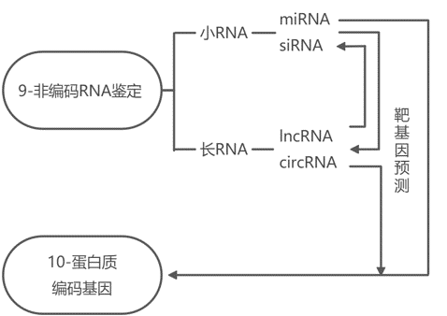
4.3 Non-coding RNA finding

Slide 45
Regulation network of non-coding RNAs

Slide 46
Examples of Non-coding RNAs
microRNA(miRNA)
  miRNA-like long hairpin
trans-acting siRNA (ta-siRNA)
  Phase siRNA (phasiRNA)
circRNA

Slide 47
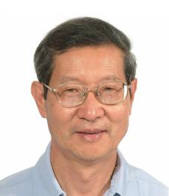
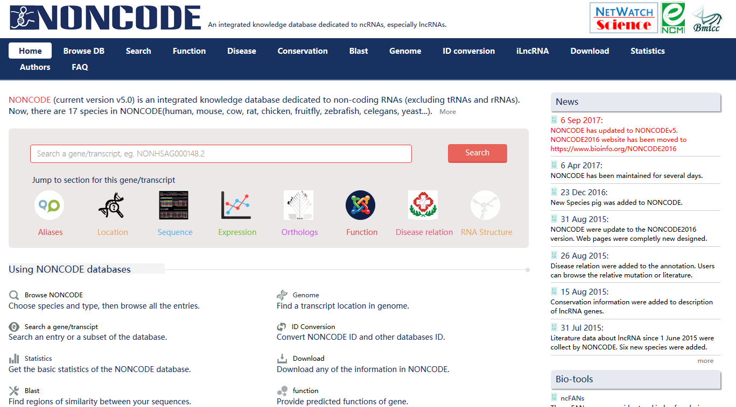
NONCODE

Slide 48
Endogenous Small RNAs and Their Biogenesis in Plants
small RNA
microRNA (miRNA)
short interference RNA (siRNA)
mRNA cleavage or translation repression
ta-siRNA
hc-siRNA
nat-siRNA
mRNA cleavage
DNA methylation and chromatin remodeling
mRNA cleavage
HEN1
SGS3
DRB1
SGS3
RDR2
RDR6
RDR6
HEN1
HEN1
HEN1
DRB?
DRB4
DRB?
DCL1
DCL1
DCL1
DCL4
DCL3
DCL2
ta-siRNA: trans-siRNA; na-siRNA: natural cis-antisense siRNA; hc-siRNA: heterchromatin siRNA; DRB:dsRNA-BINDING PROTEIN; HEN1: HUA ENHANCER 1; RDR: RNA-DEPENDENT RNA POLYMERASE; SGS3: SUPPRESSOR OF GENE SILENCING 3
Xie et al., 2004; Borsani et al., 2005; Gasciolli et al., 2005; Henderson et al., 2006

Slide 49
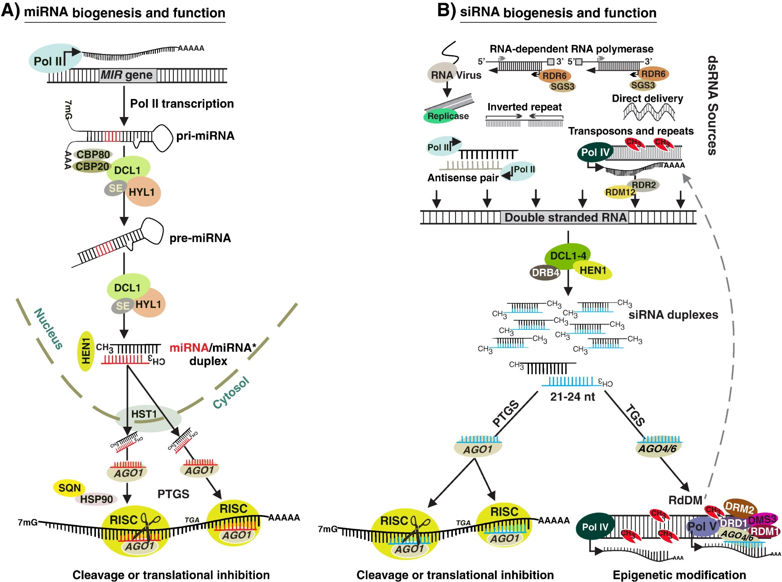
(Khraiwesh et al. 2011)

Slide 50
Comparison of miRNAs and siRNAs
 | miRNAs | siRNAs
Dicer | DCL1 | DCL1-4
Size | 21 | 21-24
5’ end | Mostly U | Mostly A for 24-mers
Origin | Mostly intergenic region | Transposable-element, repeat sequence, heterochromatic sequence
Precursor | Hairpin pri-miRNA | Long dsRNA
Copy number | One pre-miRNA, one miRNA (one arm of the foldback structure) | One precursor, many siRNA (both strands of the precursor)
Conservation | Yes | No
Target gene | trans | cis and trans
Function Mechanism | developmental regulation and stress response mRNA cleavage or translational repression | Chromatin modification and stress response DNA methylation and mRNA cleavage

Slide 51
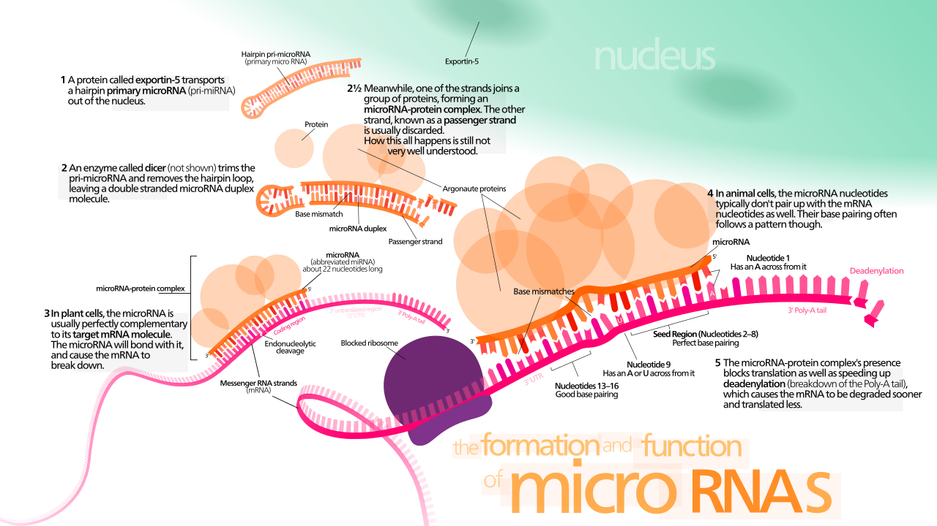
The formation and function of miRNAs

Slide 52
Discovery of miRNAs in Plants
Forward genetics: inefficiency due to the small size of miRNAs and functional redundancy among different miRNAs of the same family
Computational prediction: conservation; secondary structure, thermodynamic stability of the hairpin and free energy of folding
Exon 1
Exon 2
Exon 3
UU G A UG U - UG U C- A
GCAA GG GGCAGCAAGCU GAGG GCAACUGCAUAA UUGCAAGAA AU U GG UGA CGUU CC CCGUCGUUCGA CUCC CGUUGACGUAUU AACGUUCUU UA A CC ACU G
GU U A GU G A GU G AU A
5’
3’
Intergenic (25/34)
Exonic (2/34)
Intronic (7/34)
CGUCGUUCGAACUCCGUCGUU
5’
(Sunkar et al., 2005)
3’
Cloning: preferred, sequencing size-fractionated cDNA libraries

Slide 53
Computational prediction of miRNAs and their targets
Conserved miRNA:
  Conservation/small RNA reads;
  Secondary structure
  Thermodynamic stability of the hairpin and free energy of folding
Novel miRNAs
  Small RNA reads
  Secondary structure
  Thermodynamic stability of the hairpin and free energy of folding
Target prediction

Slide 54
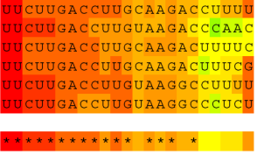
A
acccagaUgaagGUAAUAUACUAAUCCGUGCAUCCAUCGUAUAUCUUACACGUCAUGUGAACGUGCAUCGGUUCAUAAUGUUGUGUUUAUAAAUGUUAAUGGUAUGUGUGGUUGCACGGGUUUGUAUGUUGCAGacgcagcaUgaga
.(.((..((...(((((((((.((((((((((.(((.((((((((..(((((.(((((((((........)))))).))).)))))..............))))))))))).)))))))))).))))))))).....))...)).).
GUAAUAUACUAAUCCGUGCAUCCA(13) GUUGCACGGGUUUGUAUGUUGCAG (192)
GUUGCACGGGUUUG (3)
GUUGCACGGGUUUGUAUGUUGC (1)
GUUGCACGGGUUUGUAUGUUGCA (1)
GUUGCACGGGUUUGUAUGUUGCAGA(3)
UUGCACGGGUUUGUAUGUUGCAG (3)
GUUGCACGGGUUUGUAUGUUGCAGC(1)
GUUGCACGGGUUUGUAUGUUGCAGG(1)
B
5′
U
U
U
U
U
U
G
U
G
G
U
A
A
U
A
U
A
C
A
A
U
C
C
G
U
G
C
A
C
C
A
C
G
U
A
U
A
U
C
A
C
A
C
G
C
A
U
G
U
G
A
A
C
C
G
A
C
G
U
U
G
U
A
U
G
U
U
U
G
G
G
C
A
C
G
U
U
G
G
U
G
U
G
U
A
U
G
G
U
G
U
G
U
G
U
A
U
A
C
U
U
G
G
C
U
A
3′
A
A
U
U
U
U
A
U
U
G
A
U
A
U
A
A
B
Sequence reads
3
110
0
0
C
LOC_Os01g48060 (ARF3)
TAS3a1 D7(+)
TAS3a1 D6(+)
TAS3b1 D6(+)
TAS3b2 D5(+)
TAS3a2 D8(+)
TAS3a2 D7(+)
Consensus
OsTAS3a1
1279
1510
43
0/9
2/7
A
B
5’GGTGTTATCCTAACTGAGCTT 3’
||:|:|||||: ||||||||
3’CCGCGATAGGGAGGACTCGAA 5’
5’CGGTCTATCCCTCCTGAGCTG 3’
| ||||||||||||||||
3’CCGCGATAGGGAGGACTCGAA 5’
4/4
5/8
7/9+4/7
5’ AAGGTCTTGCAAGGTCAAGAA 3’
||:||||||||||||||||||
3’ TTTCAGAACGTTCCAGTTCTT 5’
TAS3b1_5’D6(+)
TAS3b2_5’D5(+)
5’ GAGGTCTTGCAAGGTCAAGAA 3’
:|:||||||||||||||||||
3’ TTTCAGAACGTTCCAGTTCTT 5’
TAS3b1_5’D6(+)
TAS3b2_5’D5(+)
D
LOC_Os01g70270 (ARF2)
5’CACCGTCCACATCCTTCTTCA 3’
|||||||||||||||||||||
3’GTGGCAGGTGTAGGAAGAAGT 5’ D10(-)
1231
OsTAS3b1
5’ AAGGTCTTGCAAGGTCAAGAA 3’
| ||:|||:||||||||||||
3’ TCCCGGAATGTTCCAGTTCTT 5’
TAS3a2_5’D7(+)
5’ GAGGTCTTGCAAGGTCAAGAA 3’
: ||:|||:||||||||||||
3’ TCCCGGAATGTTCCAGTTCTT 5’
TAS3a2_5’D7(+)
0/5
12/47
5/11
5’GGCCCTATCCCCACCGAGCTT 3’
||| ||||||| | ||||||
3’CCGCGATAGGGAGGACTCGAA 5’
5’CCGTCTATCCCTCTTGAGCTT 3’
|||||||||:|||||||
3’CCGCGATAGGGAGGACTCGAA 5’
5’ CAAGGTCTTGCAAGGTCAAGA 3’
||||||||||||||||||||
3’ TTTCCAGAACGTTCCAGTTCT 5’
TAS3a1_5’D7(+)
5’ AGAGGTCTTGCAAGGTCAAGA 3’
|:|||||||||||||||||||
3’ TTTCCAGAACGTTCCAGTTCT 5’
TAS3a1_5’D7(+)
5’ ACGGTCTTGCAAGGTCAAGAA 3’
| :||||||||||||||||||
3’ TTTCAGAACGTTCCAGTTCTT 5’ TAS3b1_5’D6(+)
1/47
19/47
5’ ACGGTCTTGCAAGGTCAAGAA 3’
| ||:|||:||||||||||||
3’ TCCCGGAATGTTCCAGTTCTT 5’ TAS3a2_5’D7(+)
5’TTGCCAACATTTCTCGTCCTC 3’
|||||||||||||||||||||
3’AACGGTTGTAAAGAGCAGGAG 5’
5’TCGCGTCTATCACTCCTCCCA 3’
|||||||||||||||||||||
3’AGCGCAGATAGTGAGGAGGGT 5’
5’ CAAGGTCTTGCAAGGTCAAGA 3’
||||||:|||||||||||
3’ AACCCAGAATGTTCCAGTTCT 5’
TAS3a1_5’D6(+)
5’ AGAGGTCTTGCAAGGTCAAGA 3’
||||||:|||||||||||
3’ AACCCAGAATGTTCCAGTTCT 5’
TAS3a1_5’D6(+)
4/47
5’ TACGGTCTTGCAAGGTCAAGA 3’
| ||||||||||||||||||
3’ TTTCCAGAACGTTCCAGTTCT 5’ TAS3a1_5’D7(+)
5’ACCGCCCCTCCTCTCGTTCTA 3’
|||||||||||||||||||||
3’TGGCGGGGAGGAGAGCAAGAT 5’ D10(-)
5’ CAAGGTCTTGCAAGGTCAAGA 3’
||||:|||:|||||||||||
3’ TTTCCGGAATGTTCCAGTTCT 5’
TAS3a2_5’D8(+)
5’ AGAGGTCTTGCAAGGTCAAGA 3’
|:|||:|||:|||||||||||
3’ TTTCCGGAATGTTCCAGTTCT 5’
TAS3a2_5’D8(+)
5’ TACGGTCTTGCAAGGTCAAGA 3’
| ||||||:|||||||||||
3’ AACCCAGAATGTTCCAGTTCT 5’ TAS3a1_5’D6(+)
OsTAS3b2
0/5
2/5
5’ TACGGTCTTGCAAGGTCAAGA 3’
| ||:|||:|||||||||||
3’ TTTCCGGAATGTTCCAGTTCT 5’ TAS3a2_5’D8(+)
5’GGCTCTATCCTCCCTGAGCTC 3’
||| ||||||: |||||||||
3’CCGCGATAGGGAGGACTCGAA 5’
5’CTGTCTATCCCTCCTGAGCTT 3’
|||||||||||||||||
3’CCGCGATAGGGAGGACTCGAA 5’
(Zhu et al. Genome Research, 2008)

Slide 55
ta-siRNA finding
Conserved ta-siRNA
  TAS3: ta-siARF
  miR390 binding sides
Novel ta-siRNA
  Small RNA reads
  Phase of small RNA reads
  miRNA targeting sites

Slide 56
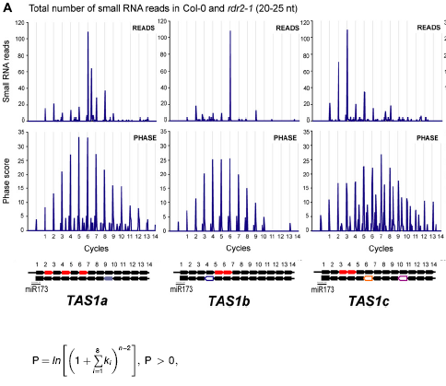
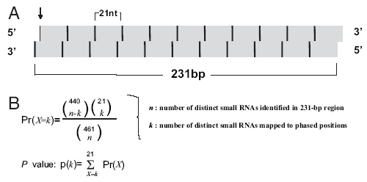
Methods
Howell et al. 2007. Plant Cell
Chen et al. 2007. PNAS
Phase peak value >1.4
P value <0.01

Slide 57
PhasiRNA loci (PHAS) were identified using the algorithm
where n = number of phase cycle positions occupied by at least one small RNA read within an eight-cycle window, and k = the total number of reads for all small RNAs with consolidated start coordinates in a given phase within an eight-cycle window.
Scan_phasiRNA:
a program to find loci with 21nt phased siRNAs (such as ta-siRNA gene TAS) using the Howell algorithm.
Shen et al., 2009, Plant Systematics and Evolution
(http://ibi.zju.edu.cn/bioinplant/tools/)

Slide 58
( Shen et al. Plant Systematics and Evolution, 2009)

Slide 60
Long or large non-coding RNAs (>200nt):
  Precursor of small noncoding RNA
  mRNA-like long noncoding RNA
  eTM
  Pol IV- and Pol V-dependent long noncoding RNA (plant-specific)
  Circular RNA
  ……

Slide 61
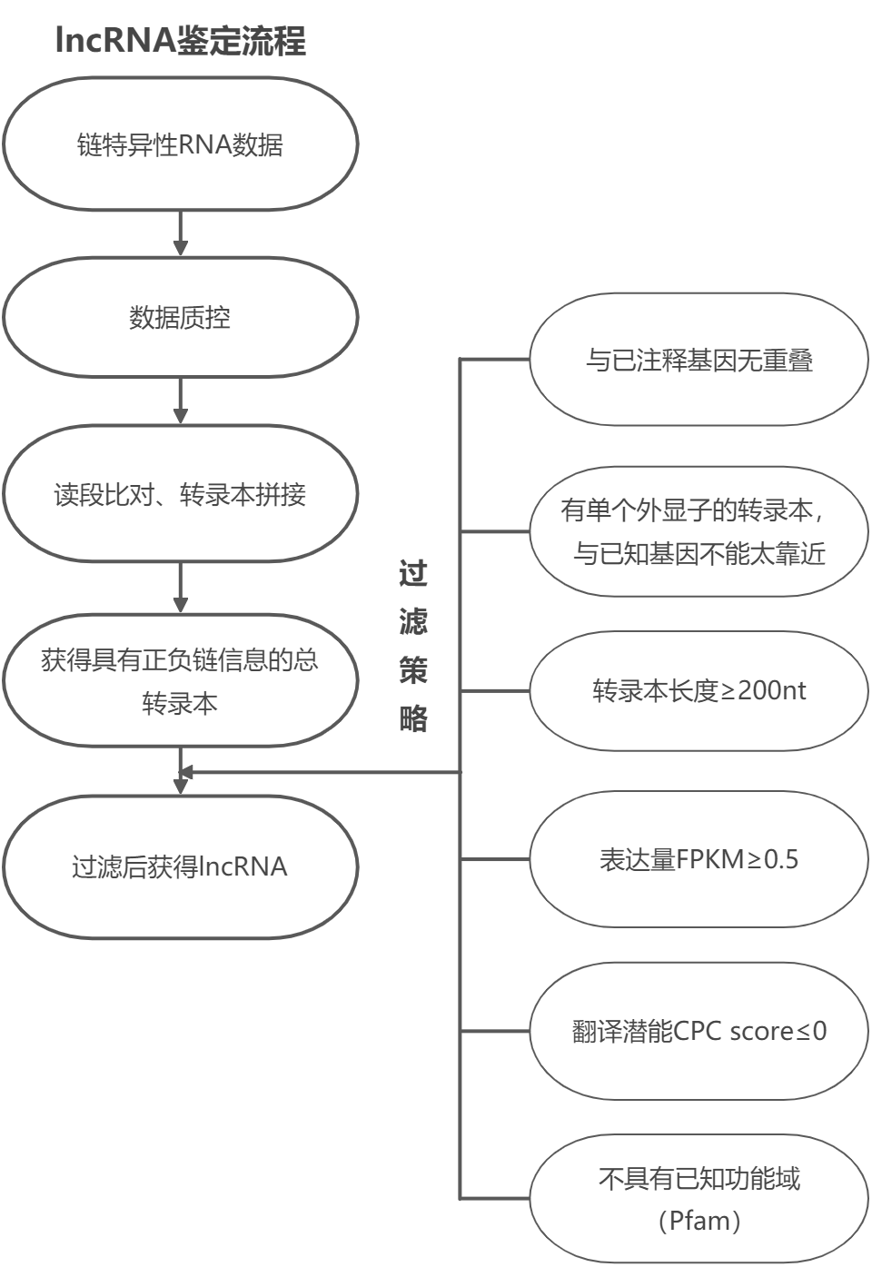

Slide 62
A
B
No. of sequence reads (log scale)
Frequency (%)
5′
P12_5′
P10_5′
P8_5′
P6_5′
P4_5′
miR436
P1_5′
Length of small RNAs (nt)
3′
P11_3′
P9_3′
P7_3′
P5_3′
P3_3′
P1_3′
C
D
No. of sequence reads (log scale)
Frequency (%)
5′
P8_5′
P6_5′
P4_5′
P2_5′
3′
Length of small RNAs (nt)
P9_3′
P7_3′
P5_3′
P3_3′
P1_3′
E
3/5
5’ CACCTTCTTCCTCTTCTGCGC 3’ 04g43210
|| |||||:||||||||| ||
3’ GTAGAAGAGGGAGAAGACACG 5’ 06g21900_P6_5′
12/12
miRNA-like long hairpin
5’ AAGCACTAAAGAGGGCAGAGA3’ 12g17310
|||||||||||||||||:|||
3’ TTCGTGATTTCTCCCGTTTCT 5’ 06g21900_P6_3′
(Zhu et al. Genome Research, 2008)

Slide 63
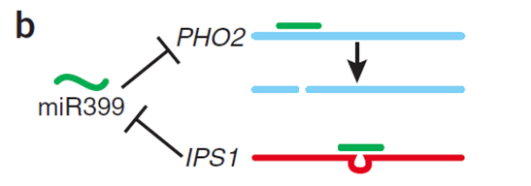
Long non-coding endogenous target mimicry (eTM), which blocks the interaction between miRNA and its authentic targets by sequestering miRNA and arresting its cleavage activity.
Arabidopsis thaliana
gma-miR1522 5’ UUUAUUGCUU--A-AAAUGAAAU 3’
||||||||| | ||||| |||
gma-eTM1522-2 3’ UAAUAACGAAGAUAUUUACGUUA 5’
miRNA
eTM
(Franco-Zorrilla et al., 2007, Nature Genetics)
Notes:
Requirement of a bulge at the cleavage site for target mimicry.
A target mimic with an unmodified central sequence (MIM172cs), which retained complementarity to the central portion of miR172 across the cleavage site (red line) opposite position 10 to 11 of the miRNA, did not change flowering time. Modification of the central sequence (TCTA to GAGT; MIM172) restored a three nucleotide bulge found in IPS1 and generated a functional target mimic, causing a delay in flowering. However, a single nucleotide mismatch introduced into the center of an authentic miR172 target site (MIM172sn), but without a bulge, was not sufficient to reduce miR172 activity. (B) Four-week old plants grown at 23°C in long days. MIM172cs and MIM172sn are phenotypically indistinguishable from wild-type Col-0 plants (see also Figure S1B). (C) Distribution of flowering times of primary transformants grown in the same conditions; compare with Col-0 plants transformed with an empty binary vector in Figure S2.
A three-nucleotide bulge
In Arabidopsis

Slide 64
Identification and Expression Analysis of eTMs for nta-miRX27
eTM Target miRNA
Topping-induced expression of endogenous nta-eTMX27 in tobacco root. A, The predicted base-pairing pattern between nta-miRX27 and its eTM nta-eTMX27. B, Semi-quantitative RT-PCR analysis of expressions of nta-eTMX27 in four tissues. C, The relative transcription levels of nta-eTMX27, QPT2 and nta-miRX27 in N. tabacum root tissues measured at 3, 6, 12, 24 and 48 h after topping.
(Li et al., 2015, Plant Physiology)
Notes:
Figure 3. Topping-induced expression of endogenous nta-eTMX27 in tobacco root. A, The predicted base-pairing pattern between nta-miRX27 and its eTM nta-eTMX27. B. Semi-quantitative RT-PCR analysis of expressions of nta-eTMX27 in four tissues. NtGAPDH was used as control. RT- represents RT negative control, i.e. RT without reverse transcriptase. C, The relative transcription levels of nta-eTMX27, QPT2 and nta-miRX27 in N. tabacum root tissues measured at 3, 6, 12, 24 and 48 h after topping. Three independent experiments, each consisting of three control and topping-treated plants, were carried out for quantification analyses, and representative results in one time are presented. The expression level at the 0 h time point (control) was arbitrarily set as 1. Error bars indicate the SD.

Slide 65
Nta-eTMX27 Induced miRNA Degradation and Repressed miRNA Function
Functional analyses of nta-eTMX27. A, Phenotypes of nta-eTMX27 overexpression and silencing plants. B, Relative expression levels of nta-eTMX27, nta-miRX27 and QPT2 . C, Average leaf nicotine contents of the Vec, nta-miRX27 and nta-STTMX27 lines. D-F, Expression levels of nta-eTMX27, nta-eTMX27(48h), QPT2(48h) in roots of transgenic plants transformed with the Vector (Vec) or ds-nta-eTMX27 construct in response to topping.
(Li et al., 2015, Plant Physiology)
Notes:
Figure 4. Functional analyses of nta-eTMX27. A, Phenotypes of nta-eTMX27 overexpression and silencing plants. Two independent and representative transgenic lines overexpressing nta-eTMX27 (nta-eTMX27-2# and nta-eTMX27-5#) and silencing nta-eTMX27 (ds-nta-eTMX27-4# and ds-nta-eTMX27-9#) were shown. B, Relative expression levels of nta-eTMX27, nta-miRX27 and QPT2 in nta-eTMX27 overexpressing and silencing transgenic plants compared with that of the Vec plants. Three individual plants per genotype were used in RT-qPCR. Bars show SD. C. Average leaf nicotine contents of the Vec, nta-miRX27 and nta-STTMX27 lines. A single asterisk indicates a significant difference (p<0.05) between the nta-miRX27 or nta-STTMX27 line and the Vec control. Error bars indicate the SD. D, Expression levels of nta-eTMX27 in roots of transgenic plants transformed with the Vector (Vec) or ds-nta-eTMX27 construct in response to topping. Samples were collected at 48 h after topping treatment (without topping as control). The expression level in the Vec plants without topping treatment was arbitrarily set as 1. Error bars indicate SD. Double asterisks indicate a significant difference (Student’s t test, p<0.01) between the two samples. E, Relative expression levels of nta-eTMX27 in roots of transgenic plants transformed with the Vec or ds-nta-eTMX27 after topping treatment at 48 h. The expression level of the Vec plants with control treatment was arbitrarily set as 1. Error bars indicate the SD. F, Relative expression levels of QPT2 in the Vec and ds-nta-eTMX27 transgenic plants after topping treatment at 48 h. Error bars indicate SD. The expression level of the Vec plants with control treatment was arbitrarily set as 1. A single asterisk indicates a significant difference (Student’s t test, P<0.05) and double asterisks indicate a highly significant difference (Student’s t test, P<0.01) between the two paired samples.

Slide 66
eTM_finder:
a tool to predict eTMs (endogenous target mimics) of miRNAs in plants.
Ye et al., 2014, Frontiers in Plant Science
(http://ibi.zju.edu.cn/bioinplant/tools/)

Slide 67
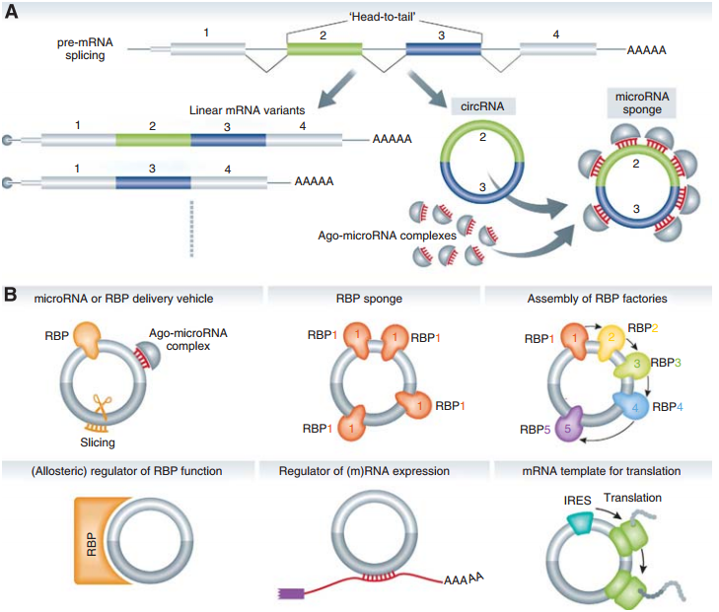
Circular
RNAs
Function as miRNA sponge (Memczak et al, Nature, 2013. Hansen et al, Nature, 2013), for example CDR1as.
Have the potential to enhance transcription of their host genes (Zhang et al. Molecular Cell, 2013. Li et al. Nature Structural & Molecular Biology, 2015).
（Hentze et al. EMBO Journal, 2013）

Slide 68
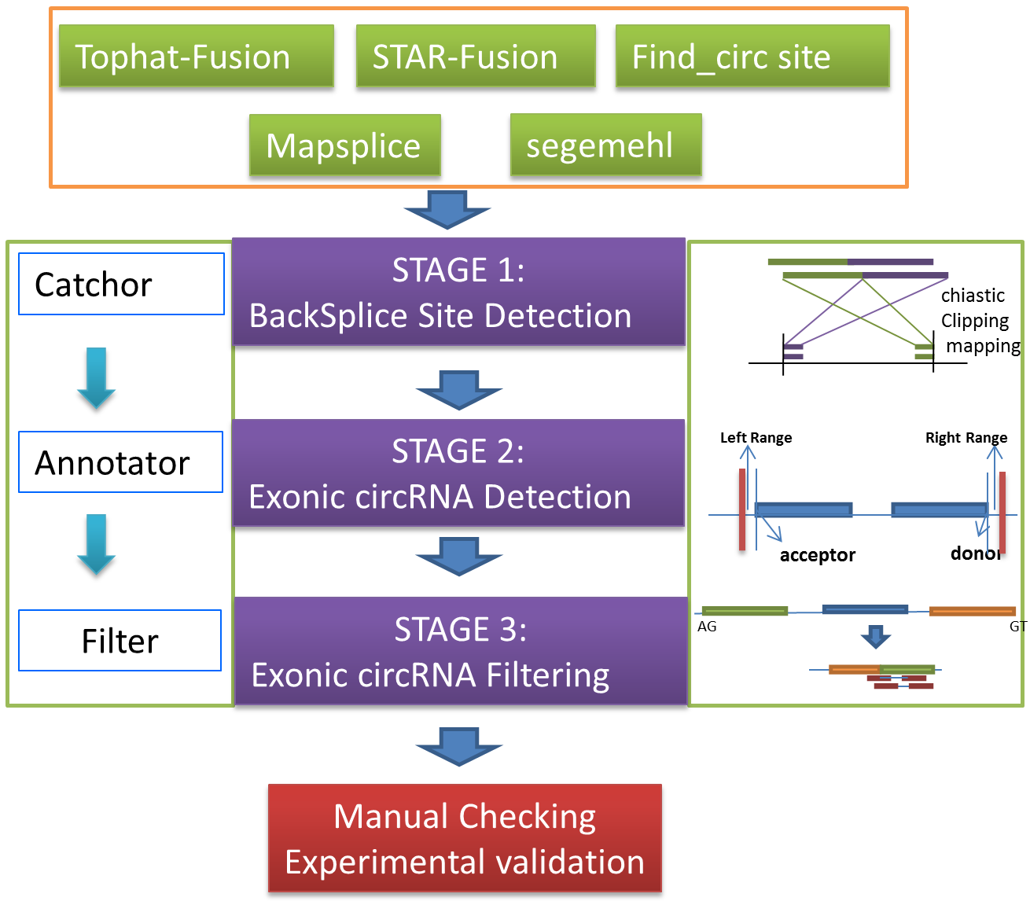
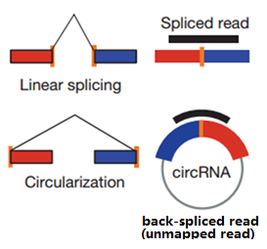
The flowchart of “PcircRNA_finder” for circRNA prediction
(Chen et al., 2016, Bioinformatics)
Notes:
It consists of three modules(stages): Catchor, Annotator, Filter.
Catchor is used to collect as many backsplice sites as possible, which are supported by chiastic clipping mapping. Annotator is used to annotate the candidate sites with gene structure annotation. Filter is used to prioritize the candidate circRNA.

Slide 69
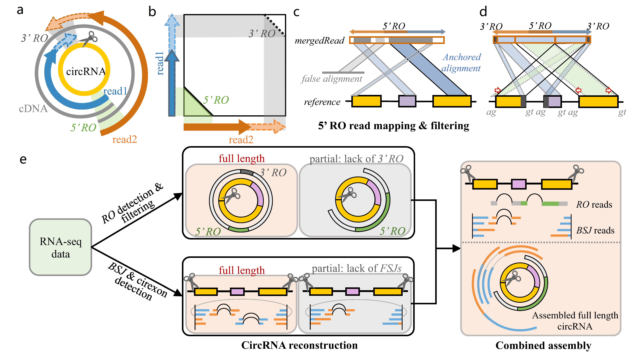

Slide 70
Genome-wide identification of circRNAs in plants
Type of circRNA | O. sativa |  | A. thaliana
 | Number | Percentage (%) | Number | Percentage (%)
Exonic circRNA | 6,074 | 50.5 | 5,152 | 85.7
Intronic circRNA | 485 | 4.0 | 1 | 0
UTR circRNA | 636 | 5.3 | 19 | 0.3
Intergenic circRNA | 705 | 5.9 | 32 | 0.5
Other circRNA* | 4,137 | 34.4 | 808 | 13.4
Total | 12,037 | 100 | 6,012 | 100
*Other circRNAs refer to those derived from two or more genes.
Notes:
Genome-wide identification of circRNAs in plants based on RibominusSeq data

Slide 71
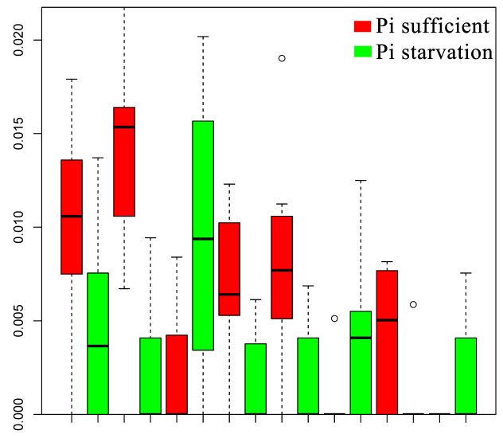
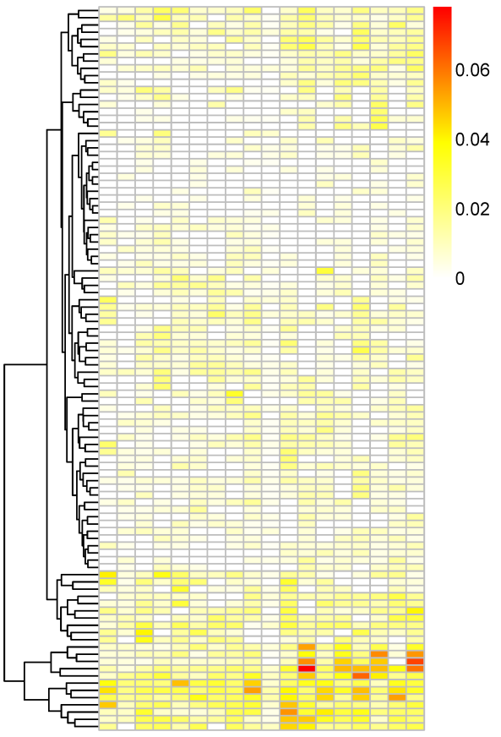
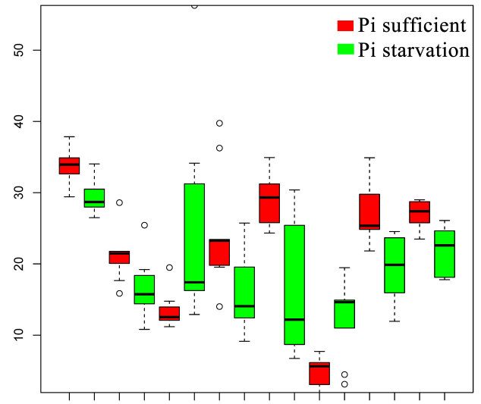
Same expression patterns of circRNAs with their host genes in O. sativa
circRNAs
Host genes
Os_ciR497
Os_ciR820
Os_ciR1069
Os_ciR495
Os_ciR669
Os_ciR723
Os_ciR899
Os_ciR559
O. sativa
Os03g43010
Os10g34480
Os04g47870
Os10g25770
Os01g64020
Os07g30300
Os05g29030
Os01g43844
(Ye et al., 2015, New Phytologist)
Notes:
phosphate

Slide 72
Assembly of full-length of circRNAs
Development of an algorithm to assemble full-length of circRNAs based on back-splicing reads and their paired-end reads
  circseq_cup
circRNAs with full-length sequence

Slide 73
The pipeline of circseq_cup
RNA-Seq data
Unmapped reads
Unmapped reads
Fusion junction site
Fusion junction finding
PE reads collection
Reads from fusion sites
P1
PE reads
P1
P2
Assembly
P2
Contig with overlap
Contig
overlap
overlap
Candidate circRNA with full-length
(Ye et al., 2016, RNA Biology)

Slide 74


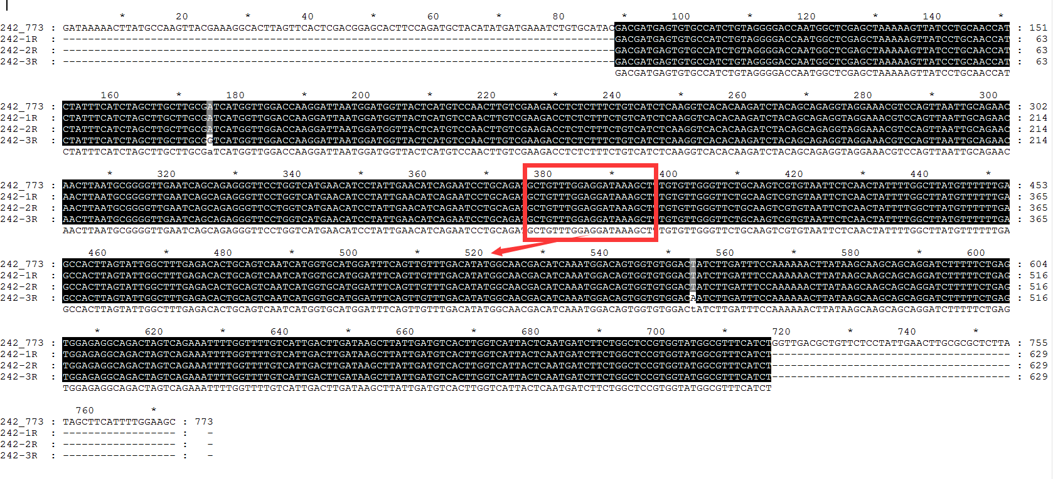
Identification and validation of circRNAs in rice and Arabidopsis genomes
Convergent primers
Convergent
Divergent
Divergent primers
gDNA
cDNA
gDNA
cDNA
Ref.
Sanger
downstream sequence
upstream sequence
Os05g51490
(Ye et al., 2016, RNA Biology)
Notes:
Including full-length sequences

Slide 75
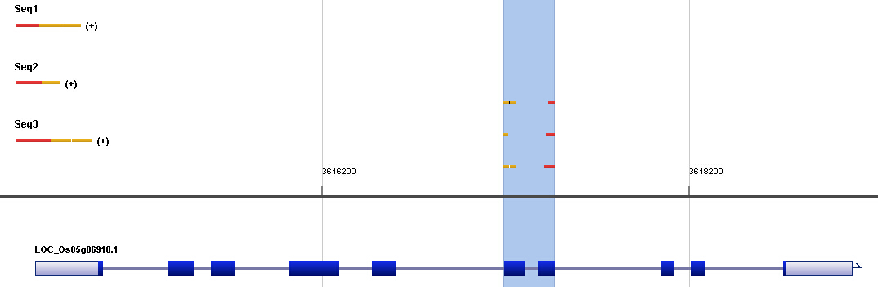
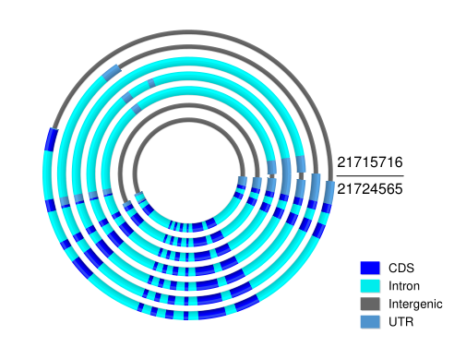
(a)
(b)
(c)
P2
P1
Divergent
primers
Figure 1. Visualization and validation of circRNAs by circRNA_pocket. (a) Graphic drawing showing an example of a rice circRNA (Os_ciR190) with three Sanger sequences supporting its backsplicing event. (b) Graphic details about the alignments of the three Sanger sequences with the linear parental gene. (c) Visualization and confirmation of Os_ciR190 full-length by Sanger sequencing of clone of full-length sequence (left) and paired-end reads from RNA-Seq data (right).
Notes:
Figure 1. Visualization and validation of circRNAs by circRNA_pocket. (a) Graphic drawing showing an example of a rice circRNA (Os_ciR190) with three Sanger sequences supporting its backsplicing event. The circRNA is generated from the region including two exons and one intron of the parent gene LOC_Os05g06910 (Ye, et al., 2015) located on Chr5: 3617186-467 of the rice genome. (b) Graphic details about the alignments of the three Sanger sequences with the linear parental gene shown by circRNA_pocket. (c) Visualization and confirmation of Os_ciR190 full-length by Sanger sequencing of clone of full-length sequence (left) and paired-end reads from RNA-Seq data (right). Both results show that the Os_ciR190 contains two exons and the intron is removed during splicing. Arrows indicate the location of the divergent primers used in full-length sequence amplification. P1 and P2 indicate the paired-end reads which cover backsplicing sites and could be assembled to be full-length of the circRNA according to their overlap.

Slide 76
A database for plant circular RNAs
(Chu et al., 2017, Molecular Plant)

Slide 77
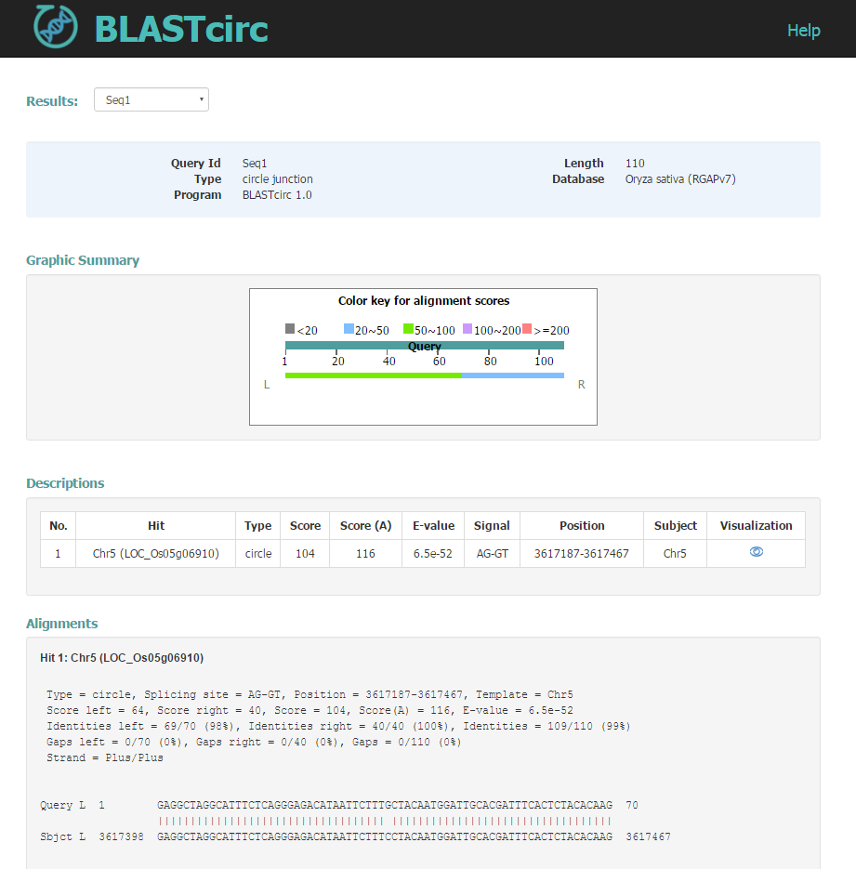
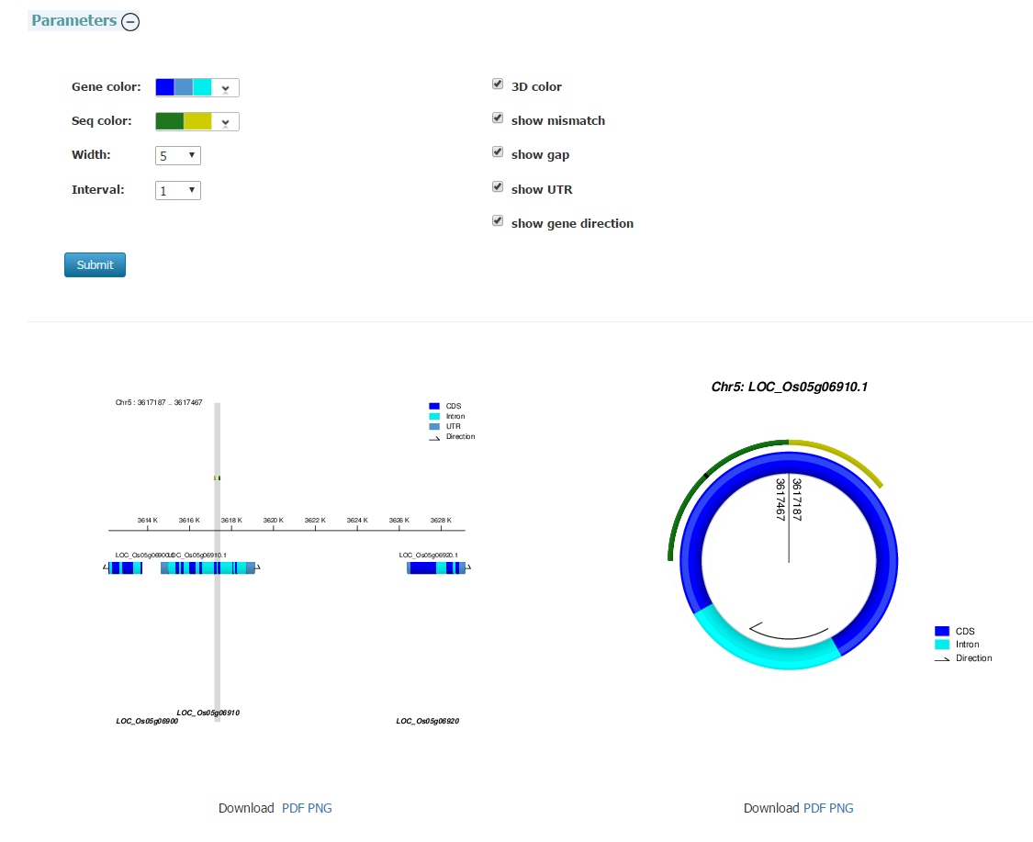
(Chu et al., 2020. Briefings in Bioinformatics)

Slide 78
circseq-cup: a program to assemble full-length sequences of circular RNAs.
Ye et al., 2016, RNA Biology
PcircRNA-finder: a program to identify circular RNAs in plants .
Chen et al., 2016, Bioinformatics
circRNA_pocket: a tool to show genomic features of circRNAs. Zhang et al., 2016, 已获得计算机软件著作权
(http://ibi.zju.edu.cn/bioinplant/tools/)

Slide 81
4.4 Genome-wide expression profiling
See PPT « Transcriptome (RNA-Seq) and annotation »

Slide 82
4.6 Organism finding in DNA samples
A $1 Million Algorithm Challenge

Slide 83

DTRA/SCC-WMD Announces $1 Million Algorithm Challenge Winner
The winner of DTRA/SCC-WMD’s most recent initiative, “The DTRA Algorithm Challenge” was recently announced by the agency
http://www.dtra.mil
www.innocentive.com

Slide 84
“The DTRA Algorithm Challenge”
The Algorithm Challenge was an open competition with a $1 million prize for the individual or team that developed an algorithm which can most rapidly and accurately characterize a complex clinical sample based solely on raw DNA sequence data.
This particular algorithm challenge focuses on using DNA sequence data in identifying pathogens in complex mixtures from clinical samples. By using sequencing as a diagnostic tool for infectious disease, the DoD will eventually have the ability to diagnose a larger number of threats (known and unknown) than ever before

Slide 85
The Challenge winner: individual- or team-developed algorithm that best meets the following criteria
Assesses the data, however complete or limited
Provides the best possible characterization of the sample
Identifies and quantifies all components when possible
Speculates (with probability and justification) when positive ID is not possible
Makes recommendations for further analysis
Does not rely on an expert user
Requires little overhead
Is fast
Notes:
两名新加坡环境生物工程中心（Singapore Centre on Environmental Life Sciences Engineering，简称SCELSE）的研究人员，以及一名来自德国图宾根大学（University of Tuebingen）的研究生，凭着这套计算程序从2700多人中脱颖而出，摘下由隶属美国国防部国防威胁降低局（Defense Threat Reduction Agency，简称DTRA）举办的计算程序挑战赛冠军（Algorithm Challenge），获得奖金100万美元（约125万新元）。这项比赛旨在协助该局进一步提升判断和制止生物威胁的能力。
根据比赛规定，参赛者或队伍必须编写一套计算程序，在限时一小时内分析主办单位提供的九组人体基因，即脱氧核糖核酸（DNA）样本，并与世界上现有的数据档案库做比对，从中辨认出里头所含有的细菌，准确率必须高出90％。
由SCELSE派出的两名研究员是目前在南洋理工大学担任访问教授的图宾根大学教授赫森（Daniel Huson），以及新加坡国立大学的解超博士。
长期钻研细菌的解超（33岁）昨天接受本报采访时表示，由他们三人耗时一个半月完成编写的计算程序，可在极短的时间内以超高准确度分析出九组基因样本中所含的五到数十种的细菌身份。
解超说：“一般上，要辨认这九组基因样本的细菌得花上几个星期到几个月，但我们的计算程序不但可在短短五分钟内做到这点，准确率还高达91％到99％。”
解超指出，这套计算程序可运用在国防领域，这包括及时阻止生物恐怖袭击发生，或避免它蔓延开来。他举例说，有关当局一旦发现有疑似生物恐怖袭击发生，相关人员可搜集血液样本，利用程序快速辨认细菌，进而协助当局研发出疫苗，避免恐怖袭击进一步扩散，让恐怖分子得逞。
另一方面，医疗机构和病人也可从这套程序中受惠，方便医生在短时间内确诊病人所感染的病菌，避免冗长的化验过程耽误病情，及时对症下药。
据了解，这套程序的知识产权仍属SCELSE，而美国政府可在“非独占性许可证”（non-exclusive license）下，让属下单位使用，协助提升防恐实力。

Slide 86

Details about the challenge
This Challenge seeks innovative algorithms to analyze samples that contain mixed segments of genetic sequence from next-generation sequencing instruments and report the identities of each organism represented in the sample and characterization of all non-host organisms. Technical details and requirements are available in the full description.
Submissions to the Challenge must include the following:
A detailed description of the proposed algorithm, and how it addresses each Technical Requirement listed in the Detailed Description of the Challenge. The project documentation should be include a well-articulated rationale, and be supported by relevant references.
Source code implementing the proposed algorithm. Include all dependencies, packages, databases, documentation, and information to generate test results by Seeker.
The award is contingent upon evaluation and validation of the submitted Solutions by the Seeker. During the evaluation period, the Seeker will validate top-scoring submissions using additional data similar to the test data provided in the Challenge.

Slide 87
From Science
Find a radically faster and more accurate way to identify the species and genes in raw DNA. As DNA sequencing becomes faster and cheaper, DTRA hopes that the challenge will inspire a highly accurate program to detect potentially dangerous organisms in DNA samples in under an hour—a vast improvement over today's capabilities

Slide 88
For participants, competing requires a high-risk investment of time up front, but it also eliminates the traditional barriers of the grant process. "Having the skill to actually solve something and having the skill to write a proposal to get the money—they're two different skill sets," says Daniel Huson, a bioinformaticist at the University of Tübingen in Germany, whose team is among the qualifiers. Enticed by the million-dollar prize, roughly 2700 people signed up for the challenge, about half of them from the United States, and 103 of these submitted work. Huson and his teammates dropped everything to devote 17-hour days to the project, but he says that the atmosphere was exhilarating and the goal worthwhile.

Slide 89
Challenge beginning 13-Feb,2013
2700 signed as solvers; 103 submitted their works
3 teams were selected in the final round
A team led by bioinformatics researcher Daniel Huson at University of Tuebingen won a $1 million Pentagon prize.
Team Huson members are: Daniel Huson, Benjamin Buchfink and Xie Chao
A full report on the contest design and scoring would be released once the challenge was over

Slide 90
“The Algorithm Challenge will lead to an enhancement of DTRA’s capability to diagnose and treat biothreats to the U.S. Armed Forces by giving DoD the ability to process and analyze biological sequence data rapidly in a realistic, moderate-to-low resource setting”

Slide 91
“Diagnostics is a critical area of emphasis for DTRA in creating new capabilities and products in detecting chemical and biological threats whether natural or intentional,” said Dr. Alan Rudolph, DTRA’s Director of Chemical/Biological Technologies.
“The Algorithm prize is a great example where we are looking for novel solutions from advanced mathematics to unlock complex human diagnostic data to better determine health status that could inform on early and effective treatment options to these threats.”

