Slide 1
3.4 Multiple sequence alignment and domain finding
《生物信息学》（第二版）（樊龙江主编，2021）配套PPT3-3
(1) Multiple sequence alignment and progressive global alignment (ClustalW)
(2) Find and model local multiple alignment
(3) How to evaluate the quality of a PSSM?

Slide 3
(1) Multiple sequence alignment and progressive global alignment (ClustalW)
Why produce a multiple sequence alignment?
Conserved regions/domains are likely to represent regions that are essential for structure and function - core of proteins
A multiple sequence alignment is a starting point for an evolutionary (phylogenetic) analysis
Using more than two sequences results in a more convincing alignment by revealing conserved regions in all of the sequences

Slide 4
Types of multiple sequence alignment
Global alignment in which entire sequences are aligned at the same time using extension of dynamic programming
Local alignment in which conserved local regions
derived by removing stretches of global alignment
found by statistical methods

Slide 5
Example of local msa
Rest of proteins do not align well
Rest of proteins do not align well
Domain that aligns well
To find an identifiable common, usually longest, pattern with some degree of variability. No gaps are shown in this example but they can be accomodated.
AGGCTT
AAGCTA
AGACTT
AAACTA
1
2
3
4

Slide 6
Challenges
Finding an optimal alignment of more than two sequences that includes matches, mismatches, and gaps, and that takes into account the degree of variation in all of the sequences at the same time poses a very difficult challenge.
A second computational challenge is identifying a reasonable method of obtaining a cumulative score for the substitutions in the column of an msa.
Notes:
Because the potential for learning about the structure and function of molecules by multiple sequence alignment (msa) is so great, computational methods have received a great deal of attention.

Slide 7
Multiple sequence alignment is computational complex
Suppose one tries to align three sequences by extending the method of aligning 2 sequences to a 3 dimensional scoring matrix.
Sequence 1
Sequence 3
Y
Problems:
Time and space needed
is length of seq. raised
to power of no. of sequences
Can do for three sequences
but not more than three
W
W
Sequence 2
?
Optimal score in 3
dimensions

Slide 8
Alignment of three sequences by dynamic programming
For three protein sequences each 300 amino acids in length and excluding gaps, the number of comparisons to be made by dynamic programming is equal to 300³ = 2.7 ×10⁷, whereas only 300² = 9 ×10⁴ is required for two sequences of this length. (The number of steps and memory required for N M-amino-acid sequences: M^{N})
Carrillo and Lipman (1988) found a way (the sum of pairs, SP method, the MSA program) to reduce the number of comparisons that must be made without compromising the attempt to find an optimal alignment.

Slide 9
Basic idea of MSA program: sum of pairs (SP) method

Slide 10
Thus, approximate methods are used, including:
a progressive global alignment of the sequences starting with an alignment of the most alike sequences and then building an alignment by adding more sequences；
iterative methods that make an initial alignment of groups of sequences and then revise the alignment to achieve a more reasonable result；
alignments based on locally conserved patterns found in the same order in the sequences；
use of statistical methods and probabilistic models of the sequences.
Notes:
The dynamic programming algorithm used for optimal alignment of pairs of sequences can be
extended to three sequences, but for more than three sequences, only a small number of
relatively short sequences may be analyzed.

Slide 11
Progressive methods of global multiple sequence alignment
Progressive alignment methods use the dynamic programming method to build a msa starting with the most related sequences and then progressively adding less-related sequences or groups of sequences to the initial alignment
(Waterman and Perlwitz 1984; Feng and Doolittle 1987, 1996; Thompson et al. 1994a; Higgins et al. 1996).
Relationships among the sequences are modeled by an evolutionary tree in which the outer branches or leaves are the sequences
Notes:
Greedy algorithms : Progressive MSA programs make the best alignment of a new sequence with the existing ones they can at the time, and then never revisit the decision. Even if changing an old decision (e.g. the gaps) could increase the score, it doesn't. This approach is called “greedy” (because it takes the best first), and is a common way to resolve exponential problems.

Slide 12
The tree is based on pair-wise comparisons of the sequences using one of the phylogenetic methods
Global multiple sequence alignment
The methods are used by CLUSTALW and the Genetics Computer Group program PILEUP.

Slide 13
CLUSTALW
CLUSTAL has been around for more than 20 years, and the authors have done much to support and improve the program (Higgins and Sharp 1988; Thompson et al. 1994a; Higgins et al. 1996). CLUSTALW is a recent version of CLUSTAL with the W standing for “weighting” to represent the ability of the program to provide weights to the sequence and program parameters, and CLUSTALX provides a graphic interface

Slide 14
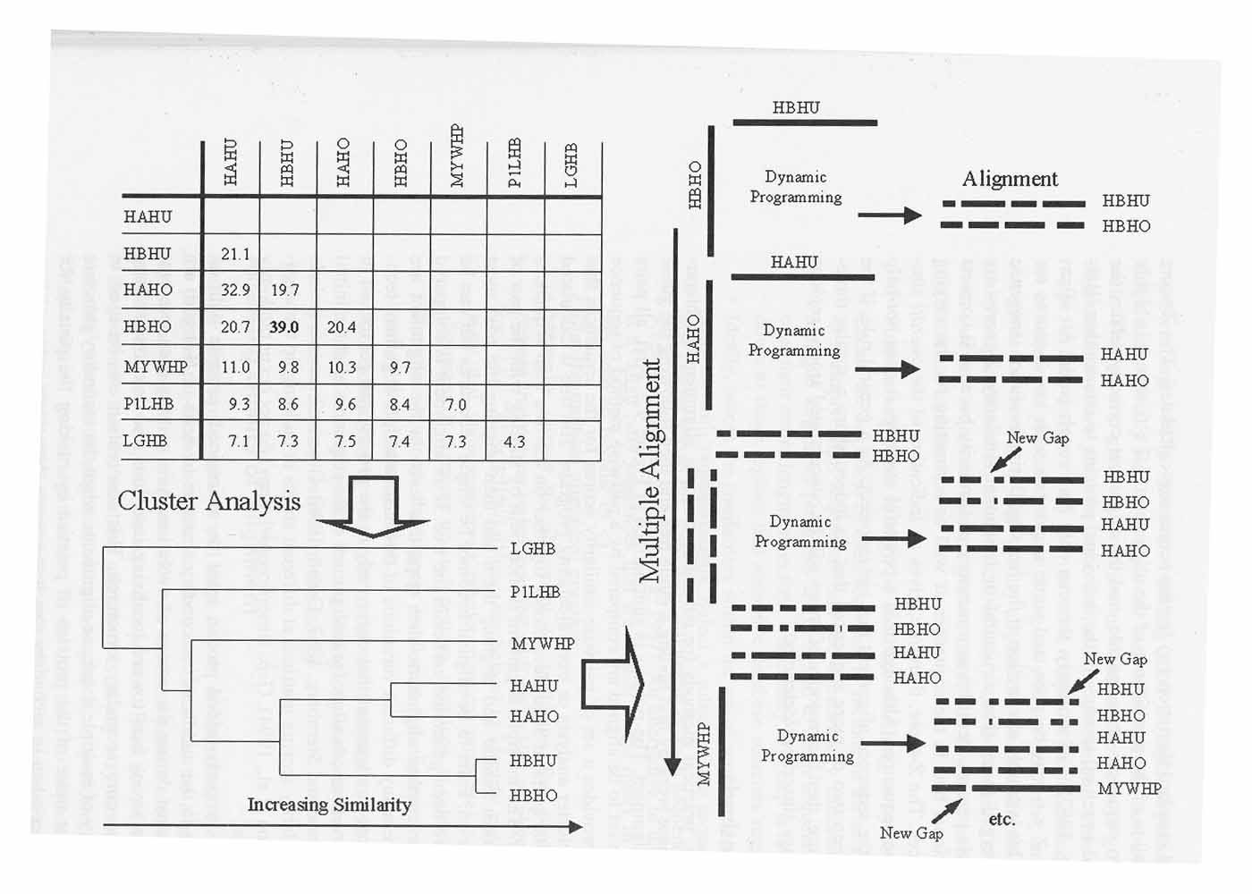
Baxenavis and Oullette, 2001
Notes:
本科生可以讲到此不必讲下面的内容

Slide 15
渐进多序列联配算法提出者
罗素·杜立特（Russell F. Doolittle）（1931-）
Notes:
后续还开发了软件（“ProPack”）。但奇怪的是，这些工具并没有流行起来。相反，同样利用该算法开发的“ClustalW”却流行起来，成为一个主流多序列联配工具。该工具由EMBL团队开发（Thompson et al.，1994）。最初来自爱尔兰一所大学的Desmond Higgins开发了“Clustal”（Higgins and Sharp，1988），后他进入EMBL，与EMBL团队成员一起开发了“ClustalW”。

Slide 16
The steps include: (1) Perform pair-wise alignments of all of the sequences; (2) use the alignment scores to produce a phylogenetic tree (for an explanation of the neighbor-joining method that is used); and (3) align the sequences sequentially, guided by the phylogenetic relationships indicated by the tree.
The initial alignments used to produce the guide tree may be obtained by a fast k-tuple or pattern-finding approach similar to FASTA that is useful for many sequences, or a slower, full dynamic programming method may be used.
An enhanced dynamic programming alignment algorithm (Myers and Miller 1988) is used to obtain optimal alignment scores.

Slide 17
Weighting scheme used by CLUSTALW

Slide 18
The scoring of gaps in a msa has to be performed in a different manner from scoring gaps in a pair-wise alignment. CLUSTALW calculates gaps in a novel way designed to place them between conserved domains.
Pascarella and Argos (1992) aligned sequences of structurally related proteins, the gaps were preferentially found between secondary structural elements. These authors also prepared a table of the observed frequency of gaps next to each amino acid in these regions. CLUSTALW uses the information in this table.

Slide 19
Features of Progressive Multiple Sequence Alignment
Handles the alignment of domains very well
Sequences must match closely enough to obtain global alignment but must not be too alike since alike sequences bias the multiple sequence alignment
The first alignments between the most alike sequences determine the alignment with all of the other sequences

Slide 20
Advantages and disadvantages
The major problem with the progressive alignment method described above is that errors in the initial alignments of the most closely related sequences are propagated to the msa.
For the difficult task of aligning more distantly related sequences, using MAFFT and Bayesian methods such as hidden Markov models (HMMs) may be useful.
For more closely relate sequences, CLUSTALW is designed to provide an adequate alignment of a large number of sequences and provide a very good indication of the domain structure of those sequences.

Slide 21
Iterative methods of multiple sequence alignment
Iterative methods is by repeatedly realigning subgroups of the sequences and then by aligning these subgroups into a global alignment of all of the sequences. The objective is to improve the overall alignment score, such as a sum of pairs score.
Selection of these groups may be based on the ordering of the sequences on a phylogenetic tree predicted in a manner similar to that of progressive alignment, separation of one or two of the sequences from the rest, or a random selection of the groups.

Slide 22
(2) Find and model local multiple alignment
Local multiple alignment and PSSM
Starting without a global multiple sequence alignment

Slide 23
Local alignment of multiple sequences
Object is to find if a set of sequences share one or more common patterns of same length (i.e. pattern or domain finding)
Pattern may be short or may include most of the sequences
Pattern may include substitutions/ may or may not include gaps
Rest of proteins do not align well
Rest of proteins do not align well
Domain that aligns well

Slide 24
Starting from a global multiple sequence alignment
Already have global multiple sequence alignment
Locate a well conserved region
Extract that region from the alignment
Model the local alignment
position-specific scoring matrix (PSSM)
sequence profile
profile hidden Markov model
Notes:
a representation of a local multiple sequence alignment – a PSSM (no gaps), profile (gaps) or HMM (gaps)

Slide 25
An example

Slide 26
Methodology
Consensus
G | T | T | C | A | A
Multiple alignment
Pattern
G | T | T | C | A | A
G | C | T | G | A | A
C | T | T | C | A | C
[AC]-A-[GC]-T-[TC]-[GC]
Profile
5 | 4 | 3 | 2 | 1
. | 0 | 0 | 1 | 0.66 | A
. | 1 | 0 | 0 | 0 | T
. | 0 | 0.66 | 0 | 0.33 | C
. | 0 | 0.33 | 0 | 0 | G
Profile HMM
Sensitivity:
Consensus < pattern < profile
Notes:
HMM找基因章节讲解

Slide 27
Protein domain/family
Most proteins have « modular » structure
Estimation: ~ 3 domains / protein
Domains (conserved sequences or structures) are identified by multiple sequence alignments
Domains can be defined by different methods:
Pattern (regular expression); used for very conserved domains
Consensus seuquence
Profiles (weighted matrices): two-dimensional tables of position specific match-, gap-, and insertion-scores, derived from aligned sequence families; used for less conserved domains
Hidden Markov Model (HMM); probabilistic models; an other method to generate profiles.
Motif : A short conserved region in a protein sequence. Motifs are frequently highly conserved parts of domains.
Notes:
Domain:蛋白质的氨基酸序列中有些在演化过程中最为保守的单元。一个结构域不能再划分为更小的结构域。
Motif:模体，基序。在比结构域更小的层次上，序列上有相似性的一些区域。如coiled-coil、信号肽等。
Profile:轮廓/Profile（分布型）A matrix representation of a conserved region in a multiple sequence alignment that allows for gaps in the alignment. The rows include scores for matching sequential columns of the alignment to a test sequence. The columns include substitution scores for amino acids and gap penalties. See also PSSM.
pattern:模式

Slide 28
Sequence Profile - Definition
Simple Profile is a type of scoring matrix
like a PSSM
has extra rows (or columns) with gap penalties
Profile is aligned with a sequence using the dynamic programming algorithm
Produces an optimal alignment of the profile with the sequence
If high score found, then the alignment is significant
Not used as much as a profile HMM

Slide 29
Protein domain/family database
Contains biologically significant « pattern / profiles/ HMM » formulated in such a way that, with appropriate computional tools, it can rapidly and reliably determine to which known family of proteins (if any) a new sequence belongs to
-> tools to identify what is the function of uncharacterized proteins translated from genomic or cDNA sequences (« functional diagnostic »)

Slide 30
Consensus sequence
W | R | Y | S
 | A | C | M
 | G | T | K
 |  | U
B: not A
D: not C
H: not G
V: not T
A example:
GTRWRYWNNN
N: any
X: unknown

Slide 31
Protein domain/family db
Secondary databases are the fruit of analyses of the sequences found in the primary sequence db
Either manually curated (i.e. PROSITE, Pfam, etc.) or automatically generated (i.e. ProDom, DOMO)
Some depend on the method used to detect if a protein belongs to a particular domain/family (patterns, profiles, HMM, PSI-BLAST)

Slide 32
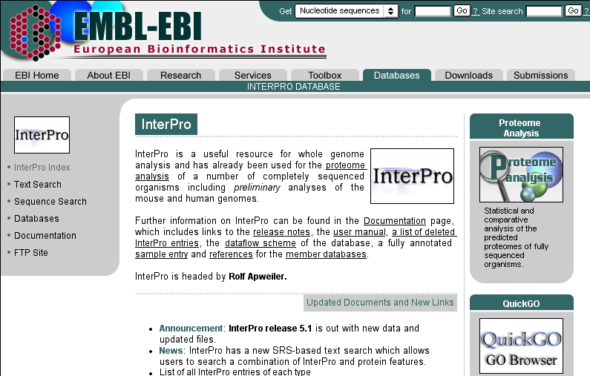
Protein domain/family db
Int
erpro
PROSITE Patterns / Profiles
ProDom Aligned motifs (PSI-BLAST) (Pfam B)
PRINTS Aligned motifs, OWL
Pfam HMM (Hidden Markov Models)
SMART HMM
TIGRfam HMM
DOMO Aligned motifs
BLOCKS Aligned motifs (PSI-BLAST)
CDD(CDART) PSI-BLAST(PSSM) of Pfam and SMART
Notes:
PROSITE,home of regular expressions and profiles;
Pfam, SMART and TIGRFAMs, keepers of hidden markov models(HMMs);
PRINTS, provider of fingerprints (groups of aligned, un-weightedmotifs);
All come from SWISS-PROT
InterPro is a database of protein families, domains and functional sites in which identifiable features found in known proteins can be applied to unknown protein sequences.

Slide 33
Starting without a global multiple sequence alignment
Find common patterns in sequences
simple hash methods
statistical methods
Expectation maximization (EM)
Gibbs sampling
Align the sequences by these patterns
Notes:
hashing:散列法，利用“lookup table”

Slide 34
Tools

Slide 36
Using the expectation maximization (E/M) method to make a PSSM
Two steps: expectation step (1-7) and maximization step (8)
1. Make a random alignment of the sequences by picking a random position in each.
2. Choose an arbitrary pattern width.
3. Make a trial log odds scoring matrix.
Sequences
randomly
aligned
Trial PSSM

Slide 37
4. Slide the trial PSSM along each sequence
5. Measure odds of matching each sequence position.
......100/1 1/25 33/1 1/3 ......
6. Sum the odds scores e.g. 5000 and then calculate the probability that trial PSSM matches each position
e.g. 100/5000 (0.02) 0.04/5000 33/5000 1/15000...
7. Repeat for all of the sequences.

Slide 38
8. Update the table with the information found from scanning the sequences (maximization step).
e.g. suppose that ….
- there are 100 A's in the first column of the original trial alignment
- that a match to sequence 1 was found with a P = 0.1
- that there was an A in the sequence at position 1
A
P of match at this position in sequence = 0.1
100 A's
Add 0.1 A's to count in column 1

Slide 39
9. Update table using all information from scanning all of the sequences, make a new table, scan sequences again....100 times (the expectation and maximization steps are repeated until the estimates of the base frequencies do not change)
10. End result: a PSSM table that represents one alignment
position 1 2 3 4 5 6
A 1.0 0.6 0.6 -3.3 -3.3 1.0
G -3.3 -1.7 -1.7 -3.3 -3.3 -3.3
C -3.3 -3.3 -3.3 2.6 -3.3 -3.3
T 0.7 -3.3 -3.3 -3.3 1.7 1.0

Slide 40
(3) How to evaluate the quality of a PSSM?
How well does the PSSM find matches in a new sequences
- this is equivalent to asking how much information is present in the PSSM?
Calculate the information content of the PSSM
Information content in the scoring matrix reduces uncertainty

Slide 41
Meaning of Uncertainty
Uncertainty is the no. of questions that must be asked to identify the correct choice i.e. the correct base or amino acid in one location of a particular pattern.
Uncertainty is reduced by the information in the scoring matrix
Example1: consider 64 cups in a row with an object hidden under one of them. The goal is to find the object with as few questions as possible. (Answer: uncertainty is six and is zero when the object is found)
1 2 3
G 1.0 0.0 0.25
A 0.0 0.5 0.25
C 0.0 0.0 0.25
T 0.0 0.5 0.25
Example2: How much uncertainty is there for:
column 1, column 2 and column 3?
For DNA sequences, what is the maximum uncertainty there can be? What is the minimum uncertainty?
Notes:
100% is G for column 1 therefore no. of questions is 0;only A or T is possible at column 2 and therefore no of questions is 1;

Slide 42
Information and Probability
I=logN=-logP, P=1/N
(Hartly, 1928)
I = - Σp_{i} log₂(p_{i})
(Shannon, 1948)
Notes:
N:事件可能发生的总数

Slide 43
香农（Claude Elwood Shannon）的一个重要贡献是将不同事件发生概率作为权重重新定义不确定性，即香农信息熵（H）：
H = - Σp_{i} log₂(p_{i})
p_{i}是特定事件i发生的概率

Slide 44
案例1（找杯子）：
找到特定杯子（内有乒乓球）的概率是1/64，所以其不确定性为以2为底的负对数[-log₂(1/64)=6比特]。
案例2（序列联配）：
对于多序列联配结果的某一列仅观察到一个碱基（第一列），则其不确定性或熵值为0，因为没有其他可能性。而对于第二列存在两个等概率的碱基，你必须问一个问题后才能得到答案，这样其熵值为1[-（0.5×log₂0.5+0.5×log₂0.5)=1].

Slide 45
#1 | #2 | #3
G | A | G
G | A | A
G | T | C
G | T | T
案例2（序列联配）：
 | #1 | #2 | #3
G | 1.0 | 0.0 | 0.25
A | 0.0 | 0.5 | 0.25
C | 0.0 | 0.0 | 0.25
T | 0.0 | 0.5 | 0.25
熵值 | 0 | 1 | 2
信息量 | 2 | 1 | 0

Slide 46
列 | A% | C% | G% | T% | 信息量
#1 | 100 | 0 | 0 | 0 | 2
#2 | 95 | 5 | 0 | 0 | 1.71
#3 | 90 | 10 | 0 | 0 | 1.53
#4 | 85 | 5 | 5 | 5 | 1.15
#5 | 80 | 10 | 5 | 5 | 0.98
#6 | 70 | 10 | 10 | 10 | 0.64
#7 | 50 | 50 | 0 | 0 | 1
#8 | 50 | 40 | 5 | 5 | 0.54
#9 | 45 | 45 | 5 | 5 | 0.53
#10 | 50 | 30 | 10 | 10 | 0.31
#11 | 35 | 35 | 15 | 15 | 0.12
#12 | 25 | 25 | 25 | 25 | 0
列由4种不同碱基构成的信息量（IC）

Slide 47
NBS domain_Kinase2 motif
氨基酸 | #1 | #2 | #3 | #4 | #5 | #6 | #7 | #8 | #9
F | 0.80 | 0.20 | 0.00 | 0.00 | 0.00 | 0.00 | 0.00 | 0.00 | 0.00
Y | 0.20 | 0.80 | 0.00 | 0.00 | 0.00 | 0.00 | 0.00 | 0.00 | 0.00
L | 0.00 | 0.00 | 0.20 | 0.20 | 0.40 | 0.00 | 0.00 | 0.00 | 0.00
I | 0.00 | 0.00 | 0.40 | 0.00 | 0.40 | 0.00 | 0.00 | 0.20 | 0.00
V | 0.00 | 0.00 | 0.40 | 0.80 | 0.00 | 0.00 | 0.00 | 0.80 | 0.00
M | 0.00 | 0.00 | 0.00 | 0.00 | 0.20 | 0.00 | 0.00 | 0.00 | 0.00
D | 0.00 | 0.00 | 0.00 | 0.00 | 0.00 | 1.00 | 1.00 | 0.00 | 0.00
W | 0.00 | 0.00 | 0.00 | 0.00 | 0.00 | 0.00 | 0.00 | 0.00 | 1.00
其他 | 0.00 | 0.00 | 0.00 | 0.00 | 0.00 | 0.00 | 0.00 | 0.00 | 0.00
IC | 3.59 | 3.59 | 2.80 | 3.59 | 2.80 | 4.32 | 4.32 | 3.59 | 4.32

Slide 48
Calculating Uncertainty and Information Content for PSSM
Uncertainty (H):
H = f_{G} log₂ (f_{G}) + f_{A} log₂ (f_{A}) +....
In general, the average amount of uncertainty (H_{c} ) in bits per symbol for column c of the PSSM is given by
H_{c} = - Σp_{ic} log₂(p_{ic})
All i
for entire PSSM H = ΣH_{c}
All columns
H is also known as the entropy of the PSSM position in information theory because the higher the value, the greater the uncertainty.
Information content (IC):
IC for column = 2 - H
IC for whole PSSM = sum of columns ICs

Slide 49
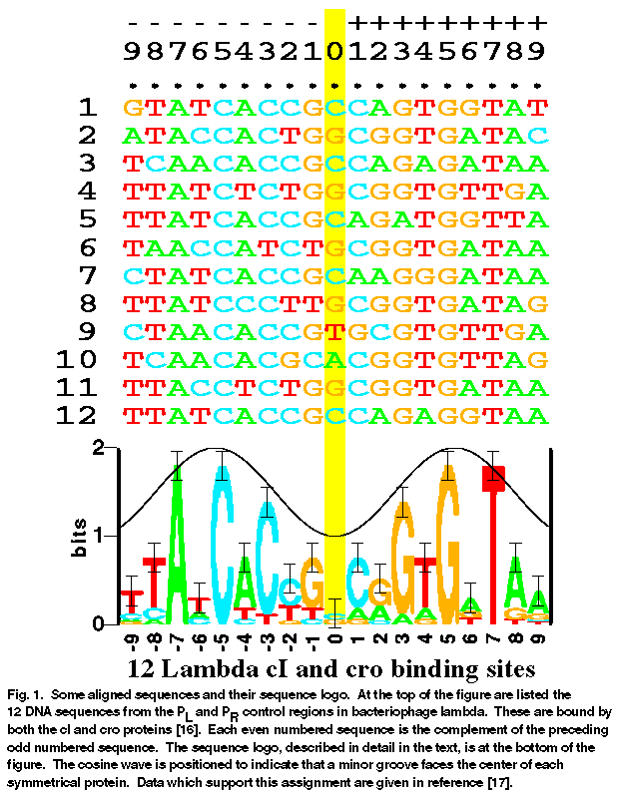
Sequence logos
Notes:
The height of each column represents the amount of information or uncertainty.

