Slide 1
3.3 Database searching for similar sequences
《生物信息学》（第二版）（樊龙江主编，2021）配套PPT3-2
1. Importance of database searches for similar sequences
2. Word or k-tuple methods
3. Assessing the significance of sequence alignments

Slide 2
3.3.1 Importance of database searches for similar sequences
“The massive quantities of data generated by genomic research ... We are swimming in a rapidly rising sea of data...how do we keep from drowning?”
Roos DS. Bioinformatics----Trying to swin in a sea of data. Science, 2001,291(5507):1260-1261
Notes:
One reason is huge data generated by the current biological studies
Another reason is that the databases can provide function clues for your unidentified sequences (next slide)

Slide 3
Doolittle RF, et al. Simian sarcoma virus onc gene, v-sis, is derived from the gene (or genes) encoding a platelet-derived growth factor. Science. 1983 Jul 15;221(4607):275-7
simian sarcoma virus (SSV) oncogene, v-sis
platelet-derived growth factor (PDG)
31AA（26 similar) / 39AA (35 similar)
It appeared likely that the retrovirus had acquired the gene from the host cell as some kind of genetic exchange event and then had produced a mutant form of the protein that could compromise the function of the normal protein when the virus infected another animal
Notes:
Doolittle RF, Hunkapiller MW, Hood LE, Devare SG, Robbins KC, Aaronson SA, Antoniades HN. Simian sarcoma virus onc gene, v-sis, is derived from the gene (or genes) encoding a platelet-derived growth factor. Science. 1983 Jul 15;221(4607):275-7
猿猴simian [‘simi8n] sarcoma[sa’kouma]
684 sequences in 1978 Dayhoff’s database
1\早已证实C型RNA肿瘤病毒或称逆转录病毒是哺乳类动物如小鼠、猫、牛、绵羊和灵长类动物自发性白血病的病因。这种病毒能通过内生的逆转录酶按照RNA顺序合成DNA的复制品，即前病毒，当其插入宿主的染色体DNA中后可诱发恶变。肿瘤病毒携带有病毒源瘤基因（v-onc），大多数脊椎动物（包括人的细胞）基因体内有与v-onc同源的基因称源瘤基因。v-onc被整合入宿主细胞的基因体内后可使邻近的基因发生恶变。逆转录病毒的感染也可致源瘤基因激活，成为恶性转变的基因，导致靶细胞恶变。进入体内的病毒基因即使不含有v-onc，如果改变了基因的正常功能，也有可能引起白血病。人类白血病的病毒病因研究已有数十年历史，但至今只有成人T细胞白血病肯定是由病毒引起的。
2\医学理论--第二十二章 癌基因与抑癌基因 ... 不难看出，v-onc原本不是病毒的基因，而是动物细胞正常基因的一个复本。 当病毒在宿主细胞内复制时，由于DNA重组而将宿主细胞基因中带有v-onc的序 列重组到病毒的基因组内。所以说c-onc是v-onc原型，又称为原癌基因（proto ...

Slide 5
Uses of Similarity Searches
Find orthologous proteins sequences in different organisms (ortho = same function)
Find paralogous sequences in same organism (para=originate from gene duplication
Align genomic sequences and expressed gene sequences (cDNAs, ESTs) to locate gene and ORFs in gene.
Mount D, 2002

Slide 6
Difficulties in Similarity Searching and Solutions
Slowness of dynamic programming alignment algorithm - use a word search, heuristic method (nearly always works but is not a guaranteed algorithm).
Low complexity regions in sequences give false high scores - filter out these regions in the query sequence
How good is the match? - Produce an optimal local alignment
How significant is the alignment score? - Provide an expect score (E value) for finding a match with an unrelated sequence in searching a sequence database of the same size
Mount D, 2002
Notes:
two methods (BLAST AND FASTA) that are at least 50 times faster than dynamic programming were developed

Slide 7
3.3.2 Word or k-tuple methods
Used by the FASTA and BLAST programs
They align two sequences very quickly, by first searching for identical short stretches of sequences (called words or k-tuples) and by then joining these words into an alignment by the dynamic programming method.
They are heuristic methods, reliable in a statistical sense, and usually provide a reliable alignment.
Heuristic methods: an empirical method of computer programming in which rules of thumb are used to find solutions and feedback is used to improve performance.

Slide 8
Wilbur WJ and Lipman DJ. 1983. Rapid similarity searches of nucleic acid and protein data banks. PNAS, 80:726-730
Heuristic method for sequence alignment is used to try to find a reasonable alignment. An example of a heuristic alignment method is starting with a search for similar sequence patterns and then building a longer alignment based on these patterns.
Rather than comparing individual residues in the two sequences, FASTA and BLAST search for matching sequence patterns or words (Wilbur and Lipman, 1983). The programs then attempts to build a local alignment based on these word matches.

Slide 9
Methods of Similarity Searching
FASTA (fast alignment) and BLAST (basic local alignment search tool) algorithms
PSI-BLAST (position-specific-iterated) and PHI-BLAST(pattern-hit-iterated)
MAST and MetaMEME on MEME server: search with PSSMs or HMMs representing domains
Mount D, 2002
Notes:
算法是一个定义良好并会终止的计算过程，是一种求解问题的工具。simultaneously

Slide 10
FASTA & BLAST story

Slide 11
FASTA
BLAST
威廉·皮尔森（William R. Pearson）
大卫·利普曼（David Lipman）
斯蒂芬·阿尔舒尔（Stephen Altschul）

Slide 12
FASTA
Algorithm
k-tuple 1-2 for amino acid and 4-6 for nucleotide
Notes:
INIT1 score (the best initial regions)
INITN score
OPT score

Slide 13
BLAST
BLAST(Basic Local Alignment Search Tool) (Altschul et al 1990), a heuristic method designed to detect alignments that optimize a measure of local similarity known as the maximal segment pair (MSP) score.
Word length: 11 (DNA sequences) and 3 (protein)
Word index
High-scoring segment pairs (HSP)

Slide 14
BLAST1 algorithm

Slide 17
Ungapped extension of hits

Slide 18
Ungappedand gapped extensions

Slide 19
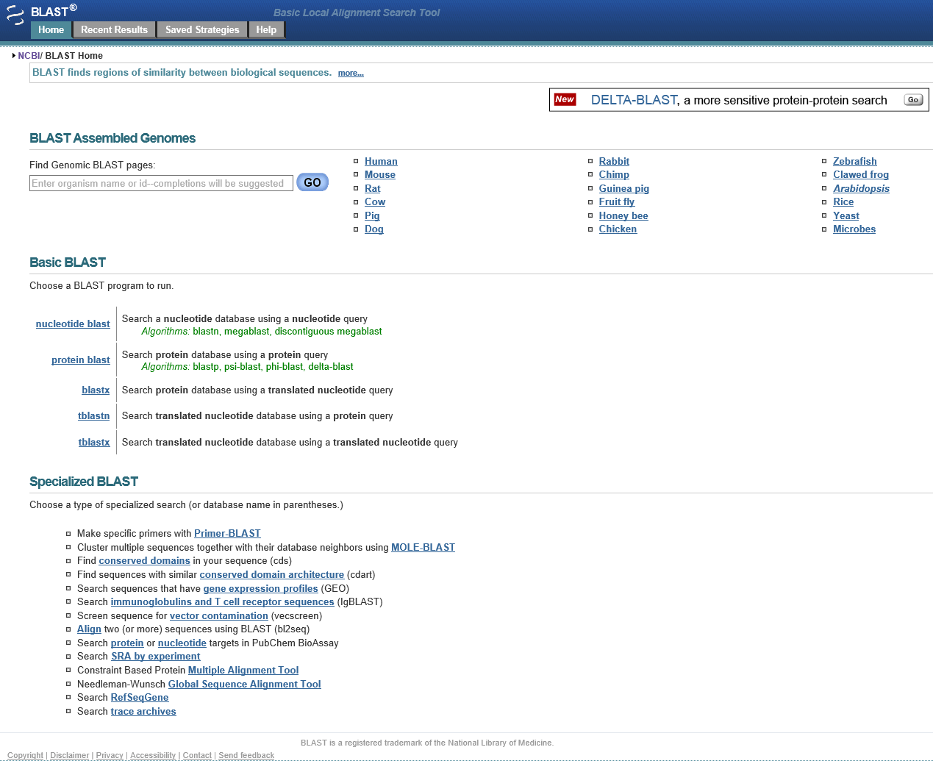
2014-12-02

Slide 20
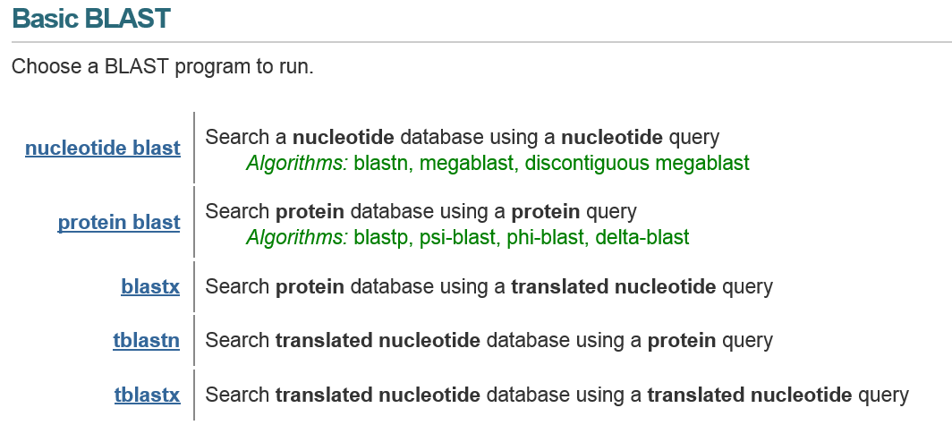

Slide 21
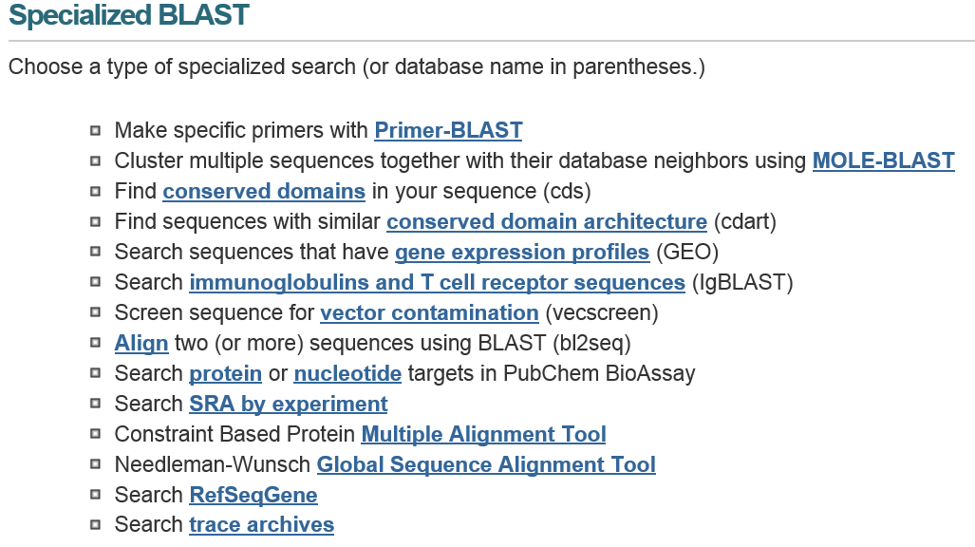

Slide 22
BLASTall
Query Sequence
Amino acid Sequence
DNA Sequence
BLASTp
tBLASTn
BLASTn
BLASTx
tBLASTx
Translated
Translated
Protein Database
Nucleotide Database

Slide 23
BLASTall
Query Sequence
Amino acid Sequence
DNA Sequence
PSI-BLAST
PHI-BLAST
DELTA-BLAST
MOLE-BLAST
Primer-BLAST
……
megaBLAST
lgBLAST
……
BLASTp
tBLASTn
BLASTn
BLASTx
tBLASTx
Translated
Translated
Protein Database
Nucleotide Database

Slide 24
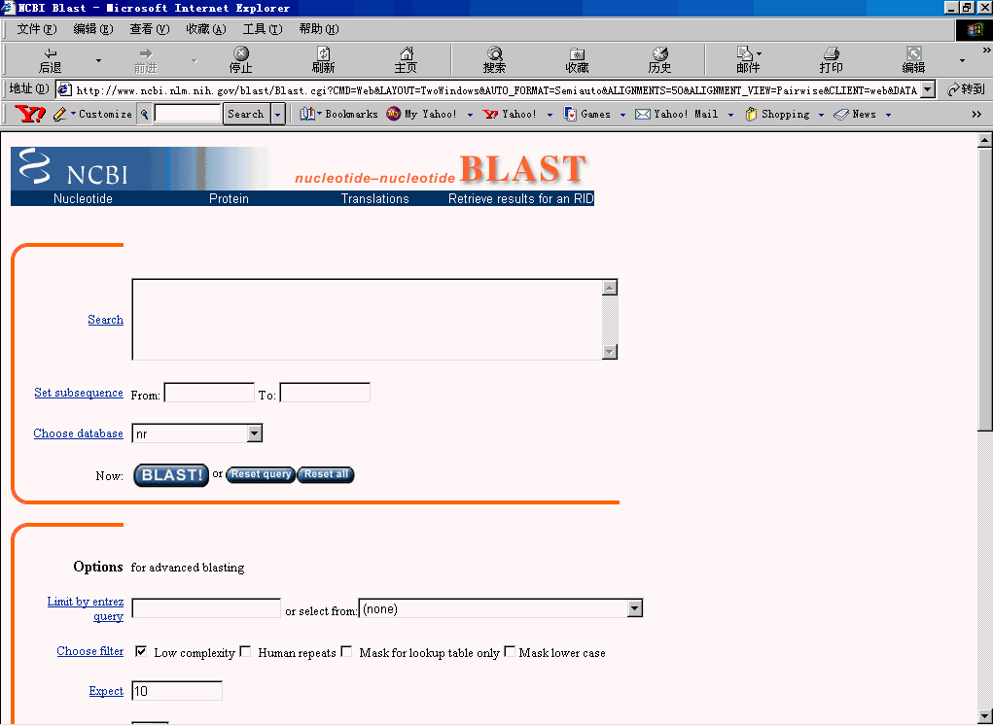
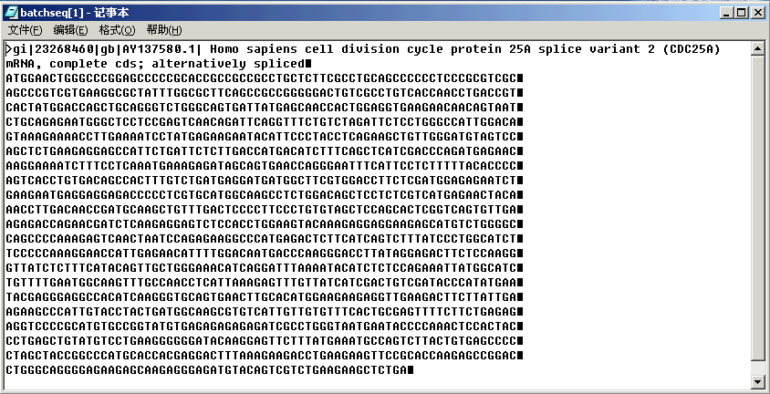
Web-based BLAST Input

Slide 25
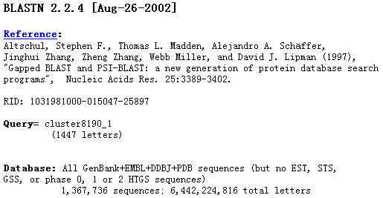
Web-based BLAST Output
i. Overview of Query

Slide 26
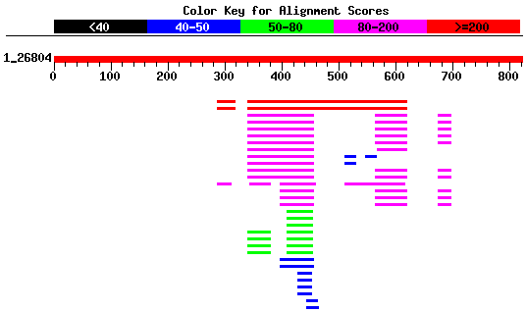
Web-based BLAST Output
ii. Graphical overview of database matches

Slide 27
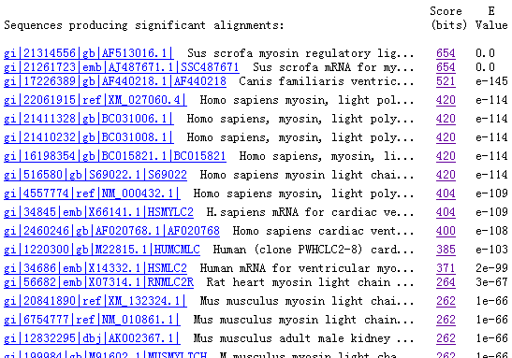
Web-based BLAST Output
iii. Descriptions of each hit (alignment)

Slide 28
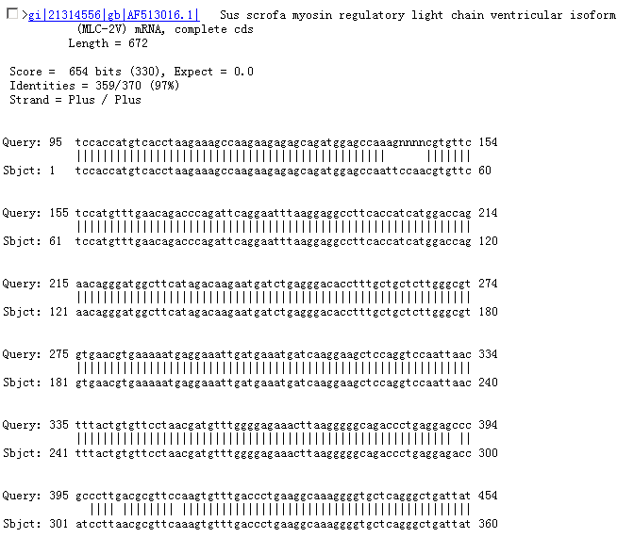
Web-based BLAST Output
iv. Pairewise alignments

Slide 29
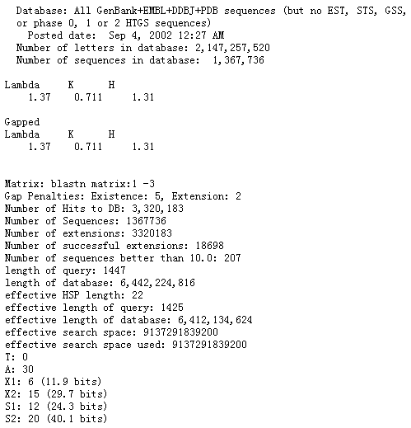
Web-based BLAST Output
v. Statistical details of the search

Slide 30
Local BLAST
On Windows PC：
(1) Download from NCBI and install
(2) Configuration: using the ncbi.ini file
[NCBI]
Data="C:\path\data\“
(3) Create or format your databases
Notes:
BLAST setup: procedures on windows PC at
http://www.ncbi.nlm.nih.gov/staff/tao/URLAPI/pc_setup.html

Slide 31
3.3.3 Assessing the significance of sequence alignments

Slide 32
The Gumbel Extreme Value Distribution : distribution of scores expected by aligning two random sequences of the same length and composition follow a distribution called the extreme value distribution (Gumbel EJ, 1962).

Slide 33
Notes:
74019条序列计算

Slide 34
Gaussian and extreme value density functions

Slide 35
The extreme value distribution
The normal distribution
Notes:
Probability density function/probability distribution
概率密度函数
Exp: where e is the natural exponential 2.71828

Slide 36
The probability that score S will be less than value x, P ( S <x ), is obtained by calculating the area under curve from - to x
∞
P-value: probability that there is at least one random MSP having score S or greater
Notes:
Negative infinity

Slide 37
E-value: the number of HSPs having score S (or higher) expected to occur only by chance
E-value is given by the formula:
Notes:
For example, if one expects to find three HSPs with score >=s is 0.93, the probability of finding at least one is 0.95. The BLAST programs report E-value rather than P-values because it is easier to understand the difference between, for example, E-value of 5 and 10 than P-values of 0.993 and 0.9995. However, when E< 0.01, P-values and E-values are nearly identical.

Slide 38
The Gumbel extreme value distribution
P(s≧x)=
1-exp[-e^{-λ(x-μ)}]
λ =
μ =
=(lnKmn)/λ
P(s≧x)=
≈Kmne^{-λs}

Slide 40
By normalizing a raw score using the formula
Notes:
可不讲！
？另一标准化：S’=lamda*s-lnk

Slide 41
BLAST Karlin-Altschul statistics
Karlin-Altschul statistics
Params | Ungapped | Gapped
Lambda | 1.33271 | 1.28
K | 0.620991 | 0.46
H | 1.12409 | 0.85

Slide 42
About H parameter
SEE ppt PDF file (Blast-informationContent-2011)

Slide 43
BLAST高级技巧

Slide 44
2014-12-02

Slide 45
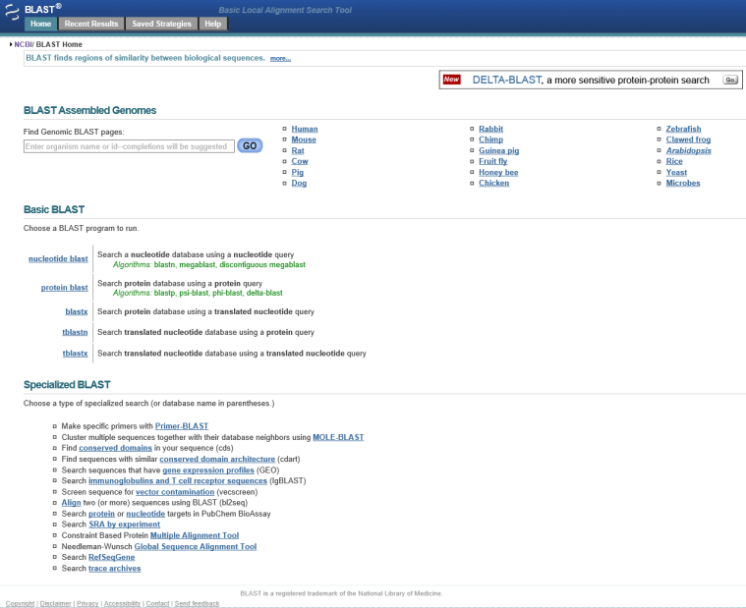
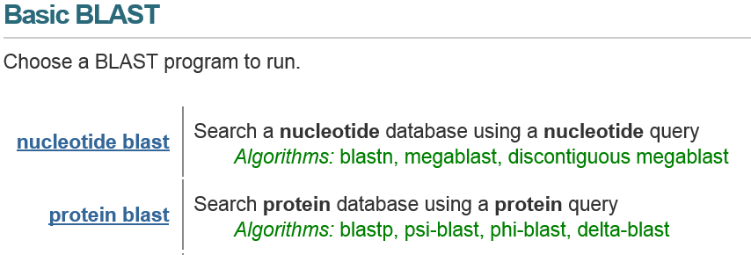

Slide 46
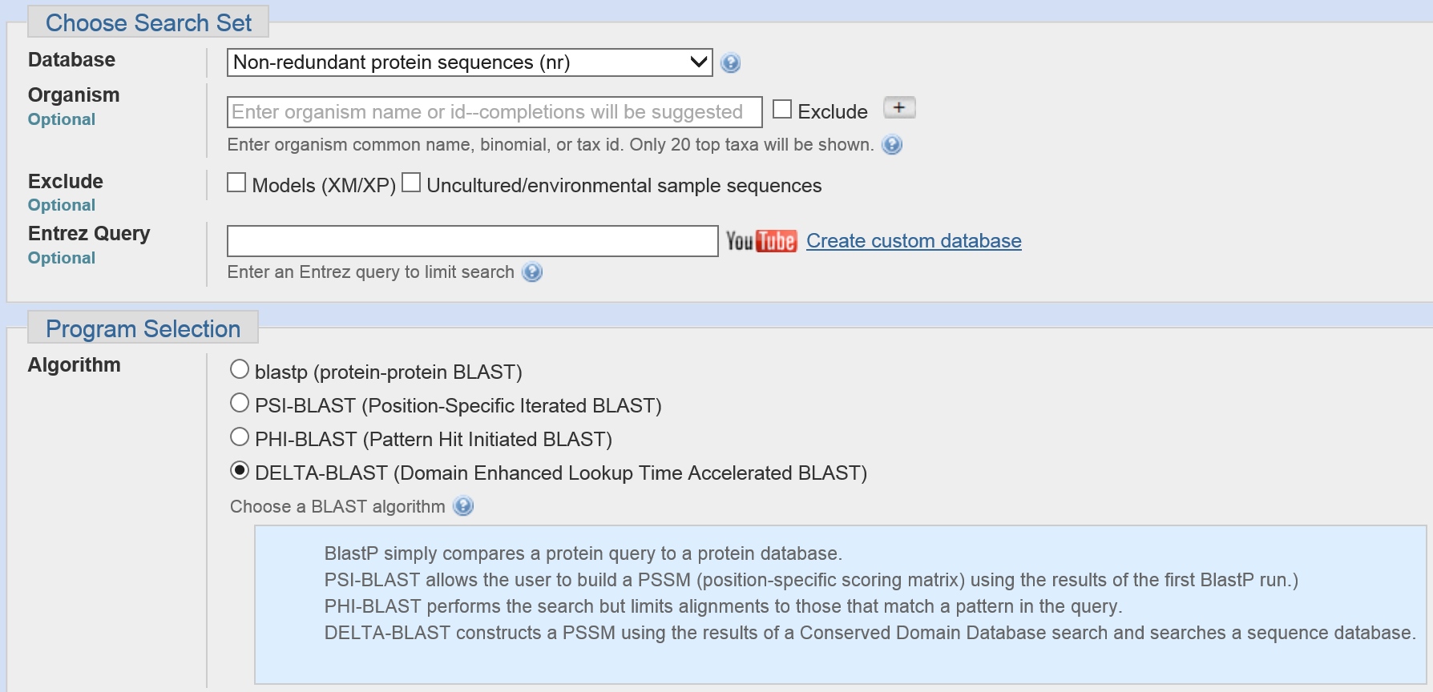
Protein sequence BLAST

Slide 47
Beyond sequences: database searching using scoring matrices, profiles and PSSMs
Previously used a single sequence to search a sequence database to locate similar sequences
Now interested in searching a database with a representation of a local multiple sequence alignment – a PSSM (no gaps), profile (gaps) or HMM (gaps)
Can also search a sequence for matches to a database of models in the form of PSSMs, profiles or HMMs (e.g. the Pfam database)
PSSM: position-specific scoring matrix; HMM: Hidden Markov Models

Slide 48
Searching a database with a PSSM or HMM
Recall that the PSSM is a matrix of scores with the columns representing positions in a local multiple sequence alignment and the rows the 20 amino acids
Database
sequence
Position 1, 2, 3…
A
C
D
…
PSSM or profile
Is there a high scoring region?
Similarly, an HMM is a probabilistic model of a multiple sequence alignment.
…
Is there a high scoring region?

Slide 49
PSI-BLAST
PSI–Blast is position-specific-iterated-blast
Generates a PSSM from the matched sequences in a BLAST search – it uses the entire sequence
Query sequence
Blast database
Caution!
Can switch domains
Matched sequences
Iterations
Add more sequences to PSSM
PSSM

Slide 51
MOLE-BLAST is a tool that helps taxonomists find closest database neighbors of submitted query sequences. It computes a multiple sequence alignment (MSA) between the query sequences along with their top BLAST database hits, and generates a phylogenetic tree. Query sequences in the tree are denoted with highlighted node labels. If the input sequences come from different genes or loci, MOLE-BLAST can cluster them and compute an MSA and a phylogenetic tree for each locus separately.

Slide 52
PHI-BLAST: regular expressions
Regular expressions provide a wide range of pattern finding options e.g. [LIVMF]-G-E-x (5,11)-[IV]
implemented in the prosite catalog and used in phi-blast
Prosite entry for ATP/GTP binding site motif A (P loop) is [AG] – x(4)-G-K-[ST]
In phi-blast, a regular expression is provided – database is searched for sequences with pattern, and then psi-blast used to expand search

Slide 53
Using a local alignment to make a PSSM
PSSM: position-specific scoring matrix
Alignment
AGGCTT
AAGCTA
AAACTT
TAACTA
AGACTT
Column/position
I II III IV V VI Sum
A 4 3 3 0 0 2 12
G 0 2 2 0 0 0 4
C 0 0 0 5 0 0 5
T 1 0 0 0 5 3 9
Column/position
I II III IV V VI Sum
A 0.8 0.6 0.6 0.0 0.0 0.4 0.4
G 0.0 0.4 0.4 0.0 0.0 0.0 0.13
C 0.0 0.0 0.0 1.0 0.0 0.0 0.17
T 0.2 0.0 0.0 0.0 1.0 0.6 0.3
Fraction of base in each column

Slide 54
Column/position Sum Bdg
I II III IV V VI freq
A 2.0 1.5 1.5 0.0 0.0 1.0 12 0.40
G 0.0 0.3 0.3 0.0 0.0 0.0 4 0.13
C 0.0 0.0 0.0 5.9 0.0 0.0 5 0.17
T 0.7 0.0 0.0 0.0 3.3 2.0 9 0.30
sum 30 1.00
Fraction divided by background frequency
A 1.0 0.6 0.6 -3.3 -3.3 1.0
G -3.3 -1.7 -1.7 -3.3 -3.3 -3.3
C -3.3 -3.3 -3.3 2.6 -3.3 -3.3
T 0.7 -3.3 -3.3 -3.3 1.7 1.0
Convert to log to base 2
A PSSM
(POSITION SPECIFIC SCORING MATRIX)
Notes:
use statistical guess for zeros (see Mount, page 360)
Regularization：pseudocounts or Dirichlet mixtures (blend in background frequencies), see Hunter’s ppt

Slide 55
Aligning the new scoring matrix with a new sequence provides a log odds alignment score
New sequence ... A G A C T A ...
Log odds matrix or PSSM
A 1.0 0.6 0.6 -3.3 -3.3 1.0
G -3.3 -1.7 -1.7 -3.3 -3.3 -3.3
C -3.3 -3.3 -3.3 2.6 -3.3 -3.3
T 0.7 -3.3 -3.3 -3.3 1.7 1.0
Conclusion:
Log odds score at this sequence position = 5.2
Odds score = 2 ^{5.2} = 37/1 in favor of not being a random match

Slide 56
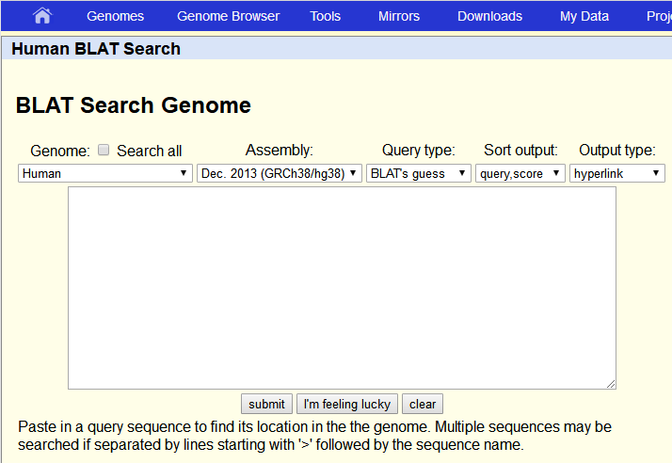
其他搜索工具

Slide 57
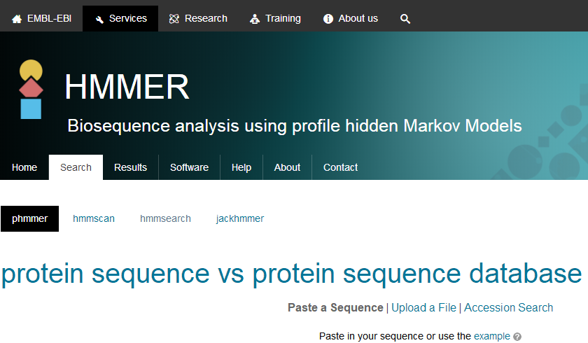
其他搜索工具

