Slide 1
Collect and store sequences
《生物信息学》（第二版）（樊龙江主编，2021）配套PPT2
» Collect sequences
»» Store sequences
»»» Use sequences

Slide 2
» Collect sequences
How to collect sequences?
DNA sequencing by the Sanger method
ABI3730: 700-900bp per read
DNA sequencing by the high-throughput approaches
Illumina Geome Analyzer Ⅱ System/ HiSeq 2000
Applied Biosystems SOLID System
454/Roche GS FLX
……
DNA sequencing by chip
Genotyping using Illumina technologies

Slide 3
Genome sequencing by the high-throuphput approaches
Whole genome sequencing
Genome re-sequencing: low coverage and deep sequencing
Extome sequencing
cDNA sequencing of expressed genes by the Sanger and the high-throughput approaches
EST
RNA-Seq
ChIP-Seq (protein-DNA interaction)
RNA sequencing by the high-throughput approaches
Non-coding small RNAs
Protein sequencing by mass spectrometry (MS) etc.
Notes:
自从1967年Edman本人推出的第一台自动测序仪来，蛋白质经历了液相测序仪——固相测序仪——气相测序仪的发展历程
MS: mass spectrum

Slide 4
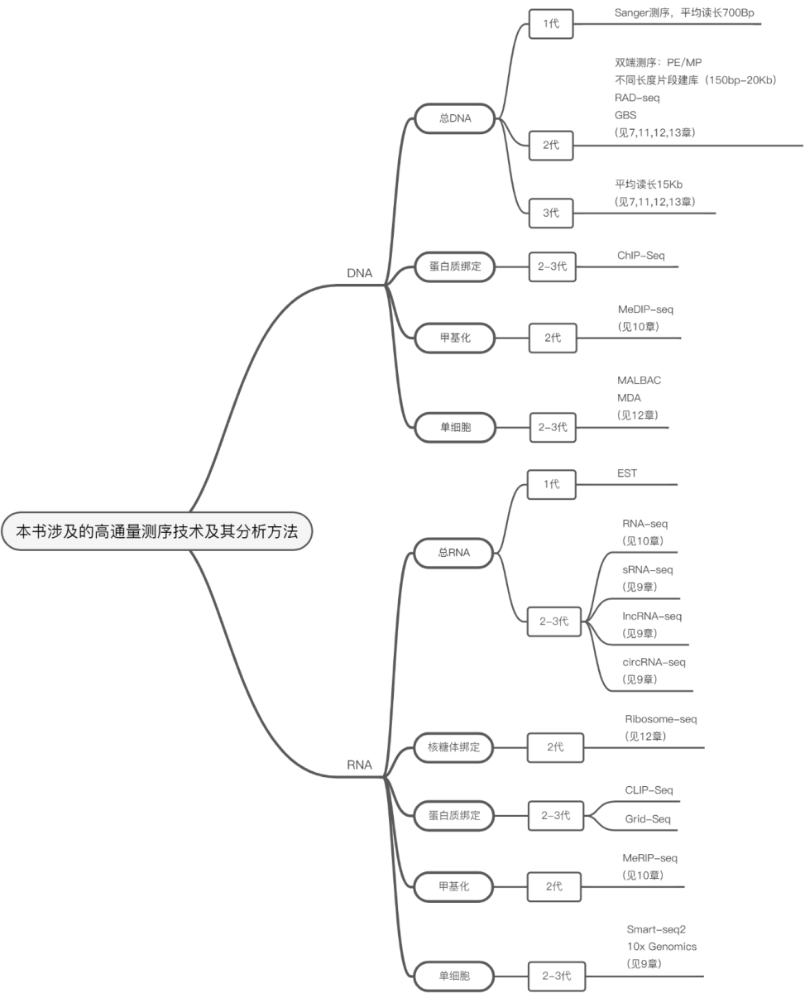

Slide 5
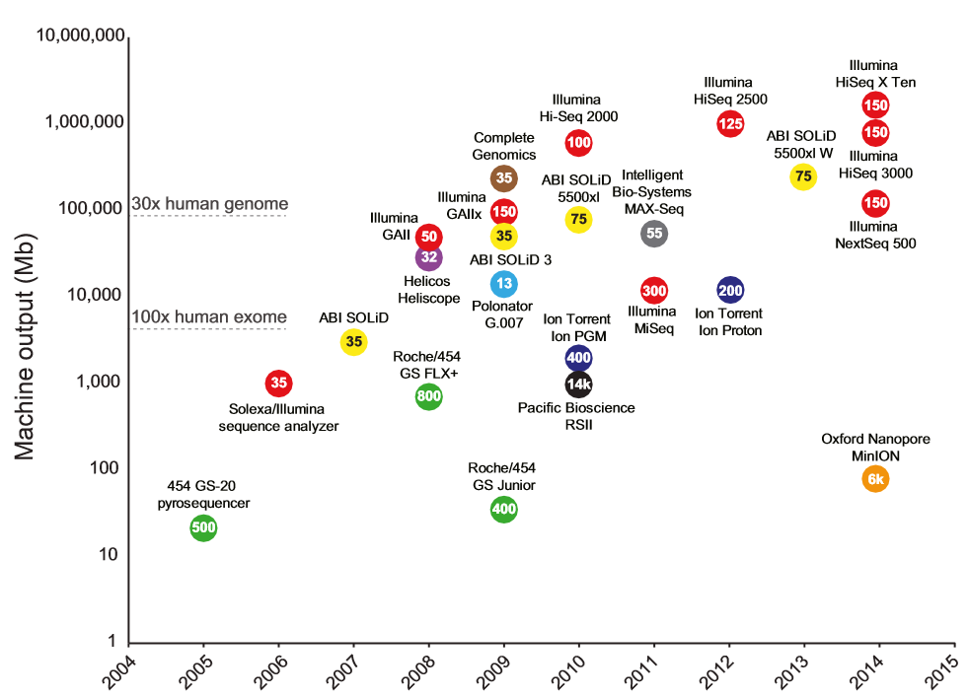
图1-1.3 高通量测序技术出现年代及其测序通量
（引自Router等，2015）

Slide 6
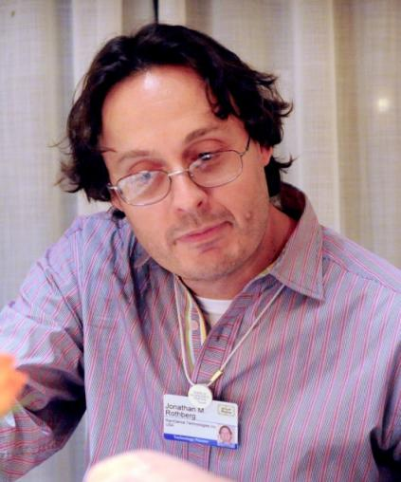
第一台高通量测序仪（454）发明人
乔纳森·马克·罗斯伯格（Jonathan Marc Rothberg）（1963-）

Slide 7
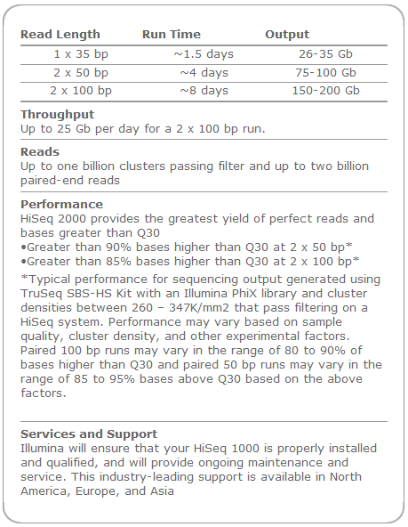
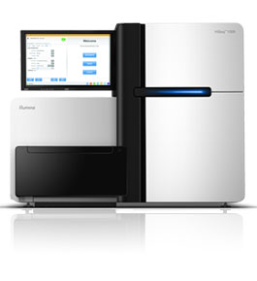
Illumina: the sequencing-by-synthesis (SBS)
www.illumina.com

Slide 8
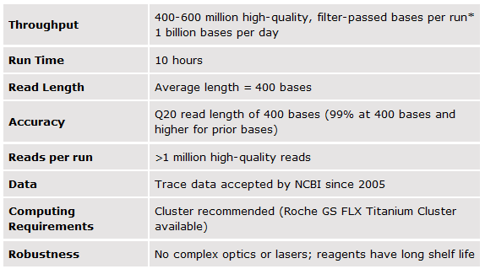
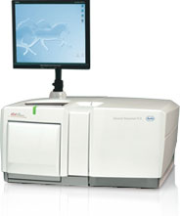
454: pyrosequencing
http://454.com

Slide 9
Comparison of three approaches
Iterm
454
Illumina
SOLiD
Paired end separation
3 kb
up to 10kb
3 kb
Read length (update)‏
250 bp (400)‏
35, 75 and 100 bp
35 and 50 bp
Cost per Mb
$ 84.39
$ 5.97
$ 5.81
Time per paired end run
7 hours
4 days
5 days

Slide 10
Sequence accuracy varies
The higher the level of accuracy required in DNA sequences, the more time-consuming and expensive the procedure
The first-pass sequences
EST
GSS
HTG
Raw reads
GenBank does permit submission of raw sequence data that have a high error rate
An error rate as high as 1 in 100

Slide 11
Brief relationship between sequencing error rate and sequencing quality
Sequencing error rate | Sequencing quality value | Character
5% | Q13 | M
1% | Q20 | T
0.1% | Q30 | ^

Slide 12
Submitting sequences to the databases is easy
The International Nucleotide Sequence Database Collaboration
GenBank
EMBL
DDBJ
A database accession number is required to publish the sequence
BankIt: an easy-to-use program with graphic interface for sequence submissions

Slide 13
»» Store sequences…
2.1 Database : nucleotide sequences
2.2 Database : protein sequences
2.3 Databases : ‘genomics’
2.4 Databases : mutation/polymorphism
2.5 Database : protein domain/family
2.6 Databases : proteomics
2.7 Databases : 3D structure
2.8 Databases : metabolic
2.9 Databases : bibliographic
2.10 Databases : others
From Amos Bairoch, et al . SIB, 2002

Slide 14
Some databases in the field of molecular biology…
AATDB, AceDb, ACUTS, ADB, AFDB, AGIS, AMSdb,
ARR, AsDb, BBDB, BCGD, Beanref, Biolmage,
BioMagResBank, BIOMDB, BLOCKS, BovGBASE,
BOVMAP, BSORF, BTKbase, CANSITE, CarbBank,
CARBHYD, CATH, CAZY, CCDC, CD4OLbase, CGAP,
ChickGBASE, Colibri, COPE, CottonDB, CSNDB, CUTG,
CyanoBase, dbCFC, dbEST, dbSTS, DDBJ, DGP, DictyDb,
Picty_cDB, DIP, DOGS, DOMO, DPD, DPlnteract, ECDC,
ECGC, EC02DBASE, EcoCyc, EcoGene, EMBL, EMD db,
ENZYME, EPD, EpoDB, ESTHER, FlyBase, FlyView,
GCRDB, GDB, GENATLAS, Genbank, GeneCards,
Genline, GenLink, GENOTK, GenProtEC, GIFTS,
GPCRDB, GRAP, GRBase, gRNAsdb, GRR, GSDB,
HAEMB, HAMSTERS, HEART-2DPAGE, HEXAdb, HGMD,
HIDB, HIDC, HlVdb, HotMolecBase, HOVERGEN, HPDB,
HSC-2DPAGE, ICN, ICTVDB, IL2RGbase, IMGT, Kabat,
KDNA, KEGG, Klotho, LGIC, MAD, MaizeDb, MDB,
Medline, Mendel, MEROPS, MGDB, MGI, MHCPEP5
Micado, MitoDat, MITOMAP, MJDB, MmtDB, Mol-R-Us,
MPDB, MRR, MutBase, MycDB, NDB, NRSub, 0-lycBase,
OMIA, OMIM, OPD, ORDB, OWL, PAHdb, PatBase, PDB,
PDD, Pfam, PhosphoBase, PigBASE, PIR, PKR, PMD,
PPDB, PRESAGE, PRINTS, ProDom, Prolysis, PROSITE,
PROTOMAP, RatMAP, RDP, REBASE, RGP, SBASE,
SCOP, SeqAnaiRef, SGD, SGP, SheepMap, Soybase,
SPAD, SRNA db, SRPDB, STACK, StyGene,Sub2D,
SubtiList, SWISS-2DPAGE, SWISS-3DIMAGE, SWISS-
MODEL Repository, SWISS-PROT, TelDB, TGN, tmRDB,
TOPS, TRANSFAC, TRR, UniGene, URNADB, V BASE,
VDRR, VectorDB, WDCM, WIT, WormPep, YEPD, YPD,
YPM, etc .................. !!!!
PlantcircBase, 2017
RiceRelativesDB, 2019
PlantscRNAdb, 2021

Slide 15
What is a database ?
A collection of
structured
searchable (index) -> table of contents
updated periodically (release) -> new edition
cross-referenced (hyperlinks) -> links with other db
data
Includes also associated tools (software) necessary for db access, db updating, db information insertion, db information deletion….
Data storage management: flat files, relational databases…

Slide 16
Why biological databases ?
Exponential growth in biological data.
Data (genomic sequences, 3D structures, 2D gel analysis, MS analysis, Microarrays….) are no longer published in a conventional manner, but directly submitted to databases.
Essential tools for biological research.

Slide 17
Some statistics
More than 1000 different ‘biological’ databases
Variable size: <100Kb to >10Gb
DNA: > 10 Gb
Protein: 1 Gb
3D structure: 5 Gb
Other: smaller
Update frequency: daily to annually
Usually accessible through the web (free !?)
Fan’s links: http://ibi.zju.edu.cn/bioinplant
Biohunt: http://www.expasy.org/BioHunt/
Google: http://www.google.com/

Slide 18
Categories of databases for Life Sciences
Sequences (DNA, protein)
Genomics
Mutation/polymorphism
Protein domain/family (----> tools)
Proteomics (2D gel, Mass Spectrometry)
3D structure
Metabolism
Bibliography
‘Others’ (Microarrays,…)

Slide 19
Sequences are stored using specified formats
Ideal minimal content of a « sequence » db
Sequences !!
Accession number (AC)
Taxonomic data
References
ANNOTATION/CURATION
Keywords
Cross-references
Documentation

Slide 20
Sequence Databases: some « technical » definitions
Data storage management:
flat file: text file
relational (e.g., Oracle, Postgres)
object oriented (rare in biological field)
Flat file format:
fasta
GCG
NBRF/PIR
MSF….
standardized format ?

Slide 21
One sequence format can be converted to another
READSEQ Online server in IBI, ZJU
SEQIO for UNIX machines

Slide 22
Examples of entries
A gene sequence
AF440696 Arabidopsis thaliana disease resistance protein RPP4 (RPP4) gene, complete cds
A genome or chromosome
NC_002578 Thermoplasma acidophilum, complete genome;
NC_003070 Arabidopsis thaliana chromosome 1, complete sequence
A protein structure
1C7K Crystal Structure Of The Zinc Protease

Slide 23
Sequence database : example
SWISS-PROT (flat file)
Accession number
ID EPO_HUMAN STANDARD; PRT; 193 AA.
AC P01588; Q9UHA0; Q9UEZ5; Q9UDZ0;
DT 21-JUL-1986 (Rel. 01, Created)
DT 21-JUL-1986 (Rel. 01, Last sequence update)
DT 20-AUG-2001 (Rel. 40, Last annotation update)
DE Erythropoietin precursor.
GN EPO.
OS Homo sapiens (Human).
OC Eukaryota; Metazoa; Chordata; Craniata; Vertebrata; Euteleostomi;
OC Mammalia; Eutheria; Primates; Catarrhini; Hominidae; Homo.
OX NCBI_TaxID=9606;
RN [1]
RP SEQUENCE FROM N.A.
RX MEDLINE=85137899; PubMed=3838366;
RA Jacobs K., Shoemaker C., Rudersdorf R., Neill S.D., Kaufman R.J.,
RA Mufson A., Seehra J., Jones S.S., Hewick R., Fritsch E.F.,
RA Kawakita M., Shimizu T., Miyake T.;
RT "Isolation and characterization of genomic and cDNA clones of human
RT erythropoietin.";
RL Nature 313:806-810(1985).
….
CC -!- FUNCTION: ERYTHROPOIETIN IS THE PRINCIPAL HORMONE INVOLVED IN THE
CC REGULATION OF ERYTHROCYTE DIFFERENTIATION AND THE MAINTENANCE OF A
CC PHYSIOLOGICAL LEVEL OF CIRCULATING ERYTHROCYTE MASS.
CC -!- SUBCELLULAR LOCATION: SECRETED.
CC -!- TISSUE SPECIFICITY: PRODUCED BY KIDNEY OR LIVER OF ADULT MAMMALS
CC AND BY LIVER OF FETAL OR NEONATAL MAMMALS.
CC -!- PHARMACEUTICAL: Available under the names Epogen (Amgen) and
CC Procrit (Ortho Biotech).
…
DR EMBL; X02158; CAA26095.1; -.
DR EMBL; X02157; CAA26094.1; -.
DR EMBL; M11319; AAA52400.1; -.
DR EMBL; AF053356; AAC78791.1; -.
DR EMBL; AF202308; AAF23132.1; -.
DR EMBL; AF202306; AAF23132.1; JOINED.
….
KW Erythrocyte maturation; Glycoprotein; Hormone; Signal; Pharmaceutical.
Taxonomy
Reference
Annotations
(comments)
Cross-references
Keywords

Slide 24
Sequence database: example (cont.)
FT SIGNAL 1 27
FT CHAIN 28 193 ERYTHROPOIETIN.
FT PROPEP 190 193 MAY BE REMOVED IN PROCESSED PROTEIN.
FT DISULFID 34 188
FT DISULFID 56 60
FT CARBOHYD 51 51 N-LINKED (GLCNAC...).
FT CARBOHYD 65 65 N-LINKED (GLCNAC...).
FT CARBOHYD 110 110 N-LINKED (GLCNAC...).
FT CARBOHYD 153 153 O-LINKED (GALNAC...).
FT VARIANT 131 132 SL -> NF (IN AN HEPATOCELLULAR
FT CARCINOMA).
FT /FTId=VAR_009870.
FT VARIANT 149 149 P -> Q (IN AN HEPATOCELLULAR CARCINOMA).
FT /FTId=VAR_009871.
FT CONFLICT 40 40 E -> Q (IN REF. 1; CAA26095).
FT CONFLICT 85 85 Q -> QQ (IN REF. 5).
FT CONFLICT 140 140 G -> R (IN REF. 1; CAA26095).
**
** ################# INTERNAL SECTION ##################
**CL 7q22;
SQ SEQUENCE 193 AA; 21306 MW; C91F0E4C26A52033 CRC64;
MGVHECPAWL WLLLSLLSLP LGLPVLGAPP RLICDSRVLE RYLLEAKEAE NITTGCAEHC
SLNENITVPD TKVNFYAWKR MEVGQQAVEV WQGLALLSEA VLRGQALLVN SSQPWEPLQL
HVDKAVSGLR SLTTLLRALG AQKEAISPPD AASAAPLRTI TADTFRKLFR VYSNFLRGKL
KLYTGEACRT GDR
//
Annotations
(features)
Sequence

Slide 25
Sequence database: example
…a SWISS-PROT entry, in fasta/Pearson format:
>sp|P01588|EPO_HUMAN ERYTHROPOIETIN PRECURSOR - Homo sapiens (Human).
MGVHECPAWLWLLLSLLSLPLGLPVLGAPPRLICDSRVLERYLLEAKEAE
NITTGCAEHCSLNENITVPDTKVNFYAWKRMEVGQQAVEVWQGLALLSEA
VLRGQALLVNSSQPWEPLQLHVDKAVSGLRSLTTLLRALGAQKEAISPPD
AASAAPLRTITADTFRKLFRVYSNFLRGKLKLYTGEACRTGDR

Slide 26
Summary
生物信息学涉及的数据库可大致分为二种：初级数据库(Primary databases)和二级数据库(Secondary databases )。初级数据库贮存原始的生物数据，如DNA序列，由晶体衍射(Crystallography)获得的蛋白质结构等。二级数据是在初级数据库的基础上经加工和增加相关信息，如真核生物启动子序列库EPD和蛋白质数据库PROSITE。
一个数据库记录(entry)一般由两部分组成：原始序列数据和描述这些数据生物学信息的注释(annotation)。
注释中包含的信息与相应的序列数据同样重要和有应用价值。不同的数据库的注释质量差异很大，因为一个数据库往往要在数据的完整性和注释工作量之间寻找一个平衡点。
各数据库记录的格式有所不同，可以转换。

Slide 27
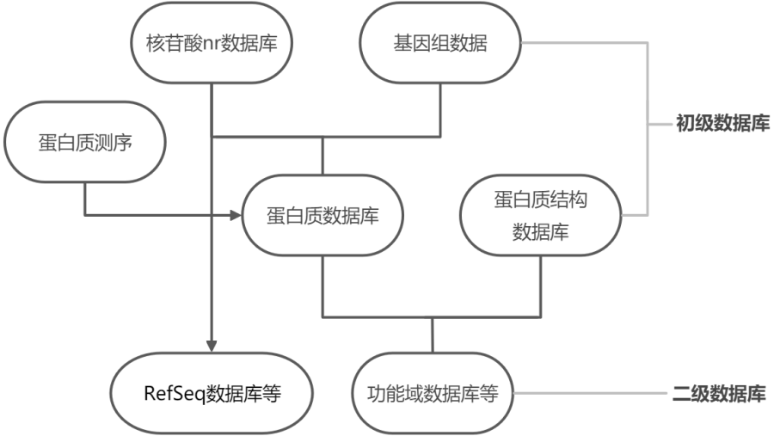

Slide 28
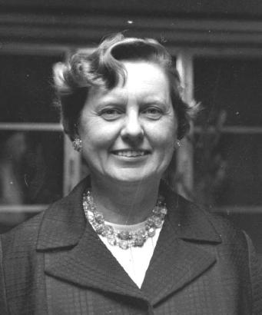
分子数据库及其开放共享的先驱
玛格丽特·戴霍夫（Margaret O. Dayhoff）（1925-1983）

Slide 29
2.1 Database : nucleotide sequences
The main DNA sequence db are
EMBL (Europe)/GenBank (USA) /DDBJ (Japan)
There are also specialized databases for the different types of RNAs (i.e. tRNA, rRNA, tm RNA, uRNA, etc…)
3D structure (DNA and RNA)
Others: Aberrant splicing db; Eucaryotic promoter db (EPD); RNA editing sites, Multimedia Telomere Resource ……

Slide 30
Nucleotids and associated topics databases (AMOS’links)
EMBL - EMBL Nucleotide sequence db (EBI)
Genbank - GenBank Nucleotide Sequence db (NCBI)
DDBJ - DNA Data Bank of Japan
dbEST - dbEST (Expressed Sequence Tags) db (NCBI)
dbSTS - dbSTS (Sequence Tagged Sites) db (NCBI)
NDB - Nucleic Acid Databank (3D structures)
BNASDB - Nucleic acid structure db from University of Pune
AsDb - Aberrant Splicing db
ACUTS - Ancient conserved untranslated DNA sequences db
Codon Usage Db
EPD - Eukaryotic Promoter db
HOVERGEN - Homologous Vertebrate Genes db
IMGT - ImMunoGeneTics db [Mirror at EBI]
ISIS - Intron Sequence and Information System
RDP - Ribosomal db Project
gRNAs db - Guide RNA db
PLACE - Plant cis-acting regulatory DNA elements db
PlantCARE - Plant cis-acting regulatory DNA elements db
sRNA db - Small RNA db
ssu rRNA - Small ribosomal subunit db
lsu rRNA - Large ribosomal subunit db
5S rRNA - 5S ribosomal RNA db
tmRNA Website
tmRDB - tmRNA dB
tRNA - tRNA compilation from the University of Bayreuth
uRNADB - uRNA db
RNA editing - RNA editing site
RNAmod db - RNA modification db
SOS-DGBD - Db of Drosophila DNA sequences annotated with regulatory binding sites
TelDB - Multimedia Telomere Resource
TRADAT - TRAnscription Databases and Analysis Tools
Subviral RNA db - Small circular RNAs db (viroid and viroid-like)
MPDB - Molecular probe db
OPD - Oligonucleotide probe db
VectorDB - Vector sequence db (seems dead!)

Slide 31
EMBL/GenBank/DDBJ
These 3 db contain mainly the same informations within 2-3 days (few differences in the format and syntax)
Serve as archives containing all sequences (single genes, ESTs, complete genomes, etc.) derived from:
Genome projects
Sequencing centers
Individual scientists
Patent offices (i.e. European Patent Office, EPO)
Non-confidential data are exchanged daily
Currently: 18 x10⁶ sequences, over 20 x10⁹ bp;
Over the last 12 months the database size has tripled
Sequences from > 50’000 different species;

Slide 32
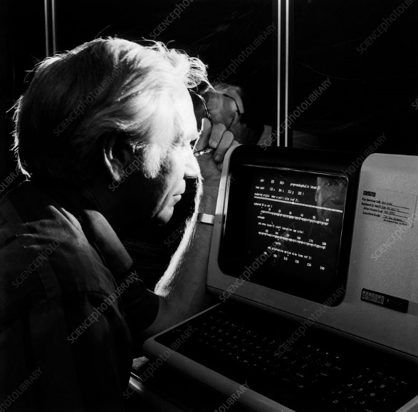
GenBank
（拍于1984年GenBank的一台计算机前）
沃尔特·戈德（Walter Goad）（1925-2000）

Slide 33
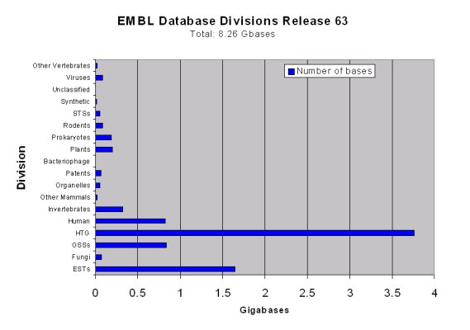
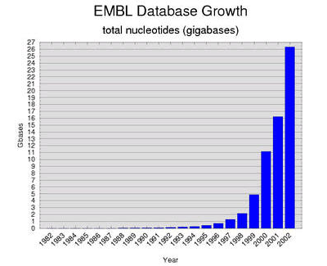
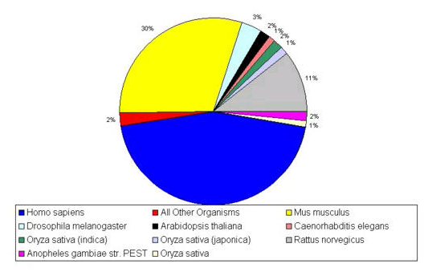
The tremendous increase in nucleotide sequences
EMBL data…first increase in data due to the PCR development…
human
High throughput genomes
(HTG)
mouse
mouse
rat
human
human
1980: 80 genes fully sequenced !

Slide 34
Categories/Qualities of nucleotid sequences
ESTs: single pass cDNA reads
GSS: Genome Survey Sequences
single pass genomic DNA sequences
HTG: ‘Unfinished’ DNA sequences generated by the high-throughput
sequencing centers

Slide 35
EMBL/GenBank/DDBJ
Heterogeneous sequence length: genomes, variants, fragments…
Sequence sizes:
max 300’000 bp /entry (! genomic sequences, overlapping)
min 10 bp /entry
Archive: nothing goes out -> highly redundant !
full of errors: in sequences, in annotations, in CDS attribution….
no consistency of annotations; most annotations are done by the submitters; heterogeneity of the quality and the completion and updating of the informations

Slide 36
BIGD（BIG Data Center）
中国北京基因组研究所的生命与健康大数据中心BIGD（BIG Data Center）
GSA：http://bigd.big.ac.cn/gsa

Slide 37
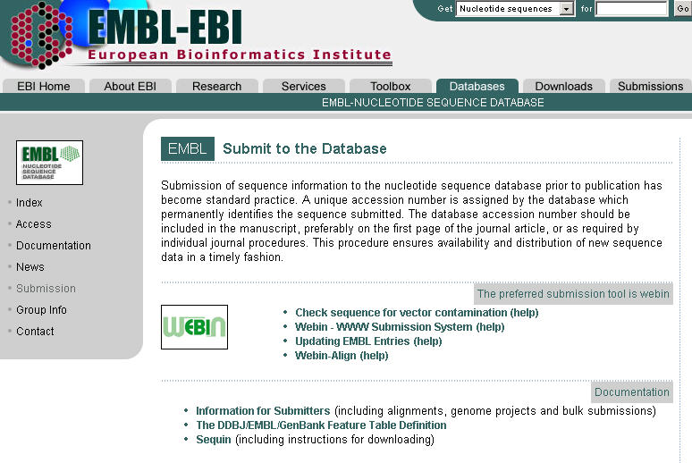

Slide 38
EMBL entry: example
ID HSERPG standard; DNA; HUM; 3398 BP.
XX
AC X02158;
XX
SV X02158.1
XX
DT 13-JUN-1985 (Rel. 06, Created)
DT 22-JUN-1993 (Rel. 36, Last updated, Version 2)
XX
DE Human gene for erythropoietin
XX
KW erythropoietin; glycoprotein hormone; hormone; signal peptide.
XX
OS Homo sapiens (human)
OC Eukaryota; Metazoa; Chordata; Craniata; Vertebrata; Euteleostomi; Mammalia;
OC Eutheria; Primates; Catarrhini; Hominidae; Homo.
XX
RN [1]
RP 1-3398
RX MEDLINE; 85137899.
RA Jacobs K., Shoemaker C., Rudersdorf R., Neill S.D., Kaufman R.J.,
RA Mufson A., Seehra J., Jones S.S., Hewick R., Fritsch E.F., Kawakita M.,
RA Shimizu T., Miyake T.;
RT Isolation and characterization of genomic and cDNA clones of human
RT erythropoietin;
RL Nature 313:806-810(1985).
XX
DR GDB; 119110; EPO.
DR GDB; 119615; TIMP1.
DR SWISS-PROT; P01588; EPO_HUMAN.
XX
…
keyword
taxonomy
references
Cross-references
Notes:
XX

Slide 39
EMBL entry (cont.)
CC Data kindly reviewed (24-FEB-1986) by K. Jacobs
FH Key Location/Qualifiers
FH
FT source 1..3398
FT /db_xref=taxon:9606
FT /organism=Homo sapiens
FT mRNA join(397..627,1194..1339,1596..1682,2294..2473,2608..3327)
FT CDS join(615..627,1194..1339,1596..1682,2294..2473,2608..2763)
FT /db_xref=SWISS-PROT:P01588
FT /product=erythropoietin
FT /protein_id=CAA26095.1
FT /translation=MGVHECPAWLWLLLSLLSLPLGLPVLGAPPRLICDSRVLQRYLLE
FT AKEAENITTGCAEHCSLNENITVPDTKVNFYAWKRMEVGQQAVEVWQGLALLSEAVLRG
FT QALLVNSSQPWEPLQLHVDKAVSGLRSLTTLLRALGAQKEAISPPDAASAAPLRTITAD
FT TFRKLFRVYSNFLRGKLKLYTGEACRTGDR
FT mat_peptide join(1262..1339,1596..1682,2294..2473,2608..2763)
FT /product=erythropoietin
FT sig_peptide join(615..627,1194..1261)
FT exon 397..627
FT /number=1
FT intron 628..1193
FT /number=1
FT exon 1194..1339
FT /number=2
FT intron 1340..1595
FT /number=2
FT exon 1596..1682
FT /number=3
FT intron 1683..2293
FT /number=3
FT exon 2294..2473
FT /number=4
FT intron 2474..2607
FT /number=4
FT exon 2608..3327
FT /note=3' untranslated region
FT /number=5
XX
SQ Sequence 3398 BP; 698 A; 1034 C; 991 G; 675 T; 0 other;
agcttctggg cttccagacc cagctacttt gcggaactca gcaacccagg catctctgag 60
tctccgccca agaccgggat gccccccagg aggtgtccgg gagcccagcc tttcccagat 120
CDS
Coding sequence
annotation
sequence

Slide 40
GenBank entry: same entry
LOCUS HSERPG 3398 bp DNA PRI 22-JUN-1993
DEFINITION Human gene for erythropoietin.
ACCESSION X02158
VERSION X02158.1 GI:31224
KEYWORDS erythropoietin; glycoprotein hormone; hormone; signal peptide.
SOURCE human.
ORGANISM Homo sapiens
Eukaryota; Metazoa; Chordata; Vertebrata; Mammalia; Eutheria;
Primates; Catarrhini; Hominidae; Homo.
REFERENCE 1 (bases 1 to 3398)
AUTHORS Jacobs,K., Shoemaker,C., Rudersdorf,R., Neill,S.D., Kaufman,R.J.,
Mufson,A., Seehra,J., Jones,S.S., Hewick,R., Fritsch,E.F.,
Kawakita,M., Shimizu,T. and Miyake,T.
TITLE Isolation and characterization of genomic and cDNA clones of human
erythropoietin
JOURNAL Nature 313 (6005), 806-810 (1985)
MEDLINE 85137899
COMMENT Data kindly reviewed (24-FEB-1986) by K. Jacobs.
FEATURES Location/Qualifiers
source 1..3398
/organism="Homo sapiens"
/db_xref="taxon:9606"
mRNA join(397..627,1194..1339,1596..1682,2294..2473,2608..3327)
exon 397..627
/number=1
sig_peptide join(615..627,1194..1261)
CDS join(615..627,1194..1339,1596..1682,2294..2473,2608..2763)
/codon_start=1
/product="erythropoietin"
/protein_id="CAA26095.1"
/db_xref="GI:312304"
/db_xref="SWISS-PROT:P01588"
/translation="MGVHECPAWLWLLLSLLSLPLGLPVLGAPPRLICDSRVLQRYLL
EAKEAENITTGCAEHCSLNENITVPDTKVNFYAWKRMEVGQQAVEVWQGLALLSEAVL
RGQALLVNSSQPWEPLQLHVDKAVSGLRSLTTLLRALGAQKEAISPPDAASAAPLRTI
…

Slide 41
GenBank entry (cont.)
…
TADTFRKLFRVYSNFLRGKLKLYTGEACRTGDR"
intron 628..1193
/number=1
exon 1194..1339
/number=2
mat_peptide join(1262..1339,1596..1682,2294..2473,2608..2760)
/product="erythropoietin"
intron 1340..1595
/number=2
exon 1596..1682
/number=3
intron 1683..2293
/number=3
exon 2294..2473
/number=4
intron 2474..2607
/number=4
exon 2608..3327
/note="3' untranslated region"
/number=5
BASE COUNT 698 a 1034 c 991 g 675 t
ORIGIN
1 agcttctggg cttccagacc cagctacttt gcggaactca gcaacccagg catctctgag
61 tctccgccca agaccgggat gccccccagg aggtgtccgg gagcccagcc tttcccagat
121 agcagctccg ccagtcccaa gggtgcgcaa ccggctgcac tcccctcccg cgacccaggg
181 cccgggagca gcccccatga cccacacgca cgtctgcagc agccccgtca gccccggagc
241 ctcaacccag gcgtcctgcc cctgctctga ccccgggtgg cccctacccc tggcgacccc

Slide 42
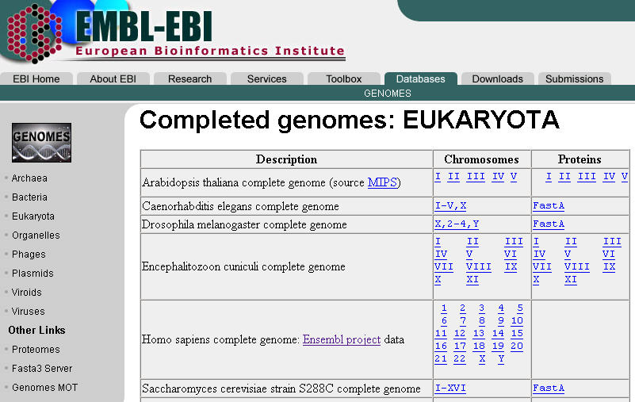
EMBL: The Genome divisions
http://www.ebi.ac.uk/genomes/
Schizosaccharomyces pombe strain 972h- complete genome

Slide 43
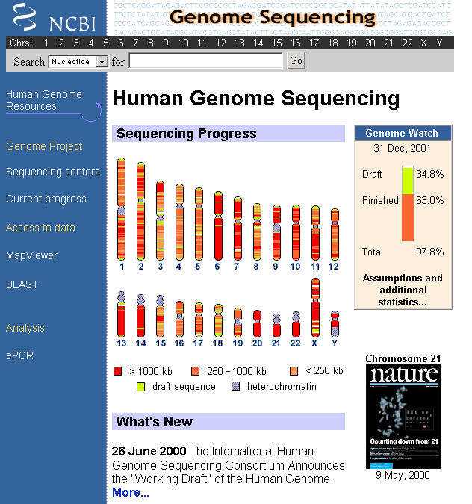
Finished: The clone insert is contiguously sequenced with high quality standard of error rate of 0.01%. There are usually no gaps in the sequence.

Slide 44
Nucleotid databases
and
« associated » genomic projects/databases
Problem:
Redundancy = makes Blasts searches of the complete
databases useless for detecting anything behond the closest homologs.
Solutions:
assemblies of genomic sequence data (contigs) and corresponding RNA and
protein sequences -> dataset of genomic contigs, RNAs and proteins
annotation of genes, RNAs, proteins, variation (SNPs), STS markers,
gene prediction, nomenclature and chromosomal location.
compute connexions to other resources (cross-references)
Examples: RefSeq/Locus link (drosophila, human, mouse, rat and zebrafish),
TIGR (microbes and plants), EnsEMBL (Eukaryota)…

Slide 45
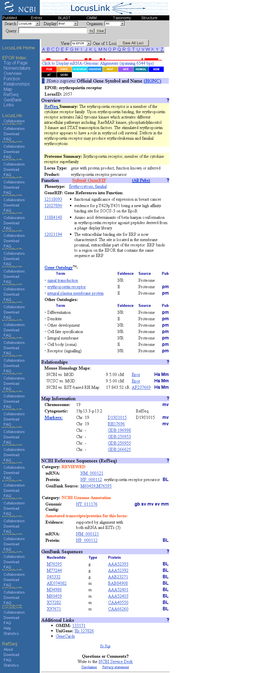
LocusLink / RefSeq
Erythropoitin receptor

Slide 47
2.2 Database : protein sequences
SWISS-PROT: created in 1986 (A.Bairoch) http://www.expasy.org/sprot/
TrEMBL: created in 1996; complement to SWISS-PROT; derived from EMBL CDS translations (« proteomic » version of EMBL)
PIR-PSD: Protein Information Resources http://pir.georgetown.edu/
Genpept: « proteomic » version of GenBank
Many specialized protein databases for specific families or groups of proteins.
Examples: AMSDb (antibacterial peptides), GPCRDB (7 TM receptors), IMGT (immune system) YPD (Yeast) etc.

Slide 48
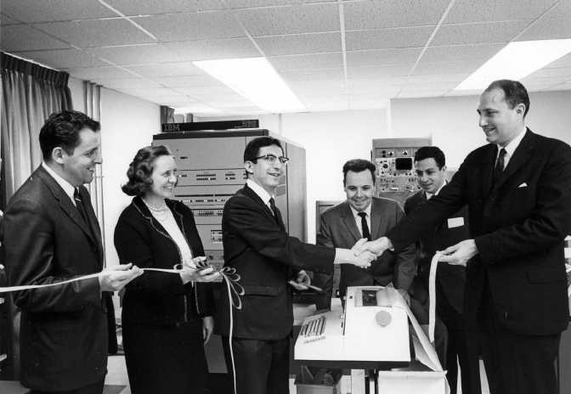
PIR
（美国国家生物医学研究基金会NBRF新计算机启用仪式，1979年5月）
罗伯特·莱德利（Robert Ledley，图左3）（1926-2012）
玛格丽特·戴霍夫（Margaret O. Dayhoff）（1925-1983）（图左2)

Slide 49

Swiss-Prot
阿莫斯·拜罗克（Amos Bairoch）

Slide 50
SWISS-PROT
Collaboration between the SIB (CH) and EMBL/EBI (UK)
Fully annotated (manually), non-redundant, cross-referenced, documented protein sequence database.
~113 ’000 sequences from more than 6’800 different species; 70 ’000 references (publications); 550 ’000 cross-references (databases); ~200 Mb of annotations.
Weekly releases; available from about 50 servers across the world, the main source being ExPASy

Slide 51
TrEMBL (Translation of EMBL)
It is impossible to cope with the quantity of newly generated data AND to maintain the high quality of SWISS-PROT -> TrEMBL, created in 1996.
TrEMBL is automatically generated (from annotated EMBL coding sequences (CDS)) and annotated using software tools.
Contains all what is not in SWISS-PROT.
SWISS-PROT + TrEMBL = all known protein sequences.
Well-structured SWISS-PROT-like resource.

Slide 52
The simplified story of a SWISS-PROT entry
Some data are not submitted to the public databases !!
(delayed or cancelled…)
cDNAs, genomes, …
« Automated »
Redundancy check (merge)
Family attribution (InterPro)
Annotation (computer)
EMBLnew EMBL
CDS
TrEMBLnew TrEMBL
« Manual »
Redundancy (merge, conflicts)
Annotation (manual)
SWISS-PROT tools (macros…)
SWISS-PROT documentation
Medline
Databases (MIM, MGD….)
Brain storming
SWISS-PROT
Once in SWISS-PROT, the entry is no more in TrEMBL, but still in EMBL (archive)
CDS: proposed and submitted at EMBL by authors or by genome projects (can be experimentally
proven or derived from gene prediction programs). TrEMBL neither translates DNA sequences, nor
uses gene prediction programs: only takes CDS proposed by the submitting authors in the EMBL entry.

Slide 53
Line code Content Occurrence in an entry
--------- ---------------------------- ---------------------------
ID Identification One; starts the entry
AC Accession number(s) One or more
DT Date Three times
DE Description One or more
GN Gene name(s) Optional
OS Organism species One or more
OG Organelle Optional
OC Organism classification One or more
RN Reference number One or more
RP Reference position One or more
RC Reference comment(s) Optional
RX Reference cross-reference(s) Optional
RA Reference authors One or more
RT Reference title Optional
RL Reference location One or more
CC Comments or notes Optional
DR Database cross-references Optional
KW Keywords Optional
FT Feature table data Optional
SQ Sequence header One
Amino Acid Sequence One
// Termination line One; ends the entry
taxonomy
references
Lines in which you may find ‘manual-annotated’ information

Slide 54
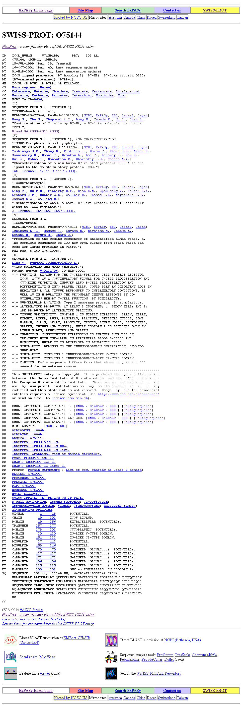
a Swiss-Prot entry…
overview
Entry name
Accession
number
sequence
Notes:
To be updated (change the complete entry ?)

Slide 55
Protein name
Gene name
Taxonomy

Slide 56
References

Slide 57
Comments

Slide 58
Cross-references

Slide 59
Keywords

Slide 60
Feature table
(sequence description)

Slide 61
Domains, functional sites, protein families
PROSITE
InterPro
Pfam
PRINTS
SMART
Mendel-GFDb
Human diseases
MIM
Protein-specific dbs
GCRDb
MEROPS
REBASE
TRANSFAC
2D and 3D Structural dbs
HSSP
PDB
Organism-spec. dbs
DictyDb
EcoGene
FlyBase
HIV
MaizeDB
MGD
SGD
StyGene
SubtiList
TIGR
TubercuList
WormPep
Zebrafish
SWISS-PROT
PTM
CarbBank
GlycoSuiteDB
2D-gel protein databases
SWISS-2DPAGE
ECO2DBASE
HSC-2DPAGE
Aarhus and Ghent
MAIZE-2DPAGE
Nucleotide sequence db
EMBL, GeneBank, DDBJ

Slide 62
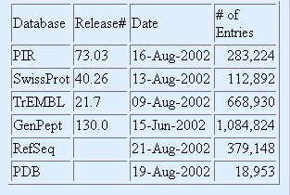
Database 2: Protein sequence
What else ?

Slide 63
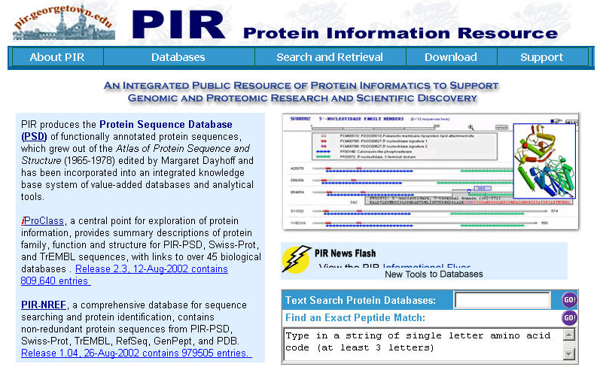
http://pir.georgetown.edu/ member databases: PIR-PSD, NRL-3D, ProClass, ProtFam and PIR-ASDB

Slide 64
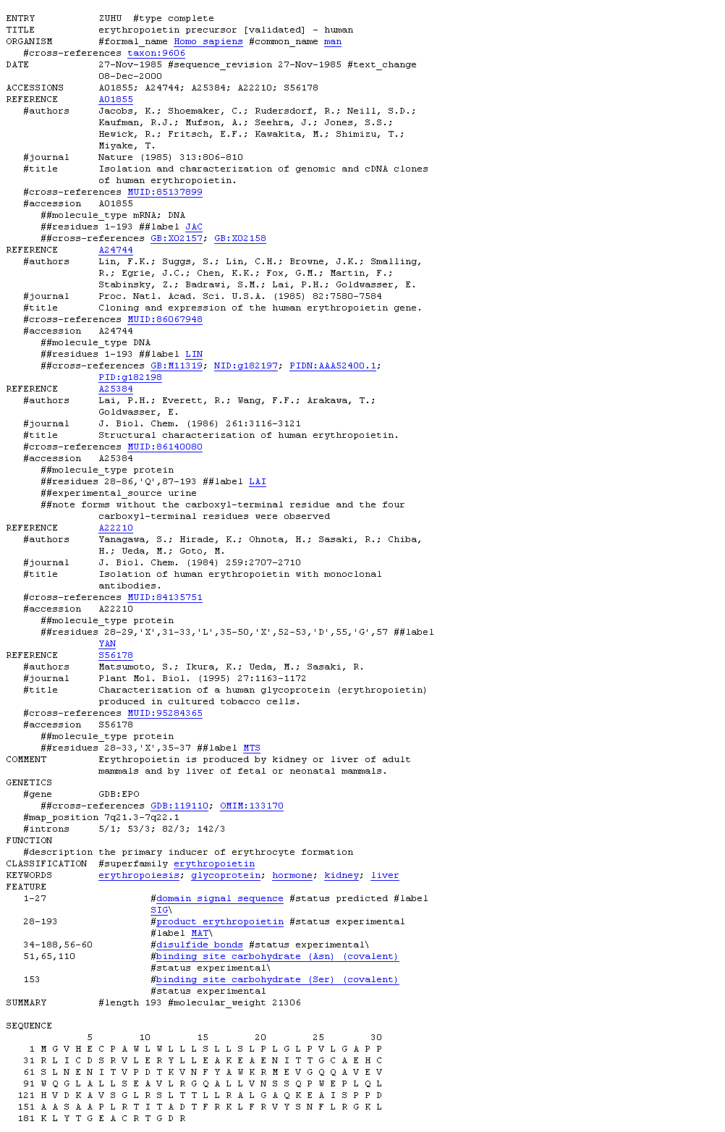
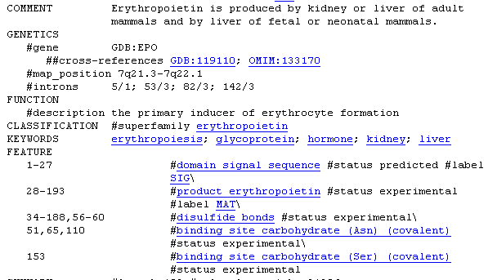
PIR-PSD: example
« well annotated »

Slide 65
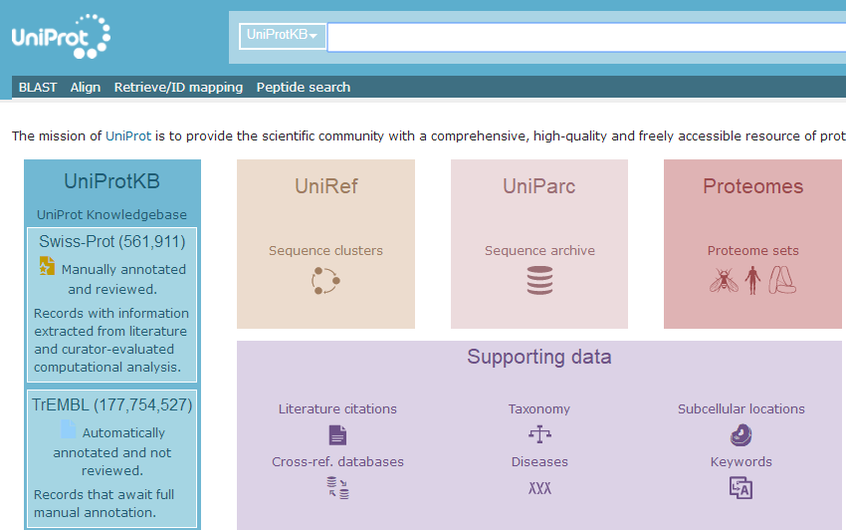

Slide 66
2.3 Databases : ‘genomics’
Contain informations on gene chromosomal location (mapping) and nomenclature, and provide links to sequence databases; has usually no sequence;
Exist for most organisms important in life science research; usually species specific.
Examples: MIM, GDB (human), MGD (mouse), FlyBase (Drosophila), SGD (yeast), TAIR(arabidopsis)、RGP(rice)、MaizeDB (maize), SubtiList (B.subtilis), etc.;
Generally relational db (Oracle, SyBase or AceDb).

Slide 67
MIM
OMIM™: Online Mendelian Inheritance in Man
catalog of human genes and genetic disorders
contains a summary of literature and reference information. It also contains links to publications and sequence information.

Slide 68
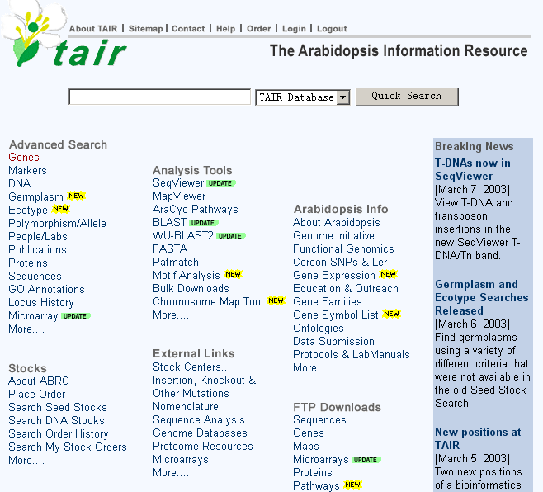

Slide 69
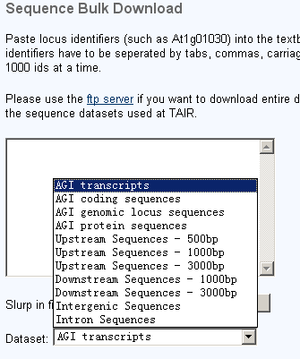
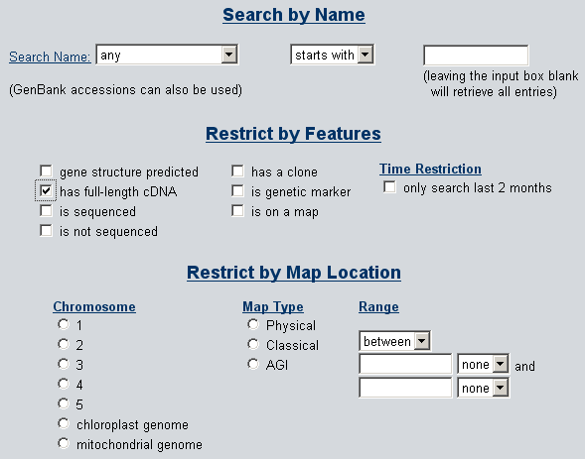

Slide 70
2.4 Databases : mutation/polymorphism
Contain informations on sequence variations linked or not to genetic diseases;
Mainly human but: OMIA - Online Mendelian Inheritance in Animals
General db:
OMIM
HMGD - Human Gene Mutation db
SVD - Sequence variation db
HGBASE - Human Genic Bi-Allelic Sequences db
dbSNP - Human single nucleotide polymorphism (SNP) db
Disease-specific db: most of these databases are either linked to a single gene or to a single disease;
p53 mutation db
ADB - Albinism db (Mutations in human genes causing albinism)
Asthma and Allergy gene db
….

Slide 71
Mutation/polymorphism: definitions
SNPs: single nucleotide polymorphisms; occur approximately once every 100 to 300 bases.
c-SNPs: coding single nucleotide polymorphisms (Single Nucleotide Polymorphisms within cDNA sequences)
SAPs: single amino-acid polymorphisms
Missense mutation: -> SAP
Nonsense mutation: -> STOP
Insertion/deletion of nucleotides -> frameshift…
! Numbering of the mutated amino acid depends on the db (aa no 1 is not necessary the initiator Met !)

Slide 72
Mutation/polymorphism
The SNP consortium (TSC) http://snp.cshl.org/
Public/private collaboration: Bayer, Roche, IBM, Pfizer, Novartis, Motorola……
Has to date discovered and characterized nearly 1.5 million SNPs; in addition, the allele frequencies in three major world populations have been determined on a subset of ~57,000 SNPs.
SNPs dbSNP at NCBI http://www.ncbi.nlm.nih.gov/SNP/
Collaboration between the National Human Genome Research Institute and the National Center for Biotechnology Information (NCBI)
Mission: central repository for both single base nucleotide subsitutions and short deletion and insertion polymorphisms (several species)
August 2002, dbSNP has submissions for 4’700’000 SNPs.
Chromosome 21 dbSNP http://csnp.isb-sib.ch/
A joint project between the Division of Medical Genetics of the University of Geneva Medical School and the SIB
Mission: comprehensive cSNP (Single Nucleotide Polymorphisms within cDNA sequences) database and map of chromosome 21

Slide 73
2.5 Database : protein domain/family
Contains biologically significant « pattern / profiles/ HMM » formulated in such a way that, with appropriate computional tools, it can rapidly and reliably determine to which known family of proteins (if any) a new sequence belongs to
-> tools to identify what is the function of uncharacterized proteins translated from genomic or cDNA sequences (« functional diagnostic »)

Slide 74
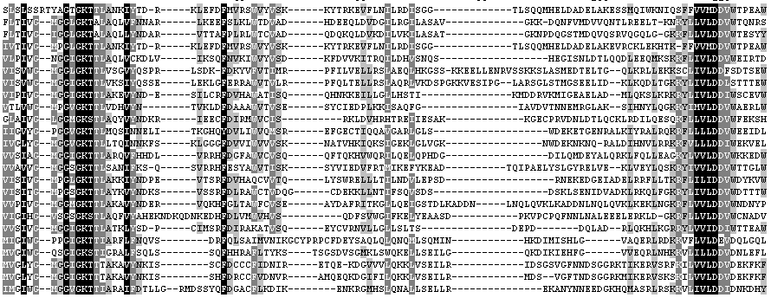
Protein domain/family
Most proteins have « modular » structure
Estimation: ~ 3 domains / protein
Domains (conserved sequences or structures) are identified by multiple sequence alignments
Motif : A short conserved region in a protein sequence. Motifs are frequently highly conserved parts of domains.
Notes:
Domain:蛋白质的氨基酸序列中有些在演化过程中最为保守的单元。一个结构域不能再划分为更小的结构域。
Motif:模体，基序。在比结构域更小的层次上，序列上有相似性的一些区域。如coiled-coil、信号肽等。
Profile:轮廓/Profile（分布型）A matrix representation of a conserved region in a multiple sequence alignment that allows for gaps in the alignment. The rows include scores for matching sequential columns of the alignment to a test sequence. The columns include substitution scores for amino acids and gap penalties. See also PSSM.
pattern:模式

Slide 75
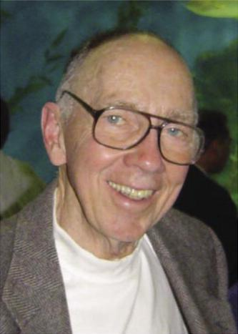
“motif”概念提出者
罗素·杜立特（Russell F. Doolittle）（1931-）

Slide 76
Domains can be defined by different methods:
Consensus seuquence
Pattern (regular expression); used for very conserved domains
Profiles (weighted matrices): two-dimensional tables of position specific match-, gap-, and insertion-scores, derived from aligned sequence families; used for less conserved domains
Hidden Markov Model (HMM); probabilistic models; an other method to generate profiles.

Slide 77
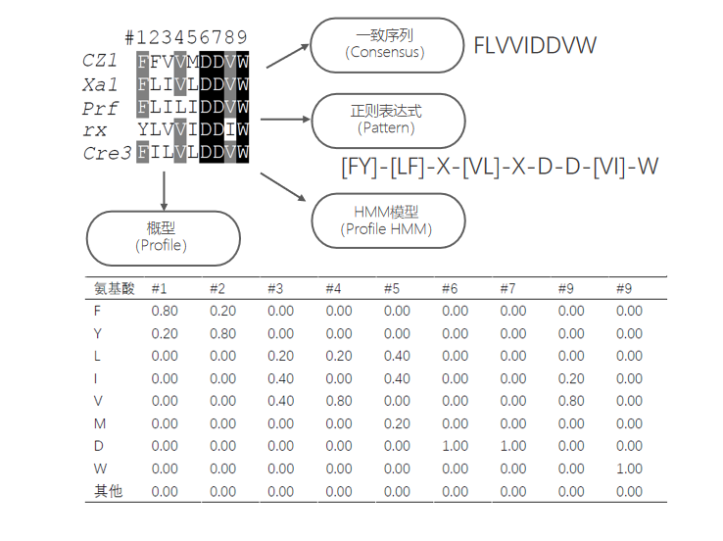

Slide 78
Protein domain/family db
Secondary databases are the fruit of analyses of the sequences found in the primary sequence db
Either manually curated (i.e. PROSITE, Pfam, etc.) or automatically generated (i.e. ProDom, DOMO)
Some depend on the method used to detect if a protein belongs to a particular domain/family (patterns, profiles, HMM, PSI-BLAST)

Slide 79
Protein domain/family db
Interpro
PROSITE Patterns / Profiles
ProDom Aligned motifs (PSI-BLAST) (Pfam B)
PRINTS Aligned motifs, OWL
Pfam HMM (Hidden Markov Models)
SMART HMM
TIGRfam HMM
DOMO Aligned motifs
BLOCKS Aligned motifs (PSI-BLAST)
CDD(CDART) PSI-BLAST(PSSM) of Pfam and SMART
Notes:
PROSITE,home of regular expressions and profiles;
Pfam, SMART and TIGRFAMs, keepers of hidden markov models(HMMs);
PRINTS, provider of fingerprints (groups of aligned, un-weightedmotifs);
All come from SWISS-PROT
InterPro is a database of protein families, domains and functional sites in which identifiable features found in known proteins can be applied to unknown protein sequences.

Slide 80
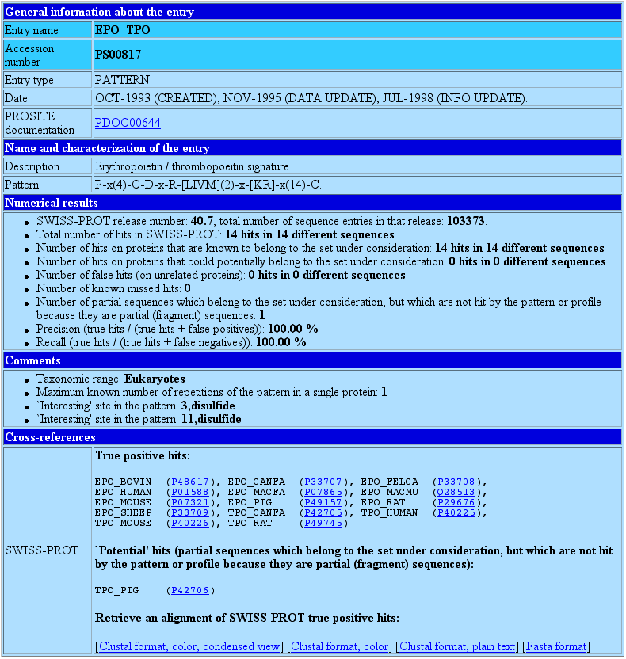
Prosite (pattern): example

Slide 81
Prosite (pattern): example

Slide 82
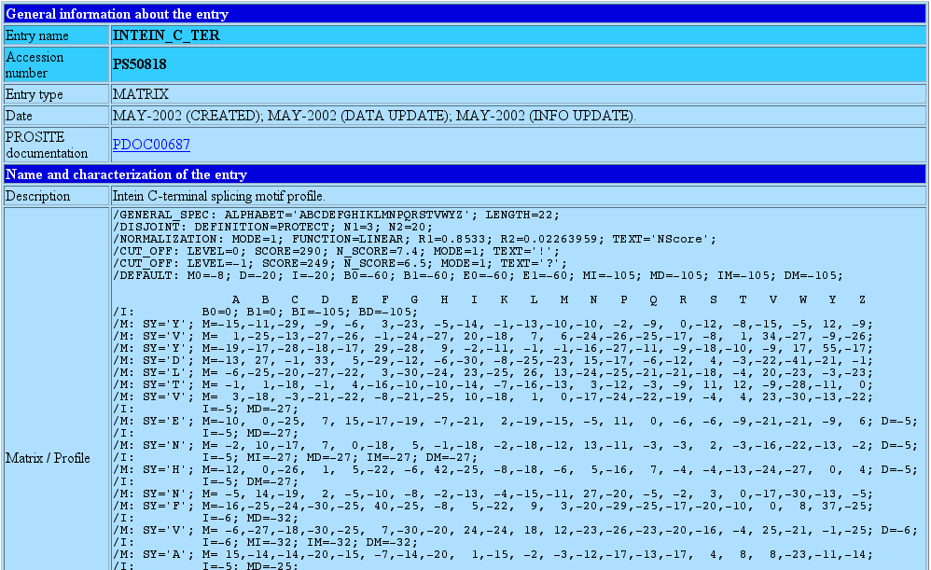
Prosite (profile): example
Notes:
/I: Profile insert position. /M: Profile match position.
B0 B0= 0 External initiation score B1 B1= 0 Internal initiation score E0 E0= 0 External termination score E1 E1= 0 Internal termination score BM BM= 0 State transition score from state B to M BI BI= * State transition score form state B to I BD BD= * State transition score from state B to D BE BE= * State transition score from state B to E MM MM= 0 State transition score from state M to M MI MI= * State transition score from state M to I MD MD= * State transition score from state M to D ME ME= 0 State transition score from state M to E

Slide 83
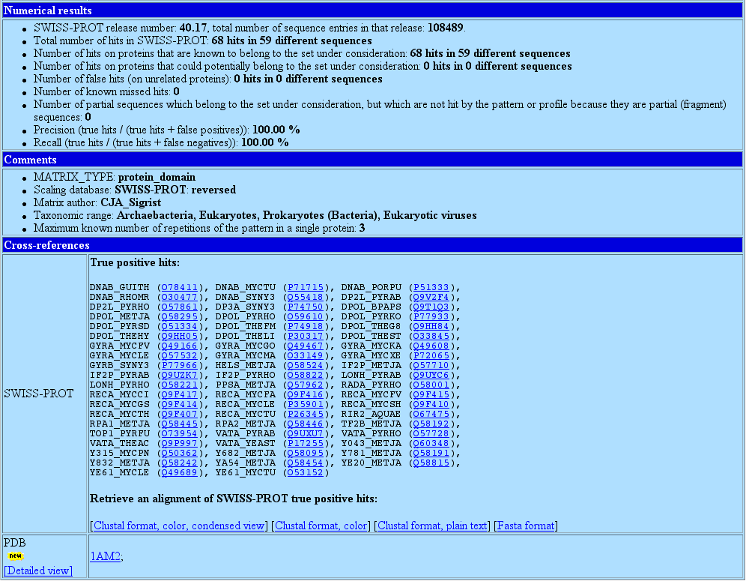
Prosite (profile): example

Slide 84
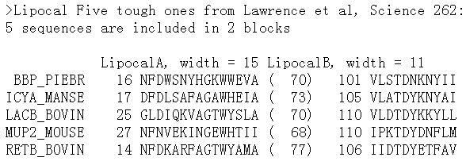
BLOCKs database
Blocks are multiply aligned ungapped segments corresponding to the most highly conserved regions of proteins
positions
weights
Notes:
部分比对被聚集在一起，在每个聚集中，80%的残基是相同的。

Slide 85
PRINTS database
PRINTS is a compendium of protein fingerprints. A fingerprint is a group of conserved motifs used to characterize a protein family
Usually the motifs do not overlap, but are separated along a sequence
A fingerprint is a set of motifs used to predict the occurrence of similar motifs, either in an individual sequence or in a database.

Slide 86
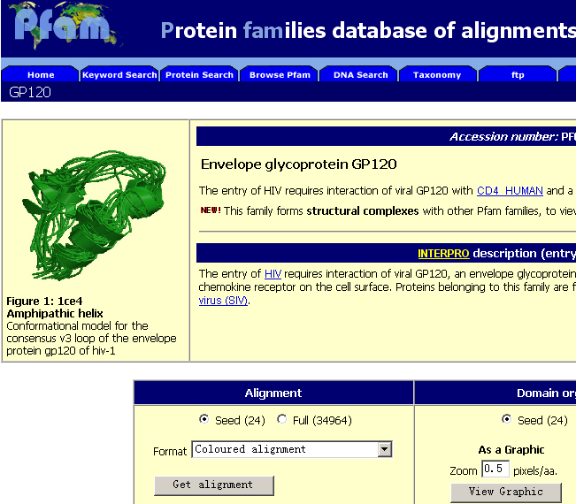
Pfam database
Pfam is a large collection of multiple sequence alignments and hidden Markov models covering many common protein domains and families
Each curated family in Pfam is represented by a seed and full alignment. The seed contains representative members of the family, while the full alignment contains all members of the family as detected with a profile hidden Markov model (HMM) constructed from the seed alignment using the HMMER2 software

Slide 87
InterPro is an integrated documentation resource for protein families, domains and sites.
Sequence-motif methods:
PROSITE,home of regular expressions and profiles;
Pfam, SMART and TIGRFAMs, keepers of hidden markov models(HMMs);
PRINTS, provider of fingerprints (groups of aligned, un-weightedmotifs);
Diagnostically, these resources have different areas of optimum application owing to the different underlying analysis methods. In terms of family coverage, the protein signature databases are similar in size but differ in content.
While all of the methods share a common interest in protein sequence classification, some focus on divergent domains (e.g., Pfam), some focus on functional sites (e.g., PROSITE), and others focus on families, specialising in hierarchical definitions from superfamily down to subfamily levels in order to pin-point specific functions (e.g., PRINTS). TIGRFAMs focus on building HMMs for functionally equivalent proteins.

Slide 88
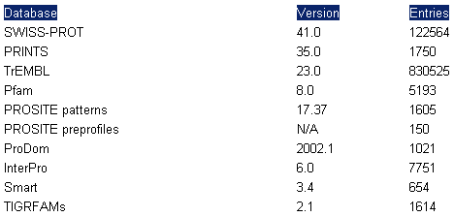
InterPro release 6.0 (2003.3)
Contains 7751 entries, representing 1748 domains, 5841 families, 147 repeats, and 15 post-translational modification sites. Member databases:
Primary databases

Slide 89
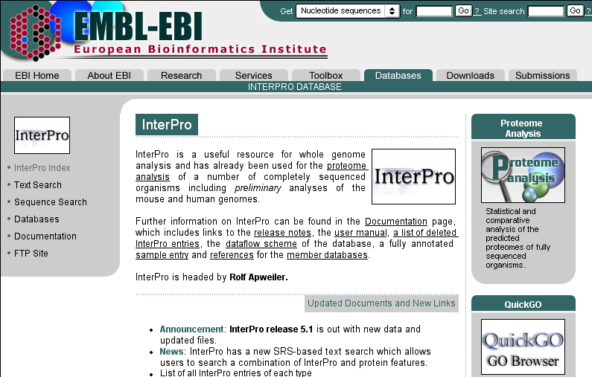
InterPro: www.ebi.ac.uk/interpro

Slide 90
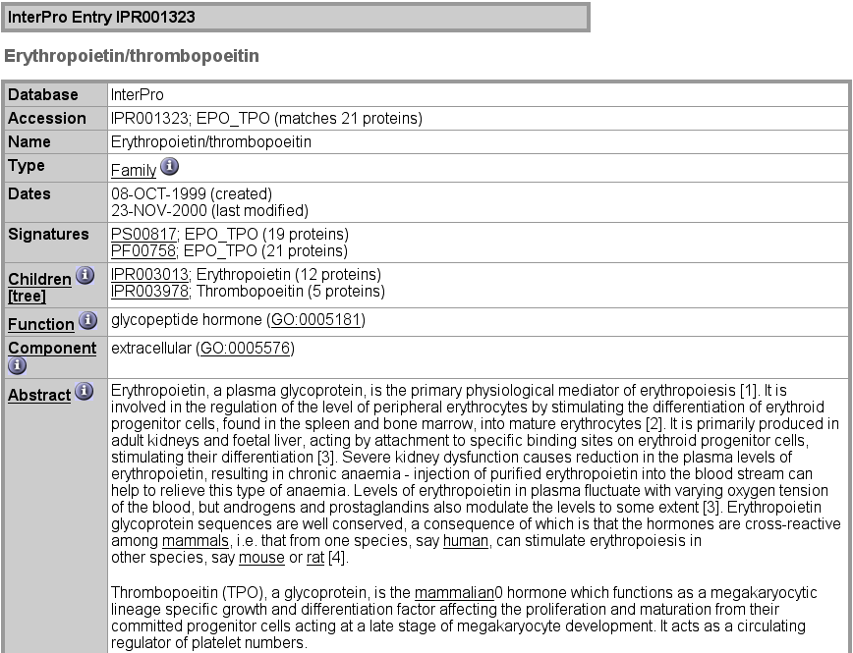
InterPro example

Slide 91
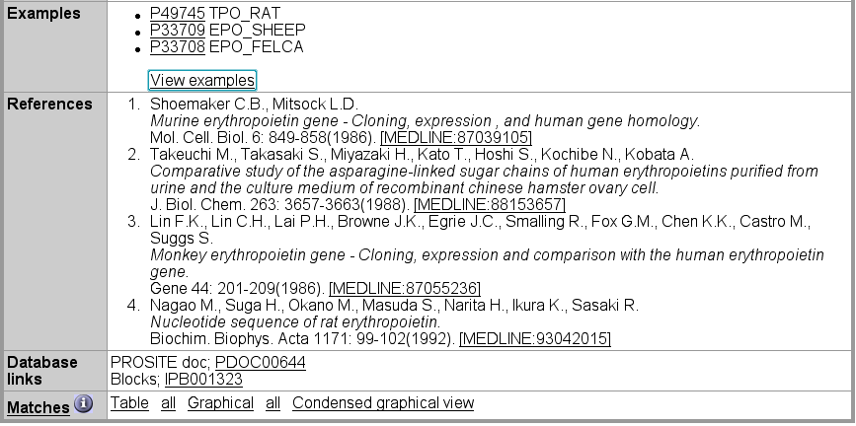
InterPro example

Slide 92
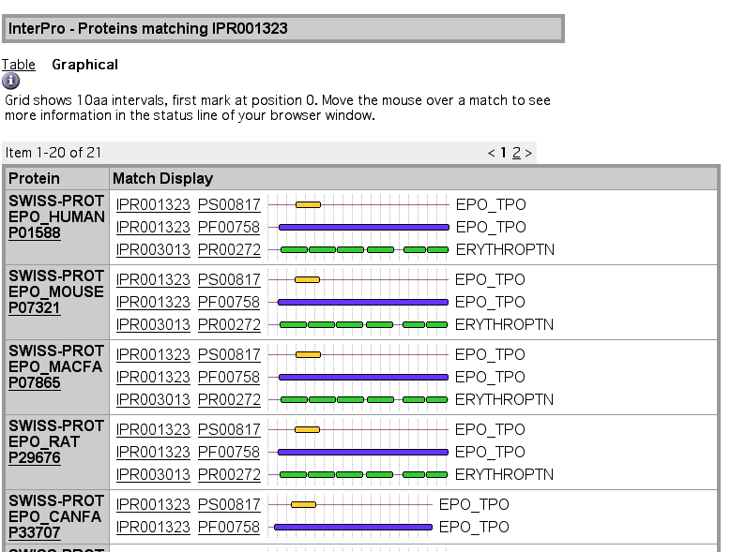
InterPro graphic example

Slide 93
2.6 Databases : proteomics
Contain informations obtained by 2D-PAGE: master images of the gels and description of identified proteins
Examples: SWISS-2DPAGE, ECO2DBASE, Maize-2DPAGE, Sub2D, Cyano2DBase, etc.
Format: composed of image and text files
Most 2D-PAGE databases are “federated” and
use SWISS-PROT as a master index
There is currently no protein Mass Spectrometry (MS) database (not for long…)

Slide 94
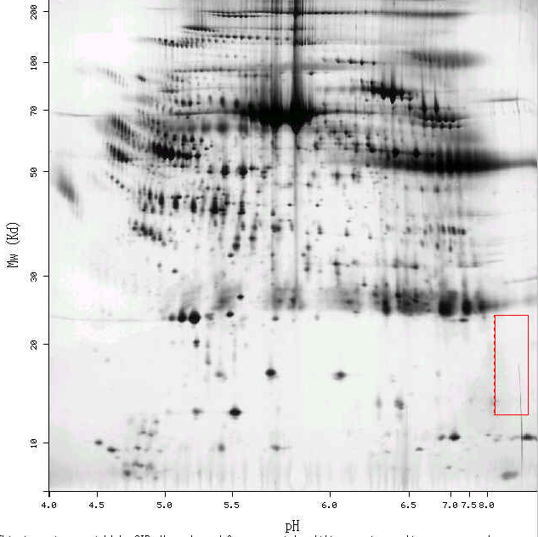
This protein does not exist in the current release of SWISS-2DPAGE.
EPO_HUMAN (human plasma)
Should be here…

Slide 95
2.7 Databases : 3D structure
Contain the spatial coordinates of macromolecules whose 3D structure has been obtained by X-ray or NMR studies
Proteins represent more than 90% of available structures (others are DNA, RNA, sugars, virus, complex protein/DNA…)
RCSB or PDB (Protein Data Bank), CATH and SCOP (structural classification of proteins (according to the secondary structures)), BMRB (BioMagResBank; NMR results)
DSSP: Database of Secondary Structure Assignments.
HSSP: Homology-derived secondary structure of proteins.
FSSP: Fold Classification based on Structure-Structure Assignments.
SWISS-MODEL: Homology-derived 3D structure db

Slide 96
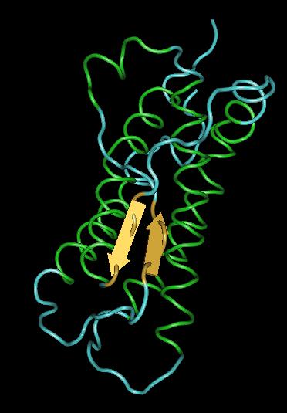
RCSB or PDB: Protein Data Bank
Managed by Research Collaboratory for Structural Bioinformatics (RCSB) (USA).
Contains macromolecular structure data on proteins, nucleic acids, protein-nucleic acid complexes, and viruses.
Specialized programs allow the vizualisation of the corresponding 3D structure. (e.g., SwissPDB-viewer, Cn3D)
Currently there are ~18’000 structure data for 6’000 different molecules, but far less protein family (highly redundant) !
EPO_HUMAN

Slide 97
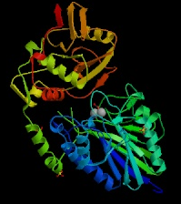
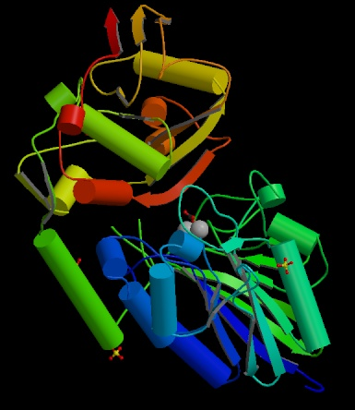
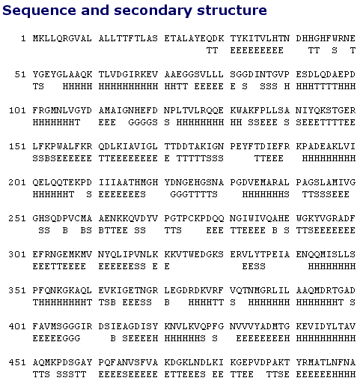
5'-Nucleotidase From E. Coli
Notes:
Each residue in the sequence is reported as a single letter code. Secondary structure is calculated and described according to an implementation of the method of Kabsch and Sander (1983) Biopolymers 22, 2577-2637. The assignments are: H=helix; B=residue in isolated beta bridge; E=extended beta strand; G=310 helix; I=pi helix; T=hydrogen bonded turn; S=bend.

Slide 98
PDB: Sequence Details
Each residue in the sequence is reported as a single letter code. Secondary structure is calculated and described according to an implementation of the method of Kabsch and Sander (1983) Biopolymers 22, 2577-2637.
The assignments are: H=helix; B=residue in isolated beta bridge; E=extended beta strand; G=310 helix; I=pi helix; T=hydrogen bonded turn; S=bend.

Slide 99
PDB example 1eer
HEADER COMPLEX (CYTOKINE/RECEPTOR) 24-JUL-98 1EER
TITLE CRYSTAL STRUCTURE OF HUMAN ERYTHROPOIETIN COMPLEXED TO ITS
TITLE 2 RECEPTOR AT 1.9 ANGSTROMS
COMPND MOL_ID: 1;
COMPND 2 MOLECULE: ERYTHROPOIETIN;
COMPND 3 CHAIN: A;
COMPND 4 ENGINEERED: YES;
COMPND 5 MUTATION: N24K, N38K, N83K, P121N, P122S;
COMPND 6 MOL_ID: 2;
COMPND 7 MOLECULE: ERYTHROPOIETIN RECEPTOR;
COMPND 8 CHAIN: B, C;
COMPND 9 FRAGMENT: EXTRACELLULAR DOMAIN;
COMPND 10 SYNONYM: EPOBP;
COMPND 11 ENGINEERED: YES;
COMPND 12 MUTATION: N52Q, N164Q, A211E
SOURCE MOL_ID: 1;
SOURCE 2 ORGANISM_SCIENTIFIC: HOMO SAPIENS;
SOURCE 3 ORGANISM_COMMON: HUMAN;
SOURCE 4 EXPRESSION_SYSTEM: ESCHERICHIA COLI;
SOURCE 5 MOL_ID: 2;
SOURCE 6 ORGANISM_SCIENTIFIC: HOMO SAPIENS;
SOURCE 7 ORGANISM_COMMON: HUMAN;
SOURCE 8 EXPRESSION_SYSTEM: PICHIA PASTORIS;
SOURCE 9 EXPRESSION_SYSTEM_VECTOR: PHIL-S1
KEYWDS ERYTHROPOIETIN, ERYTHROPOIETIN RECEPTOR, SIGNAL
KEYWDS 2 TRANSDUCTION, HEMATOPOIETIC CYTOKINE, CYTOKINE RECEPTOR
KEYWDS 3 CLASS 1, COMPLEX (CYTOKINE/RECEPTOR)
EXPDTA X-RAY DIFFRACTION
AUTHOR R.S.SYED,C.LI
REVDAT 1 01-OCT-99 1EER 0
JRNL AUTH R.S.SYED,S.W.REID,C.LI,J.C.CHEETHAM,K.H.AOKI,B.LIU,
JRNL AUTH 2 H.ZHAN,T.D.OSSLUND,A.J.CHIRINO,J.ZHANG,
JRNL AUTH 3 J.FINER-MOORE,S.ELLIOTT,K.SITNEY,B.A.KATZ,
JRNL AUTH 4 D.J.MATTHEWS,J.J.WENDOLOSKI,J.EGRIE,R.M.STROUD
SHEET 2 I 4 ILE C 154 ALA C 162 -1 N VAL C 158 O VAL C 172
SHEET 3 I 4 ARG C 191 MET C 200 -1 N ARG C 199 O ARG C 155
SHEET 4 I 4 VAL C 216 LEU C 219 -1 N LEU C 218 O TYR C 192
SSBOND 1 CYS A 7 CYS A 161
SSBOND 2 CYS A 29 CYS A 33
SSBOND 3 CYS B 28 CYS B 38
SSBOND 4 CYS B 67 CYS B 83
SSBOND 5 CYS C 28 CYS C 38
SSBOND 6 CYS C 67 CYS C 83
CISPEP 1 GLU B 202 PRO B 203 0 0.05
CISPEP 2 GLU C 202 PRO C 203 0 0.14
CRYST1 58.400 79.300 136.500 90.00 90.00 90.00 P 21 21 21 4
ORIGX1 1.000000 0.000000 0.000000 0.00000
ORIGX2 0.000000 1.000000 0.000000 0.00000
ORIGX3 0.000000 0.000000 1.000000 0.00000
SCALE1 0.017123 0.000000 0.000000 0.00000
SCALE2 0.000000 0.012610 0.000000 0.00000
SCALE3 0.000000 0.000000 0.007326 0.00000
ATOM 1 N ALA A 1 -38.912 14.988 99.206 1.00 74.25 N
ATOM 2 CA ALA A 1 -37.691 14.156 98.995 1.00 72.12 C
ATOM 3 C ALA A 1 -36.476 15.045 98.733 1.00 70.30 C
ATOM 4 O ALA A 1 -36.607 16.130 98.160 1.00 68.80 O
ATOM 5 CB ALA A 1 -37.910 13.201 97.819 1.00 70.67 C
ATOM 6 N PRO A 2 -35.278 14.597 99.162 1.00 70.55 N
ATOM 7 CA PRO A 2 -34.022 15.337 98.982 1.00 66.55 C
........
Notes:
文本格式

Slide 100
Secondary structural databases
SCOP : Structural Classification of Protein
CATH : Structural Classification (class/architecture/topology/homology)
FSSP : Fold classification based on Structure-Structure alignment of Proteins
MMDB: a Molecular Modeling Database in NCBI's macromolecular 3D Structure database
PDBsum: Summary of PDB Structure

Slide 101
2.8 Databases : metabolic
Contain informations that describe enzymes, biochemical reactions and metabolic pathways;
ENZYME and BRENDA: nomenclature databases that store informations on enzyme names and reactions;
Metabolic databases: EcoCyc (specialized on Escherichia coli), KEGG, EMP/WIT;
Usualy these databases are tightly coupled with query software that allows the user to visualise reaction schemes.

Slide 102
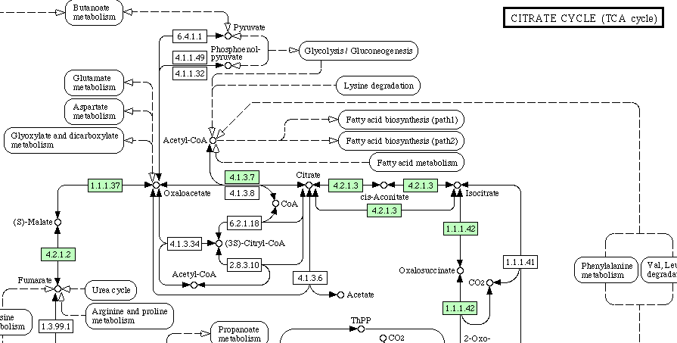
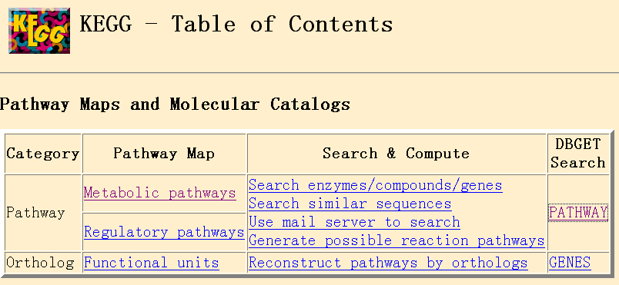
KEGG: Kyoto Encyclopedia of Genes and Genomes
www.genome.ad.jp/kegg/kegg2.html
Notes:
柠檬酸盐循环

Slide 103
2.9 Databases : bibliographic
Bibliographic reference databases contain citations and abstract informations of published life science articles;
Example: Medline
Other more specialized databases also exist (example: Agricola).

Slide 104
Medline
MEDLINE covers the fields of medicine, nursing, dentistry, veterinary medicine, the health care system, and the preclinical sciences
more than 4,600 biomedical journals published in the United States and 70 other countries
Contains over 11 million citations since 1966 until now
Contains links to biological db and to some journals
New records are added to PreMEDLINE daily!
Many papers not dealing with human are not in Medline !
Before 1970, keeps only the first 10 authors !
Not all journals have citations since 1966 !

Slide 105
Medline/Pubmed
PubMed is developed by the National Center for Biotechnology Information (NCBI)
PubMed provides access to bibliographic information such as MEDLINE, PreMEDLINE, HealthSTAR, and to integrated molecular biology databases (composite db)
PMID: 10923642 (PubMed ID)
UI: 20378145 (Medline ID)

Slide 106
2.10 Databases : others
There are many databases that cannot be classified in the categories listed previously;
Examples: ReBase (restriction enzymes), TRANSFAC (transcription factors), CarbBank, GlycoSuiteDB (linked sugars), Protein-protein interactions db (DIP, ProNet, BIND, MINT), Protease db (MEROPS), biotechnology patents db, etc.;
As well as many other resources concerning any aspects of macromolecules and molecular biology.

Slide 107
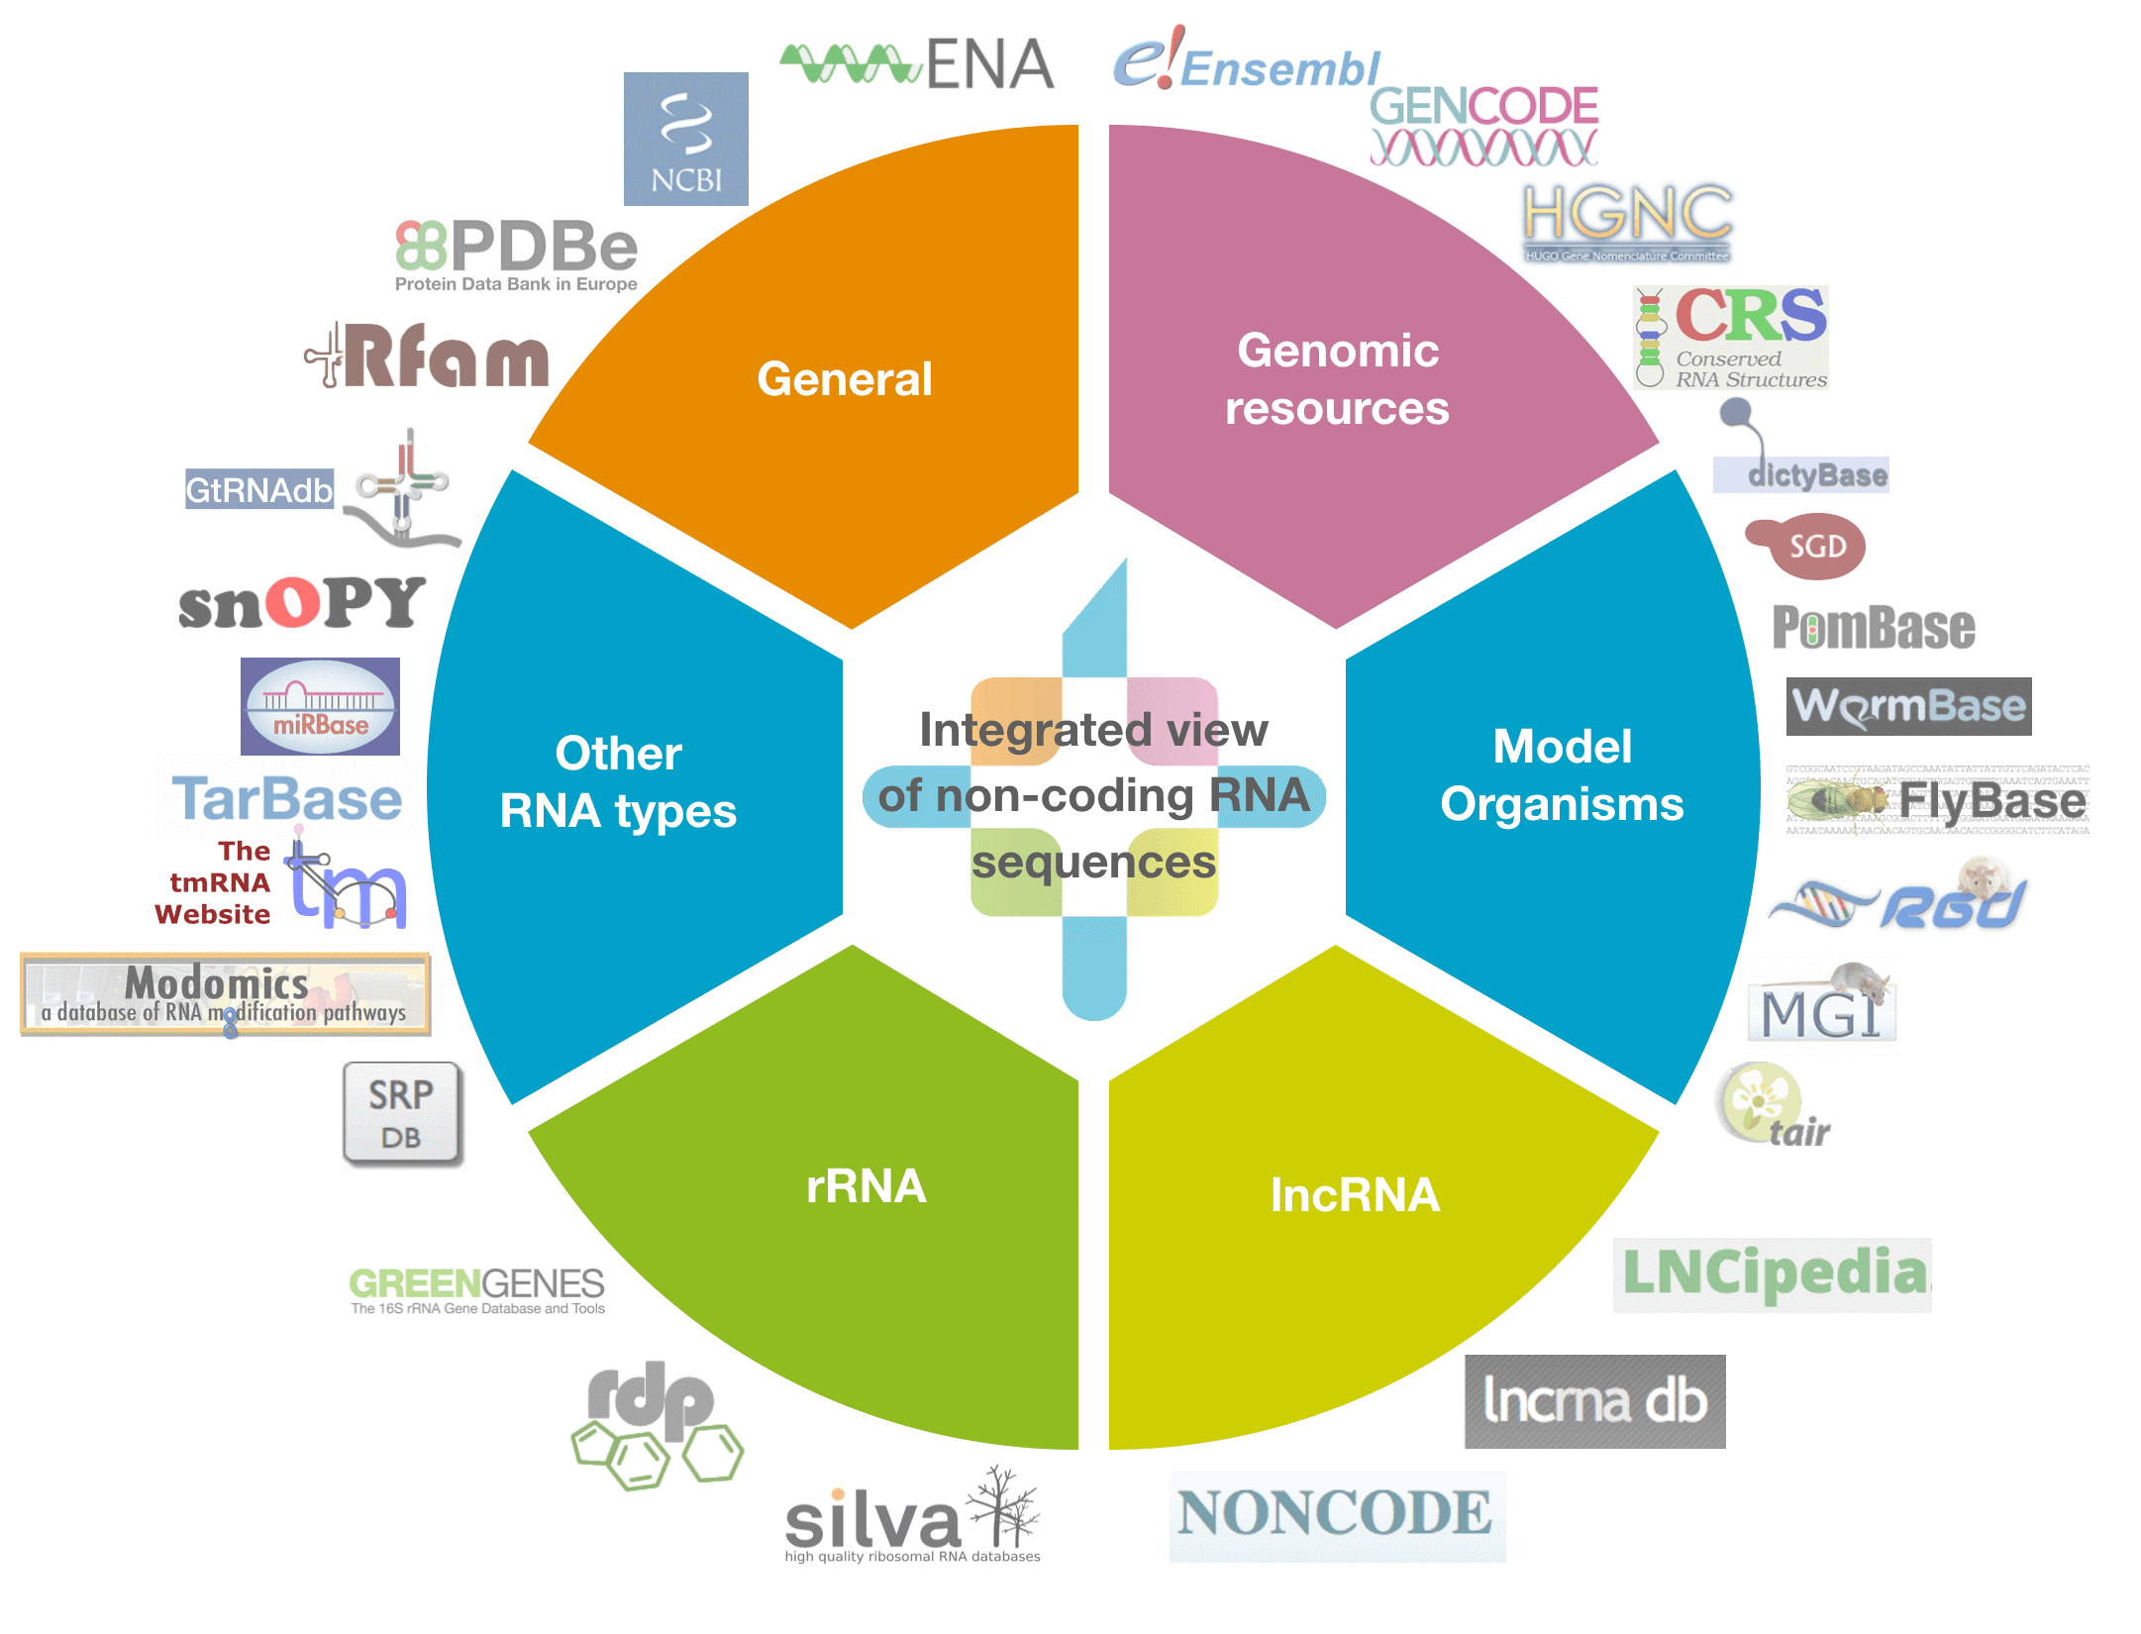

Slide 108
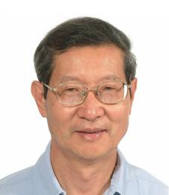
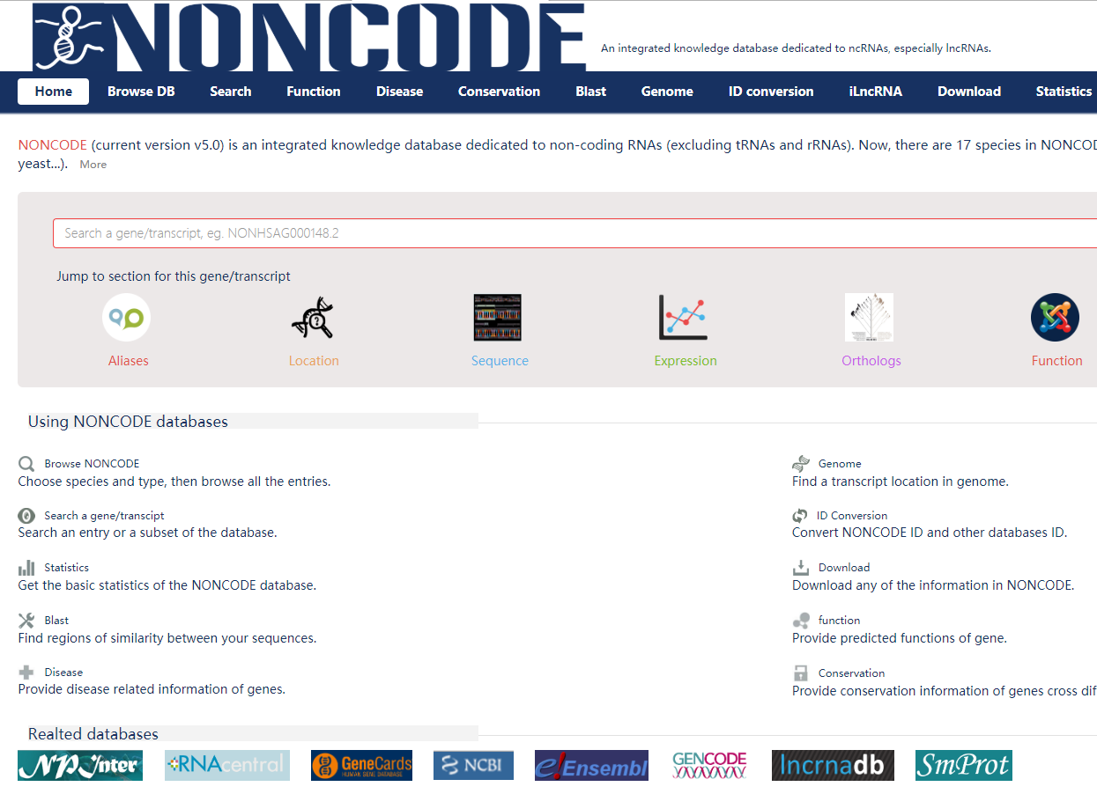

Slide 109



Slide 110

BUSCO (Benchmarking Universal Single-Copy Ortholog)
1440个基因

Slide 111

iProClass

Slide 112


Slide 113
Some important practical remarks
Databases: many errors (automated annotation) !
Not all db are available on all servers
The update frequency is not the same for all servers; creation of db_new between releases (exemple: EMBLnew; TrEMBLnew….)
Some servers add automatically useful cross-references to an entry (implicit links) in addition to already existing links (explicit links)

Slide 114
»»» Use sequences Databases can be accessed easily using retrieval tools
Sequence Retrieval System (SRS, Europe) allows any flat-file db to be indexed to any other; allows to formulate queries across a wide range of different db types via a single interface, without any worry about data structure, query languages…
Entrez (USA): less flexible than SRS but exploits the concept of « neighbouring », which allows related articles in different db to be linked together, whether or not they are cross-referenced directly
ATLAS: specific for macromolecular sequences db (i.e. NRL-3D)
….

Slide 115


Information Retrieval System
Entrez (GenBank, NCBI)
SRS (Sequence retrieval System)(EMBL)

